Slide 1
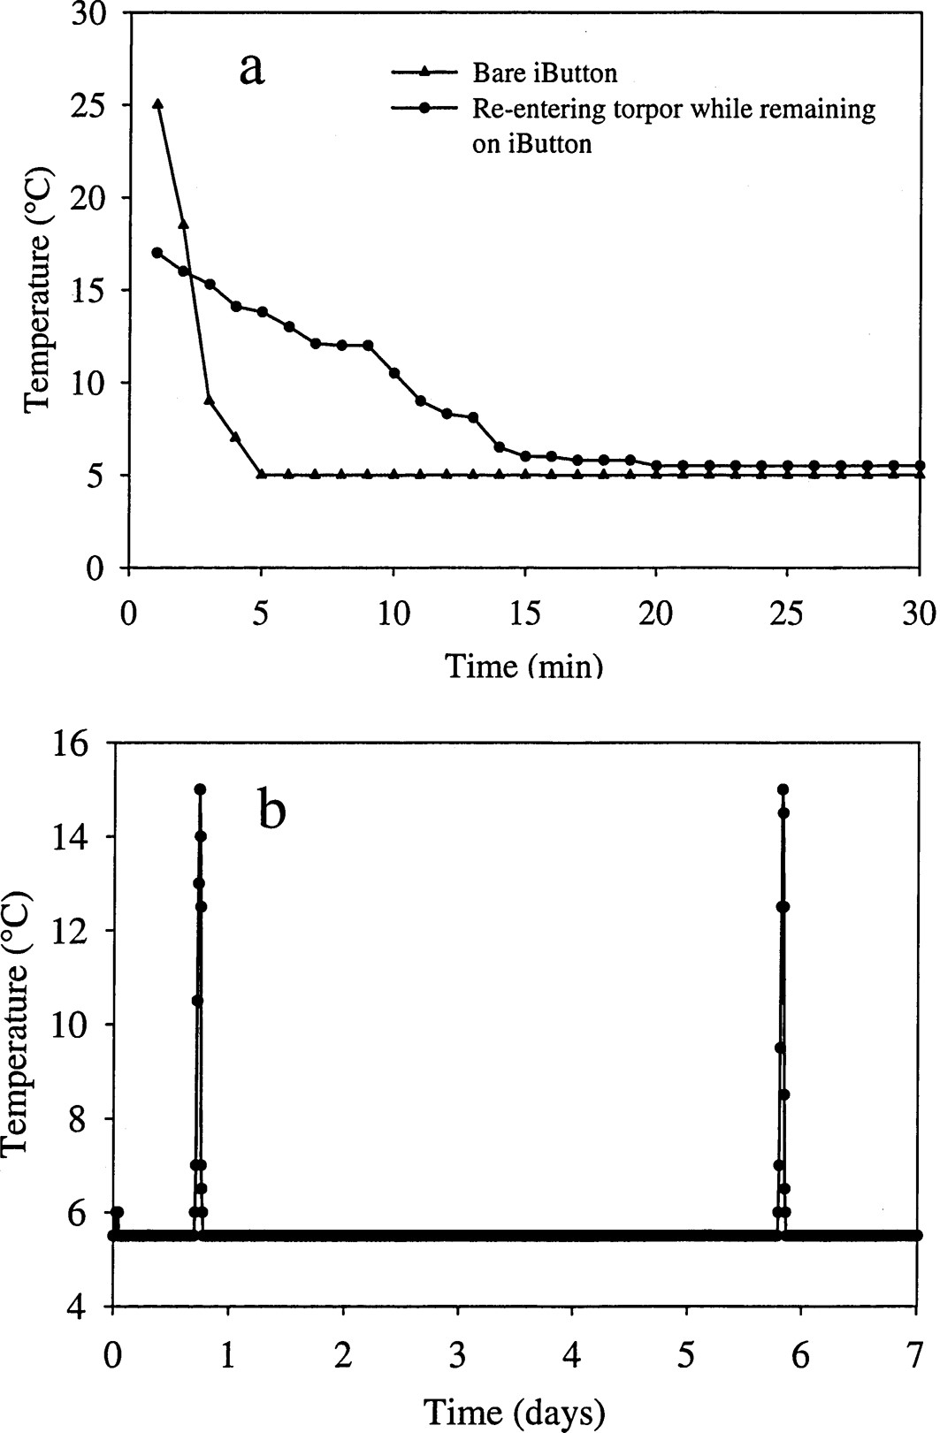
Fig. 1 Cooling rates for a warm temperature-sensitive datalogger (iButton) placed in the environmental chamber and ...
Notes:
Fig. 1 Cooling rates for a warm temperature-sensitive datalogger (iButton) placed in the environmental chamber and for a euthermic Lasiurus borealis entering torpor while remaining on an iButton at 5°C. These differences allowed for identification of arousals where no physical movement was observed, b) A subset of data depicting arousals from L. borealis at 5°C over a 7-day period.
Unless provided in the caption above, the following copyright applies to the content of this slide: © 2006 American Society of Mammalogists

Slide 2
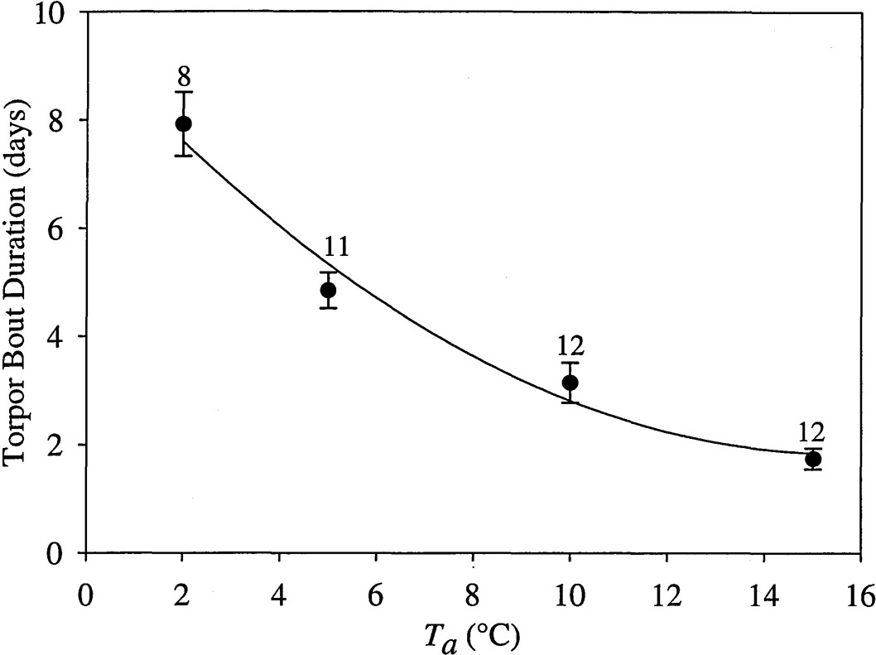
Fig. 2 Duration of torpor bouts for Lasiurus borealis in response to ambient temperature (T_{a}). Data are ...
Notes:
Fig. 2 Duration of torpor bouts for Lasiurus borealis in response to ambient temperature (Ta). Data are pooled for sex and presented as mean ± 1 SE with 2nd-order regression (torpor bout duration = 9.415 − 0.972(Ta) + 0.03 l(Ta)2). Numbers above standard error bars are number of individual bats. Torpor bouts are shorter at higher Ta (P < 0.0005) and different among all Ta treatments (P < 0.05).
Unless provided in the caption above, the following copyright applies to the content of this slide: © 2006 American Society of Mammalogists

Slide 3
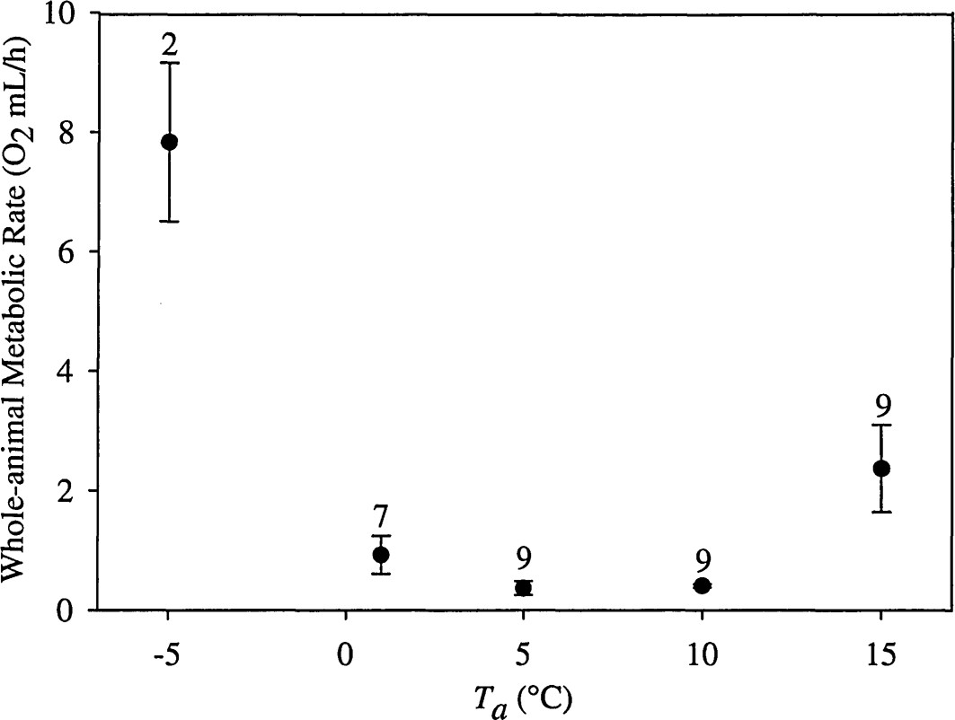
Fig. 3 Whole-animal metabolic rates of torpid Lasiurus borealis in response to ambient temperature (T_{a}). ...
Notes:
Fig. 3 Whole-animal metabolic rates of torpid Lasiurus borealis in response to ambient temperature (Ta). Data are pooled for sex and presented as mean ± 1 SE. Numbers above standard error bars are number of individual bats. Ta affected metabolic rates during torpor (P < 0.0005). Metabolic rate during torpor at -5°C was higher than at all other temperature treatments (P < 0.05), and at 15°C it was higher than at 5°C and 10°C (P < 0.05).
Unless provided in the caption above, the following copyright applies to the content of this slide: © 2006 American Society of Mammalogists

