Slide 1
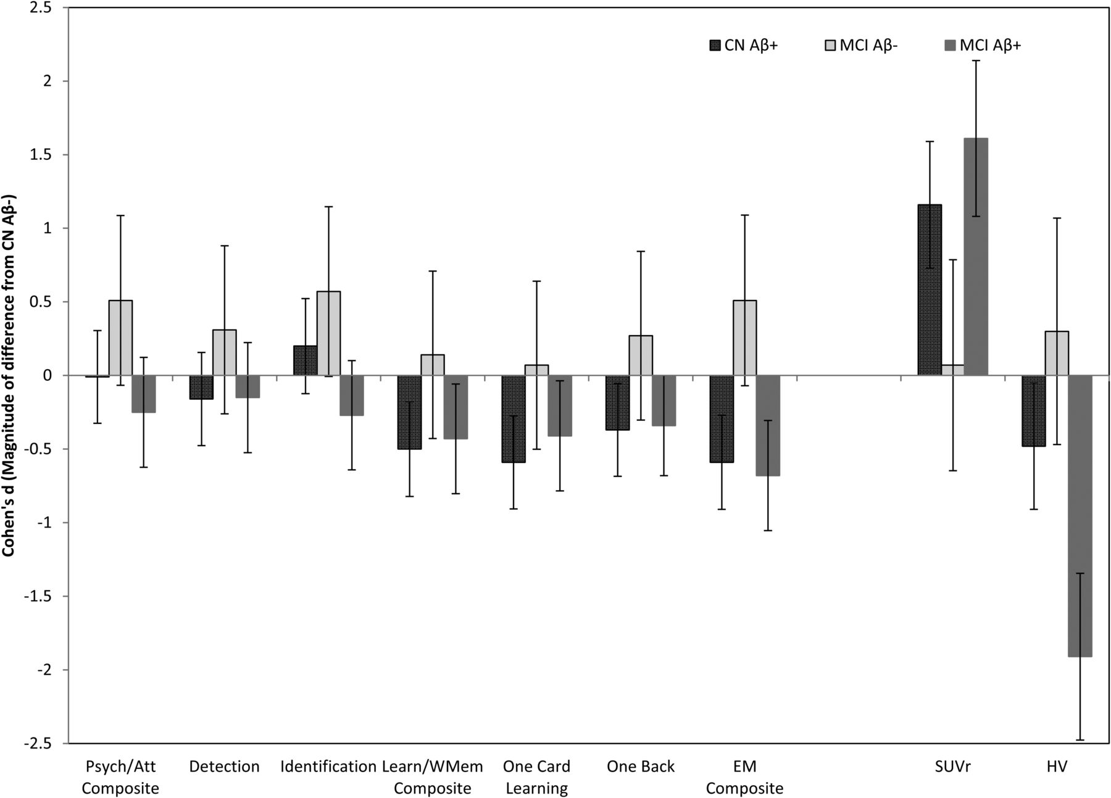
Table 2. Results of linear mixed model analyses examining change in cognition, hippocampal volume, and Aβ accumulation ...
Notes:
Table 2. Results of linear mixed model analyses examining change in cognition, hippocampal volume, and Aβ accumulation in healthy older adults and MCI over 36 months Notes: Aβ group = group membership as CN Aβ−, CN Aβ+, MCI Aβ−, or MCI Aβ+; bolded values are significant at the p < .05 or < .001 level; age, FSIQ, and APOE have been entered as covariates in all analyses, except for Psychomotor/Attention and Learning/Working Memory, where FSIQ and APOE were the only covariates. Table 3.Mean slopes (SD) of Aβ− and Aβ+ cognitively normal older adults (CN) and adults with MCI CN Aβ−CN Aβ+MCI Aβ−MCI Aβ+Mean slope (SD)nMean slope (SD)nMean slope (SD)nMean slope (SD)nNeuropsychology Psychomotor/Attention−1.321 (6.251)123−1.367 (6.056)551.806 (4.433)13−2.858 (5.524)36 Detection0.018 (0.076)1230.006 (0.074)55−0.005 (0.054)130.029 (0.067)36 Identification0.006 (0.041)1230.014 (0.040)55−0.017 (0.029)130.017 (0.038)36 Learning/Working Memory1.456 (6.882)123−1.963 (6.656)552.424 (4.869)13−1.435 (6.112)36 One Card Learning0.007 (0.072)123−0.035 (0.071)550.012 (0.051)13−0.022 (0.065)36 One Back0.030 (0.132)123−0.018 (0.129)550.065 (0.093)13−0.012 (0.117)36Neuroimaging Aβ accumulation0.015 (0.041)980.061 (0.036)330.018 (0.027)80.079 (0.032)20 Hippocampal volume−0.032 (0.047)86−0.054 (0.040)28−0.018 (0.031)7−0.119 (0.036)17Fig. 1.Magnitude of difference (Cohen's d) in the rate of change in each cognitive outcome measure, SUVR, and hippocampal volume between CN Aβ+, MCI Aβ−, and MCI Aβ+ groups relative to the CN Aβ− group (represented by the “0” line). Error bars represent 95% confidence intervals.
Unless provided in the caption above, the following copyright applies to the content of this slide: © The Author 2014. Published by Oxford University Press. All rights reserved. For permissions, please e-mail: journals.permissions@oup.com.

