Slide 1
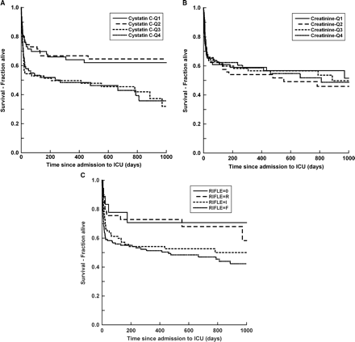
Fig. 1 (A) Kaplan–Meier survival curve of the AKI cohort by cystatin C level. (B) Kaplan–Meier survival curve of the ...
Notes:
Fig. 1 (A) Kaplan–Meier survival curve of the AKI cohort by cystatin C level. (B) Kaplan–Meier survival curve of the AKI cohort by the creatinine level. (C) Kaplan–Meier survival curve of the AKI cohort by the RIFLE classification level.
Unless provided in the caption above, the following copyright applies to the content of this slide: © Oxford University Press 2009

Slide 2
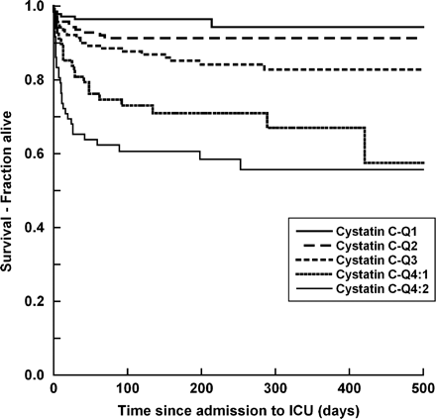
Fig. 2 Kaplan–Meier survival curve of the non-AKI cohort by the cystatin C level.
Notes:
Fig. 2 Kaplan–Meier survival curve of the non-AKI cohort by the cystatin C level.
Unless provided in the caption above, the following copyright applies to the content of this slide: © Oxford University Press 2009

