Slide 1
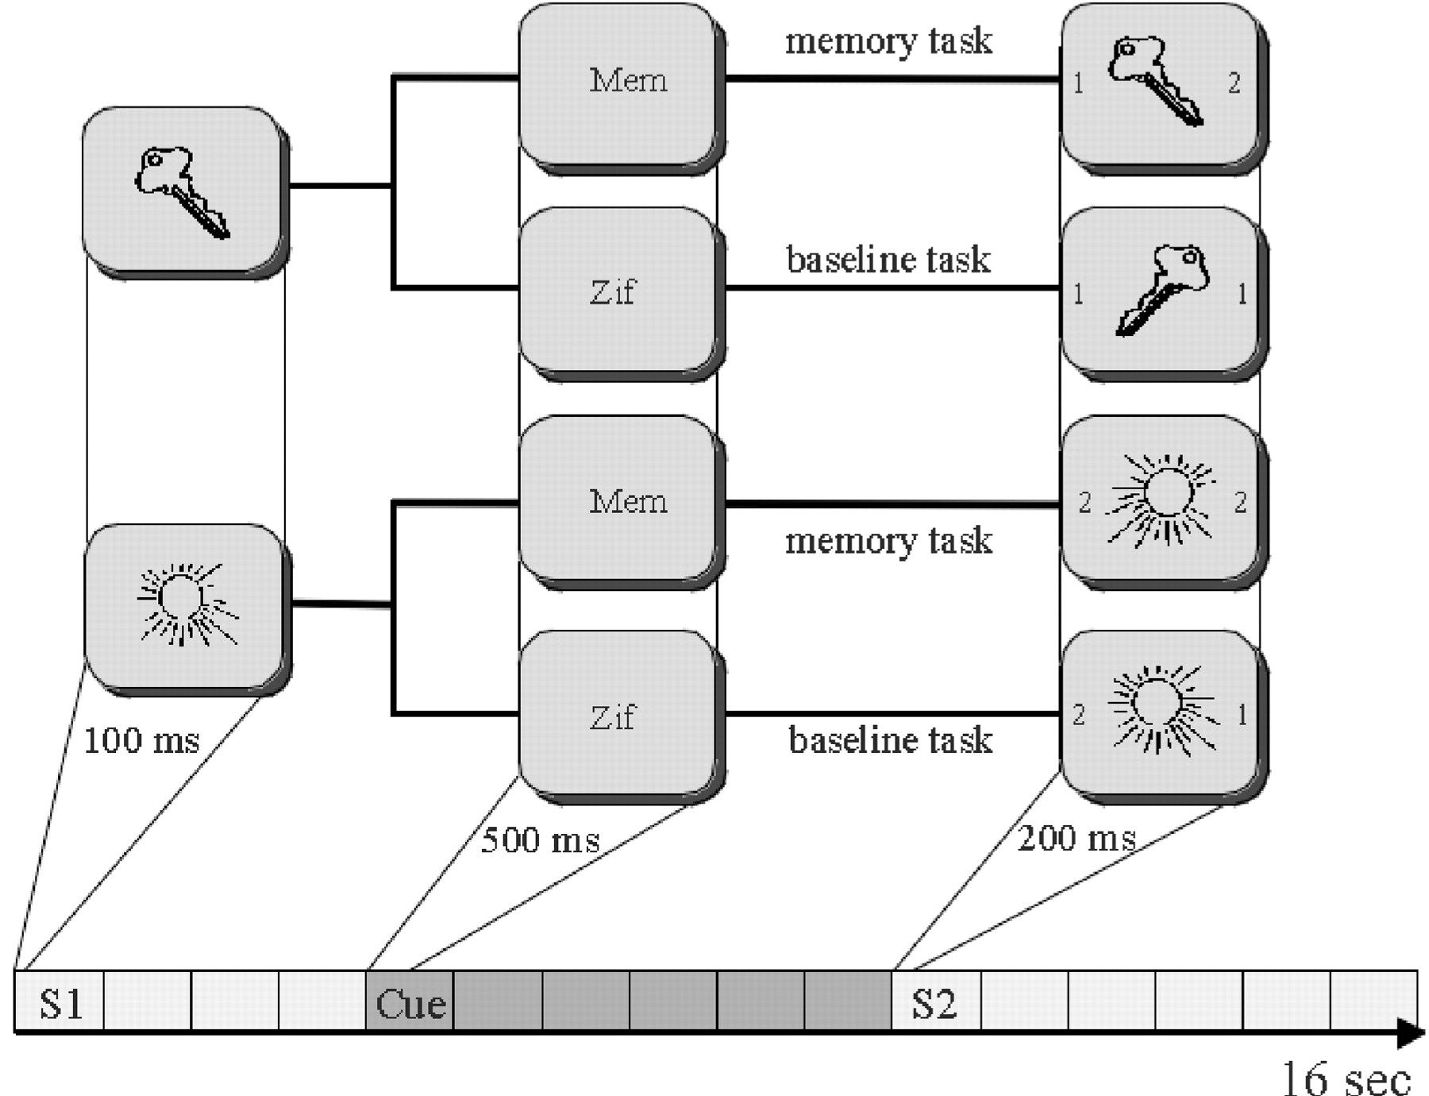
Figure 1. The working memory and control tasks. In the memory tasks the subjects had to indicate whether the same ...
Notes:
Figure 1. The working memory and control tasks. In the memory tasks the subjects had to indicate whether the same object or its mirror image was presented at S2. In the control tasks they had to indicate whether or not two digits presented at S2 (together with the object) were identical or not. Two objects with low (keys) and high (sun) symmetry ratings are presented as examples.
Unless provided in the caption above, the following copyright applies to the content of this slide: © Oxford University Press

Slide 2
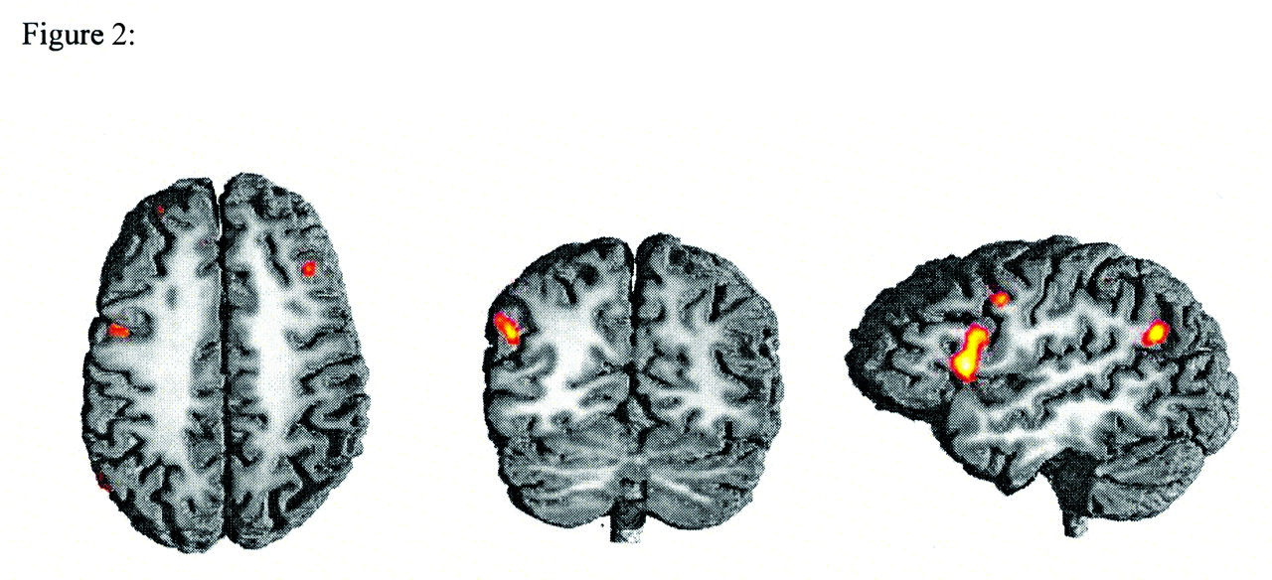
Figure 2. Activation patterns averaged across all subjects showing enhanced BOLD responses for the memory trials ...
Notes:
Figure 2. Activation patterns averaged across all subjects showing enhanced BOLD responses for the memory trials relative to the control trials. Axial, coronar and lateral views of a normalized T1 structural image of one subject are shown. Activations exceeding a threshold of Z = 2.6 are shown in this and in the following figures. Memory trials were associated with increased activation in the left ventral premotor cortex, the right middle frontal gyrus, the left inferior frontal gyrus (Broca’s area) and the left angular gyrus. Not visible but also activated in this contrast were the left superior frontal gyrus and the left anterior intraparietal sulcus (for further details see the Methods and Results sections).
Unless provided in the caption above, the following copyright applies to the content of this slide: © Oxford University Press

Slide 3
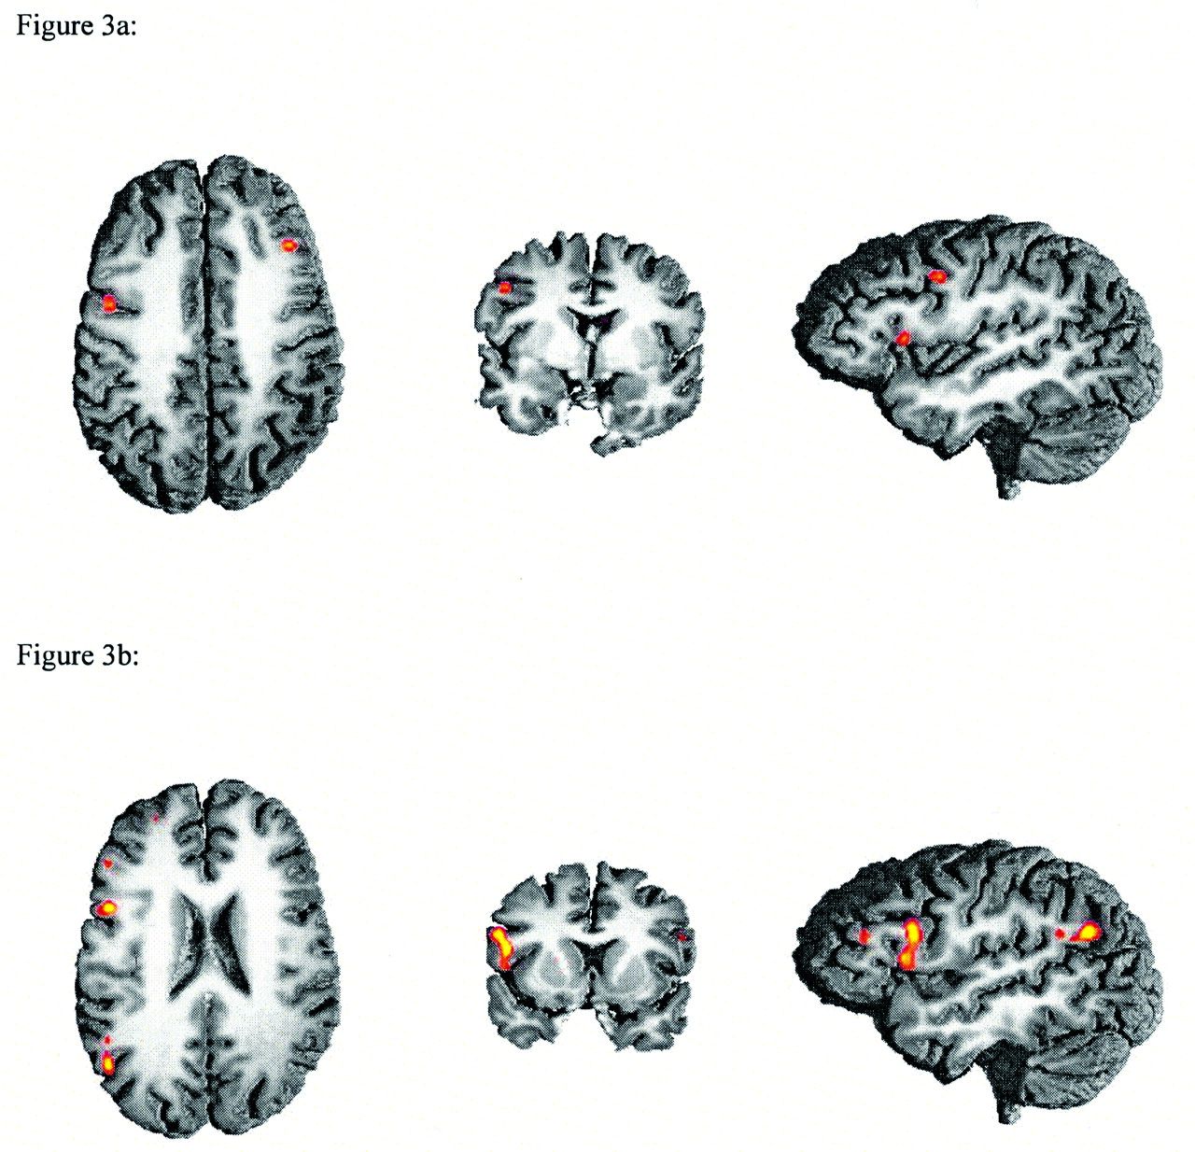
Figure 3. Activation patterns averaged across all subjects showing enhanced BOLD responses to (A) manipulable objects ...
Notes:
Figure 3. Activation patterns averaged across all subjects showing enhanced BOLD responses to (A) manipulable objects and (B) non-manipulable objects relative to the control task. Axial, coronar and lateral views of a normalized T1 structural image of one subject are shown.
Unless provided in the caption above, the following copyright applies to the content of this slide: © Oxford University Press

Slide 4
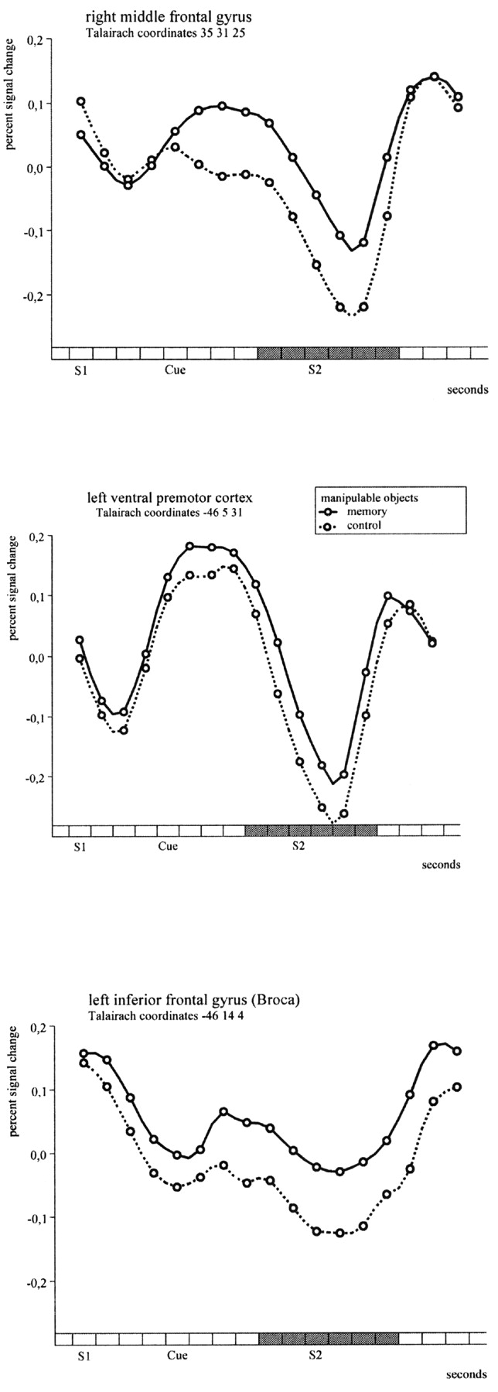
Figure 4. Percent signal change (relative to the mean value across all scans) for single voxels in the regions showing ...
Notes:
Figure 4. Percent signal change (relative to the mean value across all scans) for single voxels in the regions showing significantly enhanced responses to manipulable objects in the memory trials relative to the control trials. The spacing of the x-axis is 1 s. The shaded area indicates the location and duration of the reference function used for modelling the haemodynamic response.
Unless provided in the caption above, the following copyright applies to the content of this slide: © Oxford University Press

Slide 5
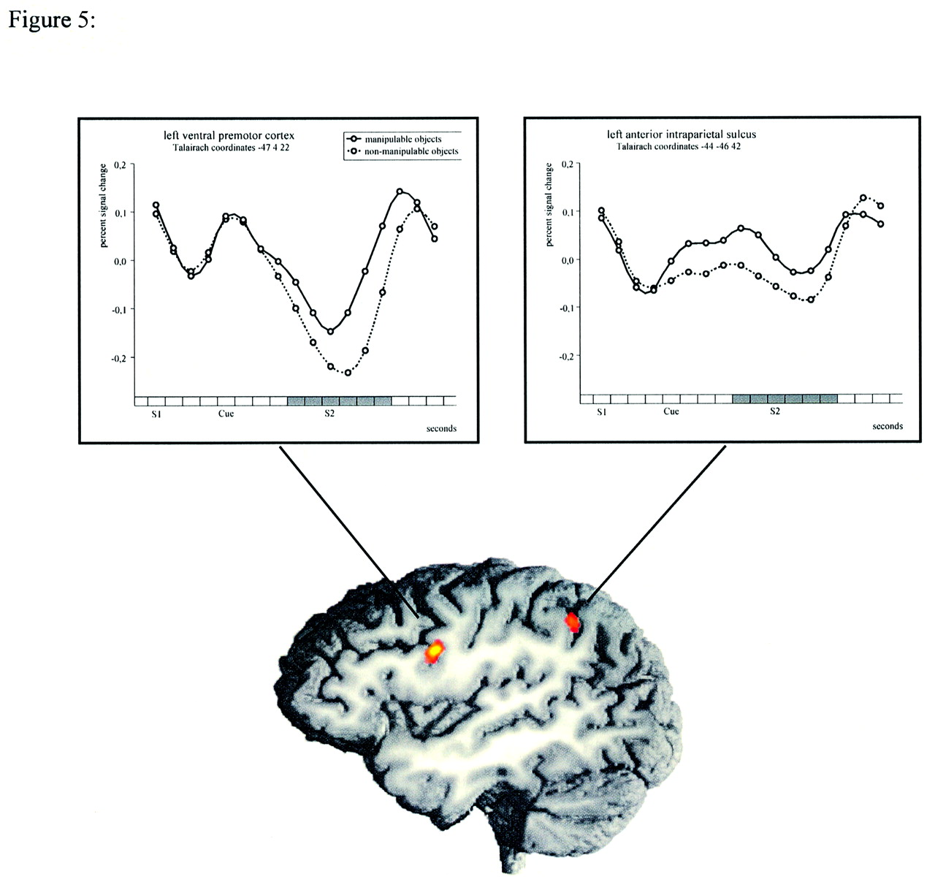
Figure 5. Brain regions showing enhanced BOLD responses for manipulable relative to non-manipulable objects in the ...
Notes:
Figure 5. Brain regions showing enhanced BOLD responses for manipulable relative to non-manipulable objects in the memory task. The time course of the BOLD response (percent signal change relative to the mean value across all scans) in the left ventral premotor cortex and in the left anterior intraparietal sulcus for both object types is shown in the upper part of the figure. The spacing of the x-axis is 1 s and the shaded area indicates the location and duration of the reference function used for modelling the haemodynamic response.
Unless provided in the caption above, the following copyright applies to the content of this slide: © Oxford University Press

