Slide 1
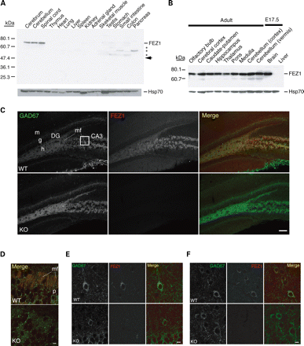
Figure 1. Spatiotemporal expression pattern of FEZ1 in mice. (A, B) Immunoblot analysis of protein extracts of various ...
Notes:
Figure 1. Spatiotemporal expression pattern of FEZ1 in mice. (A, B) Immunoblot analysis of protein extracts of various mouse tissues (A) and brain regions (B) with antibodies to FEZ1 and to Hsp70 (loading control). All extracts were from adult animals with the exception of those indicated as from embryos at embryonic day 17.5 (E17.5). The arrow in (A) indicates the predicted size of FEZ1, and the asterisks indicate non-specific bands. (C–H) Double-label immunofluorescence analysis of the distribution of FEZ1 (red in merged images) and GAD67 (green in merged images) in the dentate gyrus (C, D) and CA1 (E) regions of the hippocampus, in layers 2 and 3 of the primary motor cortex (F), in the caudate-putamen (G) and in the nucleus accumbens (H) of adult mice. The boxed region in (C) is shown at higher magnification in (D). All experimental procedures including confocal imaging were performed simultaneously under identical conditions for both wild-type (WT) and FEZ1-deficient (KO) mice. DG, dentate gyrus; g, granule cells; h, hilus; m, molecular layer; mf, mossy fiber; p, unstained somata of pyramidal neurons. (I) Immunofluorescence analysis also revealed that tyrosine hydroxylase (TH)-immunoreactive dopaminergic neurons (blue in merged images) do not express FEZ1 (red in merged images) either in somata located in the substantia nigra pars compacta (upper) or in axon fibers projecting to the nucleus accumbens (lower). Scale bars, 100 µm (C) or 10 µm (D–I).
Unless provided in the caption above, the following copyright applies to the content of this slide: © The Author 2008. Published by Oxford University Press. All rights reserved. For Permissions, please email: journals.permissions@oxfordjournals.org

Slide 2
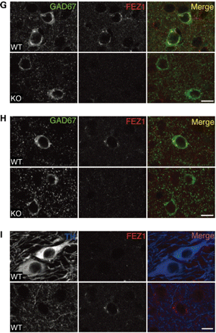
Figure 1. Spatiotemporal expression pattern of FEZ1 in mice. (A, B) Immunoblot analysis of protein extracts of various ...
Notes:
Figure 1. Spatiotemporal expression pattern of FEZ1 in mice. (A, B) Immunoblot analysis of protein extracts of various mouse tissues (A) and brain regions (B) with antibodies to FEZ1 and to Hsp70 (loading control). All extracts were from adult animals with the exception of those indicated as from embryos at embryonic day 17.5 (E17.5). The arrow in (A) indicates the predicted size of FEZ1, and the asterisks indicate non-specific bands. (C–H) Double-label immunofluorescence analysis of the distribution of FEZ1 (red in merged images) and GAD67 (green in merged images) in the dentate gyrus (C, D) and CA1 (E) regions of the hippocampus, in layers 2 and 3 of the primary motor cortex (F), in the caudate-putamen (G) and in the nucleus accumbens (H) of adult mice. The boxed region in (C) is shown at higher magnification in (D). All experimental procedures including confocal imaging were performed simultaneously under identical conditions for both wild-type (WT) and FEZ1-deficient (KO) mice. DG, dentate gyrus; g, granule cells; h, hilus; m, molecular layer; mf, mossy fiber; p, unstained somata of pyramidal neurons. (I) Immunofluorescence analysis also revealed that tyrosine hydroxylase (TH)-immunoreactive dopaminergic neurons (blue in merged images) do not express FEZ1 (red in merged images) either in somata located in the substantia nigra pars compacta (upper) or in axon fibers projecting to the nucleus accumbens (lower). Scale bars, 100 µm (C) or 10 µm (D–I).
Unless provided in the caption above, the following copyright applies to the content of this slide: © The Author 2008. Published by Oxford University Press. All rights reserved. For Permissions, please email: journals.permissions@oxfordjournals.org

Slide 3
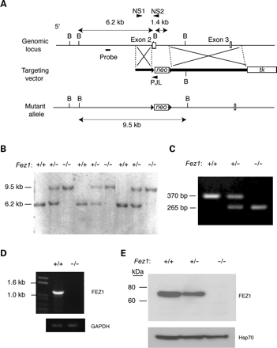
Figure 2. Targeted disruption of Fez1. (A) Schematic representation of the wild-type (WT) Fez1 locus, the targeting ...
Notes:
Figure 2. Targeted disruption of Fez1. (A) Schematic representation of the wild-type (WT) Fez1 locus, the targeting vector and the mutant allele after homologous recombination. A 1.4 kb genomic fragment including exon 2 of Fez1, which contains the start codon (ATG), was replaced with a PGK-lox-neo-poly(A) cassette. Exons, the probe used for Southern hybridization, and loxP sites (solid triangles) are shown. (B) BglII site; tk, herpes simplex virus thymidine kinase cassette. (B) Southern blot analysis of genomic DNA from the offspring of a heterozygote intercross. Genomic DNA was digested with BglII and subjected to hybridization with the probe shown in (A). DNA fragments of 6.2 and 9.5 kb correspond to the WT and mutant alleles, respectively. Genotypes are indicated by +/+ for wild type, +/− for heterozygotes and −/− for mutant homozygotes. (C) Genotyping of 20-day-old mice by polymerase chain reaction (PCR) analysis. The PCR primers NS1, NS2 and PJL are shown in (A) and were selected to generate 370 and 265 bp products for the WT and mutant alleles, respectively. (D) Reverse transcriptase-PCR analysis of FEZ1 mRNA in the brain of Fez1+/+ or Fez1−/− mice. The left lane contains molecular size standards, and GAPDH mRNA was used as an internal control. (E) Immunoblot analysis of brain extracts of Fez1+/+, Fez1+/− or Fez1−/− mice with antibodies to FEZ1.
Unless provided in the caption above, the following copyright applies to the content of this slide: © The Author 2008. Published by Oxford University Press. All rights reserved. For Permissions, please email: journals.permissions@oxfordjournals.org

Slide 4
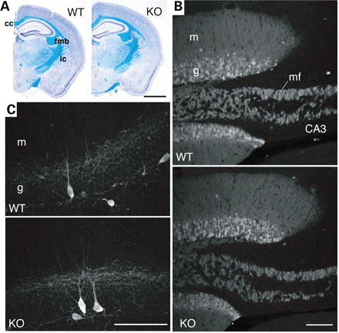
Figure 3. Absence of gross structural abnormalities in the brain of FEZ1-deficient mice. (A) Coronal sections through ...
Notes:
Figure 3. Absence of gross structural abnormalities in the brain of FEZ1-deficient mice. (A) Coronal sections through the striatum and hippocampus of wild-type (WT) or Fez1−/− (KO) mice at 3 months of age were stained by the Klüver-Barrera method. No marked differences in cytoarchitecture revealed by staining of cell bodies (dark purple) or fiber tracts (light blue) were apparent between the two genotypes. (B,C) Confocal immunofluorescence analysis of the morphology of cells in the hippocampus of WT or Fez1−/− mice at 3 months of age. Immunostaining was performed with antibodies to calbindin (B) or to parvalbumin (C). cc, corpus callosum; ic, internal capsule; fmb, fimbria hippocampi; g, granule cells of the dentate gyrus; m, molecular layer; mf, mossy fiber. Scale bars, 1 mm (A) or 100 µm (B, C).
Unless provided in the caption above, the following copyright applies to the content of this slide: © The Author 2008. Published by Oxford University Press. All rights reserved. For Permissions, please email: journals.permissions@oxfordjournals.org

Slide 5
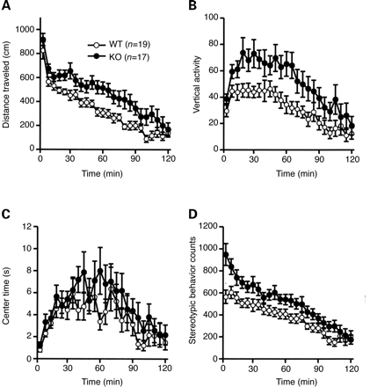
Figure 4. Increased locomotor activity of FEZ1-deficient mice in the open-field test. Distance traveled (A), vertical ...
Notes:
Figure 4. Increased locomotor activity of FEZ1-deficient mice in the open-field test. Distance traveled (A), vertical activity (B), time spent in the center (C) and stereotypic behavior counts (D) were determined for wild-type (WT) or Fez1−/− (KO) mice. Data are means±SEM for the indicated numbers (n) of mice. Repeated-measures analysis of variance revealed genotype effects of F(1, 34) = 11.541 (P = 0.0017) (A), F(1, 34) = 7.059 (P = 0.0019) (B), F(1, 34)=1.294 (P = 0.2632) (C), and F(1, 34) = 6.546 (P = 0.0151) (D).
Unless provided in the caption above, the following copyright applies to the content of this slide: © The Author 2008. Published by Oxford University Press. All rights reserved. For Permissions, please email: journals.permissions@oxfordjournals.org

Slide 6
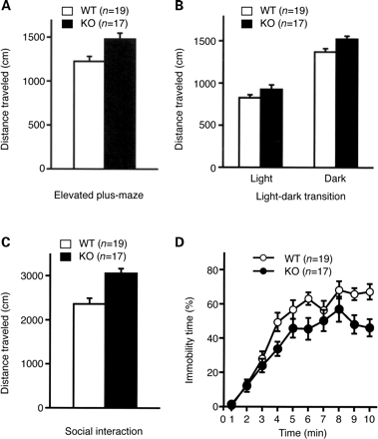
Figure 5. Increased locomotor activity of FEZ1-deficient mice in novel, social and stressful environments. (A–C) ...
Notes:
Figure 5. Increased locomotor activity of FEZ1-deficient mice in novel, social and stressful environments. (A–C) Distance traveled by wild-type (WT) or Fez1−/− (KO) mice in the elevated plus-maze test (A), in the dark chamber in the light–dark transition test (B), and in the social interaction test in a novel environment (C). (D) Immobility time of WT or mutant mice in the Porsolt forced swim test. Data are means±SEM for the indicated numbers of mice. ANOVA revealed genotype effects of F(1, 34) = 8.390 (P = 0.0066) (A), F(1, 34) = 7.501 (P = 0.0097) (B), and F(1, 15) =v15.924 (P = 0.0012) (C). Repeated-measures analysis of variance revealed a genotype effect of F(1, 34)=8.666 (P = 0.0058) (D).
Unless provided in the caption above, the following copyright applies to the content of this slide: © The Author 2008. Published by Oxford University Press. All rights reserved. For Permissions, please email: journals.permissions@oxfordjournals.org

Slide 7
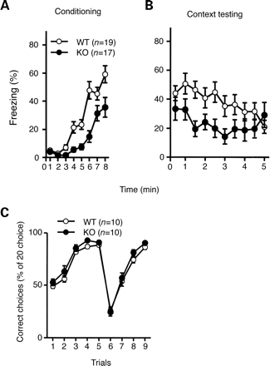
Figure 6. Effect of FEZ1 deficiency on learning and memory. (A and B) Contextual and cued fear conditioning test. ...
Notes:
Figure 6. Effect of FEZ1 deficiency on learning and memory. (A and B) Contextual and cued fear conditioning test. Fez1−/− (KO) mice showed a significant decrease in freezing behavior compared with wild-type (WT) mice during both conditioning [genotype effect of F(1, 30) = 19.461 (P = 0.001) by repeated-measures analysis of variance (ANOVA)] (A) and context testing [genotype effect of F(1, 34) = 7.286 (P = 0.0107)] (B). (C) T-maze test. FEZ1-deficient mice made more correct choices than did WT controls [genotype effect of F(1, 18) = 5.487 (P = 0.0309) by repeated-measures ANOVA]. All data are means±SEM for the indicated numbers of mice.
Unless provided in the caption above, the following copyright applies to the content of this slide: © The Author 2008. Published by Oxford University Press. All rights reserved. For Permissions, please email: journals.permissions@oxfordjournals.org

Slide 8
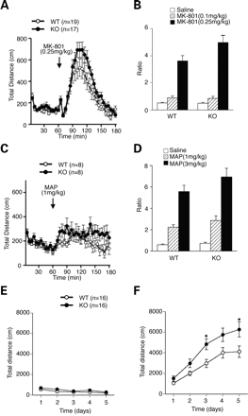
Figure 7. Enhanced responsiveness of Fez1^{−/−} mice to MK-801 or methamphetamine. (A and B) Stimulation of ...
Notes:
Figure 7. Enhanced responsiveness of Fez1−/− mice to MK-801 or methamphetamine. (A and B) Stimulation of locomotor activity by single injection of MK-801 (0.1 or 0.25 mg/kg, i.p.). The increases in total distance were significantly greater in Fez1−/− (KO) mice than in wild-type (WT) controls with the dose of 0.25 mg/kg (A). The ratio between activity before injection and that after injection is shown (B). The locomotor activity by MK-801 with the dose of 0.1 mg/kg was not different between genotypes. Repeated-measures analysis of variance (ANOVA) revealed genotype effects of F(1, 38) = 0.029 (P = 0.8658) with the dose of 0.1 mg/kg and F(1, 30) = 4.308 (P = 0.0466) at the dose of 0.25 mg/kg. (C and D) Stimulation of locomotor activity by acute injection of methamphetamine (1 or 3 mg/kg, i.p.). The locomotor activity by methamphetamine with the dose of 1 mg/kg was not statistically different between genotypes (C). The ratio between activity before injection and that after injection is shown (D). There is no statistical difference between genotypes either with the dose of 1 or 3 mg/kg. Repeated-measures ANOVA revealed genotype effects of F(1, 34) = 1.621 (P = 0.2237) at the dose of 1 mg/kg and F(1, 34) = 1.792 (P = 0.1896) at the dose of 3 mg/kg. (E and F) Enhanced locomotor sensitization to methamphetamine in Fez1−/− mice. After i.p. saline injection on day 0, saline (E) and 1 mg/kg methamphetamine (F) were i.p. injected to WT and FEZ1-deficient mice once a day from day 1 to day 5. Immediately after injection of saline or methamphetamine, locomotor activity was counted for a 10 min-period. In (E), there is no difference in locomotor activity between two genotypes; genotype effect, F(1, 14)=3.185 (P = 0.096). Daily administration of methamphetamine at dose of 1 mg/kg induces locomotor sensitization in both WT and FEZ1-deficient mice, but the rate of increase is greater in FEZ1-deficient mice than in WT controls (F). Genotype effect, F(1, 14) = 7.005 (P = 0.0191); genotype×trial interaction, F(1, 28) = 5.596 (P = 0.0252), *P < 0.05 versus WT mice.
Unless provided in the caption above, the following copyright applies to the content of this slide: © The Author 2008. Published by Oxford University Press. All rights reserved. For Permissions, please email: journals.permissions@oxfordjournals.org

Slide 9
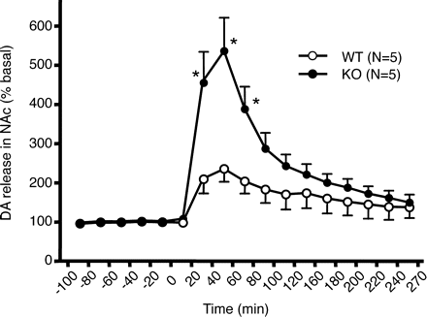
Figure 8. Enhanced methamphetamine-induced release of dopamine in the nucleus accumbens of FEZ1-deficient mice. The ...
Notes:
Figure 8. Enhanced methamphetamine-induced release of dopamine in the nucleus accumbens of FEZ1-deficient mice. The extracellular concentration of dopamine (DA) in the nucleus accumbens of freely moving wild-type (WT) or Fez1−/− (KO) mice was determined by in vivo microdialysis and high-performance liquid chromatography. After collection of basal fractions, methamphetamine (1 mg/kg, i.p) was administrated at time 0, and six fractions were collected every 20 min. Dopamine concentration was expressed as a percentage of the average of that in the five baseline fractions obtained immediately before drug administration. Baseline dopamine release tended to be higher (but not significantly so) in FEZ1-deficient mice than in WT mice (1.15 ± 0.36 versus 0.70 ± 0.32 pmol/20 min, respectively). Data are means±SEM for the indicated numbers of mice. Repeated-measures analysis of variance revealed a genotype effect of F(1, 88) = 6.347 (P < 0.005), a time effect of F (11, 88) = 53.358 (P < 0.0001) and a genotype×time effect of F(11, 88) = 17.604 (P < 0.0001). *P < 0.05 versus WT mice (Scheffe's test).
Unless provided in the caption above, the following copyright applies to the content of this slide: © The Author 2008. Published by Oxford University Press. All rights reserved. For Permissions, please email: journals.permissions@oxfordjournals.org

