Slide 1
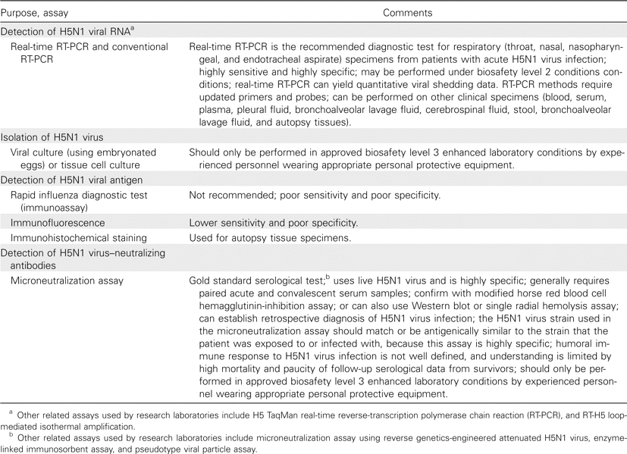
Table 1 Methods for detecting human infection with highly pathogenic avian influenza A (H5N1) virus.
Notes:
Table 1 Methods for detecting human infection with highly pathogenic avian influenza A (H5N1) virus.
Unless provided in the caption above, the following copyright applies to the content of this slide: © 2009 by the Infectious Diseases Society of America

Slide 2
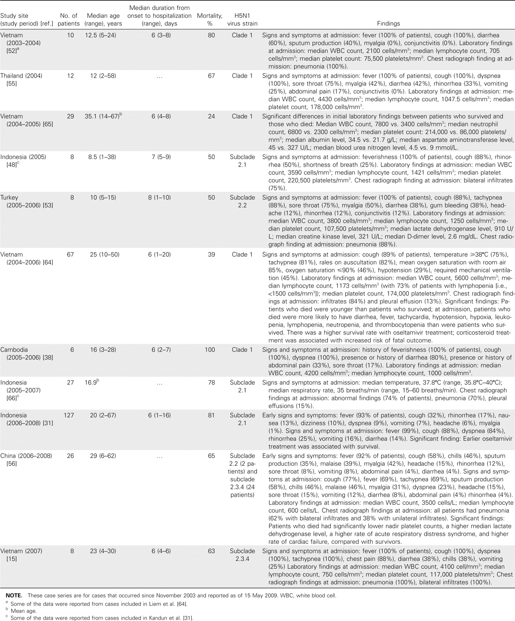
Table 2 Characteristics of hospitalized patients with H5N1 virus infection reported in case series
Notes:
Table 2 Characteristics of hospitalized patients with H5N1 virus infection reported in case series
Unless provided in the caption above, the following copyright applies to the content of this slide: © 2009 by the Infectious Diseases Society of America

