Slide 1
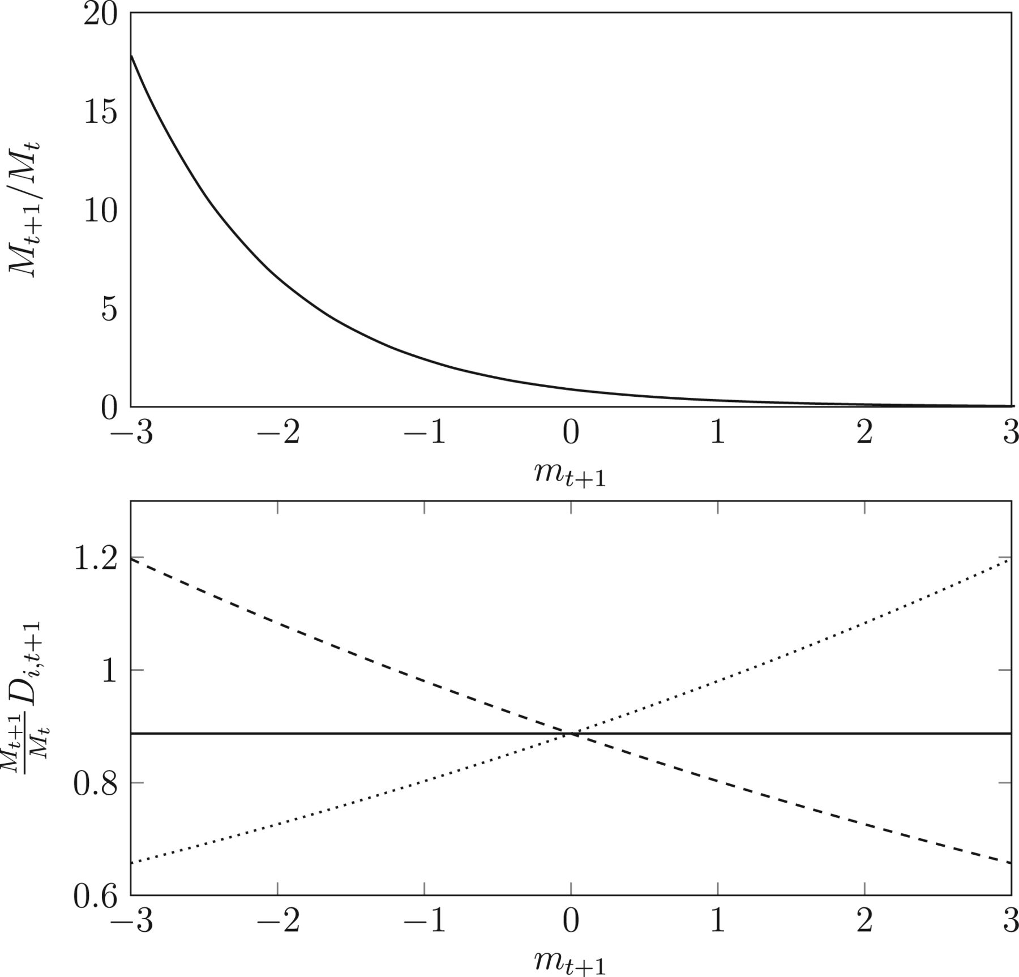
Figure 1 The effect of a mean-preserving spread in ${\beta }_{i,t+1}$ across states of the world This figure plots the ...
Notes:
Figure 1 The effect of a mean-preserving spread in ${\beta }_{i,t+1}$ across states of the world This figure plots the pricing kernel $M_{t+1}/M_{t}$ and the present value of the dividend $\frac{{{M_{t + 1}}}}{{{M_t}}}$$D_{i,t+1}$ as functions of the state of the world (i.e., $m_{t+1}$) for different values of ${\beta }_{i,t+1}$. For the bottom panel, the solid line corresponds to ${\beta }_{i,t+1} =1$, the dashed line corresponds to ${\beta }_{i,t+1} =0.9$, and the dotted line corresponds to ${\beta }_{i,t+1} =1.1$. The mean dividend growth rate, ${\bar d_i}$ , and the idiosyncratic shocks, $d_{i,t+1}$, are both set to zero; the risk-free rate $r_{f}$ is set to 2%; the variance in the pricing kernel $V_{m}$ is set to 0.2; and $D_{i,t}$ is normalized to 1.
Unless provided in the caption above, the following copyright applies to the content of this slide: © The Author 2012. Published by Oxford University Press on behalf of The Society for Financial Studies. All rights reserved. For Permissions, please e-mail: journals.permissions@oup.com.

Slide 2
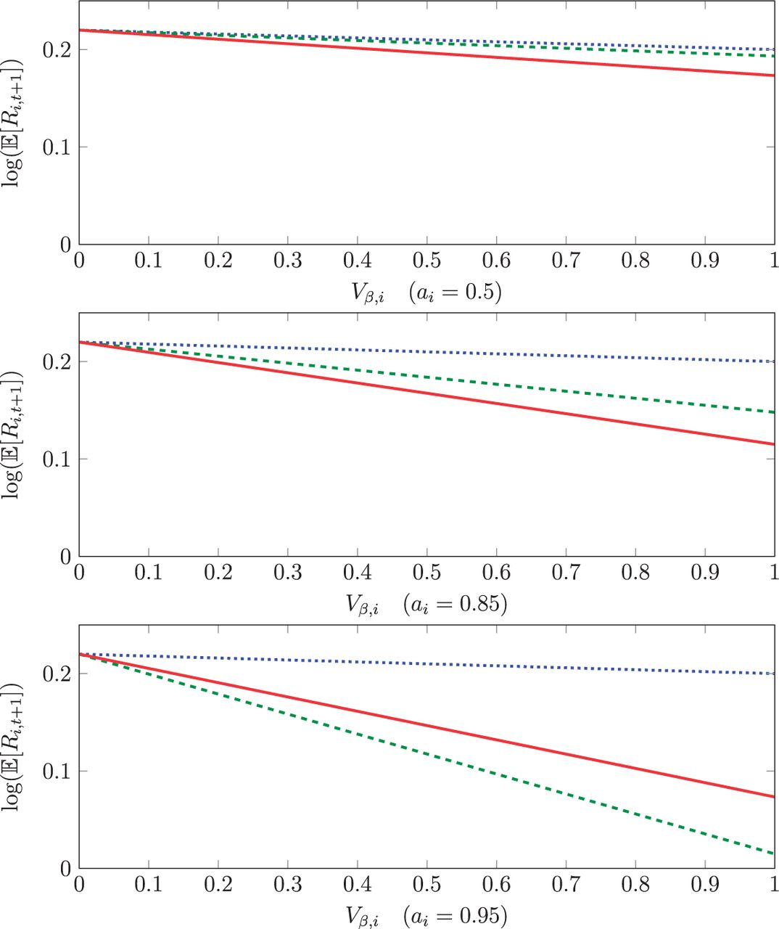
Figure 2 Log expected returns as a function of uncertainty about factor $loadingsV_{{\beta },i}$ This figure plots the ...
Notes:
Figure 2 Log expected returns as a function of uncertainty about factor $loadingsV_{{\beta },i}$ This figure plots the (log) expected return on stock $i$ (i.e., $\log (\mathbb E[{R_{i,t + 1}}])$ ) as a function of the uncertainty about its factor loadings, $V_{{\beta },i}$, for three different levels of persistence, $a_{i}$, in factor loadings. The dotted line plots the i.i.d. benchmark presented in Proposition 1, the dashed line plots the no-information benchmark of Corollary 3, and the solid line plots the full-information benchmark of Corollary 4. The risk-free rate $r_{f;}$ is set to 2%, the variance in the pricing kernel, $V_{m}$, is set to 0.2, the unconditional mean factor loading, $b_{i}$, is set to 1, and the long-run mean price-dividend ratio is set to $P D_{i,t} =4$, which implies ${\rho }_{i} =0.80$.
Unless provided in the caption above, the following copyright applies to the content of this slide: © The Author 2012. Published by Oxford University Press on behalf of The Society for Financial Studies. All rights reserved. For Permissions, please e-mail: journals.permissions@oup.com.

Slide 3
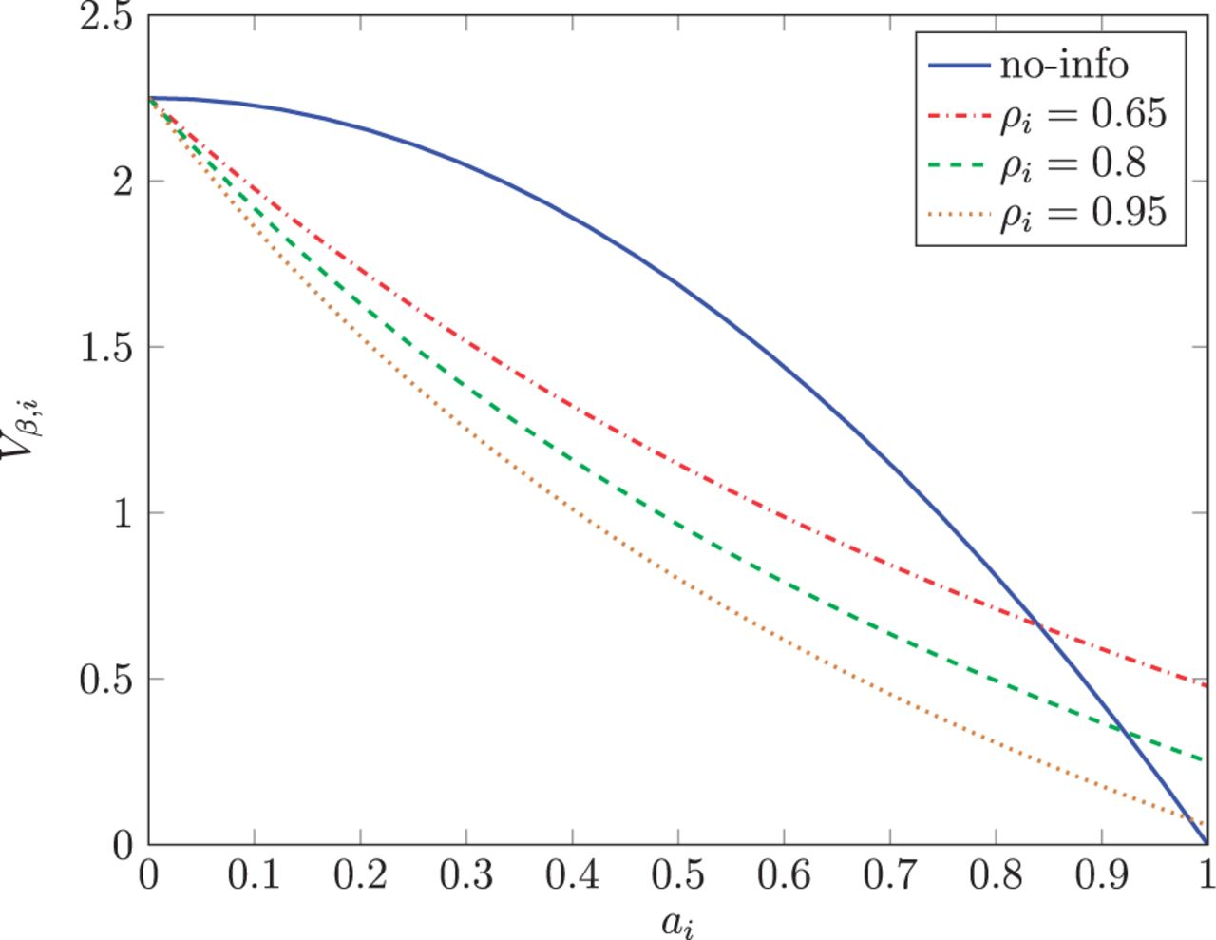
Figure 3 Factor-loading uncertainty and persistence pairs This figure plots parameter values of $V_{{\beta },i}$ and ...
Notes:
Figure 3 Factor-loading uncertainty and persistence pairs This figure plots parameter values of $V_{{\beta },i}$ and $a_{i}$ such that the model-implied effect of factor-loading uncertainty on annualized expected returns is 450 basis points. The solid line corresponds to the no-information benchmark of Corollary 3, and the dashed-dotted, dashed, and dotted lines correspond to the full-information benchmark of Corollary 4, for ${\rho }_{i}$ equal to 0.65, 0.8, and 0.95, respectively. The aggregate risk premium (i.e., $V_{m}$) is set to 0.2.
Unless provided in the caption above, the following copyright applies to the content of this slide: © The Author 2012. Published by Oxford University Press on behalf of The Society for Financial Studies. All rights reserved. For Permissions, please e-mail: journals.permissions@oup.com.

