Slide 1
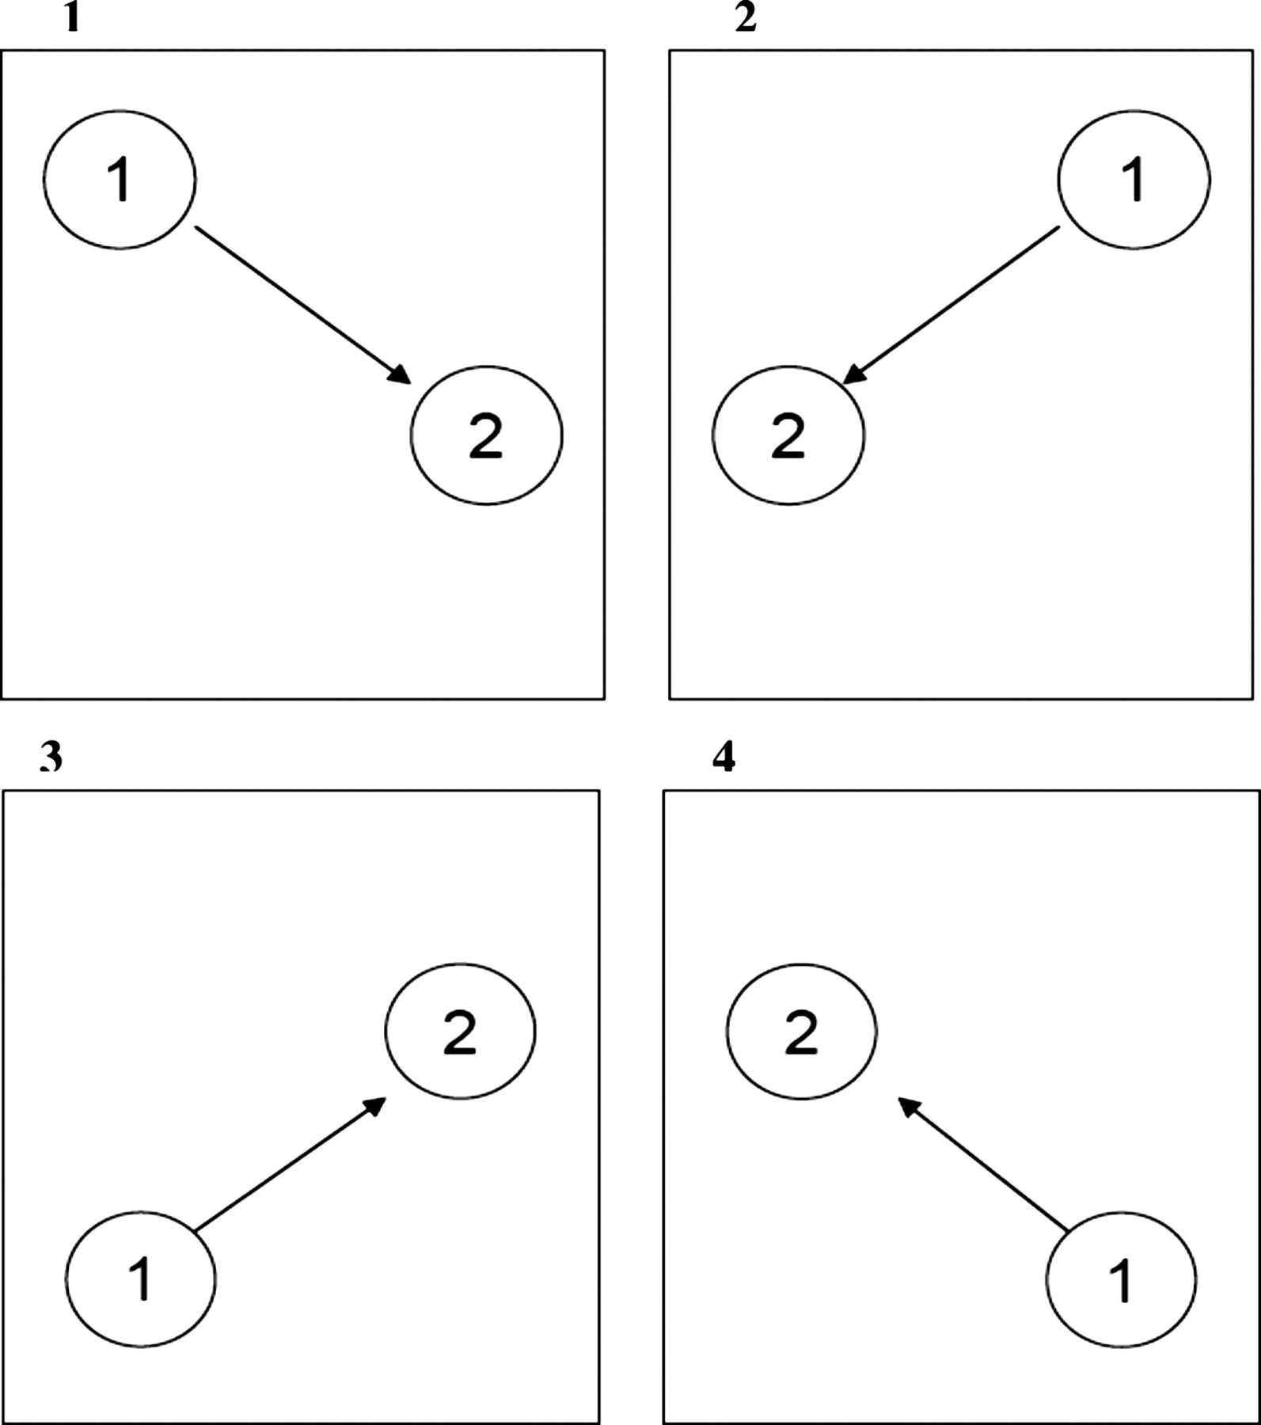
Fig. 1. Pattern of the development of three new versions of TMT A and B. A is the original version.
Notes:
Fig. 1. Pattern of the development of three new versions of TMT A and B. A is the original version.
Unless provided in the caption above, the following copyright applies to the content of this slide: © The Author 2011. Published by Oxford University Press. All rights reserved. For permissions, please e-mail: journals.permissions@oup.com.

Slide 2
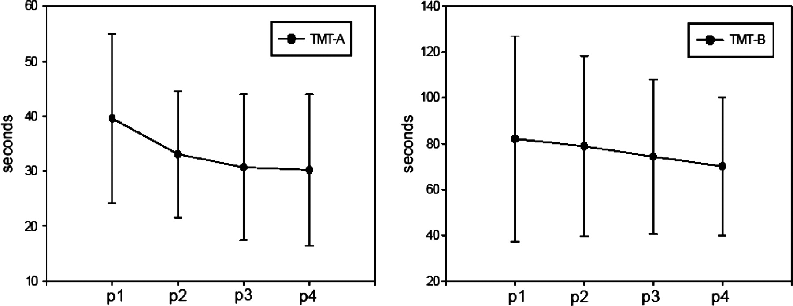
Fig. 2. Mean (±SD) processing times of the four versions of TMT A and B presented at positions 1, 2, 3, and 4. p1–4, ...
Notes:
Fig. 2. Mean (±SD) processing times of the four versions of TMT A and B presented at positions 1, 2, 3, and 4. p1–4, positions 1–4.
Unless provided in the caption above, the following copyright applies to the content of this slide: © The Author 2011. Published by Oxford University Press. All rights reserved. For permissions, please e-mail: journals.permissions@oup.com.

