Slide 1
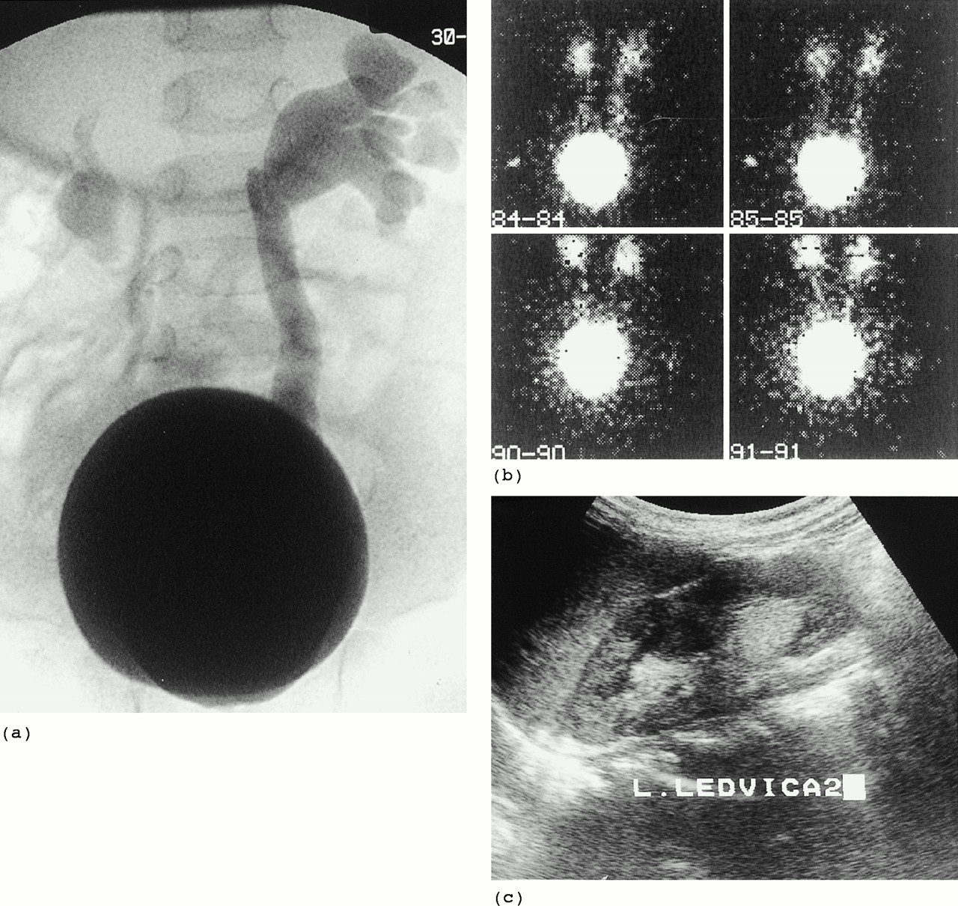
Fig. 1. Imaging techniques for the detection of vesicoureteric reflux. (a) Voiding cystourethrography (VCUG); (b) ...
Notes:
Fig. 1. Imaging techniques for the detection of vesicoureteric reflux. (a) Voiding cystourethrography (VCUG); (b) direct radionuclide voiding cystography (DRVC); (c) voiding urosonography (VUS).
Unless provided in the caption above, the following copyright applies to the content of this slide: © European Renal Association-European Dialysis and Transplant Association

