Slide 1
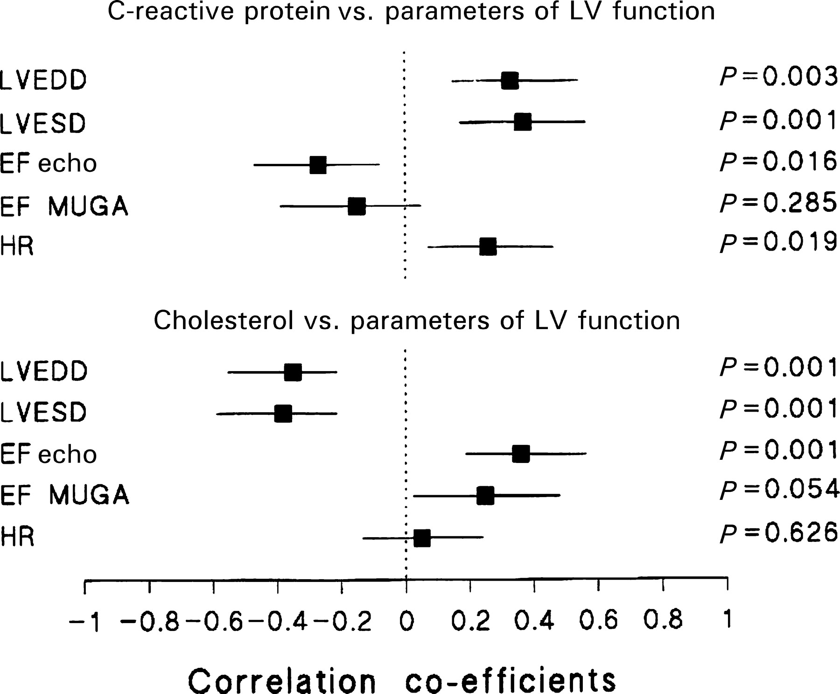
Figure 1 Correlation co-efficients of total cholesterol and C-reactive protein vs. parameters of LV ...
Notes:
Figure 1 Correlation co-efficients of total cholesterol and C-reactive protein vs. parameters of LV dimensions and function.
Unless provided in the caption above, the following copyright applies to the content of this slide: © The European Society of Cardiology 2005. All rights reserved. For Permissions, please e-mail: journals.permissions@oupjournals.org

Slide 2
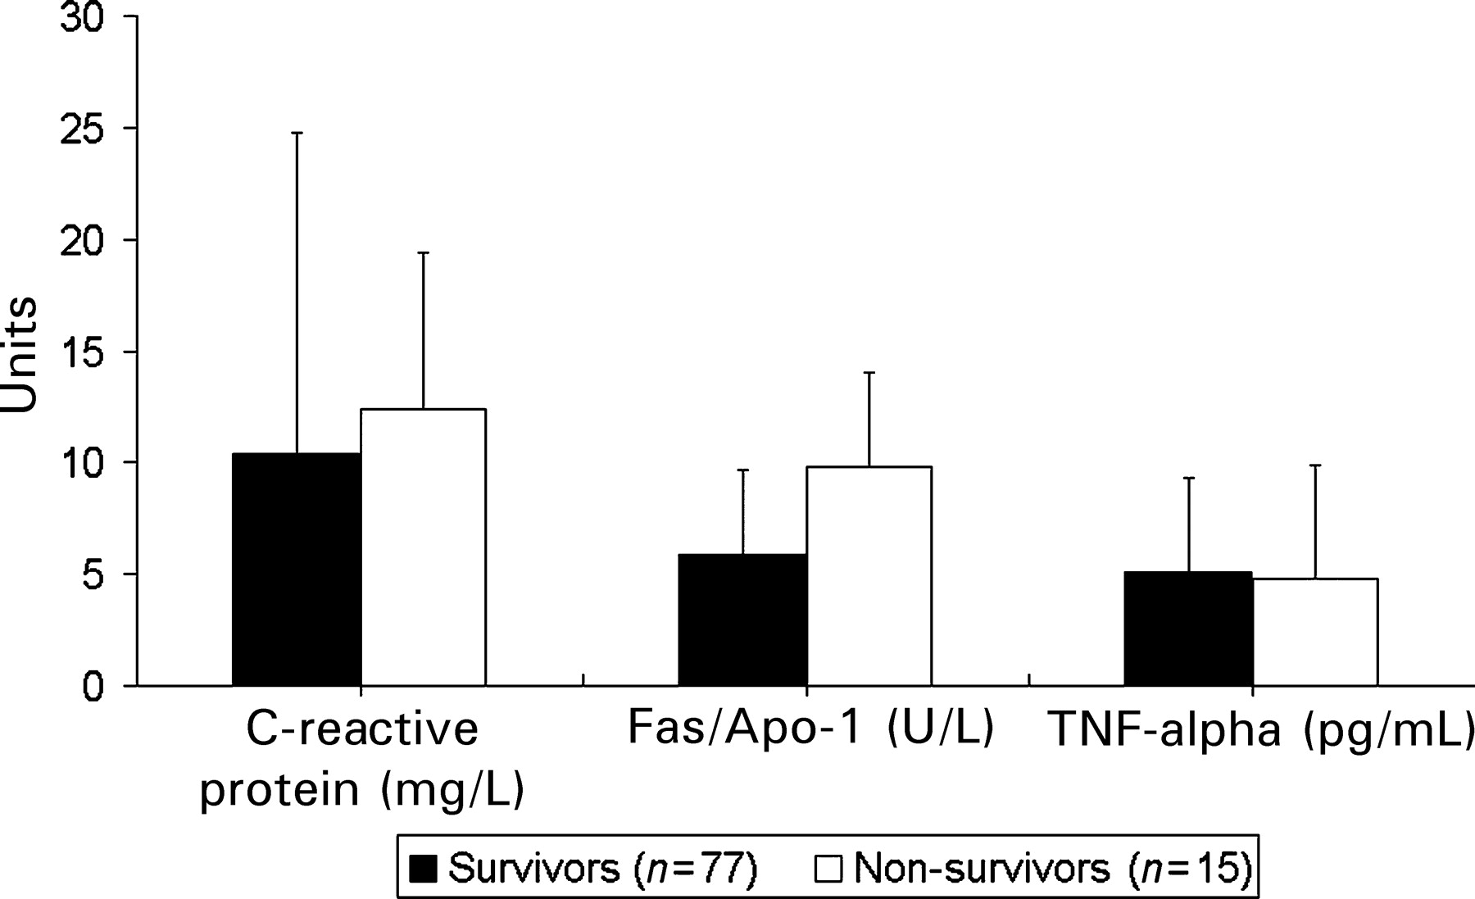
Figure 2 Baseline plasma inflammatory markers of deceased patients vs. survivors. Only differences in ...
Notes:
Figure 2 Baseline plasma inflammatory markers of deceased patients vs. survivors. Only differences in baseline plasma levels of Fas/Apo-1 were significant, P=0.002.
Unless provided in the caption above, the following copyright applies to the content of this slide: © The European Society of Cardiology 2005. All rights reserved. For Permissions, please e-mail: journals.permissions@oupjournals.org

