Slide 1
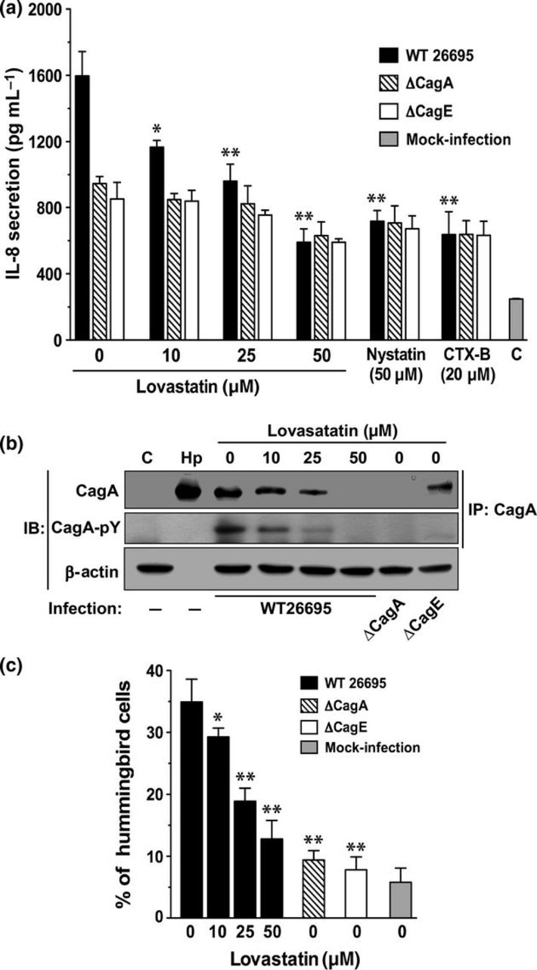
1 Helicobacter pyloriCagA-induced responses in AGS cells are dependent on the levels of cellular cholesterol. ...
Notes:
1 Helicobacter pyloriCagA-induced responses in AGS cells are dependent on the levels of cellular cholesterol. (a) AGS cells pretreated with lovastatin (0–50 μM), nystatin (50 μg mL−1), or CTX-B (20 μg mL−1), subsequently infected with wild-type, ∆CagA, or ∆CagE H elicobacter pylori. After incubation for 6 h, the concentration of IL-8 in the culture supernatant was analyzed using a standard ELISA method. (b) Total cell lysates from infected cells were immunoprecipitated (IP) for CagA following by subjected to immunoblot (IB) for analysis of the translocated or tyrosine-phosphorylated CagA. (c) Hummingbird phenotype induced by CagA in H elicobacter pylori-infected cells was inhibited by treatment with lovastatin. C, untreated cells; mock-infection, uninfected cells; Hp, bacterial lysate; WT 26695, wild-type H elicobacter pylori strain 26695; CTX-B, cholera toxin subunit B. Statistical analysis was evaluated using Student's t-test. *P< 0.05 and **P <0.01 compared with WT 26695 infected cells without pretreatment of agents.
Unless provided in the caption above, the following copyright applies to the content of this slide: © 2011 Federation of European Microbiological Societies. Published by Blackwell Publishing Ltd. All rights reserved

Slide 2
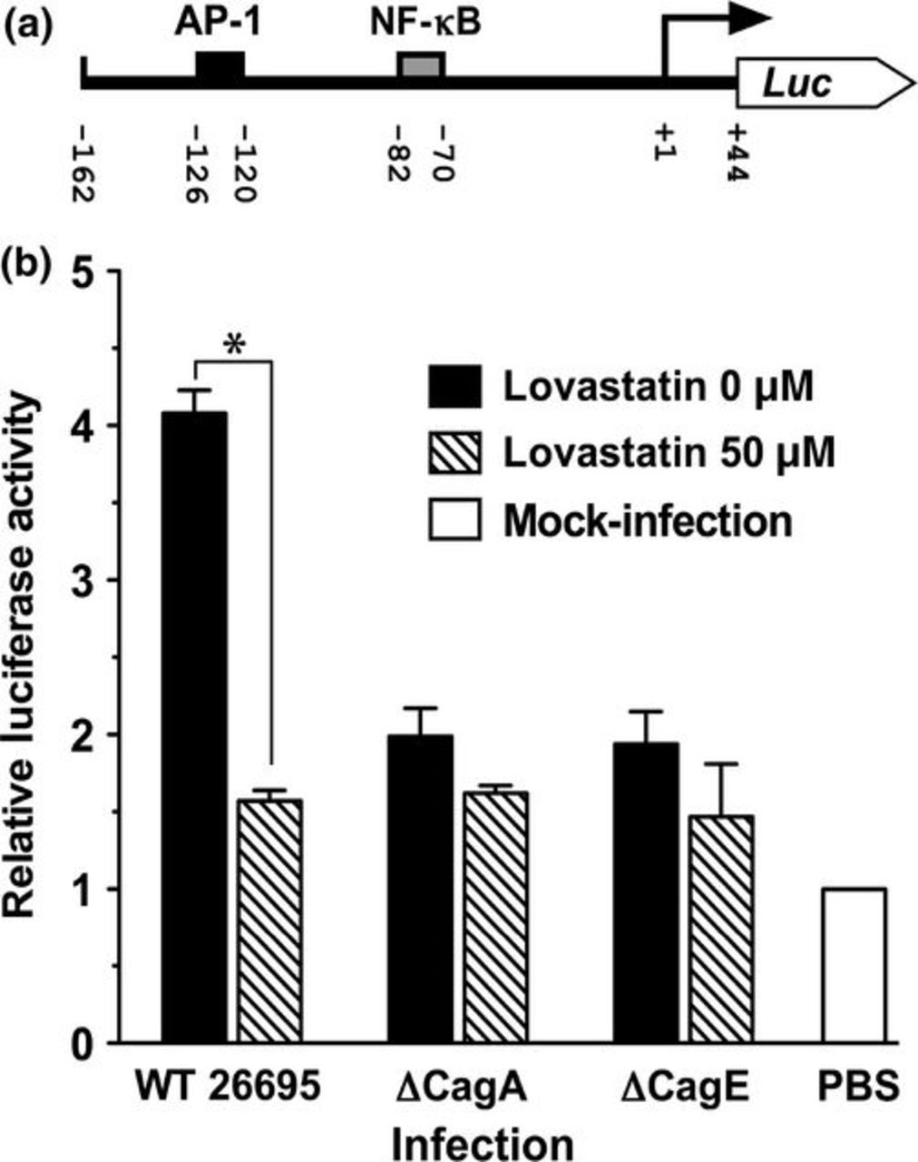
2 Cholesterol is required for H elicobacter pyloriCagA-induced IL-8 promoter activity. (a) A schematic ...
Notes:
2 Cholesterol is required for H elicobacter pyloriCagA-induced IL-8 promoter activity. (a) A schematic representation of IL8-Luc construct. AP-1, activator protein-1; NF-κB, nuclear factor-kappaB; Luc, luciferase reporter. In all numbering, the transcription initiation site is denoted by +1. (b) AGS cells were transfected with IL8-Luc vector. After 24 h transfection, the cells were then treated with lovastatin prior H elicobacter pylori infection. Cells were infected with wild-type (WT 26695), ∆CagA, or ∆CagE mutant H elicobacter pylori for 6 h and then subjected to luciferase activity assays. The significant of the difference was assessed using Student's t-test. *P< 0.05.
Unless provided in the caption above, the following copyright applies to the content of this slide: © 2011 Federation of European Microbiological Societies. Published by Blackwell Publishing Ltd. All rights reserved

Slide 3
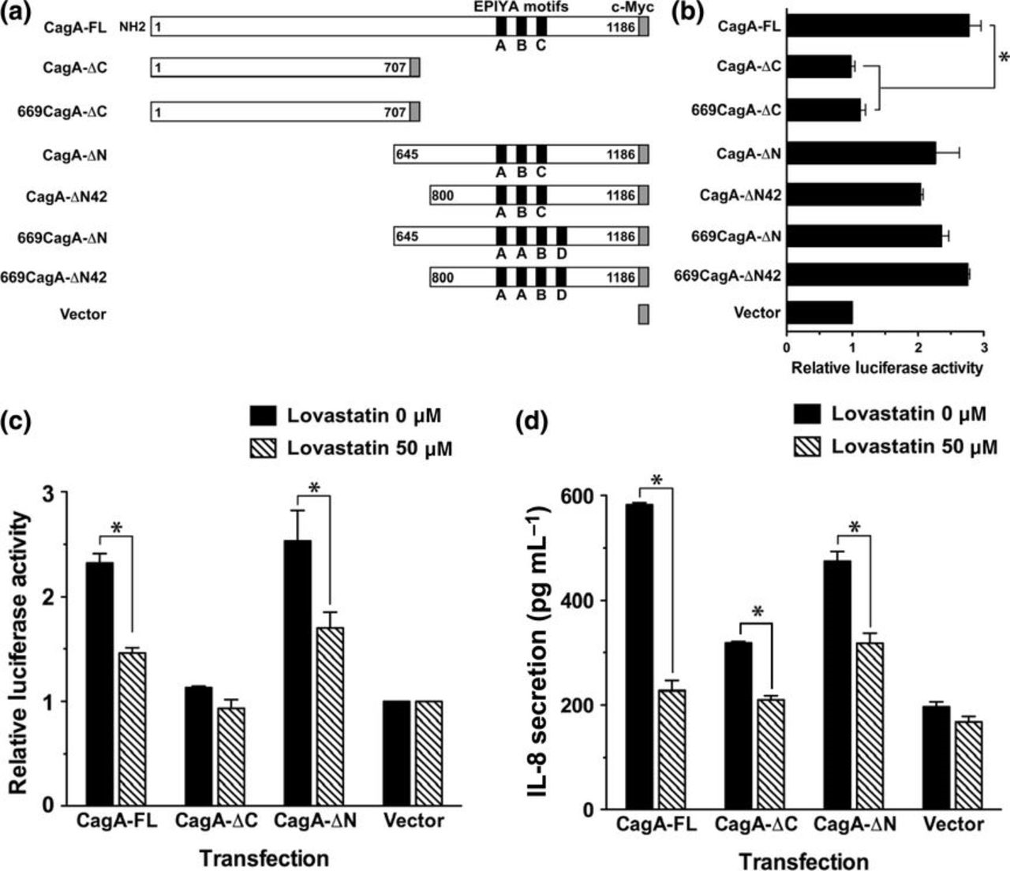
3 The CagA C-terminal domain containing EPIYAs is crucial for the CagA-induced IL-8 promoter activation (b and ...
Notes:
3 The CagA C-terminal domain containing EPIYAs is crucial for the CagA-induced IL-8 promoter activation (b and c) and IL-8 secretion (d) in AGS cells. (a) Schematic representation of wild-type 26695 (ABC-type EPIYAs) and a series of truncated mutants based on wild-type 26695 and v669 isolate (AABD-type EPIYAs). The EPIYA motifs and c-Myc tag are marked. The numbering indicates the number of amino acid residues. (b) AGS cells were co-transfected with the CagA expression constructs and IL8-Luc for 24 h, and then subjected to luciferase activity assays. For quantification, each luciferase activity is shown relative to the luciferase activity of the empty vector (mock-infection)-transfected AGS cells. Data represented as means and standard deviations of three independent experiments. (c and d) AGS cells were co-transfected with the indicated CagA constructs and IL-8-Luc followed by incubation in the absence or presence of lovastatin. On the following day, cell lysates and cultured supernatants were subjected to luciferase activity (c) and IL-8 ELISA assay (d), respectively. Statistical significance was evaluated using Student's t-test (*P< 0.05).
Unless provided in the caption above, the following copyright applies to the content of this slide: © 2011 Federation of European Microbiological Societies. Published by Blackwell Publishing Ltd. All rights reserved

Slide 4
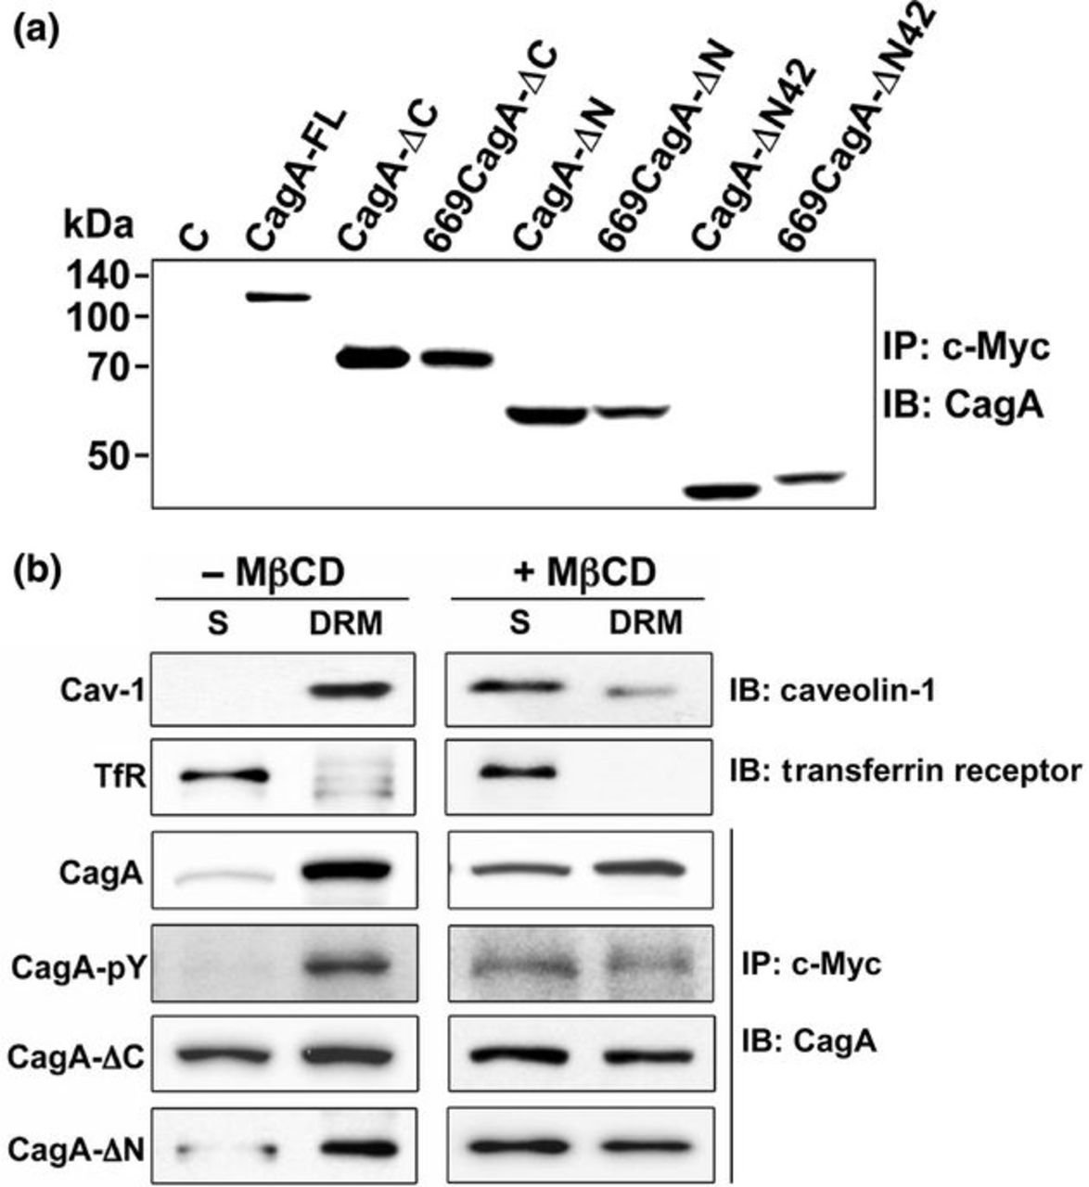
4 CagA C-terminal domain interacts with cholesterol-rich microdomains. (a) Detection of different CagA ...
Notes:
4 CagA C-terminal domain interacts with cholesterol-rich microdomains. (a) Detection of different CagA expression in HEK-293T cells. Cell lysates were prepared and subjected to immunoprecipitation (IP) using anti-Myc antibody followed by immunoblotting (IB) analysis using anti-CagA antibody. Molecular mass markers (kDa) are indicated. (b) HEK-293T cells were transfected with various CagA expression constructs for 24 h as indicated and then treated with or without 5 mM MβCD. The cell lysates were fractionated by the cold-detergent extraction using 1% Triton X-100, followed by centrifugation to separate DRM and detergent-soluble (S) fractions. Each fraction was subjected to IP using anti-Myc antibody and IB analysis using antibodies against CagA, phosphorylated CagA (CagA-pY). IB by Caveolin-1 (Cav-1) and TfR antibodies were used to mark DRM and S fractions, respectively.
Unless provided in the caption above, the following copyright applies to the content of this slide: © 2011 Federation of European Microbiological Societies. Published by Blackwell Publishing Ltd. All rights reserved

Slide 5
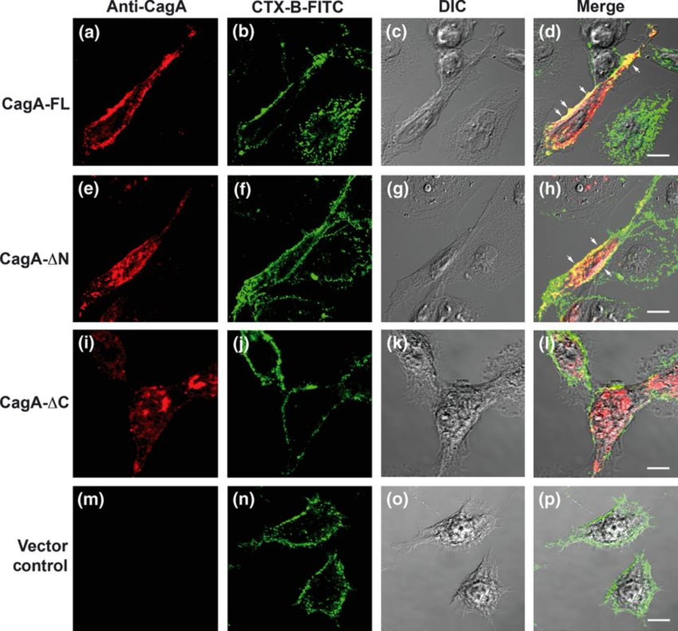
5 The CagA C-terminal domain targets to membrane GM1-containing microdomains in confocal images. AGS cells were ...
Notes:
5 The CagA C-terminal domain targets to membrane GM1-containing microdomains in confocal images. AGS cells were transfected with CagA-FL, CagA-ΔN, CagA-ΔC expression vectors, or empty vectors, respectively, as indicated. The transfected cells were fixed and stained with anti-CagA (red) and FITC-conjugated CTX-B to visualize GM1 (green) and analyzed using confocal microscopy. Regions of CagA co-localization appear in yellow in the overlay as denoted by arrows. DIC, differential interference contrast. Representative images are shown. Scale bars, 10 μm.
Unless provided in the caption above, the following copyright applies to the content of this slide: © 2011 Federation of European Microbiological Societies. Published by Blackwell Publishing Ltd. All rights reserved

