Slide 1
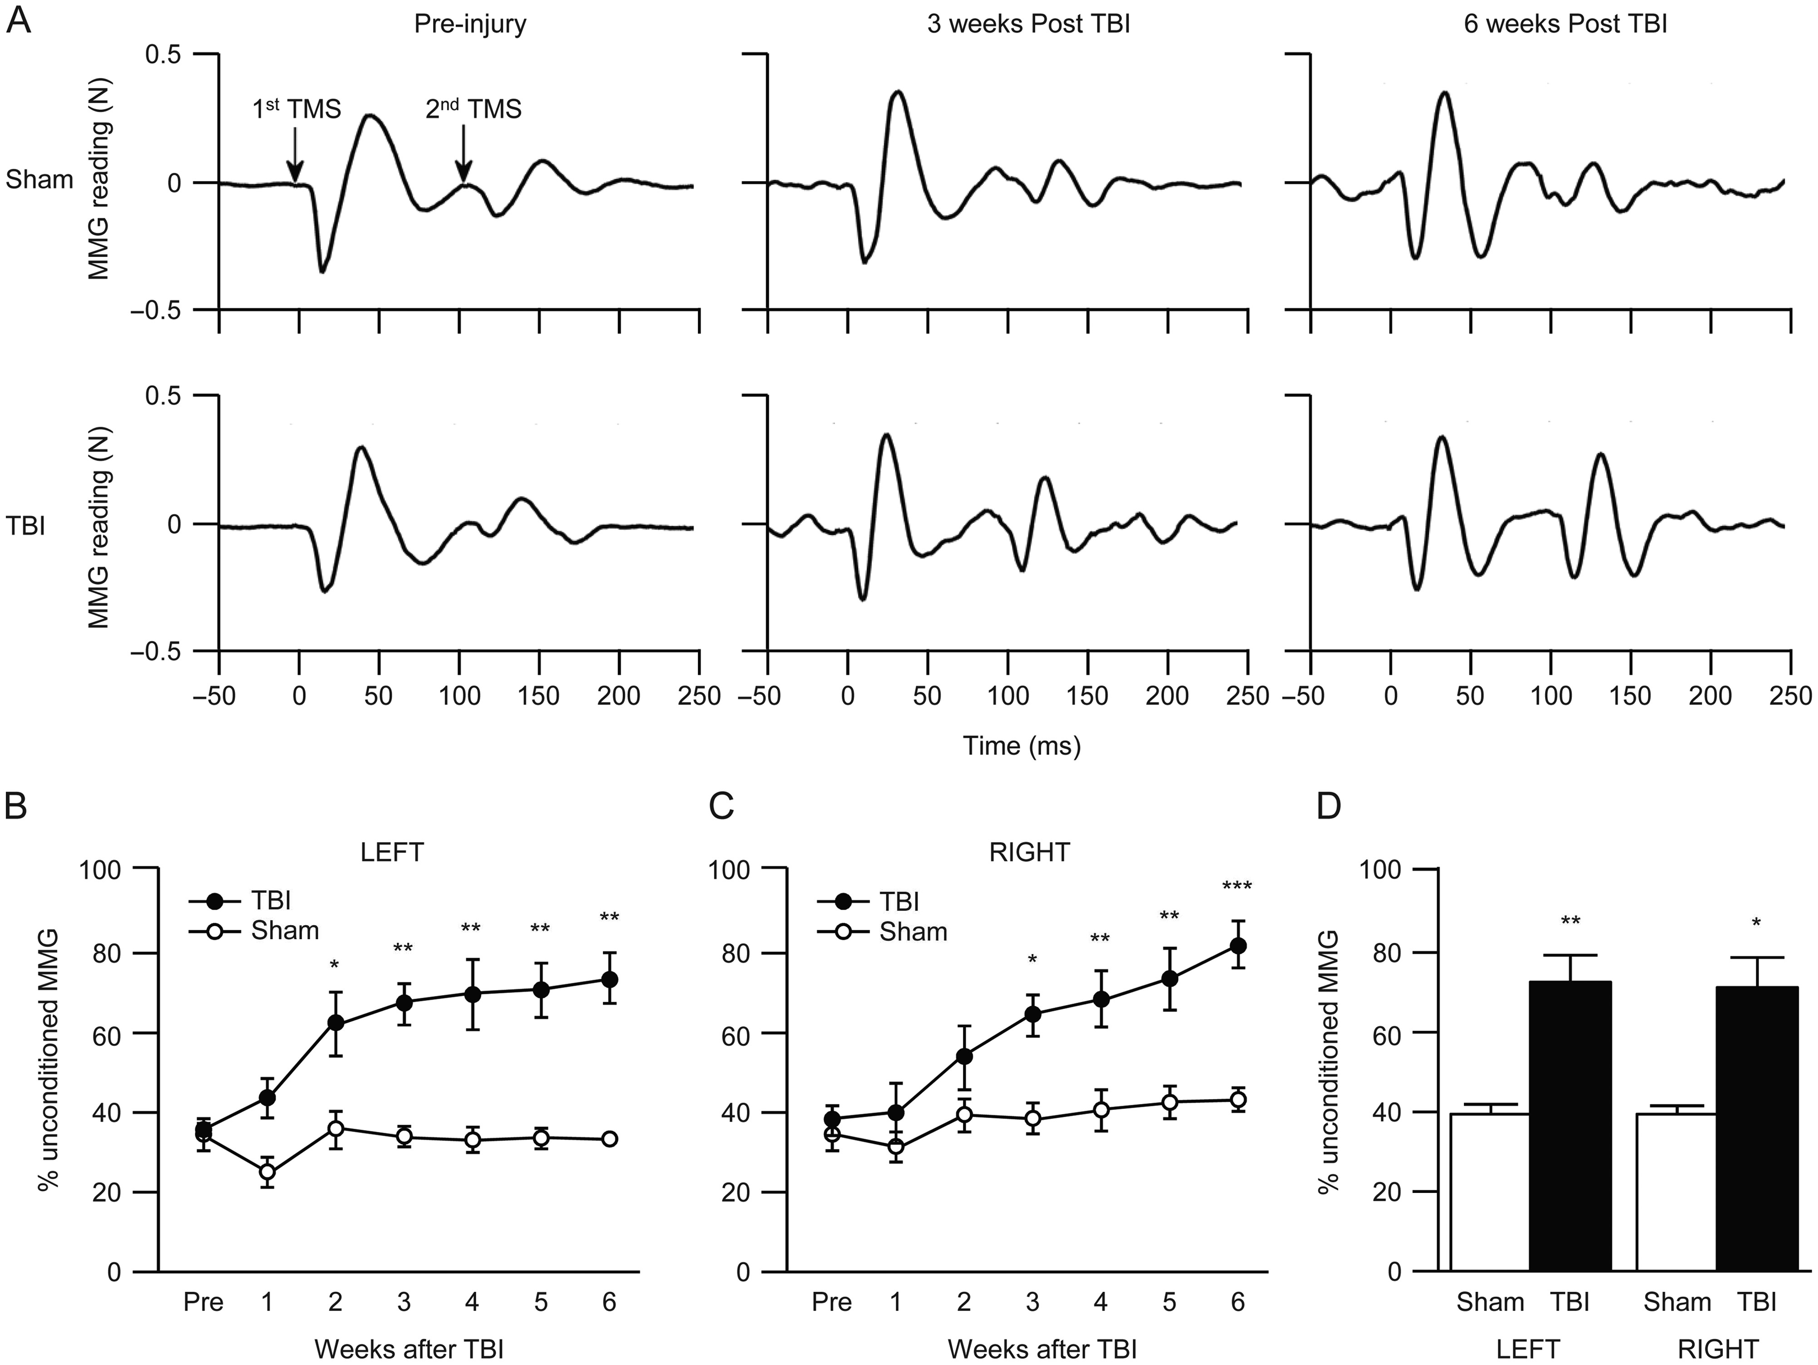
Figure 1. LI-ppTMS reveals progressive loss of intracortical inhibition following TBI. (A) Representative MMG traces ...
Notes:
Figure 1. LI-ppTMS reveals progressive loss of intracortical inhibition following TBI. (A) Representative MMG traces with 100 ms ISI with 100% MO intensity show no obvious changes between pre- and post-injury (3 and 6 weeks) in the sham control (upper panel, left to right) but progressive reduction in inhibition after TBI (lower panel, left to right). (B, C) Time course of LI-ppTMS changes at 100 ms ISI in left limb (B, closed circle •) and right limb (C, closed circle •) of TBI rats (N = 6). Sham control groups are shown in both panels as open circle (o) (N = 5). Error bars = SEM, *P < 0.05, **P < 0.01, ***P < 0.001 Fisher LSD. (D) Average paired-pulse inhibition (also with 100 ms ISI) in a separate cohort of rats tested 6 weeks after verum or sham TBI. To control for the confound of weekly stimulation, these groups were not exposed to ppTMS until 6 weeks after injury (error bars = SEM, *P < 0.05, **P < 0.01, **P < 0.001, unpaired t-test, N = 5 per group).
Unless provided in the caption above, the following copyright applies to the content of this slide: © The Author 2016. Published by Oxford University Press. All rights reserved. For Permissions, please e-mail: journals.permissions@oup.com

Slide 2
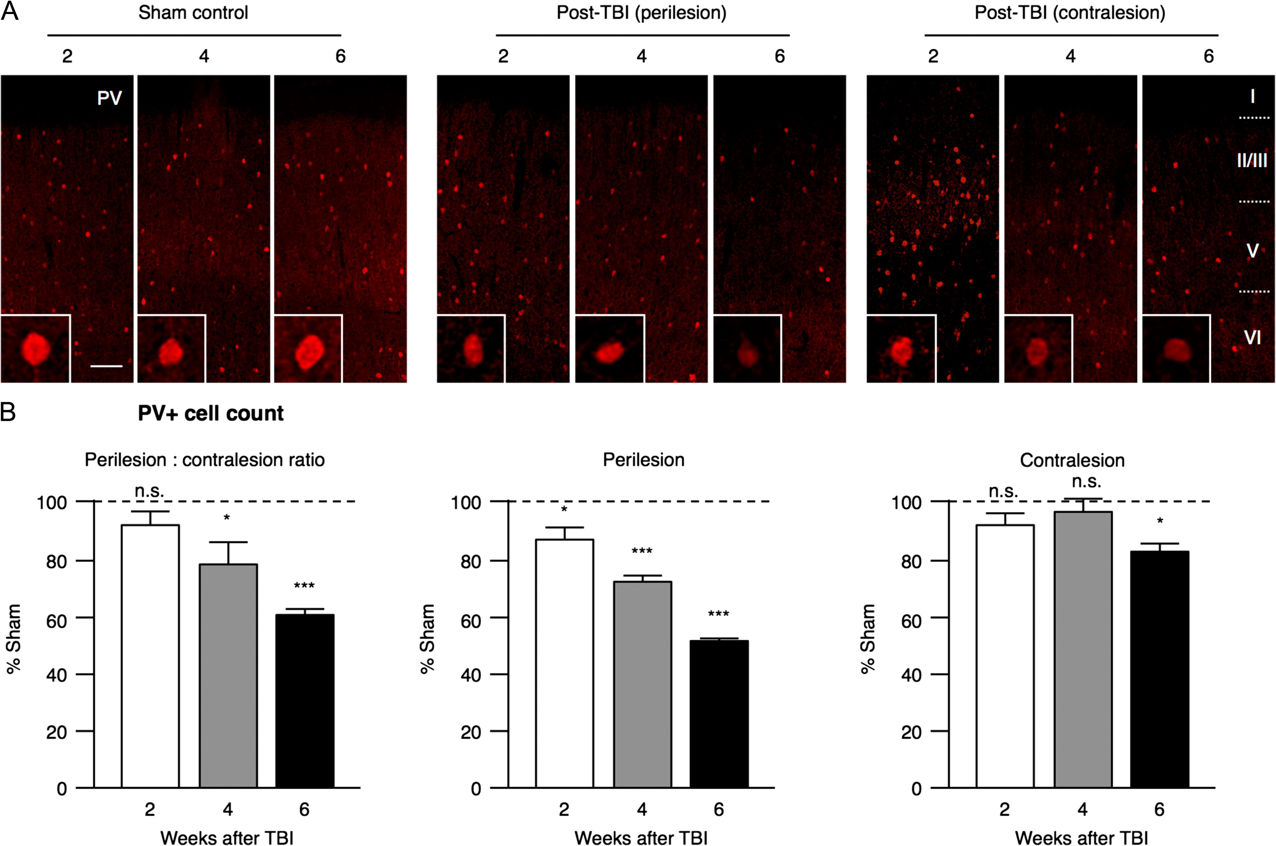
Figure 2. PV+ cell loss after TBI. (A) Rats underwent sham operation (Sham) or FPI (post-TBI) then sacrificed at ...
Notes:
Figure 2. PV+ cell loss after TBI. (A) Rats underwent sham operation (Sham) or FPI (post-TBI) then sacrificed at different time points (2, 4, and 6 weeks). Cortical sections through motor area were immunostained with antibodies against PV (anti-PV, Swant). Confocal images (900 × 400 µm) from Sham control, perilesional and contralesional sides from post-TBI brains are shown. Cortical layers I–VI are indicated. Scale bar = 100 µm. High magnification images of individual cells are displayed in insets. (B) The number of PV+ cells at the perilesional side (middle panel), contralesional side (right panel), and their ratio (left panel) calculated for each time point after TBI (2, 4, and 6 weeks) (error bars = SEM, n.s. = not significant, *P < 0.05, **P < 0.01, ***P < 0.001, Tukey's multiple comparison test, N = 5 per group).
Unless provided in the caption above, the following copyright applies to the content of this slide: © The Author 2016. Published by Oxford University Press. All rights reserved. For Permissions, please e-mail: journals.permissions@oup.com

Slide 3
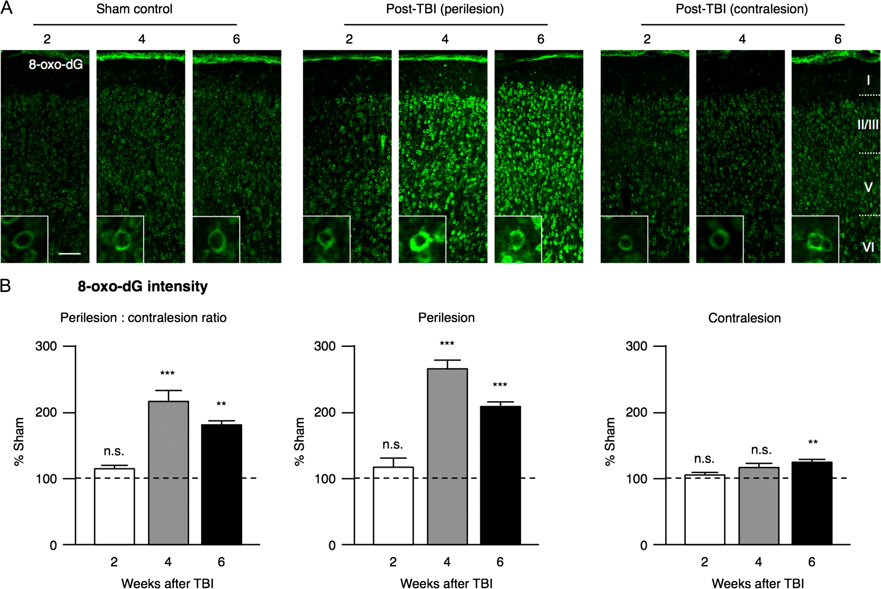
Figure 3. Increased oxidative stress after TBI. (A) Rats underwent sham operation (Sham) or FPI (post-TBI) then ...
Notes:
Figure 3. Increased oxidative stress after TBI. (A) Rats underwent sham operation (Sham) or FPI (post-TBI) then sacrificed at different time points (2, 4, and 6 weeks). Cortical sections through motor area were immunostained with antibodies against mitochondrial DNA damage (anti-8-oxo-dG, Trevigen). Confocal images (900 × 400 µm) from Sham control, perilesional and contralesional sides from post-TBI brains are shown. Cortical layers I–VI are indicated. Scale bar = 100 µm. High magnification images of individual cells are displayed in insets. (B) The signal intensity for 8-oxo-dG immunostaining at the perilesional side (middle panel), contralesional side (right panel), and their ratio (left panel) calculated for each time point after TBI (2, 4, and 6 weeks) (error bars = SEM, n.s. = not significant, **P < 0.01, ***P < 0.001, Tukey's multiple comparison test, N = 5 per group).
Unless provided in the caption above, the following copyright applies to the content of this slide: © The Author 2016. Published by Oxford University Press. All rights reserved. For Permissions, please e-mail: journals.permissions@oup.com

Slide 4
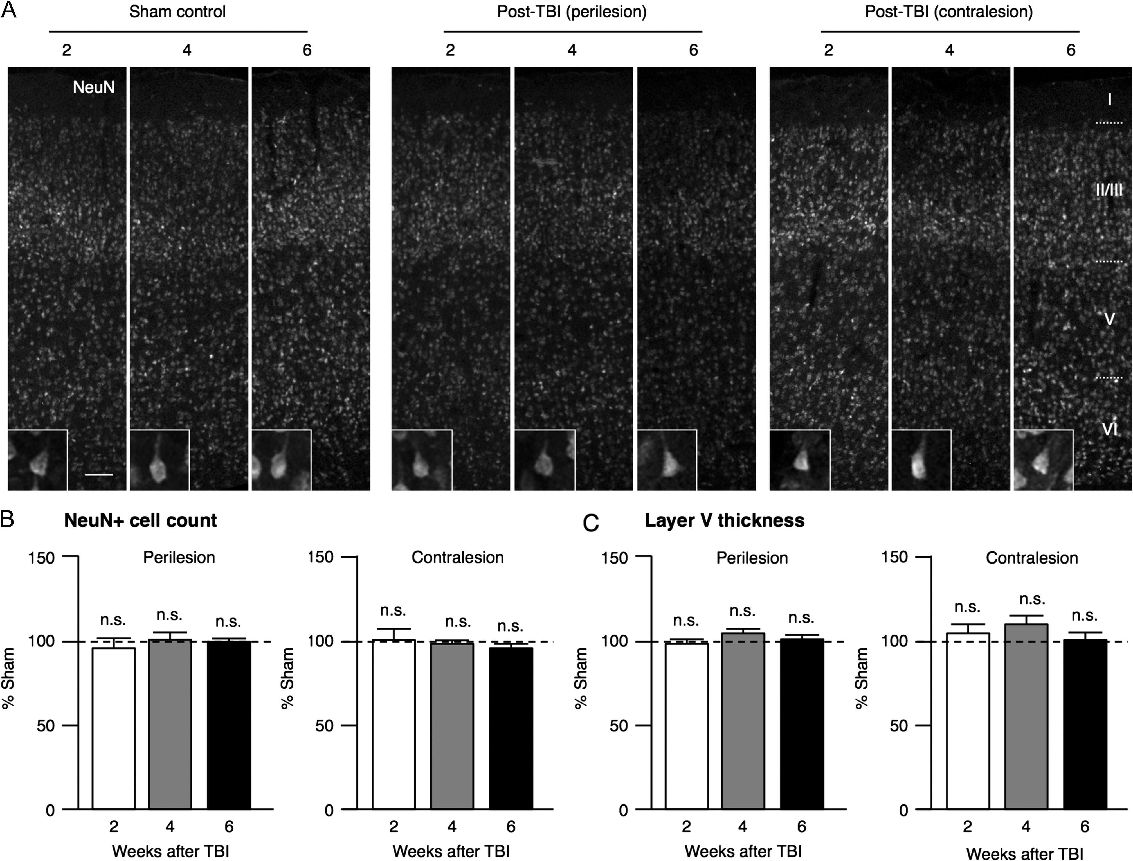
Figure 4. Unchanged neuronal cell counts and cortical thickness after TBI. (A) Rats underwent sham operation (Sham) or ...
Notes:
Figure 4. Unchanged neuronal cell counts and cortical thickness after TBI. (A) Rats underwent sham operation (Sham) or fluid percussion injury (post-TBI) then sacrificed at different time points (2, 4 and 6 weeks). Cortical sections through motor area were immunostained with antibodies against NeuN (anti-NeuN, Millipore). Confocal images (900 x 400μm) from Sham control, perilesional and contralesional sides from Post-TBI brains are shown. Cortical layers I-VI are indicated. Scale bar = 100 μm. High magnification images of individual cells are displayed in insets. (B) Quantification of NeuN immunostaining. The proportion of identified NeuN-positive cells at the perilesional (left panel)or contralesional sides (right panel) calculated with respect to sham for each time point after TBI (2, 4 and 6 weeks). (C) The thickness of layer V at the perilesional (left panel) or contralesional sides (right panel) calculated for each time point after TBI (2, 4 and 6 weeks). (Error bars = S.E.M., n.s. = not significant, Tukey’s multiple comparison test, N = 5 per group)
Unless provided in the caption above, the following copyright applies to the content of this slide: © The Author 2016. Published by Oxford University Press. All rights reserved. For Permissions, please e-mail: journals.permissions@oup.com

Slide 5
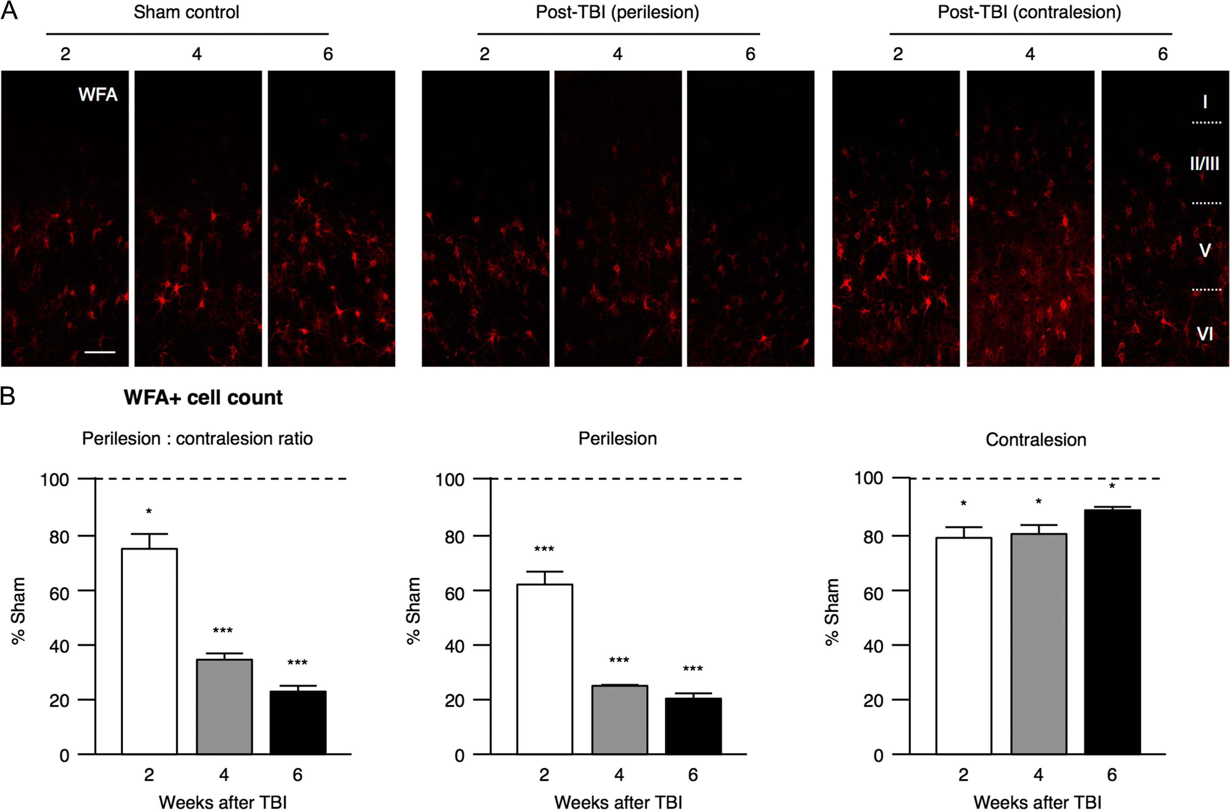
Figure 5. Reduced PNN+ cells after TBI. (A) Rats underwent sham operation (Sham) or FPI (post-TBI) then sacrificed at ...
Notes:
Figure 5. Reduced PNN+ cells after TBI. (A) Rats underwent sham operation (Sham) or FPI (post-TBI) then sacrificed at different time points (2, 4, and 6 weeks). Cortical sections through motor area were stained with Wisteria floribunda agglutinin (WFA, Sigma-Aldrich) to reveal PNN structure. Confocal images (900 × 400 µm) from Sham control, perilesional and contralesional sides from post-TBI brains are shown. Cortical layers I–VI are indicated. Scale bar = 100 µm (see Fig. 6 for high magnification images of individual cells). (B) The number of cells positively stained for WFA at the perilesional side (middle panel), contralesional side (right panel), and their ratio (left panel) calculated for each time point after TBI (2, 4, and 6 weeks) (error bars = SEM, n.s. = not significant, *P < 0.05, ***P < 0.001, Tukey's multiple comparison test, N = 5 per group).
Unless provided in the caption above, the following copyright applies to the content of this slide: © The Author 2016. Published by Oxford University Press. All rights reserved. For Permissions, please e-mail: journals.permissions@oup.com

Slide 6
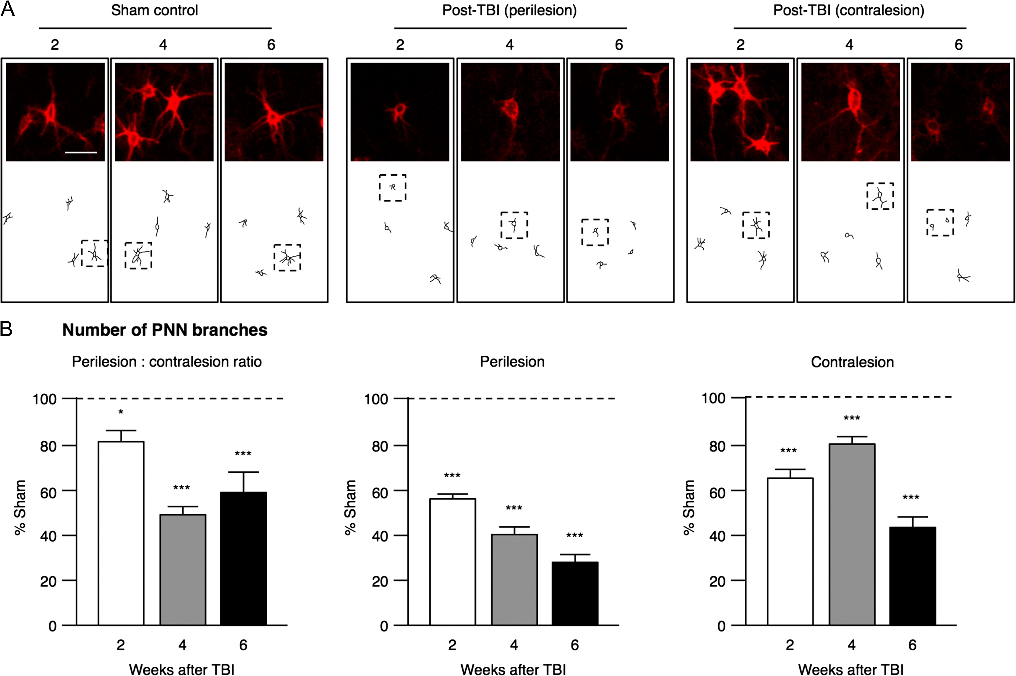
Figure 6. Reduced PNN complexity after TBI. (A) Tracings of PNN branches in layer V/VI stained by WFA revealing ...
Notes:
Figure 6. Reduced PNN complexity after TBI. (A) Tracings of PNN branches in layer V/VI stained by WFA revealing impoverished structures after TBI. High magnification images of individual PNN+ cells are shown (corresponding to those cells highlighted in the sketch tracing). Scale bar = 25 µm. (B) The number of PNN branches at the perilesional side (middle panel), contralesional side (right panel), and their ratio (left panel) calculated for each time point after TBI (2, 4, and 6 weeks) (error bars = SEM, n.s. = not significant, *P < 0.05, ***P < 0.001, Tukey's multiple comparison test, N = 5 per group).
Unless provided in the caption above, the following copyright applies to the content of this slide: © The Author 2016. Published by Oxford University Press. All rights reserved. For Permissions, please e-mail: journals.permissions@oup.com

Slide 7
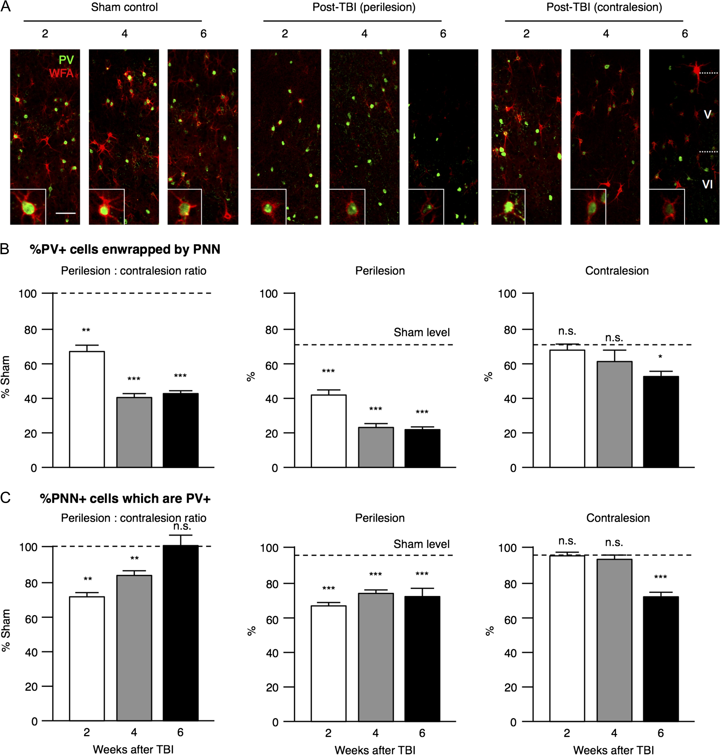
Figure 7. Loss of PV+ cells enwrapped by PNN after TBI. (A) Rats underwent sham operation (Sham) or FPI (post-TBI) then ...
Notes:
Figure 7. Loss of PV+ cells enwrapped by PNN after TBI. (A) Rats underwent sham operation (Sham) or FPI (post-TBI) then sacrificed at different time points (2, 4, and 6 weeks). Cortical sections through motor area were stained with anti-PV (shown in green) and WFA (shown in red). Confocal images (600 × 400 µm) from Sham control, perilesional and contralesional sides from post-TBI brains are shown. Scale bar = 100 µm. High magnification images of individual cells are displayed in insets. (B) Percentage of PV+ cells positively stained with WFA at the perilesional side (middle panel), contralesional side (right panel), and their ratio (left panel) calculated for each time point after TBI (2, 4, and 6 weeks). (C) Loss of PNN+ cells which are PV+ after TBI. The percentage of PNN+ cells positively stained with PV at the perilesional side (middle panel), contralesional side (right panel), and their ratio (left panel) calculated for each time point after TBI (2, 4, and 6 weeks). Results are compared with sham levels as indicated by the dotted line (error bars = SEM, n.s. = not significant, *P < 0.05, **P < 0.01, ***P < 0.001, Tukey's multiple comparison test, N = 5 per group).
Unless provided in the caption above, the following copyright applies to the content of this slide: © The Author 2016. Published by Oxford University Press. All rights reserved. For Permissions, please e-mail: journals.permissions@oup.com

Slide 8
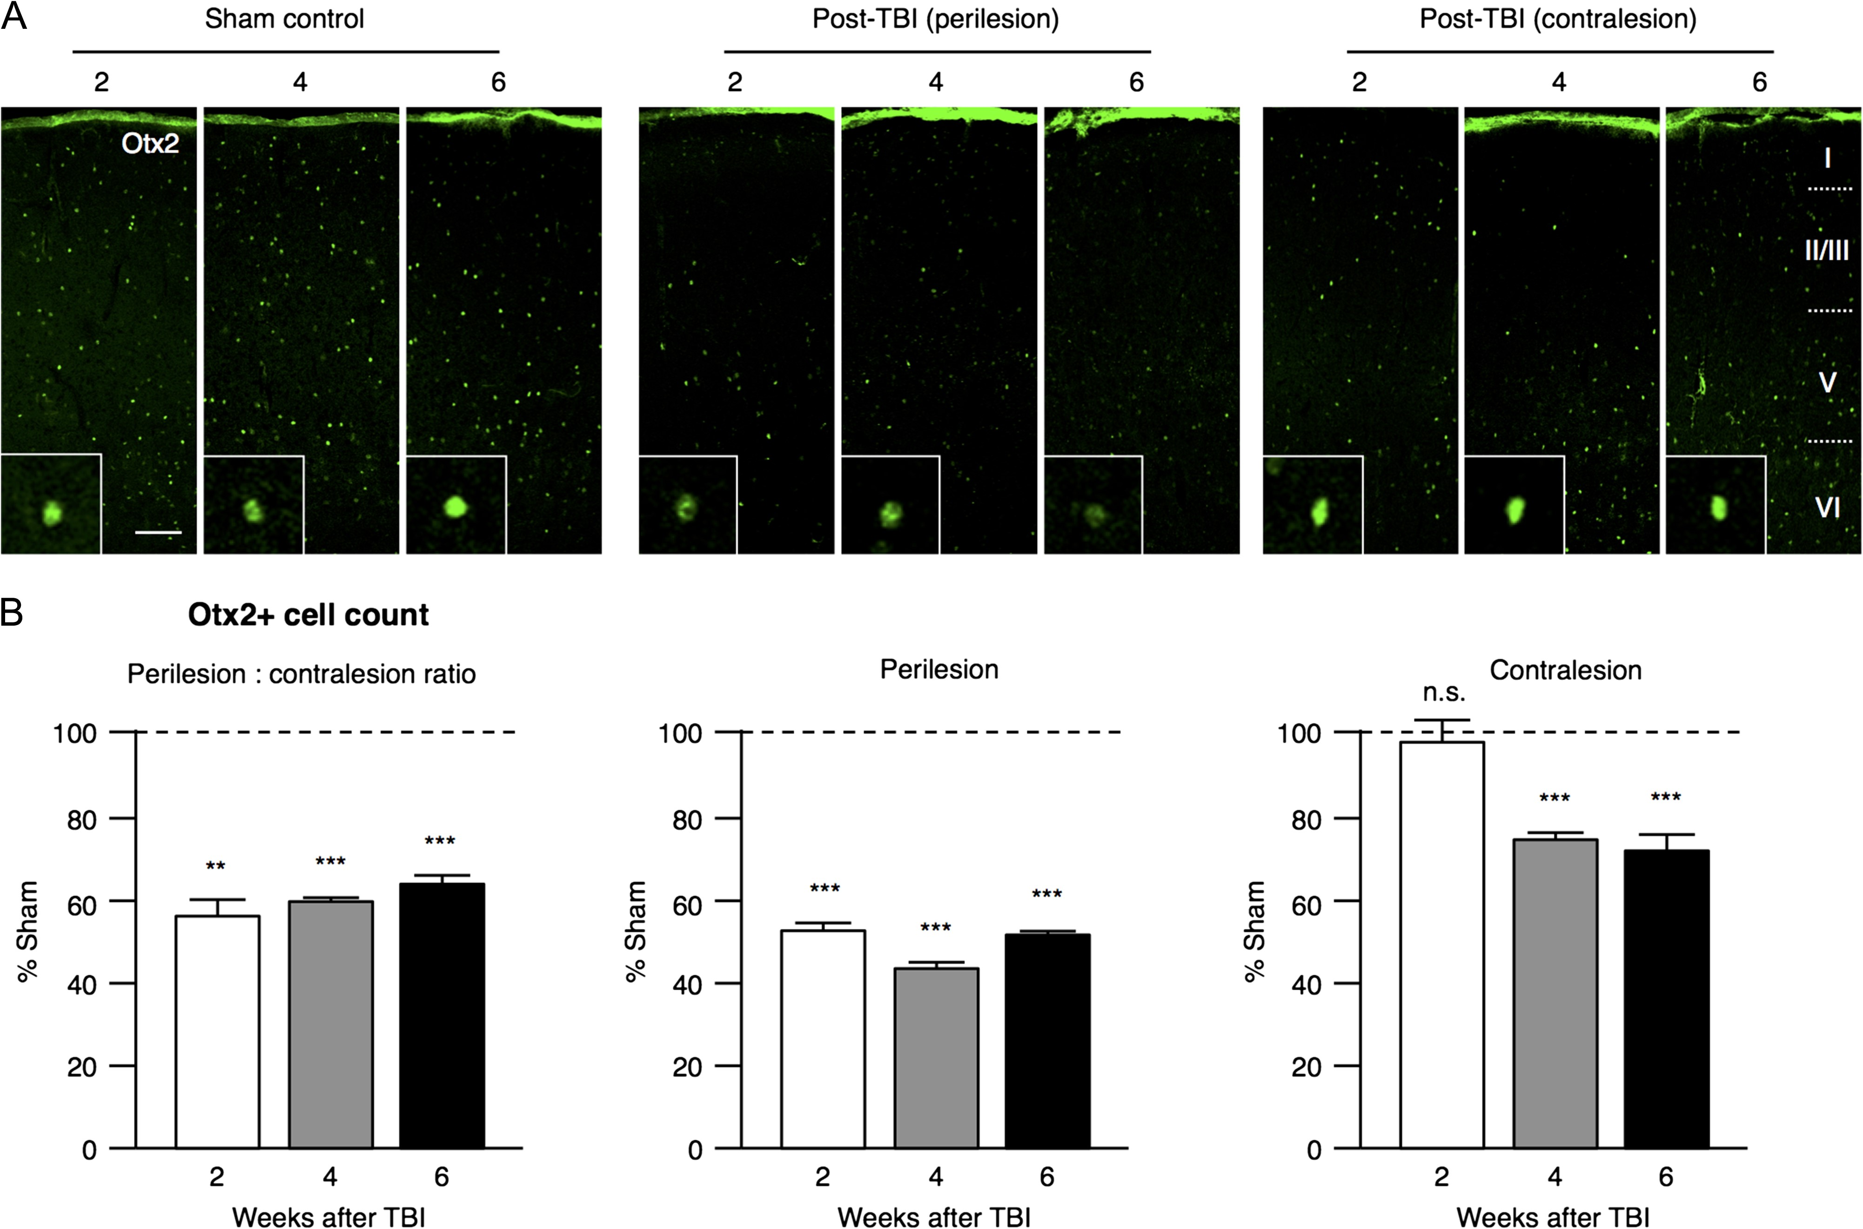
Figure 8. Loss of Otx2 accumulation after TBI. (A) Rats underwent sham operation (Sham) or FPI (post-TBI) then ...
Notes:
Figure 8. Loss of Otx2 accumulation after TBI. (A) Rats underwent sham operation (Sham) or FPI (post-TBI) then sacrificed at different time points (2, 4, and 6 weeks). Cortical sections through motor area were stained with anti-Otx2 (c/o Dr Alain Prochiantz, College de France). Confocal images (900 × 400 µm) from Sham control, perilesional and contralesional sides from post-TBI brains are shown. Cortical layers I–VI are indicated. Scale bar = 100 µm. High magnification images of individual cells are displayed in insets. (B) The number of cells positively stained with Otx2 at the perilesional side (middle panel), contralesional side (right panel), and their ratio (left panel) calculated for each time point after TBI (2, 4, and 6 weeks) (error bars = SEM, n.s. = not significant, **P < 0.01, ***P < 0.001, Tukey's multiple comparison test, N = 5 per group).
Unless provided in the caption above, the following copyright applies to the content of this slide: © The Author 2016. Published by Oxford University Press. All rights reserved. For Permissions, please e-mail: journals.permissions@oup.com

Slide 9
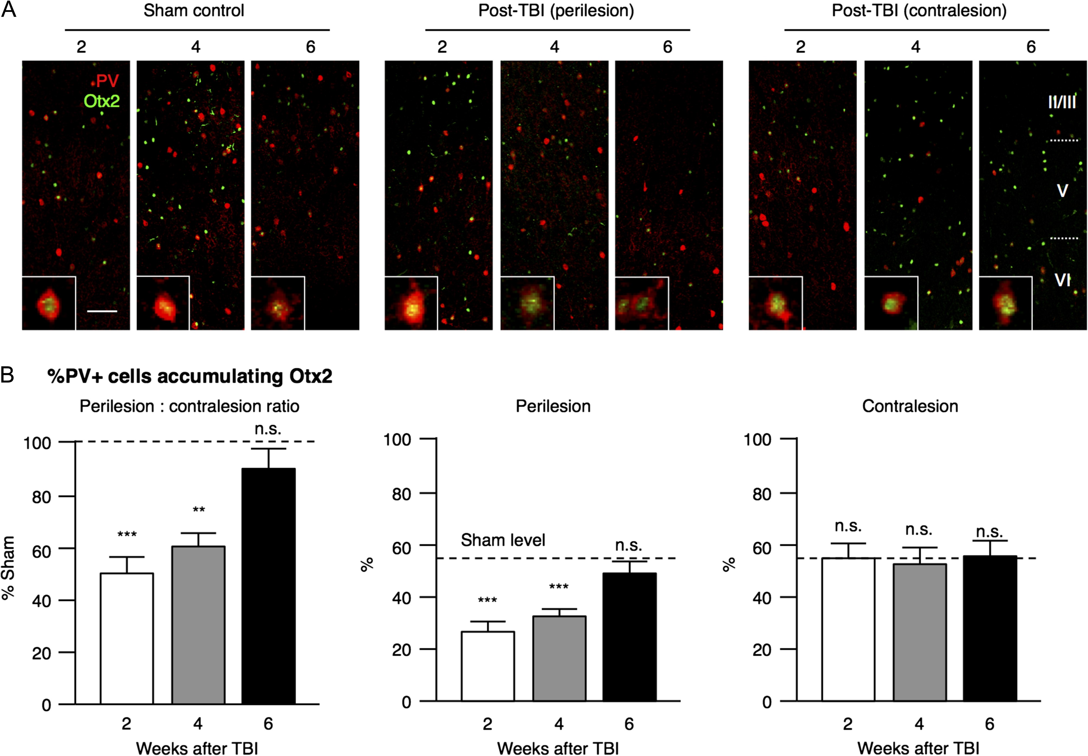
Figure 9. Retention of PV+ cells accumulating Otx2 after TBI. (A) Rats underwent sham operation (Sham) or FPI ...
Notes:
Figure 9. Retention of PV+ cells accumulating Otx2 after TBI. (A) Rats underwent sham operation (Sham) or FPI (post-TBI) then sacrificed at different time points (2, 4, and 6 weeks). Cortical sections through motor area were stained with anti-PV (shown in red) and anti-Otx2 (shown in green). Confocal images (600 × 400 µm) from Sham control, perilesional and contralesional sides from post-TBI brains are shown. Scale bar = 100 µm. High magnification images of individual cells are displayed in insets. (B) Percentage of PV+ cells positively stained with Otx2 at the perilesional side (middle panel), contralesional side (right panel), and their ratio (left panel) calculated for each time point after TBI (2, 4, and 6 weeks). Results are compared with sham levels as indicated by the dotted line (error bars = SEM, n.s. = not significant, *P < 0.05, **P < 0.01, ***P < 0.001; Tukey's multiple comparison test, N = 5 per group).
Unless provided in the caption above, the following copyright applies to the content of this slide: © The Author 2016. Published by Oxford University Press. All rights reserved. For Permissions, please e-mail: journals.permissions@oup.com

