Slide 1
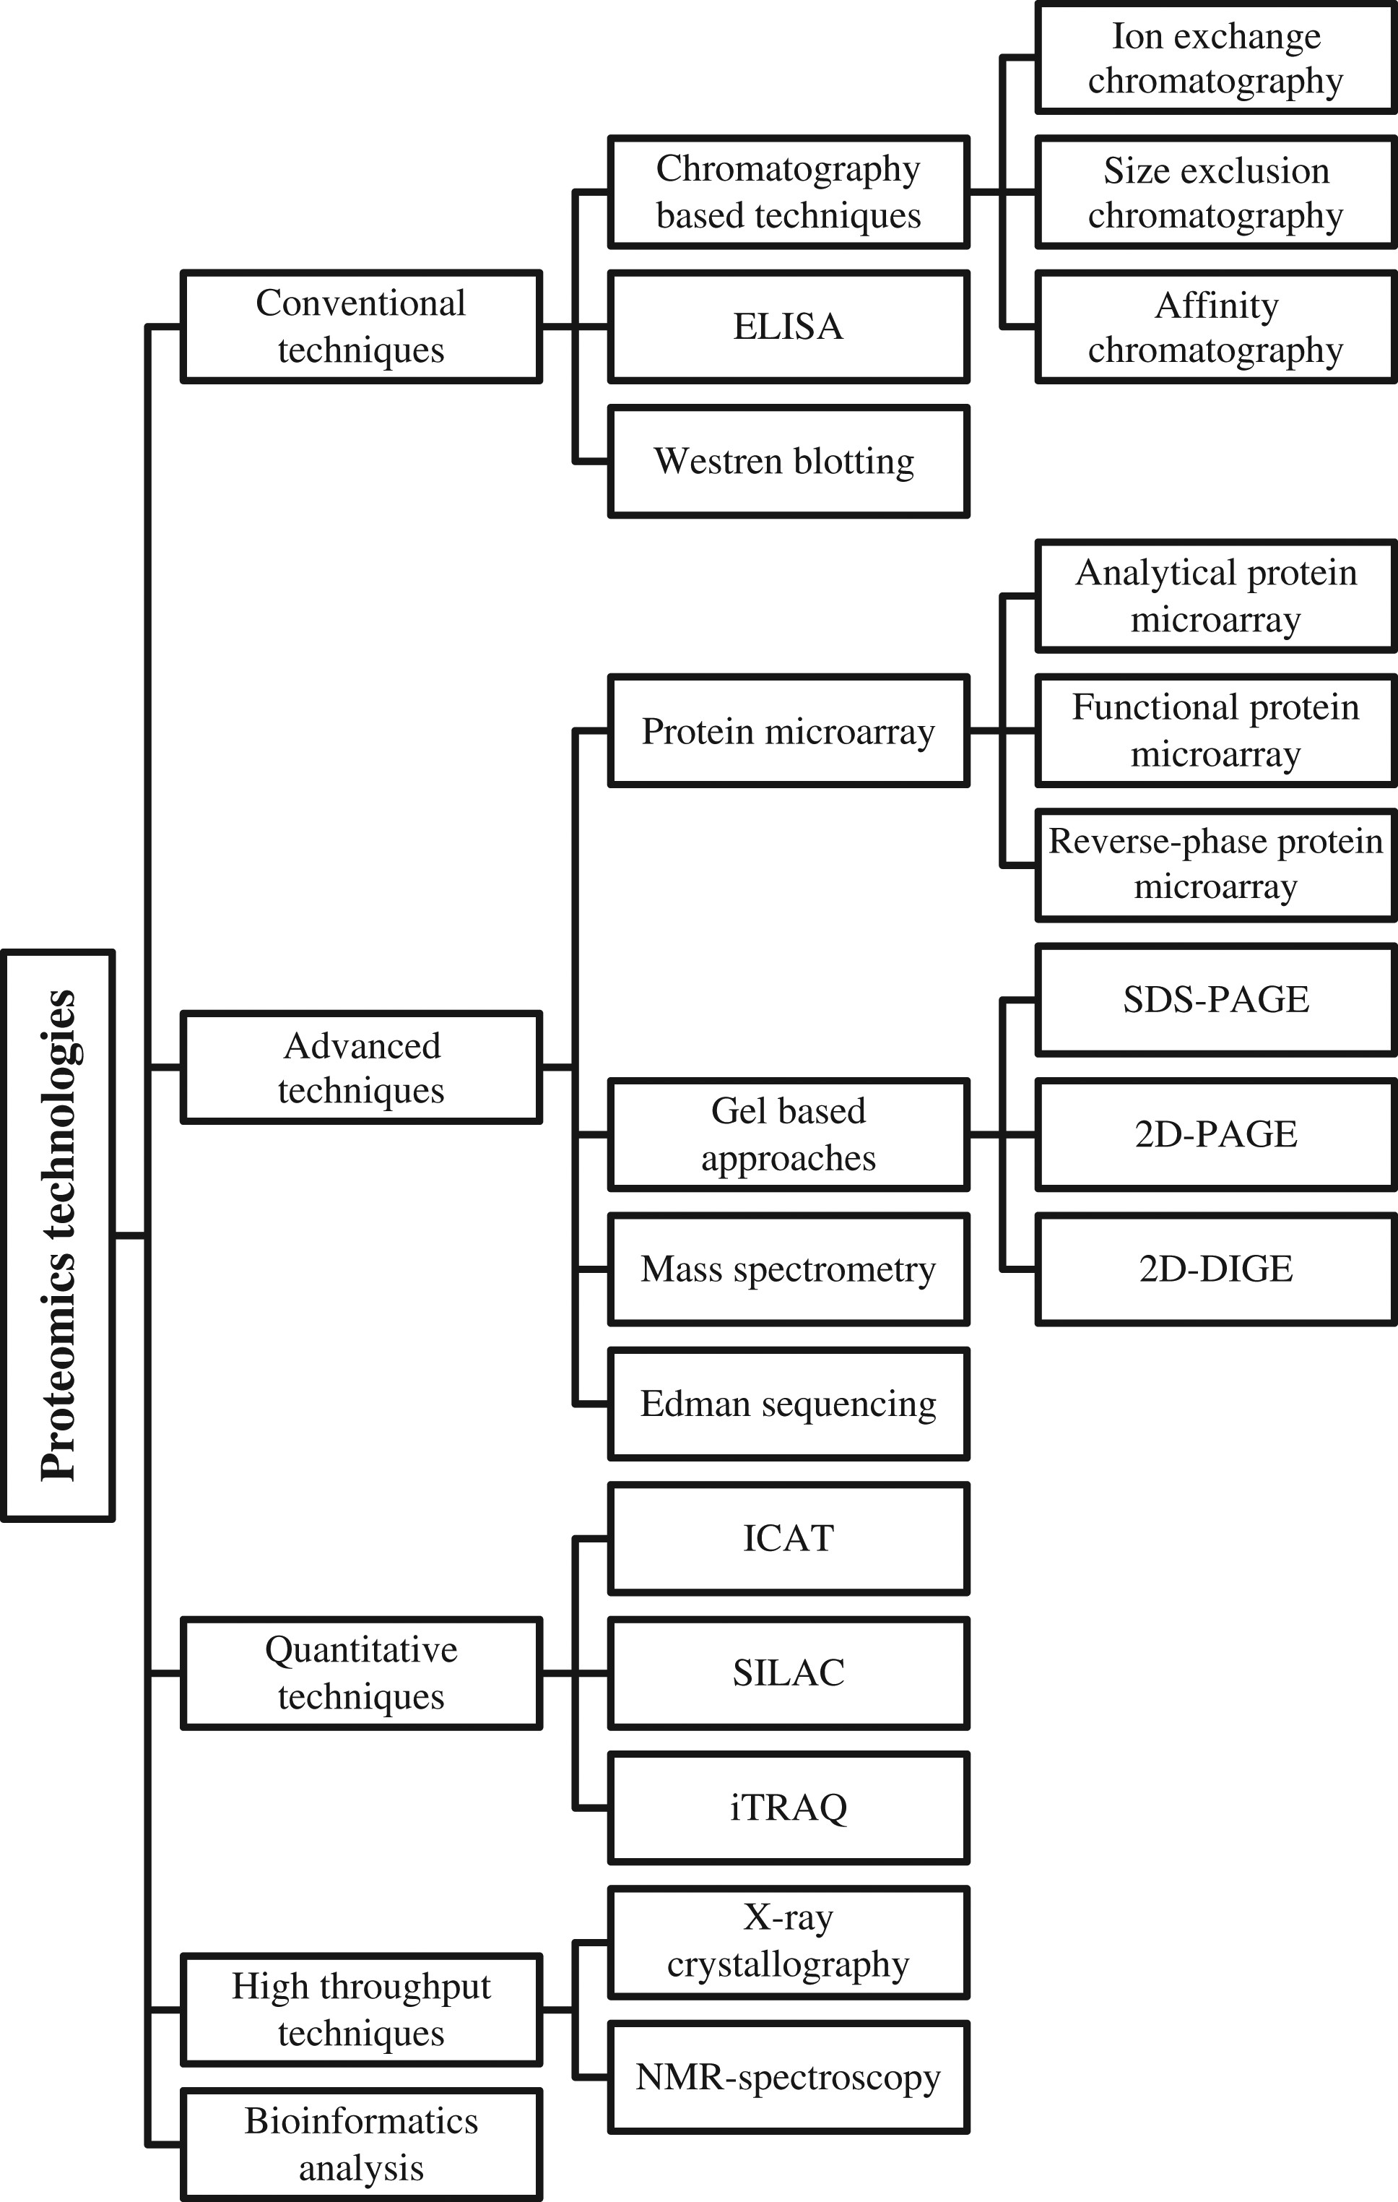
Figure 1. An overview of proteomics techniques.
Notes:
Figure 1. An overview of proteomics techniques.
Unless provided in the caption above, the following copyright applies to the content of this slide: © The Author 2016. Published by Oxford University Press. All rights reserved. For Permissions, please email: journals.permissions@oup.com

Slide 2
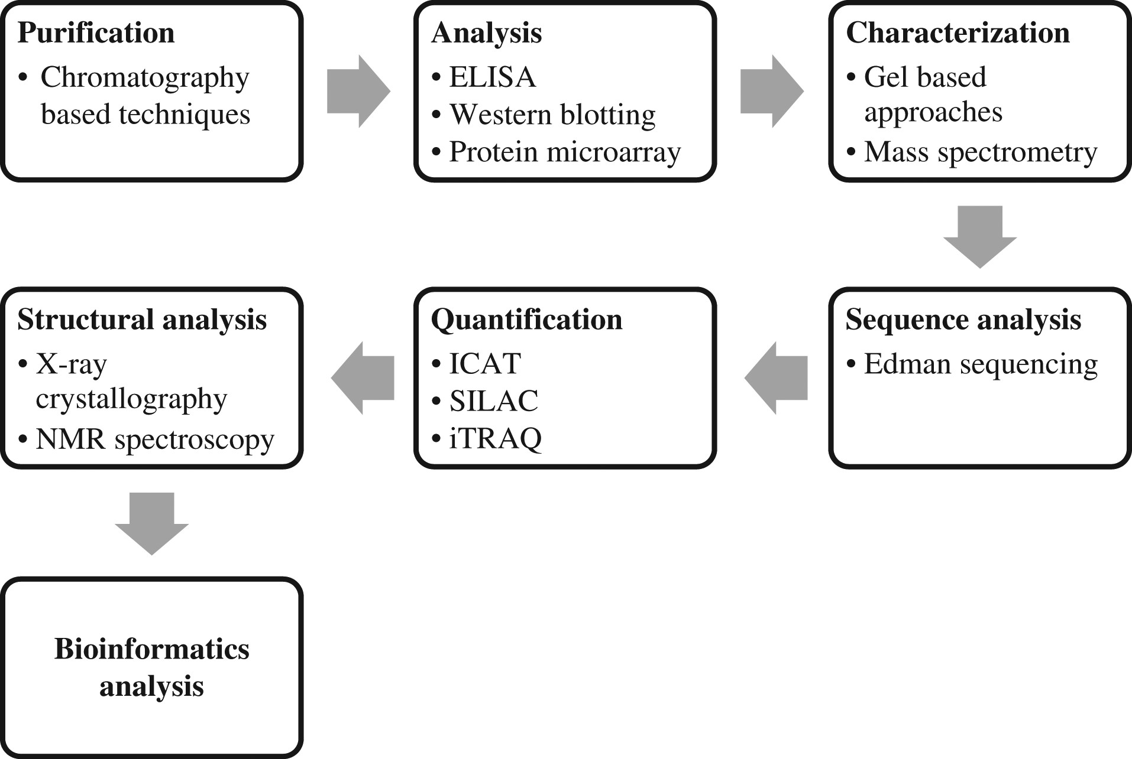
Figure 2. Applications of proteomics techniques.
Notes:
Figure 2. Applications of proteomics techniques.
Unless provided in the caption above, the following copyright applies to the content of this slide: © The Author 2016. Published by Oxford University Press. All rights reserved. For Permissions, please email: journals.permissions@oup.com

Slide 3
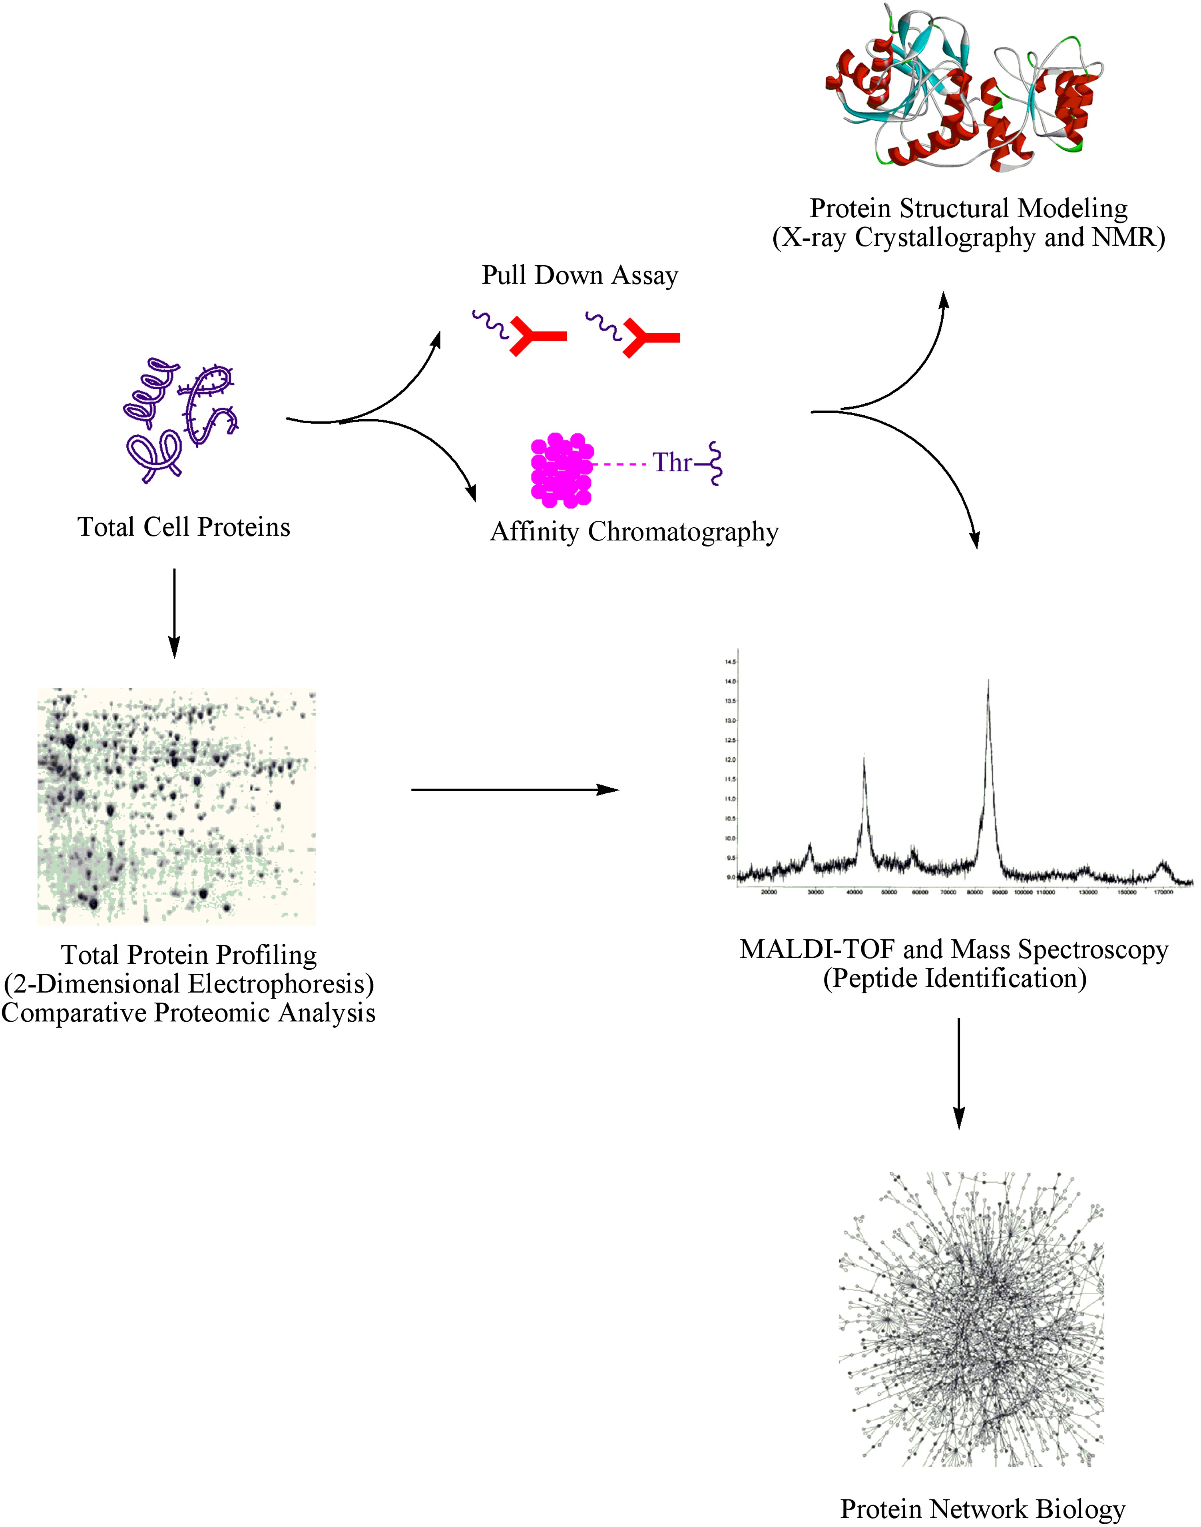
Figure 3. Schematic representation of protein analysis. The conventional methodology for protein analysis includes ...
Notes:
Figure 3. Schematic representation of protein analysis. The conventional methodology for protein analysis includes protein extraction, purification and structural studies. Cells or tissue are processed by various physical (sonication) and chemical (detergents) techniques for the extraction of total protein. Based upon physiochemical nature of polypeptides, the protein of interest can be separated out by different chromatographic techniques. Various methods including X-ray crystallography, NMR and MALDI-TOF are extensively used for structural elucidation and functional characterization of proteins. Nowadays, high-throughput techniques including total proteome analysis and MALDI-TOF are employed to study protein network biology.
Unless provided in the caption above, the following copyright applies to the content of this slide: © The Author 2016. Published by Oxford University Press. All rights reserved. For Permissions, please email: journals.permissions@oup.com

