Slide 1
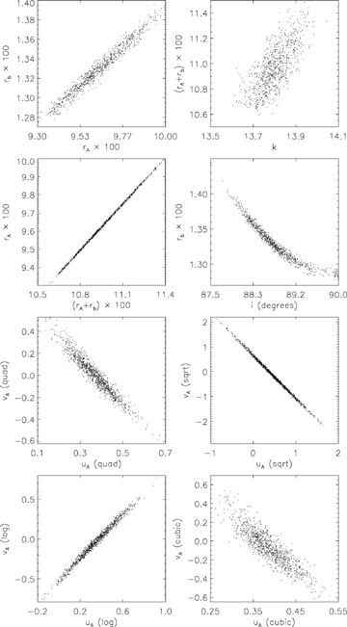
Figure 2 Scatter plots showing some results of the Monte Carlo analysis used to measure the uncertainties in the ...
Notes:
Figure 2 Scatter plots showing some results of the Monte Carlo analysis used to measure the uncertainties in the light-curve parameters. The upper four panels show results obtained using linear LD: it can be seen that rA and (rA+rb) are strongly correlated with each other in this representative case, whilst rb and i are also correlated. The lower four panels show the correlations between the two LDCs for each of the non-linear LD laws: the correlation is the strongest for square root and weakest for cubic.
Unless provided in the caption above, the following copyright applies to the content of this slide: © 2008 The Author. Journal compilation © 2008 RAS

Slide 2
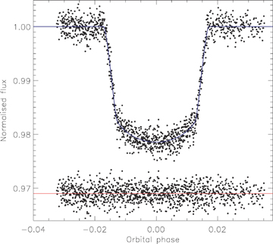
Figure 1 Phased light curve of the transits of TrES-1 from Winn et al. (2007d) compared to the best fit found using ...
Notes:
Figure 1 Phased light curve of the transits of TrES-1 from Winn et al. (2007d) compared to the best fit found using jktebop and the quadratic LD law with both LDCs included as fitted parameters. The residuals of the fit are plotted at the bottom of the figure, offset from zero.
Unless provided in the caption above, the following copyright applies to the content of this slide: © 2008 The Author. Journal compilation © 2008 RAS

Slide 3
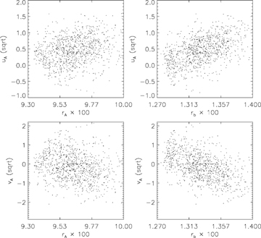
Figure 3 Scatter plots similar to Fig. 2 but showing the weakness of the correlations between the LDCs and the ...
Notes:
Figure 3 Scatter plots similar to Fig. 2 but showing the weakness of the correlations between the LDCs and the fractional radii of the star and planet. The square-root LD law was used for the results in this plot as this law should show the strongest correlations.
Unless provided in the caption above, the following copyright applies to the content of this slide: © 2008 The Author. Journal compilation © 2008 RAS

Slide 4
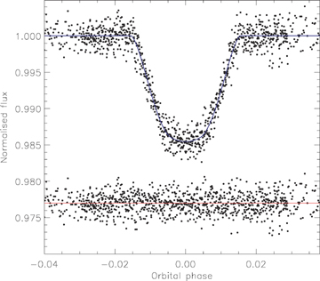
Figure 4 Phased light curve of the transits of TrES-2 from Holman et al. (2007b) compared to the best fit found using ...
Notes:
Figure 4 Phased light curve of the transits of TrES-2 from Holman et al. (2007b) compared to the best fit found using jktebop and the quadratic LD law with the linear LDC included as a fitted parameter. The residuals of the fit are plotted at the bottom of the figure, offset from zero.
Unless provided in the caption above, the following copyright applies to the content of this slide: © 2008 The Author. Journal compilation © 2008 RAS

Slide 5
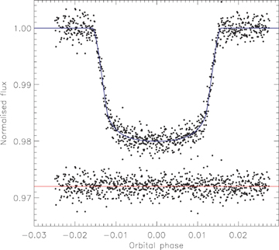
Figure 5 Phased light curve of the transits of XO-1 from Holman et al. (2006) compared to the best fit found using ...
Notes:
Figure 5 Phased light curve of the transits of XO-1 from Holman et al. (2006) compared to the best fit found using jktebop and the quadratic LD law with the linear LDC included as a fitted parameter. The residuals of the fit are plotted at the bottom of the figure, offset from zero.
Unless provided in the caption above, the following copyright applies to the content of this slide: © 2008 The Author. Journal compilation © 2008 RAS

Slide 6
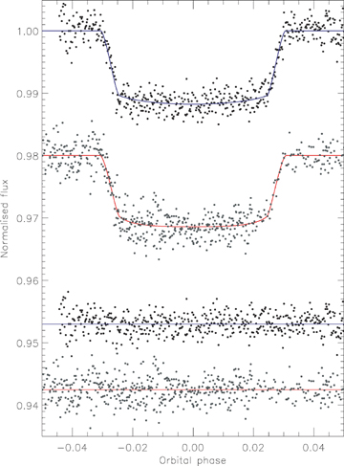
Figure 6 Phased light curves of the transits of WASP-1 from Shporer et al. (2007) (grey points) and Charbonneau et al. ...
Notes:
Figure 6 Phased light curves of the transits of WASP-1 from Shporer et al. (2007) (grey points) and Charbonneau et al. (2007) (black points) compared to the best fits found using jktebop (red line for the Shporer data and blue line for the Charbonneau data) and the quadratic LD law with the linear LDC included as a fitted parameter. The residuals of the fits are plotted at the bottom of the figures, offset from zero.
Unless provided in the caption above, the following copyright applies to the content of this slide: © 2008 The Author. Journal compilation © 2008 RAS

Slide 7
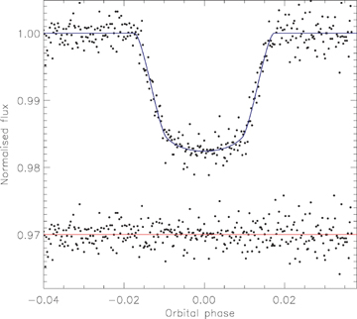
Figure 7 Phased light curve of the transit of WASP-2 from Charbonneau et al. (2007) compared to the best fit found ...
Notes:
Figure 7 Phased light curve of the transit of WASP-2 from Charbonneau et al. (2007) compared to the best fit found using jktebop and the quadratic LD law with the linear LDC included as a fitted parameter. The residuals of the fit are plotted at the bottom of the figure, offset from zero.
Unless provided in the caption above, the following copyright applies to the content of this slide: © 2008 The Author. Journal compilation © 2008 RAS

Slide 8
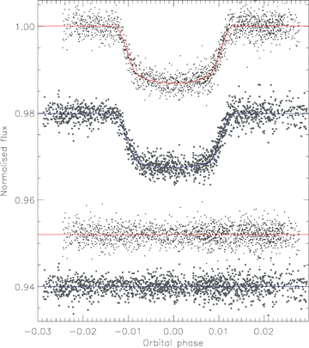
Figure 8 Phased light curves of the transit of HAT-P-1 from Winn et al. (2007c) compared to the best fits found using ...
Notes:
Figure 8 Phased light curves of the transit of HAT-P-1 from Winn et al. (2007c) compared to the best fits found using jktebop and the quadratic LD law. The FLWO z-band data are plotted at the top and the Lick Z-band light curve is offset by −0.02. The residuals of the fit are plotted at the bottom of the figure, offset from zero.
Unless provided in the caption above, the following copyright applies to the content of this slide: © 2008 The Author. Journal compilation © 2008 RAS

Slide 9
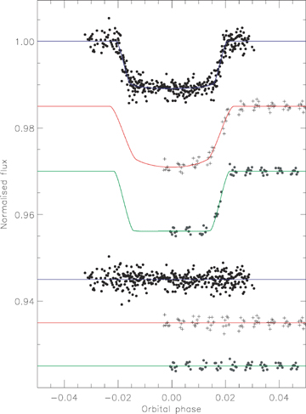
Figure 9 Phased light curves of the transits of OGLE-TR-10 from Holman et al. (2007a) (top) and Pont et al. (2007a) (V ...
Notes:
Figure 9 Phased light curves of the transits of OGLE-TR-10 from Holman et al. (2007a) (top) and Pont et al. (2007a) (V middle, R lower) compared to the best fits found using jktebop and the quadratic LD law with the linear LDC included as a fitted parameter. The residuals of the fit are plotted at the bottom of the figure, offset from zero.
Unless provided in the caption above, the following copyright applies to the content of this slide: © 2008 The Author. Journal compilation © 2008 RAS

Slide 10
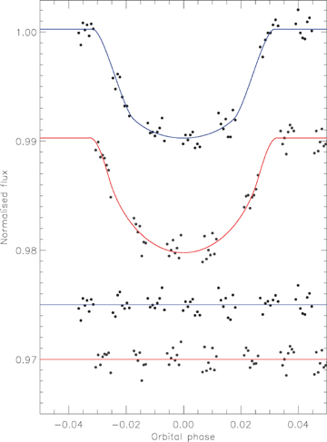
Figure 10 Phased light curve of the transits of OGLE-TR-56 from Pont et al. (2007a) compared to the best fit found ...
Notes:
Figure 10 Phased light curve of the transits of OGLE-TR-56 from Pont et al. (2007a) compared to the best fit found using jktebop and the quadratic LD law with the linear LDC included as a fitted parameter. The upper (blue) curve is for the V-band and the lower (red) for the R-band data. The residuals of the fit are plotted at the bottom of the figure, offset from zero.
Unless provided in the caption above, the following copyright applies to the content of this slide: © 2008 The Author. Journal compilation © 2008 RAS

Slide 11
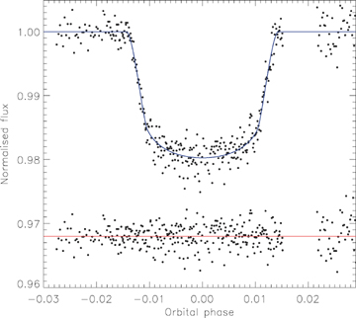
Figure 11 Phased light curve of the transits of OGLE-TR-111 from Winn et al. (2007a) compared to the best fit found ...
Notes:
Figure 11 Phased light curve of the transits of OGLE-TR-111 from Winn et al. (2007a) compared to the best fit found using jktebop and the quadratic LD law with the linear LDC included as a fitted parameter. The residuals of the fit are plotted at the bottom of the figure, offset from zero.
Unless provided in the caption above, the following copyright applies to the content of this slide: © 2008 The Author. Journal compilation © 2008 RAS

Slide 12
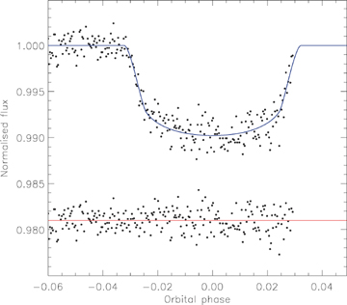
Figure 12 Phased light curve of the transit of OGLE-TR-132 from Gillon et al. (2007a) compared to the best fit found ...
Notes:
Figure 12 Phased light curve of the transit of OGLE-TR-132 from Gillon et al. (2007a) compared to the best fit found using jktebop and the quadratic LD law with the linear LDC included as a fitted parameter. The residuals of the fit are plotted at the bottom of the figure, offset from zero.
Unless provided in the caption above, the following copyright applies to the content of this slide: © 2008 The Author. Journal compilation © 2008 RAS

Slide 13
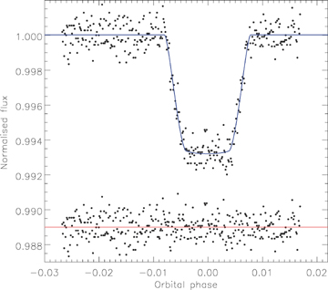
Figure 13 Phased light curve of the transit of GJ 436 from Spitzer compared to the best fit found using jktebop and the ...
Notes:
Figure 13 Phased light curve of the transit of GJ 436 from Spitzer compared to the best fit found using jktebop and the quadratic LD law with both LDCs included as fitted parameters. The residuals of the fit are plotted at the bottom of the figure, offset from zero.
Unless provided in the caption above, the following copyright applies to the content of this slide: © 2008 The Author. Journal compilation © 2008 RAS

Slide 14
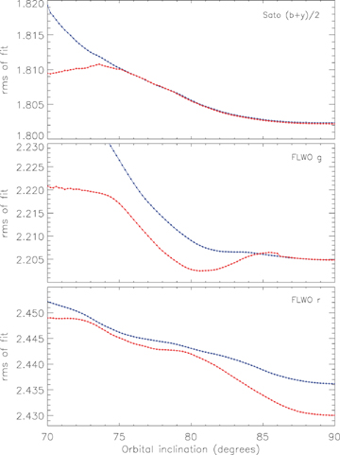
Figure 14 Variation of the root-mean-square of the residuals of the fits to the Sato et al. (2005) (top panel) and the ...
Notes:
Figure 14 Variation of the root-mean-square of the residuals of the fits to the Sato et al. (2005) (top panel) and the Charbonneau et al. (2006) FLWO g (middle) and r (bottom) light curves as a function of the orbital inclination. In each case only the quadratic LD law was used and the upper (blue) line is for fits where both LDCs were fixed and the lower (red) line is for fits where the linear LDC was fitted for.
Unless provided in the caption above, the following copyright applies to the content of this slide: © 2008 The Author. Journal compilation © 2008 RAS

Slide 15
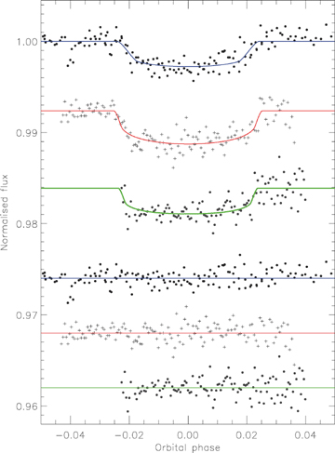
Figure 15 Phased light curves of the transits of HD 149026 from Sato et al. (2005) (top) and Charbonneau et al. (2006) ...
Notes:
Figure 15 Phased light curves of the transits of HD 149026 from Sato et al. (2005) (top) and Charbonneau et al. (2006) (g middle, r lower) compared to the best fit found using jktebop and the quadratic LD law. For the Sato et al. (2005) data the linear LDC was fitted for whereas for the Charbonneau et al. (2006) LCs all LDCs were fixed at theoretically expected values. The residuals of the fit are plotted at the bottom of the figure, offset from zero. All three data sets have been binned by a factor of 5 for display purposes. The differences between the best-fitting solutions for the three light curves are clear through the partial eclipse phases, and show that better data are needed.
Unless provided in the caption above, the following copyright applies to the content of this slide: © 2008 The Author. Journal compilation © 2008 RAS

Slide 16
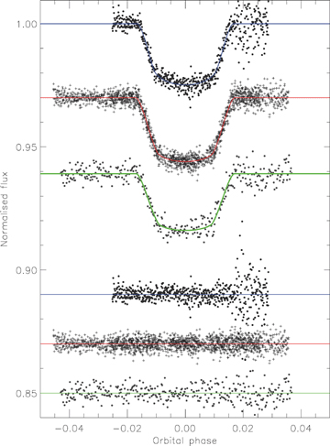
Figure 16 Phased light curves of the transits of HD 189733 from Bakos et al. (2006b) (top) and Winn et al. (2007a) ...
Notes:
Figure 16 Phased light curves of the transits of HD 189733 from Bakos et al. (2006b) (top) and Winn et al. (2007a) (middle: FLWO z; bottom: WISE I) compared to the best fit found using jktebop and the quadratic LD law with the linear LDCs included as fitted parameters. The residuals of the fit are plotted at the bottom of the figure, offset from zero.
Unless provided in the caption above, the following copyright applies to the content of this slide: © 2008 The Author. Journal compilation © 2008 RAS

Slide 17
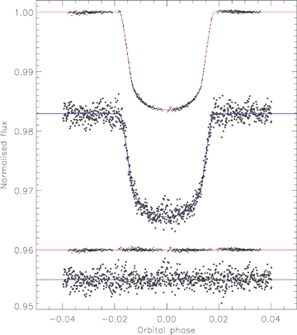
Figure 17 Phased light curves of the transit of HD 209458 from Brown et al. (2001) (upper) and Rowe et al. (2006) ...
Notes:
Figure 17 Phased light curves of the transit of HD 209458 from Brown et al. (2001) (upper) and Rowe et al. (2006) (lower) compared to the best fits found using jktebop and the quadratic LD law. Each consecutive set of 10 points of the MOST light curve has been combined to make the plot clearer. The HST light curve is unbinned. The residuals of the fit are plotted at the bottom of the figure, offset from zero.
Unless provided in the caption above, the following copyright applies to the content of this slide: © 2008 The Author. Journal compilation © 2008 RAS

Slide 18
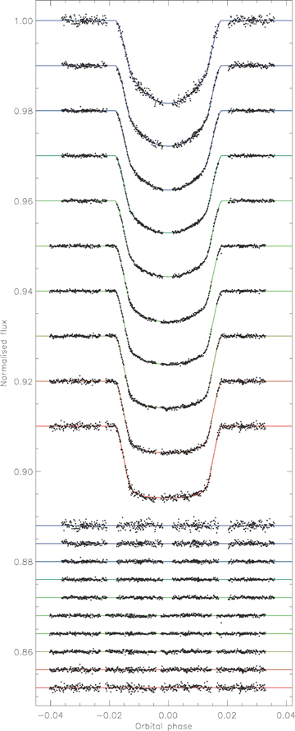
Figure 18 Phased light curves of the transit of HD 209458 from Knutson et al. (2007b) compared to the best fits found ...
Notes:
Figure 18 Phased light curves of the transit of HD 209458 from Knutson et al. (2007b) compared to the best fits found using jktebop and the quadratic LD law (both LDCs fitted). The data are plotted with the bluest passband at the top and the reddest at the bottom, with offsets to make the plot clear. The residuals of the fits follow the same sequence and are plotted at the bottom of the figure with offsets from zero.
Unless provided in the caption above, the following copyright applies to the content of this slide: © 2008 The Author. Journal compilation © 2008 RAS

Slide 19
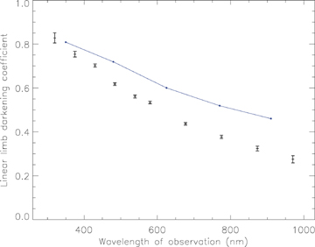
Figure 19 Variation of the linear LD law coefficient with wavelength of observation for the jktebop solutions of the 10 ...
Notes:
Figure 19 Variation of the linear LD law coefficient with wavelength of observation for the jktebop solutions of the 10 HST LCs of HD 209458 presented by Knutson et al. (2007b). The uncertainty on each point comes from Monte Carlo simulations. The filled circles connected by a solid line show the predicted LDCs for the SDSS ugriz passbands from Claret (2004). In each case the central wavelength of the passband is plotted; detailed conclusions from these figures must take into account the passband response function as well as central wavelength.
Unless provided in the caption above, the following copyright applies to the content of this slide: © 2008 The Author. Journal compilation © 2008 RAS

Slide 20
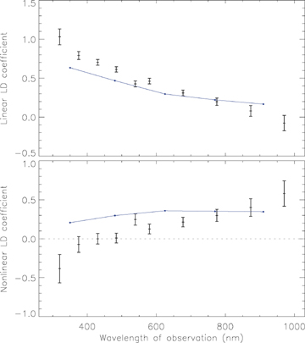
Figure 20 Variation with wavelength of the linear and non-linear coefficients of the quadratic LD law for the 10 HST ...
Notes:
Figure 20 Variation with wavelength of the linear and non-linear coefficients of the quadratic LD law for the 10 HST light curves of HD 209458 (Knutson et al. 2007b). The uncertainty on each point comes from Monte Carlo simulations. The filled circles connected by a solid line show the predicted LDCs for the SDSS ugriz passbands from Claret (2004). The central wavelengths of the passbands are plotted; detailed conclusions from these figures must take into account the passband response function as well as central wavelength.
Unless provided in the caption above, the following copyright applies to the content of this slide: © 2008 The Author. Journal compilation © 2008 RAS

Slide 21
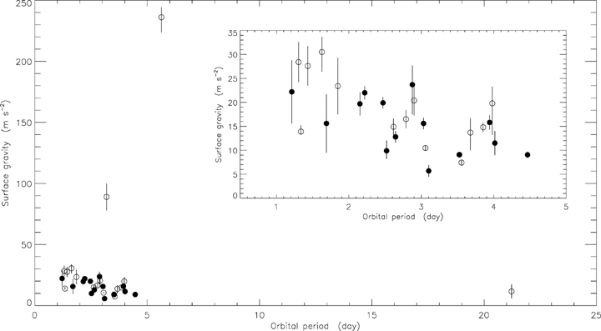
Figure 21 Comparison between the surface gravities and orbital periods of the known transiting exoplanets. Filled ...
Notes:
Figure 21 Comparison between the surface gravities and orbital periods of the known transiting exoplanets. Filled circles denote the values obtained in this work and open circles the systems for which values have been taken from the literature. The error bars for HD 209458 (Porb= 3.52 d) are smaller than the plotted symbol. A close-up of the main population of known TEPs is shown in the inset panel.
Unless provided in the caption above, the following copyright applies to the content of this slide: © 2008 The Author. Journal compilation © 2008 RAS

