Slide 1
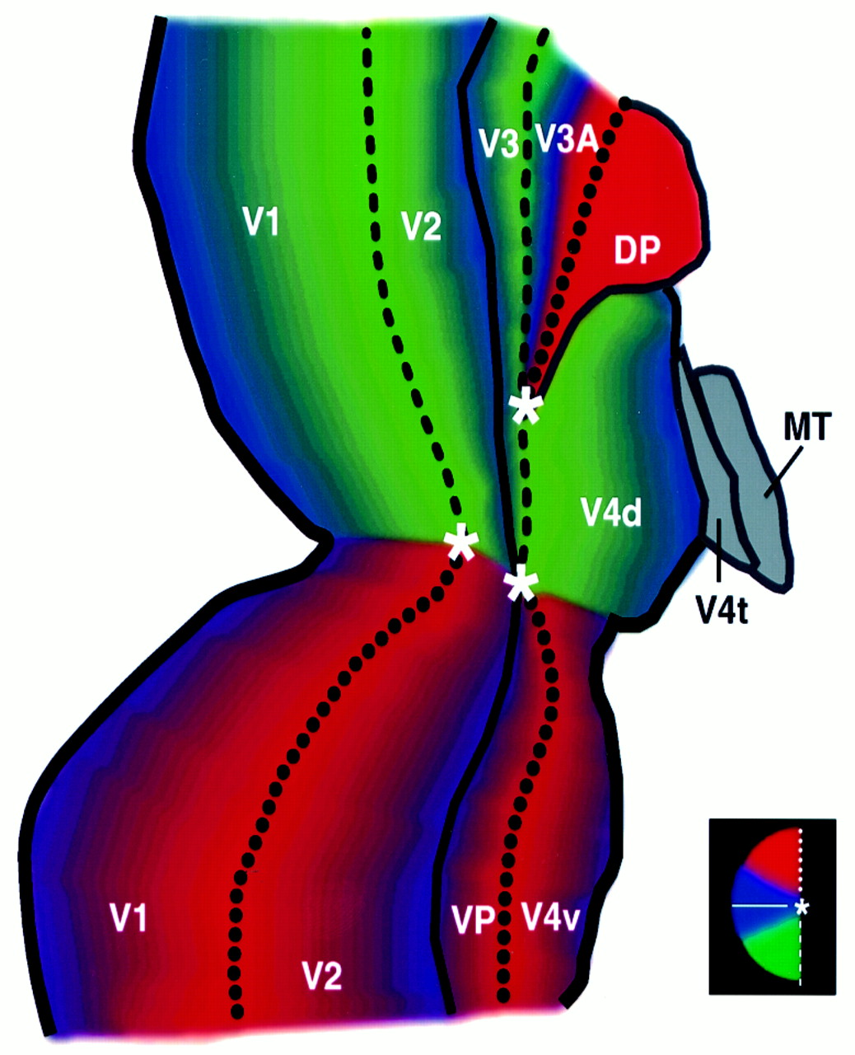
Figure 1. Diagram of the retinotopic organization of macaque area V4 and neighboring areas. The diagram is drawn in ...
Notes:
Figure 1. Diagram of the retinotopic organization of macaque area V4 and neighboring areas. The diagram is drawn in flattened cortical format, from a right hemisphere. Representations of the fovea (at the V1/V2 and V3/VP/V4 borders, and in V3A) are indicated with an asterisk. Within each area, increasingly peripheral eccentricities are represented at increasingly distant locations from those asterisks, approximately perpendicular to the lines of iso-polar angle. Lines of iso-polar angle are mapped roughly as radii from the foveal asterisks (see red, blue and green logo on the bottom right). Representations of the horizontal meridia are indicated using solid black lines, and representations of the upper and lower vertical meridian are indicated with dotted and dashed black lines, respectively. Areas and area boundaries which are not well-defined retinotopically, or not relevant here, are indicated using gray. Previously published maps all agree on the retinotopy of macaque areas V1, V2 and V3/VP. However, the descriptions of retinotopy and area borders can differ in reports from increasingly more anterior (generally, higher-order) areas. Thus the retinotopy in V3A in Gattass et al. (Gattass et al., 1988) differs slightly from that described by Van Essen and colleagues (Van Essen et al., 1990, 1992; Felleman and Van Essen, 1991b). Similarly, area ‘DP’ is included in the maps of some groups (Andersen et al., 1985; May and Andersen, 1986; Felleman and Van Essen, 1991b), but not in the maps drawn by others (Gattass et al., 1988; Colby and Duhamel, 1991). Early retinotopic studies of V4 by one group (Baizer and Maguire, 1983; Maguire and Baizer 1984) were inconsistent with a single retinotopic area. Many of those apparent discrepancies were later rationalized by Gattass et al. (Gattass et al., 1988). Where previous reports differ from each other, we have incorporated the data that are most cited, most recent, and/or best documented. The dorsal and ventral subdivisions of V4 (V4d and V4v, respectively) are largely separate from each other. V4d and V4v border each other only at the foveal representation, and diverge increasingly at the representation of progressively greater eccentricities. This ‘bisected’ arrangement is similar to that found in V2 and V3/VP. Thus in V4d, the fovea is represented inferiorly, and increasing visual field eccentricity is mapped superiorly and anteriorly, between V3A and MT. According to current views, V4d includes a representation of just the lower visual field, not the upper. In one previous report (Gattass et al., 1988), a portion of the upper visual field near the horizontal meridian was also included in V4d, instead of V4v. This unusual upper field representation was later attributed instead to adjacent area TEO (Boussaoud et al., 1991), and this figure adopts that assumption. The ‘field sign’ (Sereno et al., 1994, 1995b) in both V4 subdivisions matches the visual field geometry, as in V2 (thus, opposite to the mirror-symmetric field signs found in V1 and V3/VP).
Unless provided in the caption above, the following copyright applies to the content of this slide: © Oxford University Press

Slide 2
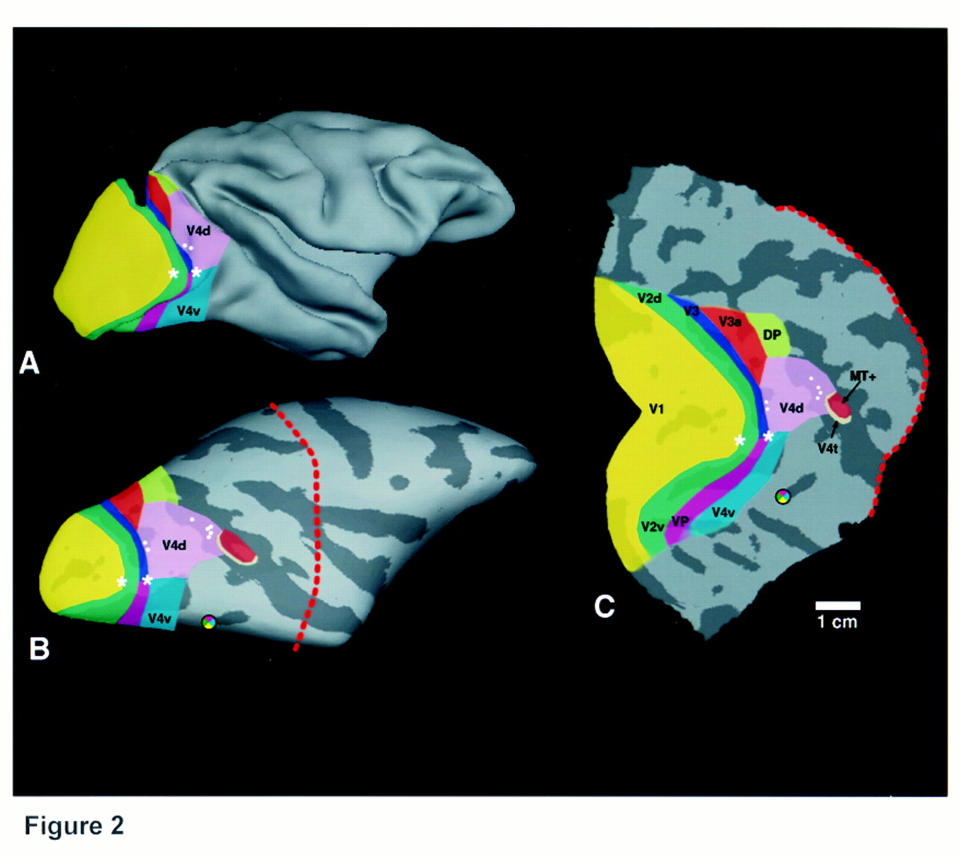
Figure 2. The topography of V4 and other areas in macaque visual cortex, in relationship to previous measures of color ...
Notes:
Figure 2. The topography of V4 and other areas in macaque visual cortex, in relationship to previous measures of color selectivity. All panels are from the same hemisphere. The area maps are shown on a near-normal (folded) cortex (A), and the ‘inflated’ cortical surface (B), from a lateral viewpoint (anterior/posterior = rightmost/leftmost in the figure, respectively). The posterior part of the cortex [(i.e. to the left of the dashed red line in (B)] is shown in (C), in the flattened cortical format. In (B) and (C), lighter and darker gray indicate regions of the cortical surface which are curved either convexly or concavely in vivo (thus, corresponding roughly to gyri or sulci, respectively). Representations of the fovea in V1/V2 and V3/VP/V4 are indicated with asterisks. The scale bar [bottom right, (C)] corresponds to 1cm in the flattened cortical surface, excepting uncorrected spatial distortion due to cortical flattening. The visual areas are labeled in (C), and the corresponding areas are indicated using common colors in (A) and (B). Each white dot in V4d indicates the approximate location where a significant patch of color-selective cells was reported in previous single unit studies (Zeki, 1973, 1977). Such receptive fields were almost always located in the lower visual field, which confirms that they were located in dorsal V4. In human visual cortex, multiple neuroimaging studies have revealed a small region of color-selective activity located in the collateral sulcus, which may be involved in the clinical syndrome of prosopagnosia. This area has been described variously as either ‘V8’ (Hadjikhani et al., 1998), ‘V4’ (Lueck et al., 1989) or ‘VO’ (Wandell, 1999). In this diagram of macaque areas, the colored ‘pinwheel’ logo indicates the location where the homologous color-selective area would be located, assuming that a homologous region exists in macaques, and that the neighborhood relationships between cortical areas are evolutionarily conserved between humans and macaques. An additional color-selective, non-retinotopic area has been described anterior to this in human cortex (Beauchamp et al., 1999; Bartels and Zeki, 2000), but that anterior area is not considered here.
Unless provided in the caption above, the following copyright applies to the content of this slide: © Oxford University Press

Slide 3
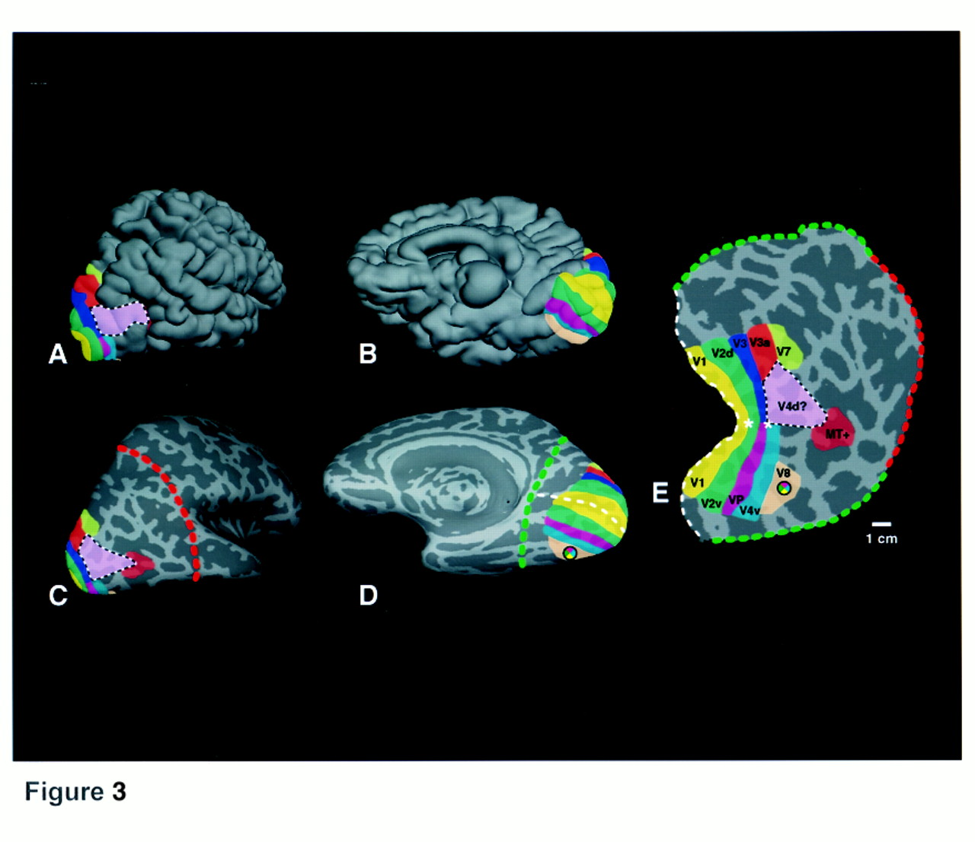
Figure 3. The topography of V4 and other areas in human visual cortex, in relationship to previous measures of color ...
Notes:
Figure 3. The topography of V4 and other areas in human visual cortex, in relationship to previous measures of color selectivity. In most respects, the format is similar to that shown in Figure 2. However, in human visual cortex, the map of corresponding areas is ‘pulled’ further back into the medial bank, as if it was a printed pattern on a two-dimensional sheet. Thus to illustrate analogous regions on the human cortical map, we show both medial and lateral views of the normal folded cortex in (A) and (B) and the inflated cortex in (C) and (D). The same cortex in the flattened cortical format is shown in (E). The location of the artificial ‘cut’ lines used to separate the flattened patch in (E) are shown in (C) and (D) (red, green and white dashed lines). The location and topography of the cortical areas were based on functional and anatomical MR tests in each subject. The scale bar in (E) indicates ~1 cm. Based on the topography of areas which border V4v in macaque (i.e. V3A, V4v, MT), the location where a V4d homologue would be located in human visual cortex (the V4d ‘topologue’) is bounded using dashed white/black lines, and filled in pink [(see (E)]. Area V4v is filled in dark blue. The location of the ventral color-selective area (‘V8’) is indicated in tan, including the color pinwheel logo. Anatomical studies suggest that a homologue of area V4t (the MT ‘ring’ or ‘crescent’) may also exist (Tootell et al., 1985; Kaas and Morel, 1993; Tootell and Taylor, 1995); if so, it should lie along the border where MT+ meets the V4d topologue.
Unless provided in the caption above, the following copyright applies to the content of this slide: © Oxford University Press

Slide 4
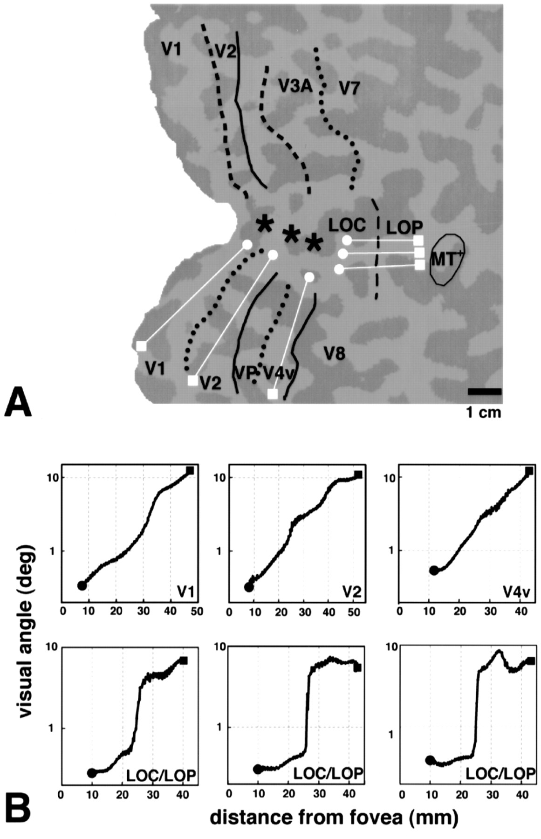
Figure 4. In the human V4d topologue, fMRI maps reveal an unusual representation of retinotopic eccentricity. (A)–(D) ...
Notes:
Figure 4. In the human V4d topologue, fMRI maps reveal an unusual representation of retinotopic eccentricity. (A)–(D) show phase-encoded maps of retinotopic eccentricity, produced by ring-shaped stimuli at systematically varied eccentricities, from two representative hemispheres. For ease of comparison, all examples are shown in right hemisphere format, but results were equivalent in both hemispheres. The top two maps, (A) and (B), had a cumulative spatial filtering of 2.5 mm (half-width at half-maximum), as elsewhere in the text. (C) and (D) show the same maps without this spatial post-processing. The ‘pixelated’ nature of the images in (C) and (D) reflects the acquisition voxel size (3 × 3 mm). The retinotopic area borders were based on an automated field sign analysis (Sereno, 1995). The stimuli were scaled in size and retinotopic position, consistent with a generalized cortical magnification factor (Sereno et al., 1995b; Tootell et al., 1997, 1998). Cortical regions showing relative increases to stimuli which were increasingly further from the fovea are coded in red, blue and green, respectively (see logo, bottom right). The calibration bar indicates ~1 cm. In such retinotopic maps, significant activity was typically absent from the very center of the foveal representation (i.e. the foveola), since an unchanging fixation spot occluded the retinotopic stimuli in that location. Thus it was necessary to estimate the area borders, and the representation of the foveola, within these signal-poor central regions. The limits of uncertainty near the foveal representation are indicated with a short white line crossing the iso-polar area borders. The V4d topologue is also drawn for each subject, using dashed white/black lines, as in Figure 3. In the classical retinotopic areas (e.g. V1, V2, V3/VP, V3A, V4v), this pseudocolor rendering of retinotopic eccentricity activity produced parallel bands of red > blue > green (when the stimuli were centered at visual field eccentricities of 1.6, 4.2 and 11.3°, respectively), with continuous and gradual transitions between them. However in the V4d topologue, there was a systematic under-representation of ‘middle’ eccentricities within our stimulus range. Thus the pseudocolor blue line was thin or absent in this region, in both the filtered and unfiltered maps [(e.g. (A)–(D)]. Much of the V4d topologue appeared to be activated preferentially by either foveal (red) or peripheral (green) stimulus eccentricities, as in classical retinotopic areas. For convenience, we call the centrally and peripherally activated regions ‘LOC’ and ‘LOP’, respectively.
Unless provided in the caption above, the following copyright applies to the content of this slide: © Oxford University Press

Slide 5
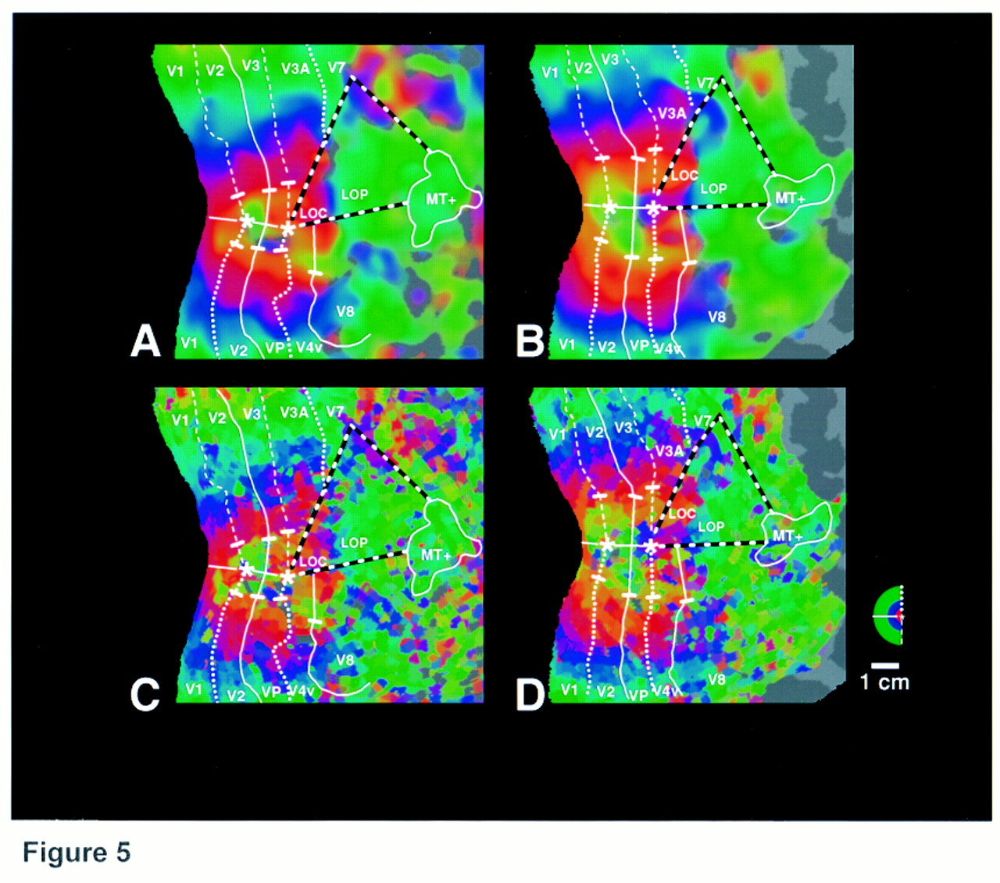
Figure 5. One-dimensional measurements of optimal retinotopic eccentricity clarify the unusual representation of ...
Notes:
Figure 5. One-dimensional measurements of optimal retinotopic eccentricity clarify the unusual representation of retinotopic eccentricity in LOC and LOP. (A) shows the map from which measurements were made, and the six corresponding measurements are shown in (B). As much as possible, measurements were made from lines running near-perpendicular to lines of constant eccentricity (white lines), from near-foveal representations (white circles), to more peripheral representations (white squares), with each measurement confined to a single cortical area/region. The calibration bar [bottom right, (A)] indicates ~1 cm. Data from three classical retinotopic areas (V1, V2 and V4v) are shown in the top three graphs of (B). Such plots yielded continuous and near-exponential decreases in cortical magnification from increasingly peripheral visual field locations, consistent with earlier measures of the cortical magnification factor. However, analogous data from LOC/LOP were quite different. Measurements taken from LOC/LOP [(top-to-bottom in (A)] are shown from left-to-right, respectively, in (B). Within LOC or LOP, such data shows small, apparently random fluctuations in the optimal visual field location, from either the foveal region (<~0.5°) or from regions peripheral to ~4°, respectively. At the LOC/LOP border, there was a sharp discontinuity. Overall, such data suggest that there may be just two cortical areas (LOC and LOP), each with a complementary bias for stimuli in either foveal or peripheral eccentricities, with little or no systematic retinotopic gradient linking the two regions.
Unless provided in the caption above, the following copyright applies to the content of this slide: © Oxford University Press

Slide 6
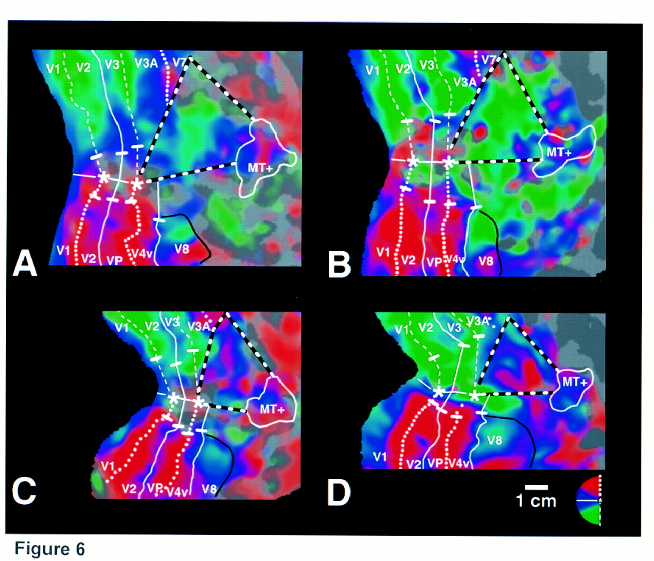
Figure 6. In the V4d topologue, the fMRI maps reveal a non-systematic representation of retinotopic polar angle, ...
Notes:
Figure 6. In the V4d topologue, the fMRI maps reveal a non-systematic representation of retinotopic polar angle, across different hemispheres. Each panel shows the polar angle maps from the same two hemispheres shown in Figure 4, plus two additional hemispheres to illustrate the range of results obtained. The figure format here is similar, except that the pseudocolor rendering is different. Here, red codes cortical regions which were preferentially activated by the upper visual field, blue for the polar angles spanning the horizontal meridian, and green for the lower visual field (see polar angle logo, bottom right). The spatial filtering here is equivalent to that in Figure 4A,B. Comparison of (A)–(D) shows that within the classical retinotopic areas (V1, V2, V3/VP, V3A and V4v), the polar angle retinotopy is quite consistent across subjects. However, in the V4d topologue (enclosed in white/black dashed lines), the polar angle maps vary between subjects, seemingly randomly.
Unless provided in the caption above, the following copyright applies to the content of this slide: © Oxford University Press

Slide 7
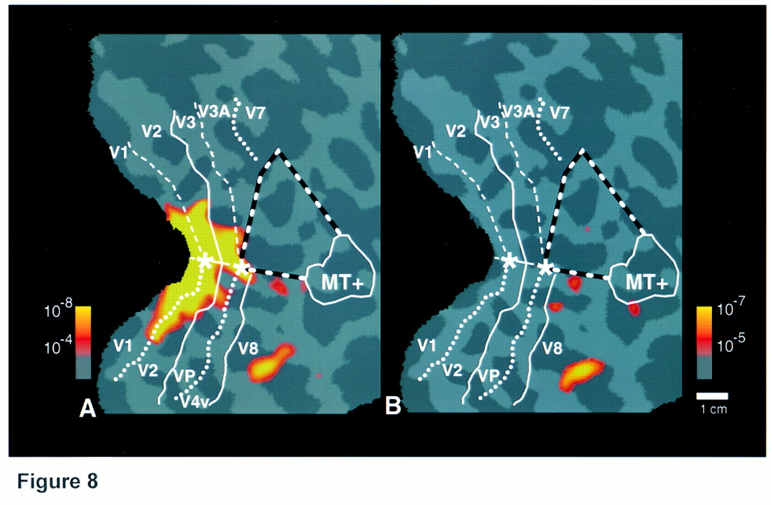
Figure 8. Neither V4v nor the V4d topologue is significantly color-selective. (A) shows the functional activity ...
Notes:
Figure 8. Neither V4v nor the V4d topologue is significantly color-selective. (A) shows the functional activity produced during the comparison of stimuli (radial sine wave gratings), modulated in either luminance or equiluminant color. The orange–red regions were preferentially activated by the color-varying stimuli. This activated region includes mostly the foveal representation of the classically retinotopic areas (e.g. V1, V2, V3/VP, etc.). However, an additional small area was also activated in ventral cortex, in the depth of the collateral sulcus, anterior to retinotopically defined V4v. We call this ventral color-selective area ‘V8’ (Hadjikhani et al., 1998), but the apparently identical area was previously called ‘V4’. It corresponds to the cortical region indicated by the pinwheel color logo in Figures 2 and 3. (B) shows activation in V8 of the same subject, produced by the percept of a color afterimage on a uniform gray stimulus. In this stimulus comparison, the pattern of activation is much more selective for V8. Area V8 is a long distance (~5cm, center-to-center) across the cortical surface from the V4d topologue.
Unless provided in the caption above, the following copyright applies to the content of this slide: © Oxford University Press

Slide 8
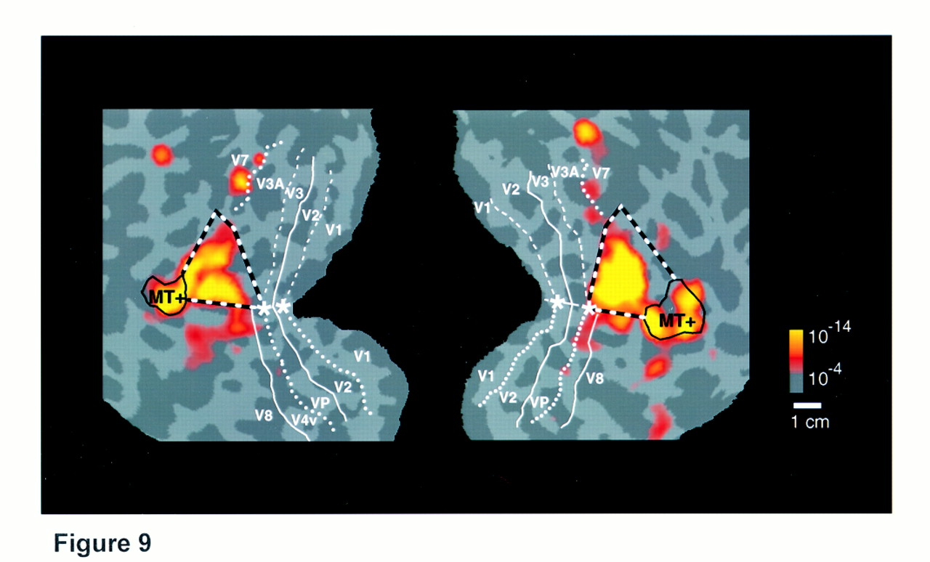
Figure 9. Functional selectivity in the V4d topologue differs from that in V4v. This figure shows the activity ...
Notes:
Figure 9. Functional selectivity in the V4d topologue differs from that in V4v. This figure shows the activity produced by viewing of kinetic motion boundaries embedded in random dot stimuli, compared with viewing otherwise identical, transparently moving random dot stimuli lacking motion boundaries. For ease of comparison, it is shown from the same subject illustrated in Figure 8, but here the patterns are shown in both left and right hemispheres, on the left and right of the figure, respectively. Consistent with earlier reports, the kinetic motion boundaries produced high relative activity in a region located between V3A, V4v and MT+—exactly where the V4d topologue is located. This functionally defined area has been called ‘KO’ (Orban et al., 1995; Dupont et al., 1997; Van Oostende et al., 1997). Here, increased activity produced by kinetic boundaries was also higher in MT+.
Unless provided in the caption above, the following copyright applies to the content of this slide: © Oxford University Press

Slide 9
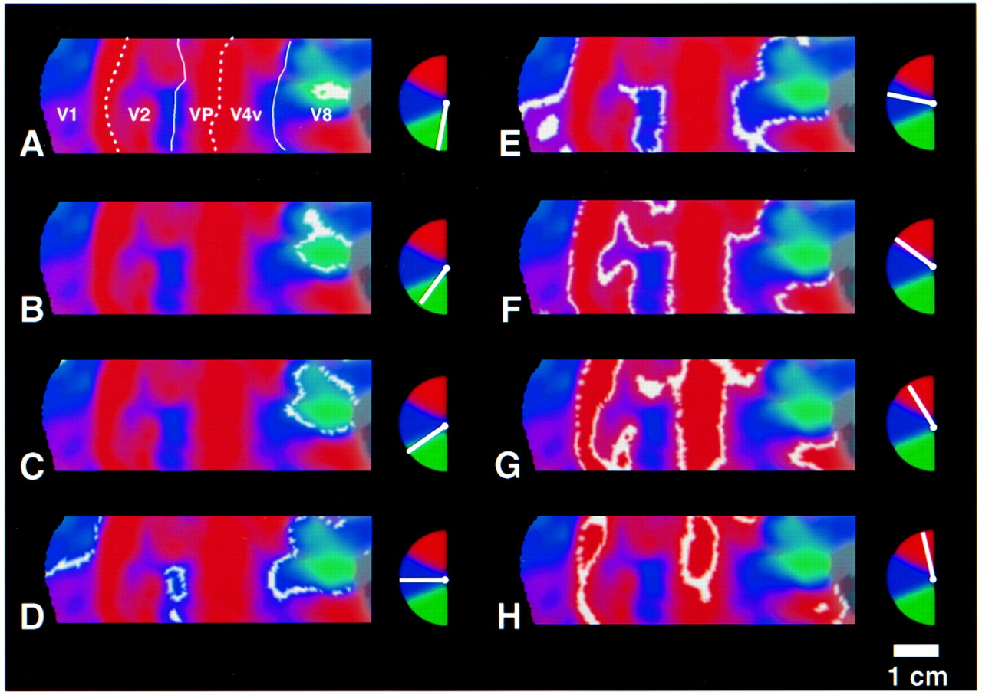
Figure 10. Detailed polar angle retinotopy of V4v, V8 and neighboring areas. This figure shows the peak fMRI response ...
Notes:
Figure 10. Detailed polar angle retinotopy of V4v, V8 and neighboring areas. This figure shows the peak fMRI response (noisy white lines) corresponding to retinotopic polar angle differences of ~20°, superimposed on the standard pseudocolor rendering of areas V1, V2, VP and V4v, indicated in (A). To the right of each panel is a logo indicating the stimulus polar angle (white line). The complete contralateral visual field is represented in V8, from the lower visual field (A,B), across the horizontal meridian (C–E), to the upper visual field (F–H). In contrast, V4v includes only a representation of the upper visual field (E–H). The upper visual field representations in V4v and V8 are of opposing field sign and can be clearly distinguished in this high-resolution data (E–H).
Unless provided in the caption above, the following copyright applies to the content of this slide: © Oxford University Press

