Slide 1
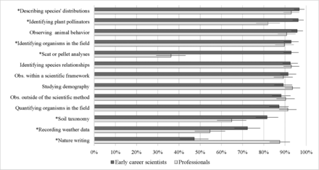
Figure 1. The survey results regarding whether the described activities encompass the term natural history. The ...
Notes:
Figure 1. The survey results regarding whether the described activities encompass the term natural history. The percentages are those respondents indicating that they agree or strongly agree that natural history encompasses these activities. The error bars represent the margin of error (half-width of a 95% confidence interval).
Unless provided in the caption above, the following copyright applies to the content of this slide: © The Author(s) 2016. Published by Oxford University Press on behalf of the American Institute of Biological Sciences. All rights reserved. For Permissions, please e-mail: journals.permissions@oup.com.

Slide 2
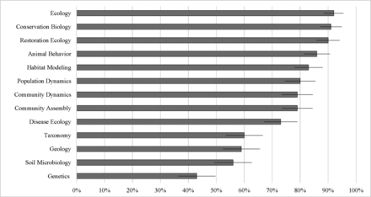
Figure 2. The early-career scientists’ responses to whether natural history was foundational to current areas of active ...
Notes:
Figure 2. The early-career scientists’ responses to whether natural history was foundational to current areas of active research in the ecological or environmental sciences. The percentages indicate the proportion of “very applicable” responses. The error bars represent the margin of error (half-width of a 95% confidence interval).
Unless provided in the caption above, the following copyright applies to the content of this slide: © The Author(s) 2016. Published by Oxford University Press on behalf of the American Institute of Biological Sciences. All rights reserved. For Permissions, please e-mail: journals.permissions@oup.com.

Slide 3
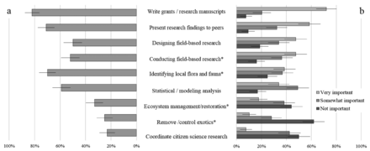
Figure 3. The proportion of responses from ecological professionals regarding (a) the frequency they employ identified ...
Notes:
Figure 3. The proportion of responses from ecological professionals regarding (a) the frequency they employ identified skills daily to monthly in their current employment and (b) the level of importance placed on having those skills when evaluating potential employees. The asterisks (*) indicate activities with direct links to natural-history skill sets. The error bars represent the margin of error (half-width of a 95% confidence interval).
Unless provided in the caption above, the following copyright applies to the content of this slide: © The Author(s) 2016. Published by Oxford University Press on behalf of the American Institute of Biological Sciences. All rights reserved. For Permissions, please e-mail: journals.permissions@oup.com.

