Slide 1
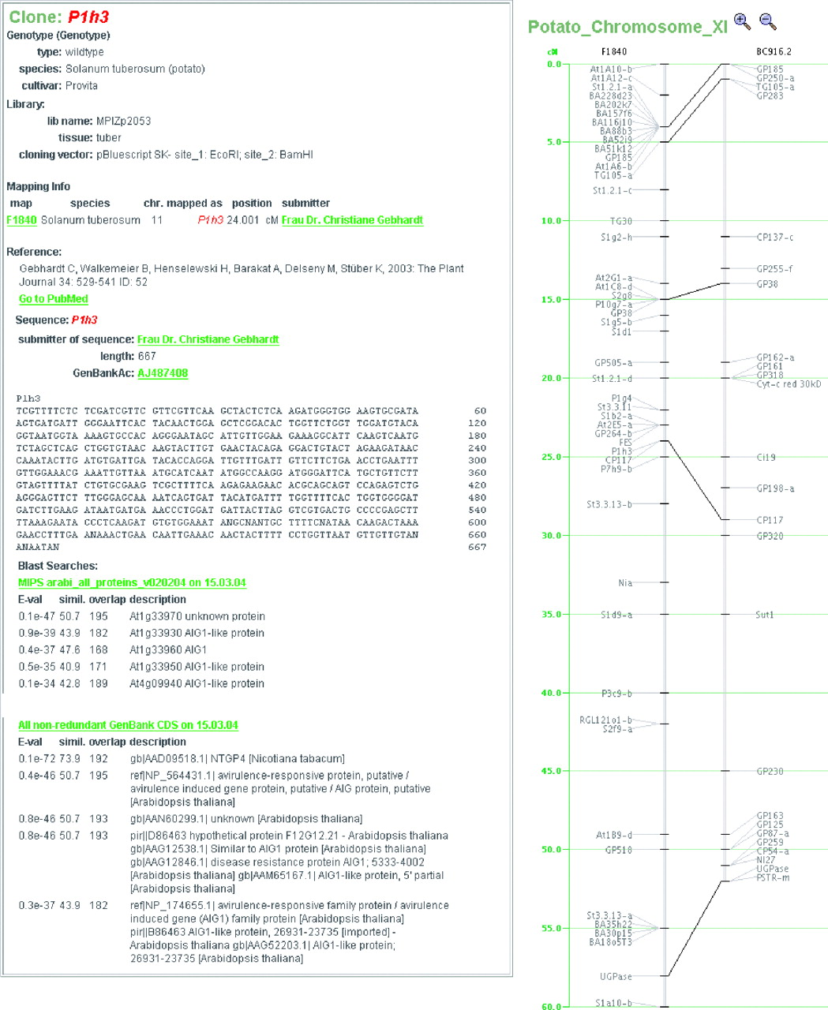
Figure 1. GreenCards and YAMB interfaces. Via GreenCards a data search can be started and detailed information on ...
Notes:
Figure 1. GreenCards and YAMB interfaces. Via GreenCards a data search can be started and detailed information on selected objects, like genotype and mapping information, publication references and sequence data as well as BLAST results are accessible. GreenCards is integrated with YAMB, which is a Java servlet tool for the display of mapping data.
Unless provided in the caption above, the following copyright applies to the content of this slide: © 2005, the authors Nucleic Acids Research, Vol. 33, Database issue © Oxford University Press 2005; all rights reserved

