Slide 1
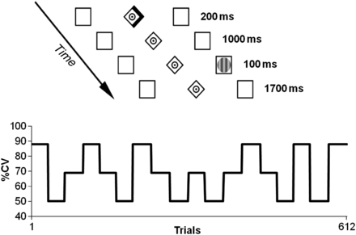
Figure 1. Illustration of the experimental task and the manipulation of %CV over the 612 trials.
Notes:
Figure 1. Illustration of the experimental task and the manipulation of %CV over the 612 trials.
Unless provided in the caption above, the following copyright applies to the content of this slide: © The Author 2013. Published by Oxford University Press.This is an Open Access article distributed under the terms of the Creative Commons Attribution License (http://creativecommons.org/licenses/by-nc/3.0/), which permits non-commercial use, distribution, and reproduction in any medium, provided the original work is properly cited. For commercial re-use, please contact journals.permissions@oup.com

Slide 2
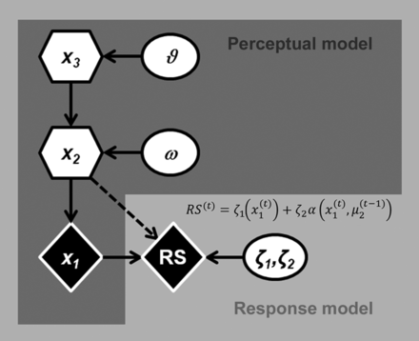
Figure 2. Graphical illustration of the perceptual (generative) model with states x₁, x₂, and ...
Notes:
Figure 2. Graphical illustration of the perceptual (generative) model with states x1, x2, and x3. The model parameters ω and $\vartheta $ impact on the time course of subjects' inferred belief about the states x and are estimated from the individual subject RS data. Circles represent constants, while diamonds represent quantities that change in time (i.e., that carry a time (or trial) index). Hexagons, like diamonds, represent quantities that change in time but that additionally depend on their previous state in time in a Markovian fashion.
Unless provided in the caption above, the following copyright applies to the content of this slide: © The Author 2013. Published by Oxford University Press.This is an Open Access article distributed under the terms of the Creative Commons Attribution License (http://creativecommons.org/licenses/by-nc/3.0/), which permits non-commercial use, distribution, and reproduction in any medium, provided the original work is properly cited. For commercial re-use, please contact journals.permissions@oup.com

Slide 3
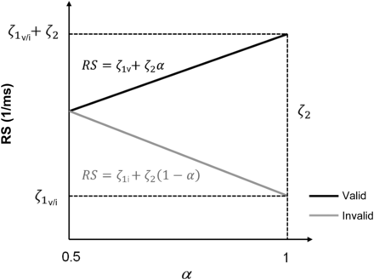
Figure 3. Illustration of the relationship between RS (inverse RT) and the quantity $\alpha $, representing the amount ...
Notes:
Figure 3. Illustration of the relationship between RS (inverse RT) and the quantity $\alpha $, representing the amount of attentional resources allocated to the cued location. For each response model, RS were assumed to be linearly related to $\alpha $ (which differs between the 3 models, see Appendix). Note the opposite behaviour of RS for increasing $\alpha $ on valid (black line and equation) and invalid (gray line and equation) trials (cf. eq. 5).
Unless provided in the caption above, the following copyright applies to the content of this slide: © The Author 2013. Published by Oxford University Press.This is an Open Access article distributed under the terms of the Creative Commons Attribution License (http://creativecommons.org/licenses/by-nc/3.0/), which permits non-commercial use, distribution, and reproduction in any medium, provided the original work is properly cited. For commercial re-use, please contact journals.permissions@oup.com

Slide 4
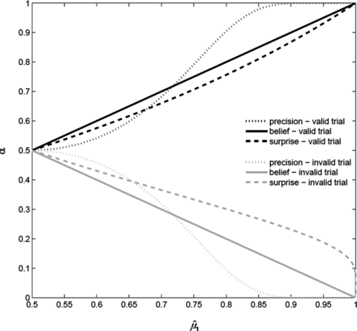
Figure 4. Illustration of the amount of attentional resources $\alpha $ for the 3 different theoretical response models ...
Notes:
Figure 4. Illustration of the amount of attentional resources $\alpha $ for the 3 different theoretical response models as a function of $\hat \mu _1 $.
Unless provided in the caption above, the following copyright applies to the content of this slide: © The Author 2013. Published by Oxford University Press.This is an Open Access article distributed under the terms of the Creative Commons Attribution License (http://creativecommons.org/licenses/by-nc/3.0/), which permits non-commercial use, distribution, and reproduction in any medium, provided the original work is properly cited. For commercial re-use, please contact journals.permissions@oup.com

Slide 5
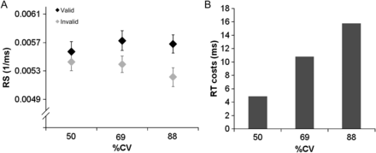
Figure 5. (A) Average RS in valid and invalid trials for the 3 (true) %CV levels. Error bars depict standard errors of ...
Notes:
Figure 5. (A) Average RS in valid and invalid trials for the 3 (true) %CV levels. Error bars depict standard errors of the mean (SEM) (B) Illustration of how the observed RS costs after invalid cueing translate into RT differences (in ms).
Unless provided in the caption above, the following copyright applies to the content of this slide: © The Author 2013. Published by Oxford University Press.This is an Open Access article distributed under the terms of the Creative Commons Attribution License (http://creativecommons.org/licenses/by-nc/3.0/), which permits non-commercial use, distribution, and reproduction in any medium, provided the original work is properly cited. For commercial re-use, please contact journals.permissions@oup.com

Slide 6
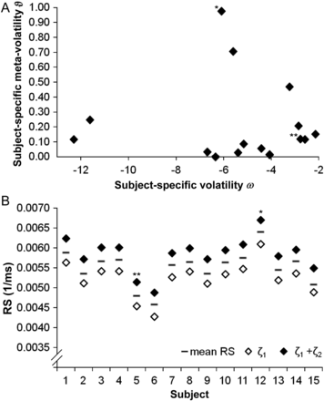
Figure 6. (A) Illustration of the subject-specific patterns for the values of the volatility estimate ω and the ...
Notes:
Figure 6. (A) Illustration of the subject-specific patterns for the values of the volatility estimate ω and the meta-volatility estimate $\vartheta $. (B) Illustration of minimal and maximal RS (as derived from the response model parameters ζ1 (averaged for valid and invalid trials) and ζ2) in relation to overall (mean) RS. The symbols single and double asterisks denote the data from subjects A and B depicted in Figure 8, respectively.
Unless provided in the caption above, the following copyright applies to the content of this slide: © The Author 2013. Published by Oxford University Press.This is an Open Access article distributed under the terms of the Creative Commons Attribution License (http://creativecommons.org/licenses/by-nc/3.0/), which permits non-commercial use, distribution, and reproduction in any medium, provided the original work is properly cited. For commercial re-use, please contact journals.permissions@oup.com

Slide 7
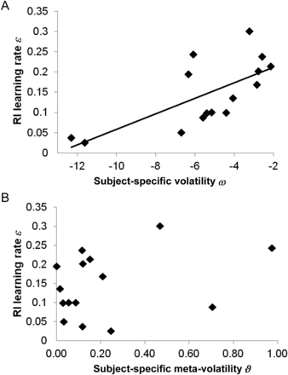
Figure 7. Relationship between the perceptual parameters ω and $\vartheta $, and the Rescorla–Wagner learning rate ε.
Notes:
Figure 7. Relationship between the perceptual parameters ω and $\vartheta $, and the Rescorla–Wagner learning rate ε.
Unless provided in the caption above, the following copyright applies to the content of this slide: © The Author 2013. Published by Oxford University Press.This is an Open Access article distributed under the terms of the Creative Commons Attribution License (http://creativecommons.org/licenses/by-nc/3.0/), which permits non-commercial use, distribution, and reproduction in any medium, provided the original work is properly cited. For commercial re-use, please contact journals.permissions@oup.com

Slide 8
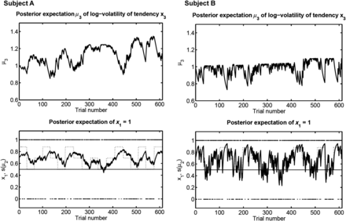
Figure 8. Illustration of the time course of μ₃ (upper panels) and s(μ₂) (lower panels) during ...
Notes:
Figure 8. Illustration of the time course of μ3 (upper panels) and s(μ2) (lower panels) during observation of x1 (black diamonds) for 2 exemplary subjects with different parameters for ω and $\vartheta $. The true %CV is depicted as a dotted line. It can be seen that subject A (ω = −6.09; $\vartheta = 0.\hbox{97}$) shows slower updating of the probability estimate that the target will appear at the cued location than subject B (ω = −2.78; $\vartheta = 0.\hbox{12}$). This can be attributed to subject A's lower value of ω (reflecting the subject's belief in a less volatile environment).
Unless provided in the caption above, the following copyright applies to the content of this slide: © The Author 2013. Published by Oxford University Press.This is an Open Access article distributed under the terms of the Creative Commons Attribution License (http://creativecommons.org/licenses/by-nc/3.0/), which permits non-commercial use, distribution, and reproduction in any medium, provided the original work is properly cited. For commercial re-use, please contact journals.permissions@oup.com

Slide 9
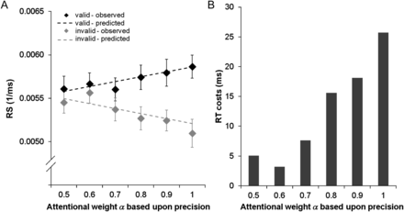
Figure 9. (A) Observed and predicted average RS in valid and invalid trials as a function of the precision-dependent ...
Notes:
Figure 9. (A) Observed and predicted average RS in valid and invalid trials as a function of the precision-dependent attentional weight parameter $\alpha $ (attention to cued location; calculated for the group average values). Error bars depict standard errors of the mean (SEM). The lines correspond to the predictions using the average response model parameters, over subjects. (B) Illustration of how the observed RS costs after invalid cueing translate into RT differences (in ms).
Unless provided in the caption above, the following copyright applies to the content of this slide: © The Author 2013. Published by Oxford University Press.This is an Open Access article distributed under the terms of the Creative Commons Attribution License (http://creativecommons.org/licenses/by-nc/3.0/), which permits non-commercial use, distribution, and reproduction in any medium, provided the original work is properly cited. For commercial re-use, please contact journals.permissions@oup.com

