Slide 1
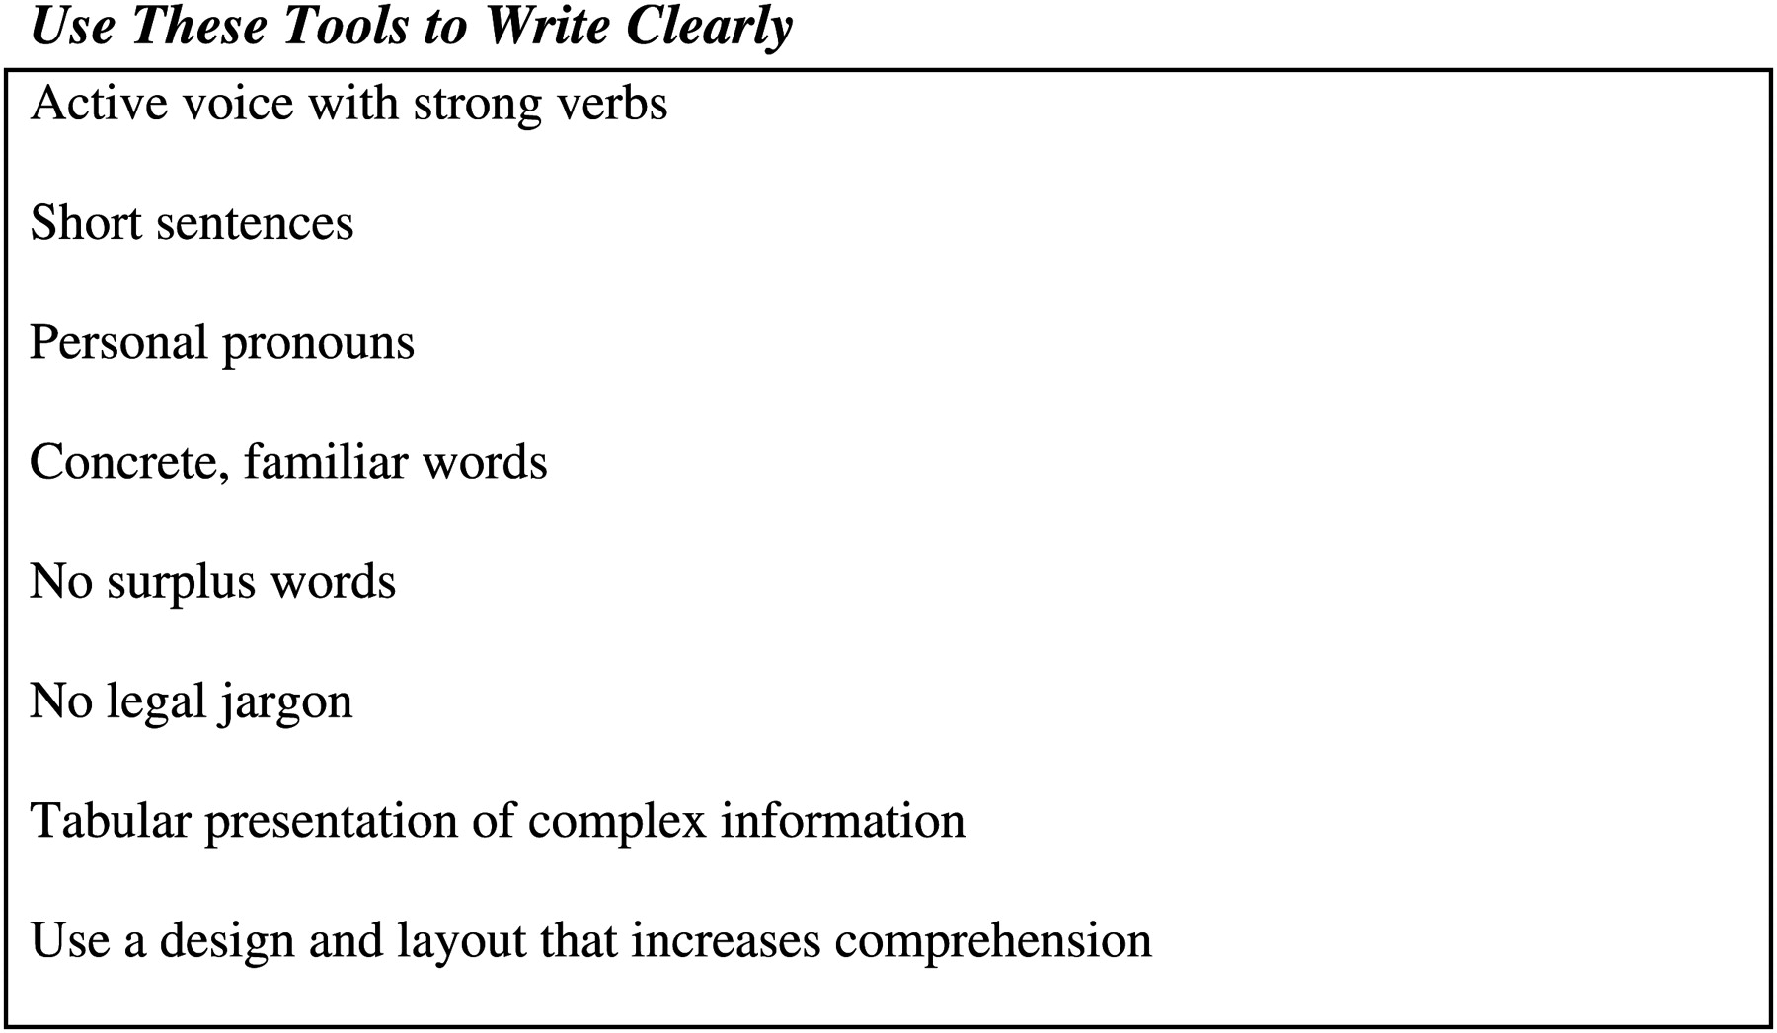
Fig. 1: Recommendations for writing clear language from Plain English at a Glance (Smith and Wallace, n.d.).
Notes:
Fig. 1: Recommendations for writing clear language from Plain English at a Glance (Smith and Wallace, n.d.).
Unless provided in the caption above, the following copyright applies to the content of this slide: © The Author (2010). Published by Oxford University Press. All rights reserved. For Permissions, please email: journals.permissions@oup.com

Slide 2
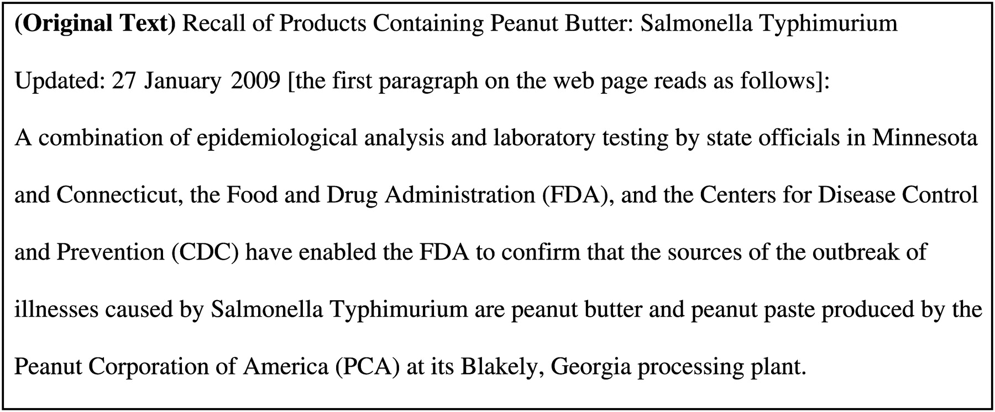
Fig. 2: Simplifying the peanut butter contamination text from the U.S. Food and Drug Administration (FDA) web page on ...
Notes:
Fig. 2: Simplifying the peanut butter contamination text from the U.S. Food and Drug Administration (FDA) web page on salmonella and peanut products (U.S. Food and Drug Administration, 2009).
Unless provided in the caption above, the following copyright applies to the content of this slide: © The Author (2010). Published by Oxford University Press. All rights reserved. For Permissions, please email: journals.permissions@oup.com

Slide 3
Fig. 3: Standard and usual simplification using simple vocabulary and simple sentences.
Notes:
Fig. 3: Standard and usual simplification using simple vocabulary and simple sentences.
Unless provided in the caption above, the following copyright applies to the content of this slide: © The Author (2010). Published by Oxford University Press. All rights reserved. For Permissions, please email: journals.permissions@oup.com

Slide 4
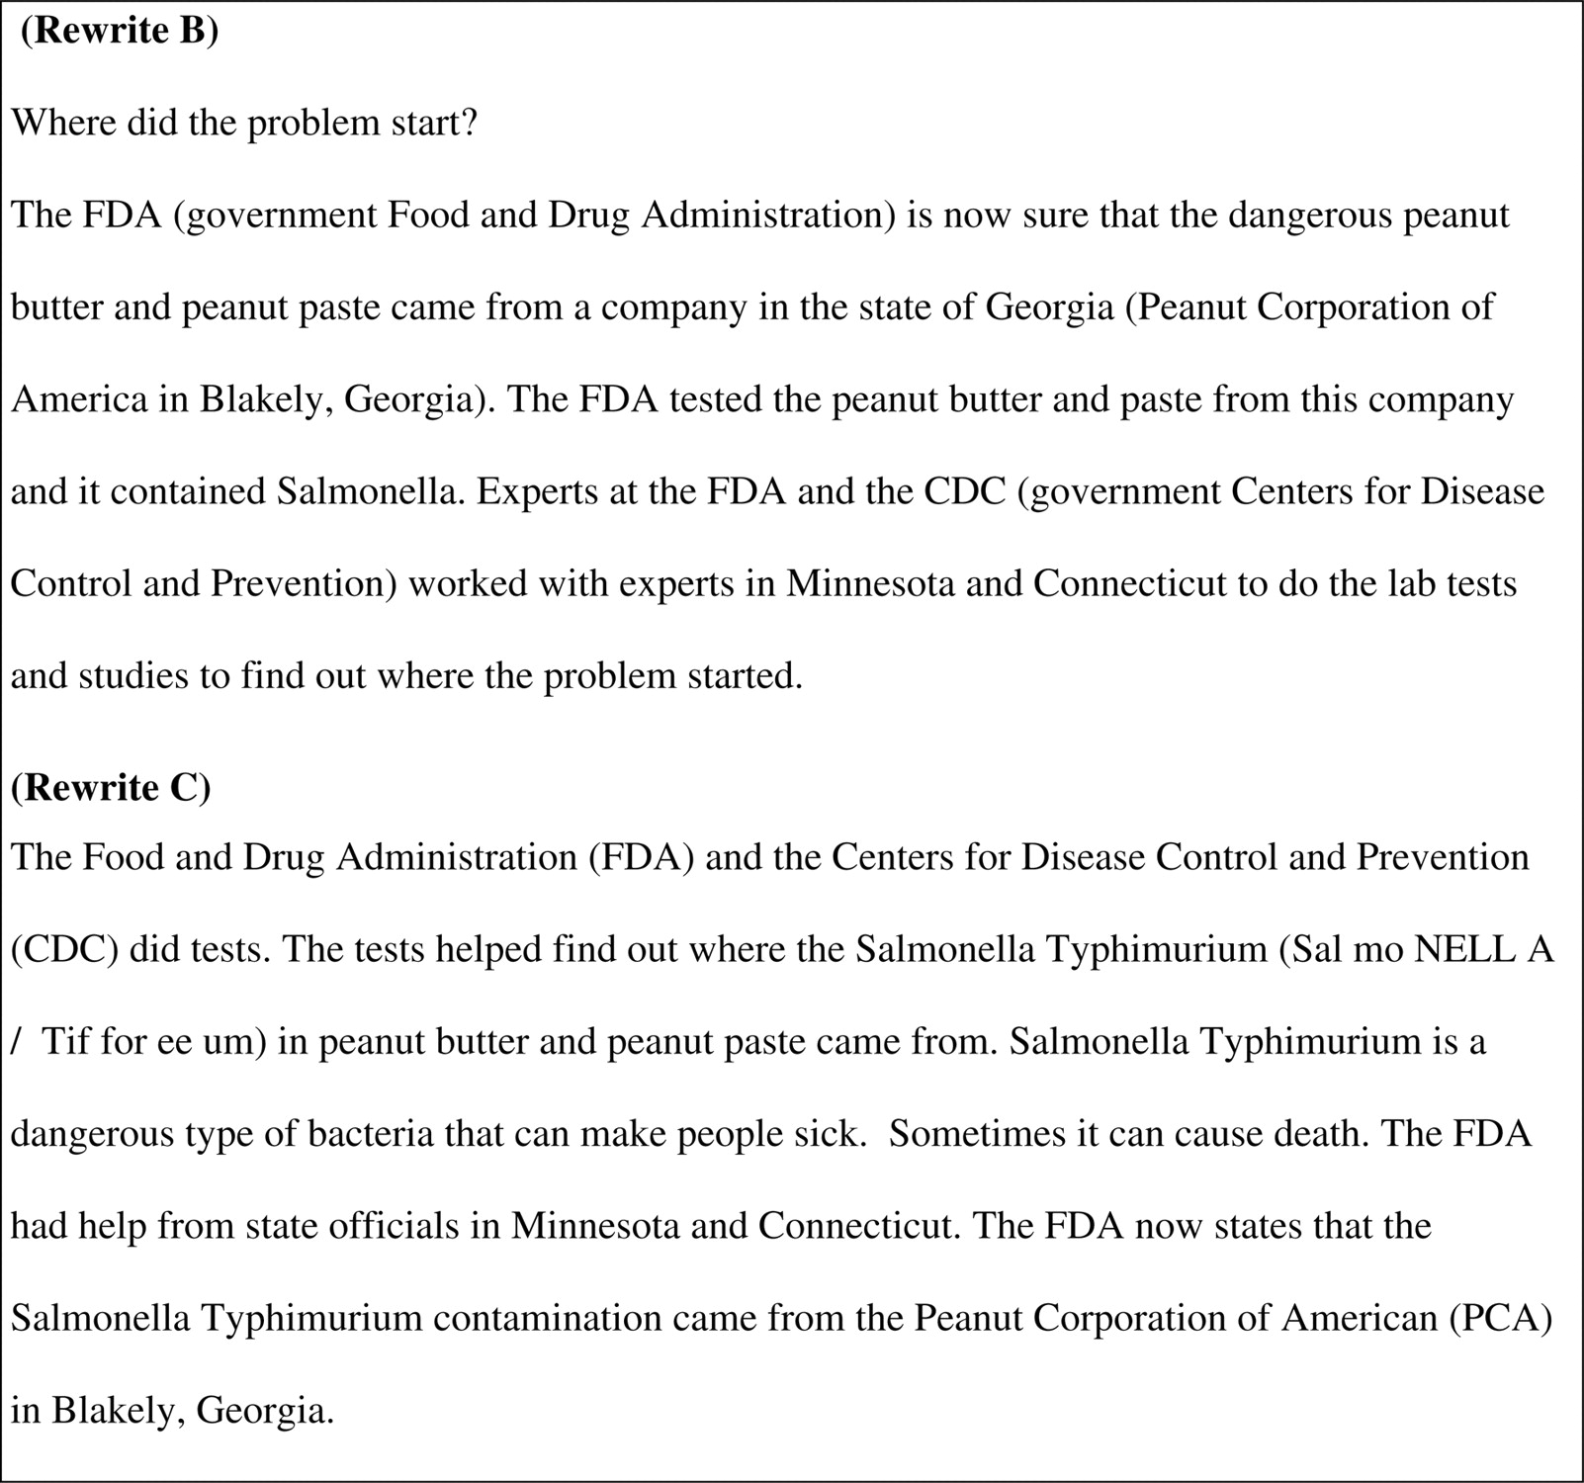
Fig. 4: Two different ways to rewrite.
Notes:
Fig. 4: Two different ways to rewrite.
Unless provided in the caption above, the following copyright applies to the content of this slide: © The Author (2010). Published by Oxford University Press. All rights reserved. For Permissions, please email: journals.permissions@oup.com

Slide 5
Fig. 5: NYCMTA Poster. Subway Poster © and “If you See Something, Say Something®” New York Metropolitan ...
Notes:
Fig. 5: NYCMTA Poster. Subway Poster © and “If you See Something, Say Something®” New York Metropolitan Transportation Authority. Used with permission.
Unless provided in the caption above, the following copyright applies to the content of this slide: © The Author (2010). Published by Oxford University Press. All rights reserved. For Permissions, please email: journals.permissions@oup.com

Slide 6
Fig. 6: Early model of communication.
Notes:
Fig. 6: Early model of communication.
Unless provided in the caption above, the following copyright applies to the content of this slide: © The Author (2010). Published by Oxford University Press. All rights reserved. For Permissions, please email: journals.permissions@oup.com

Slide 7
Fig. 7: Elaborated communication model from Jakobson (Jakobson, 1960).
Notes:
Fig. 7: Elaborated communication model from Jakobson (Jakobson, 1960).
Unless provided in the caption above, the following copyright applies to the content of this slide: © The Author (2010). Published by Oxford University Press. All rights reserved. For Permissions, please email: journals.permissions@oup.com

Slide 8
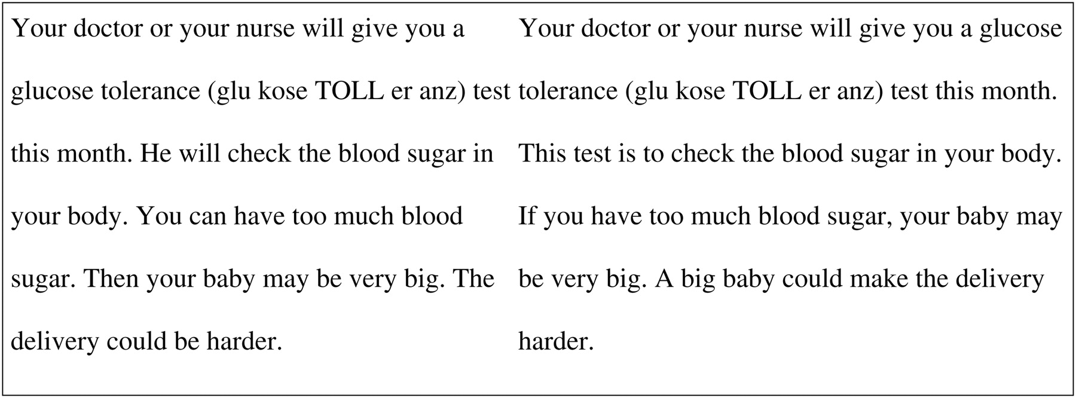
Fig. 8: Medical test example.
Notes:
Fig. 8: Medical test example.
Unless provided in the caption above, the following copyright applies to the content of this slide: © The Author (2010). Published by Oxford University Press. All rights reserved. For Permissions, please email: journals.permissions@oup.com

Slide 9
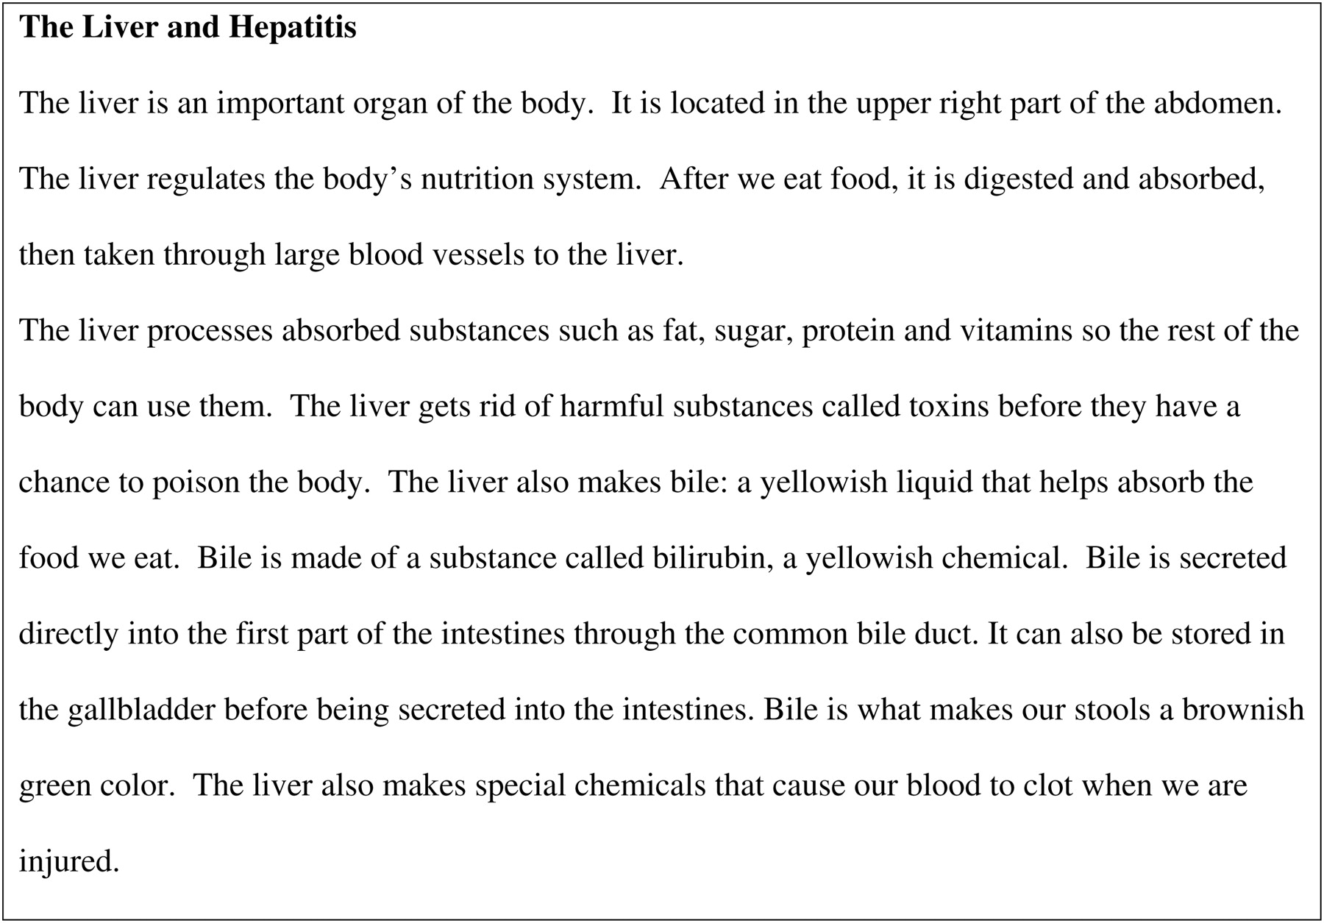
Fig. 9: Patient education information on Hepatitis C from MedlinePlus (MedlinePlus, 2009a).
Notes:
Fig. 9: Patient education information on Hepatitis C from MedlinePlus (MedlinePlus, 2009a).
Unless provided in the caption above, the following copyright applies to the content of this slide: © The Author (2010). Published by Oxford University Press. All rights reserved. For Permissions, please email: journals.permissions@oup.com

Slide 10
Fig. 10: H1N1 Flu (Swine Flu) text from MedlinePlus (MedlinePlus, 2009b).
Notes:
Fig. 10: H1N1 Flu (Swine Flu) text from MedlinePlus (MedlinePlus, 2009b).
Unless provided in the caption above, the following copyright applies to the content of this slide: © The Author (2010). Published by Oxford University Press. All rights reserved. For Permissions, please email: journals.permissions@oup.com

Slide 11
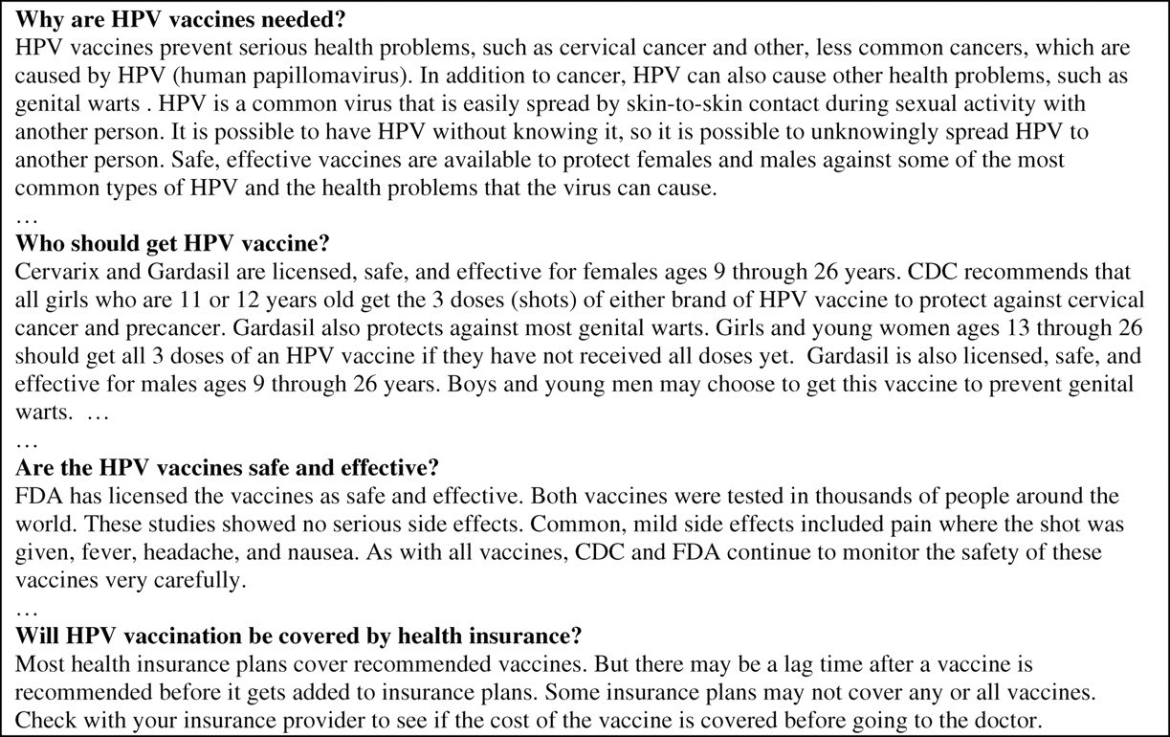
Fig. 11: Excerpts from Vaccines and Preventable Diseases: HPV Vaccine - Questions & Answers (CDC, 2009).
Notes:
Fig. 11: Excerpts from Vaccines and Preventable Diseases: HPV Vaccine - Questions & Answers (CDC, 2009).
Unless provided in the caption above, the following copyright applies to the content of this slide: © The Author (2010). Published by Oxford University Press. All rights reserved. For Permissions, please email: journals.permissions@oup.com

