Slide 1
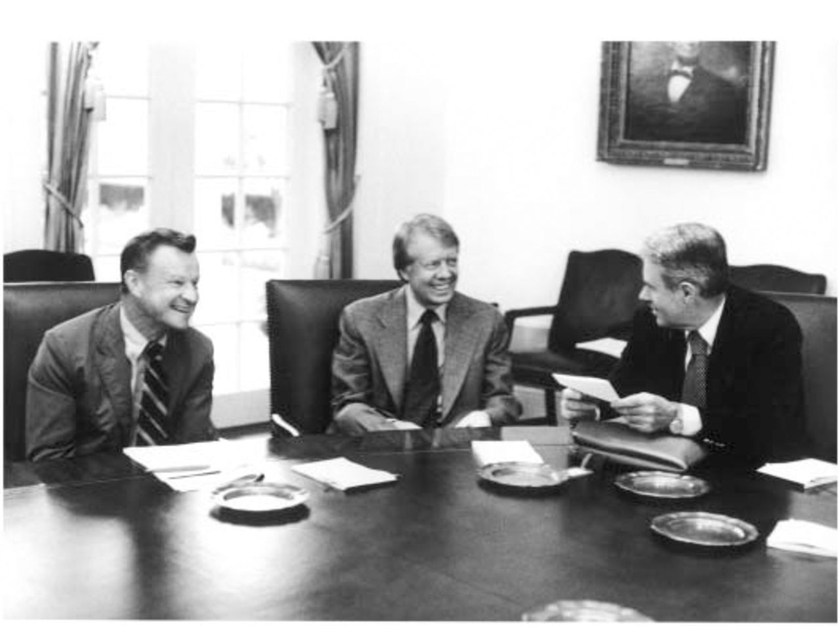
Figure 1 National Security Advisor Zbigniew Brzezinski, President Jimmy Carter, Secretary of State Cyrus Vance, 14 ...
Notes:
Figure 1 National Security Advisor Zbigniew Brzezinski, President Jimmy Carter, Secretary of State Cyrus Vance, 14 August 1977. ( Jimmy Carter Presidential Library)
Unless provided in the caption above, the following copyright applies to the content of this slide: © The Society for Historians of American Foreign Relations (SHAFR)

Slide 2
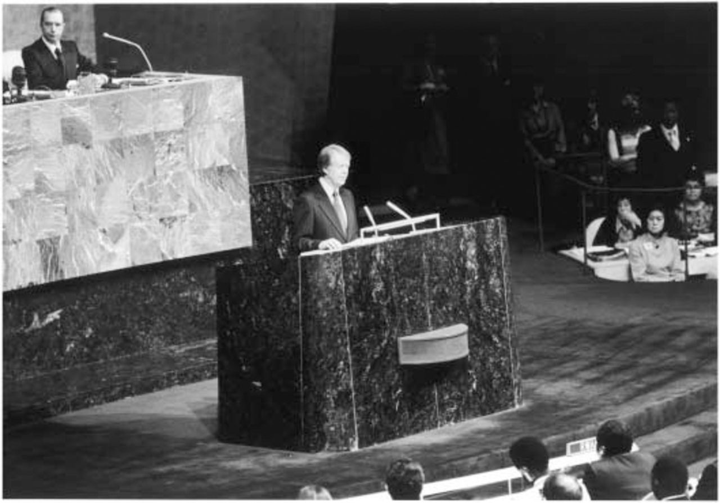
Figure 2 Jimmy Carter addresses the United Nations, 4 October 1977. ( Jimmy Carter Presidential Library)
Notes:
Figure 2 Jimmy Carter addresses the United Nations, 4 October 1977. ( Jimmy Carter Presidential Library)
Unless provided in the caption above, the following copyright applies to the content of this slide: © The Society for Historians of American Foreign Relations (SHAFR)

