Slide 1
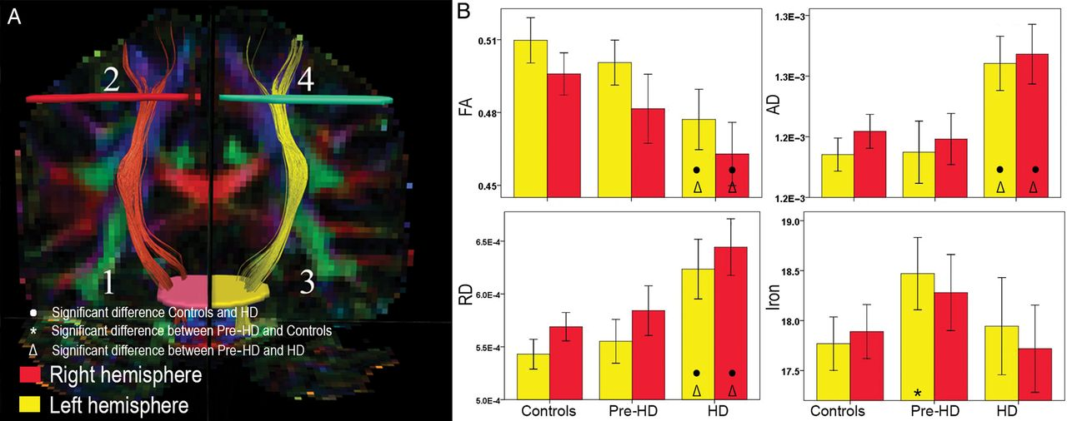
Table 2 Tractography group comparisons Note: Significant FDR corrected results are in BOLD. Figure 1.CST tractography ...
Notes:
Table 2 Tractography group comparisons Note: Significant FDR corrected results are in BOLD. Figure 1.CST tractography and group comparisons. (A) Numbers 1–4 show tractography ROI placement on a single subject for the left and right CST. (B) Bar graphs show differences between CST FA, AD, and RD for the left and right hemisphere. The error bars represent the standard error mean (SEM).
Unless provided in the caption above, the following copyright applies to the content of this slide: © The Author 2014. Published by Oxford University Press. All rights reserved. For Permissions, please e-mail: journals.permissions@oup.com

Slide 2
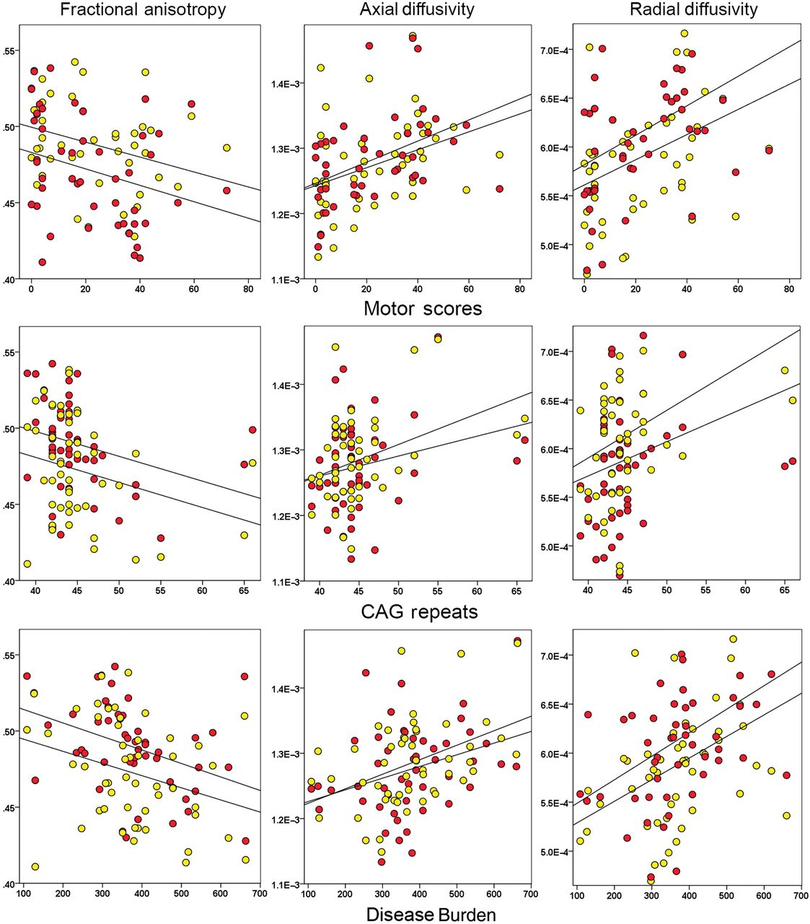
Figure 2. Significant motor and genetic correlations with CST FA, AD, and RD.
Notes:
Figure 2. Significant motor and genetic correlations with CST FA, AD, and RD.
Unless provided in the caption above, the following copyright applies to the content of this slide: © The Author 2014. Published by Oxford University Press. All rights reserved. For Permissions, please e-mail: journals.permissions@oup.com

Slide 3
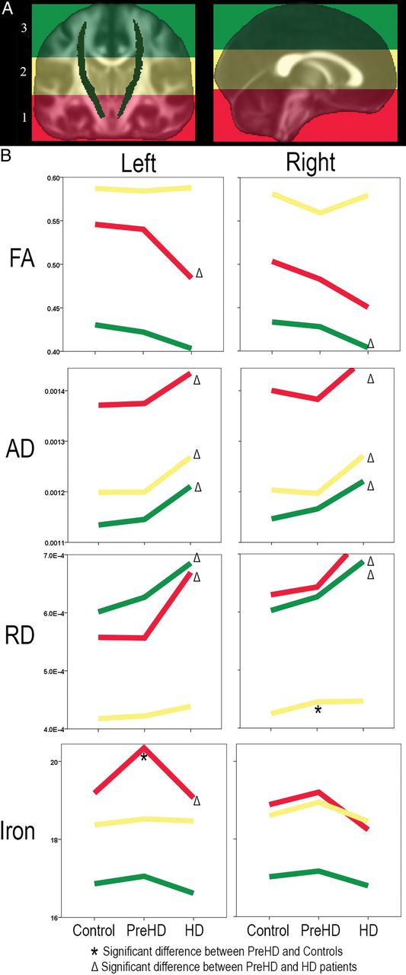
Figure 3. Regional CST microstructural properties group comparisons. (A) Divisions on the FMRIB58_FA atlas to create ...
Notes:
Figure 3. Regional CST microstructural properties group comparisons. (A) Divisions on the FMRIB58_FA atlas to create regional masks. (B) Graphs show group differences between regional CST FA, AD, and RD for the left and right hemisphere.
Unless provided in the caption above, the following copyright applies to the content of this slide: © The Author 2014. Published by Oxford University Press. All rights reserved. For Permissions, please e-mail: journals.permissions@oup.com

