Slide 1
Figure 1. Experimental paradigm and design. In a set of 3-move problems, the task parameters search depth and goal ...
Notes:
Figure 1. Experimental paradigm and design. In a set of 3-move problems, the task parameters search depth and goal hierarchy were experimentally manipulated within a 2 × 2 factorial design. Search depth involves the need to mentally accomplish intermediate moves and associated interdependencies. That is, even in relatively simple problems, it may be necessary not to put a ball into its goal position but somewhere else first in order to free the way for another ball to be placed into its respective final position (see the white ball in problems with an intermediate move). Goal hierarchy concerns the obviousness of priorities for individual goal moves that can be deduced from the structure of the goal state. That is, goal hierarchy relates to the possible configurations of the goal state that differentially predispose the consecutive order of the final goal moves. For instance, if all 3 balls are stacked on a single rod, the ball at the bottom definitely has to be in its goal position before the ball that is second from the bottom, and so on. See Materials and Methods for further details.
Unless provided in the caption above, the following copyright applies to the content of this slide: © The Author 2010. Published by Oxford University Press. All rights reserved. For permissions, please e-mail: journals.permissions@oup.com

Slide 2
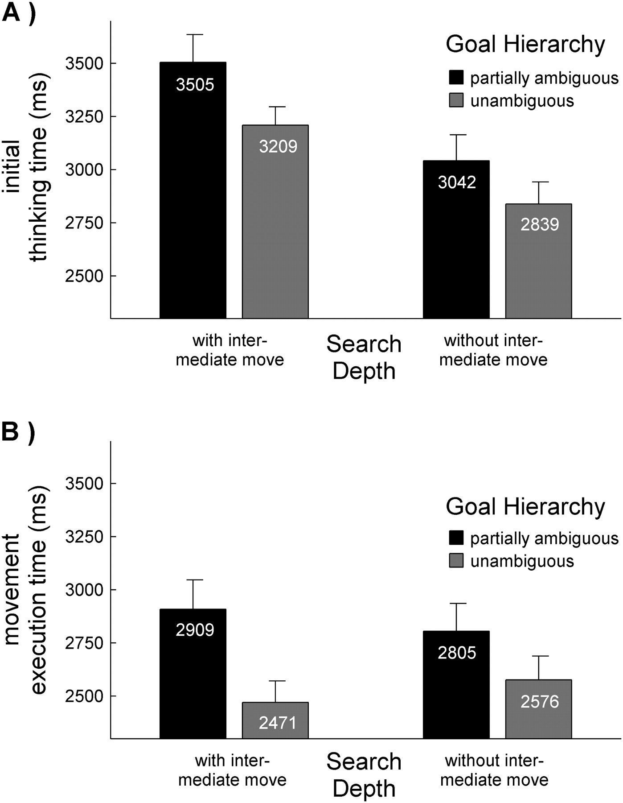
Figure 2. Latency analyses. Mean initial thinking times (A) and movement execution times (B) are plotted with respect ...
Notes:
Figure 2. Latency analyses. Mean initial thinking times (A) and movement execution times (B) are plotted with respect to search depth and goal hierarchy that were experimentally manipulated in a 2 × 2 factorial design. Numbers within bars provide means, and error bars indicate standard error of means.
Unless provided in the caption above, the following copyright applies to the content of this slide: © The Author 2010. Published by Oxford University Press. All rights reserved. For permissions, please e-mail: journals.permissions@oup.com

Slide 3
Figure 3. Task-dependent activation of left and right dlPFC. Activation patterns related to the main effects of goal ...
Notes:
Figure 3. Task-dependent activation of left and right dlPFC. Activation patterns related to the main effects of goal hierarchy (left side) and search depth (right side) at a voxel-wise threshold of P 4.05; cluster size k > 20 voxels). In the coronar views, planes were selected that contained the dlPFC activation maxima for goal hierarchy (y = 32) and search depth (y = 36). Activations are displayed on an average brain template created from the segmented and normalized brains of all included subjects (n = 24).
Unless provided in the caption above, the following copyright applies to the content of this slide: © The Author 2010. Published by Oxford University Press. All rights reserved. For permissions, please e-mail: journals.permissions@oup.com

Slide 4
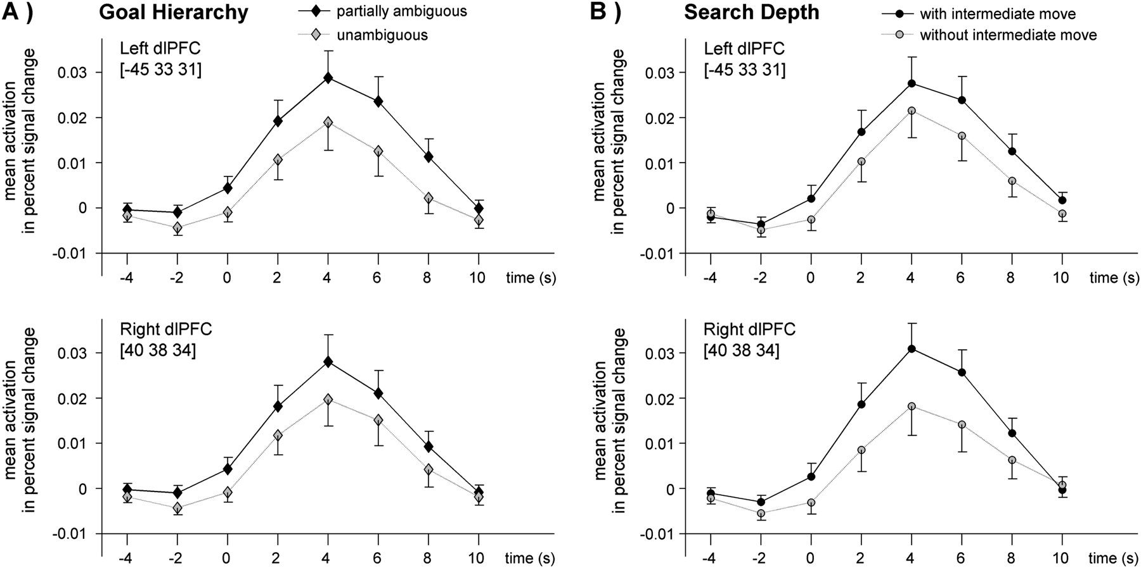
Figure 4. Main effects of (A) goal hierarchy and (B) search depth in left (top) and right dlPFC (bottom). Plots ...
Notes:
Figure 4. Main effects of (A) goal hierarchy and (B) search depth in left (top) and right dlPFC (bottom). Plots illustrate the time course of the hemodynamic response across FIR basis functions (i.e., time bins). Error bars indicate standard error of means.
Unless provided in the caption above, the following copyright applies to the content of this slide: © The Author 2010. Published by Oxford University Press. All rights reserved. For permissions, please e-mail: journals.permissions@oup.com

Slide 5
Figure 5. Mean differences in task-dependent activation for left and right dlPFC (A) and FEF (B). Bars illustrate the ...
Notes:
Figure 5. Mean differences in task-dependent activation for left and right dlPFC (A) and FEF (B). Bars illustrate the mean activation differences of the experimentally manipulated task parameters (goal hierarchy: partially vs. unambiguous; search depth: with vs. without an intermediate move). Numbers within panel provide means, and error bars indicate standard error of means.
Unless provided in the caption above, the following copyright applies to the content of this slide: © The Author 2010. Published by Oxford University Press. All rights reserved. For permissions, please e-mail: journals.permissions@oup.com

Slide 6
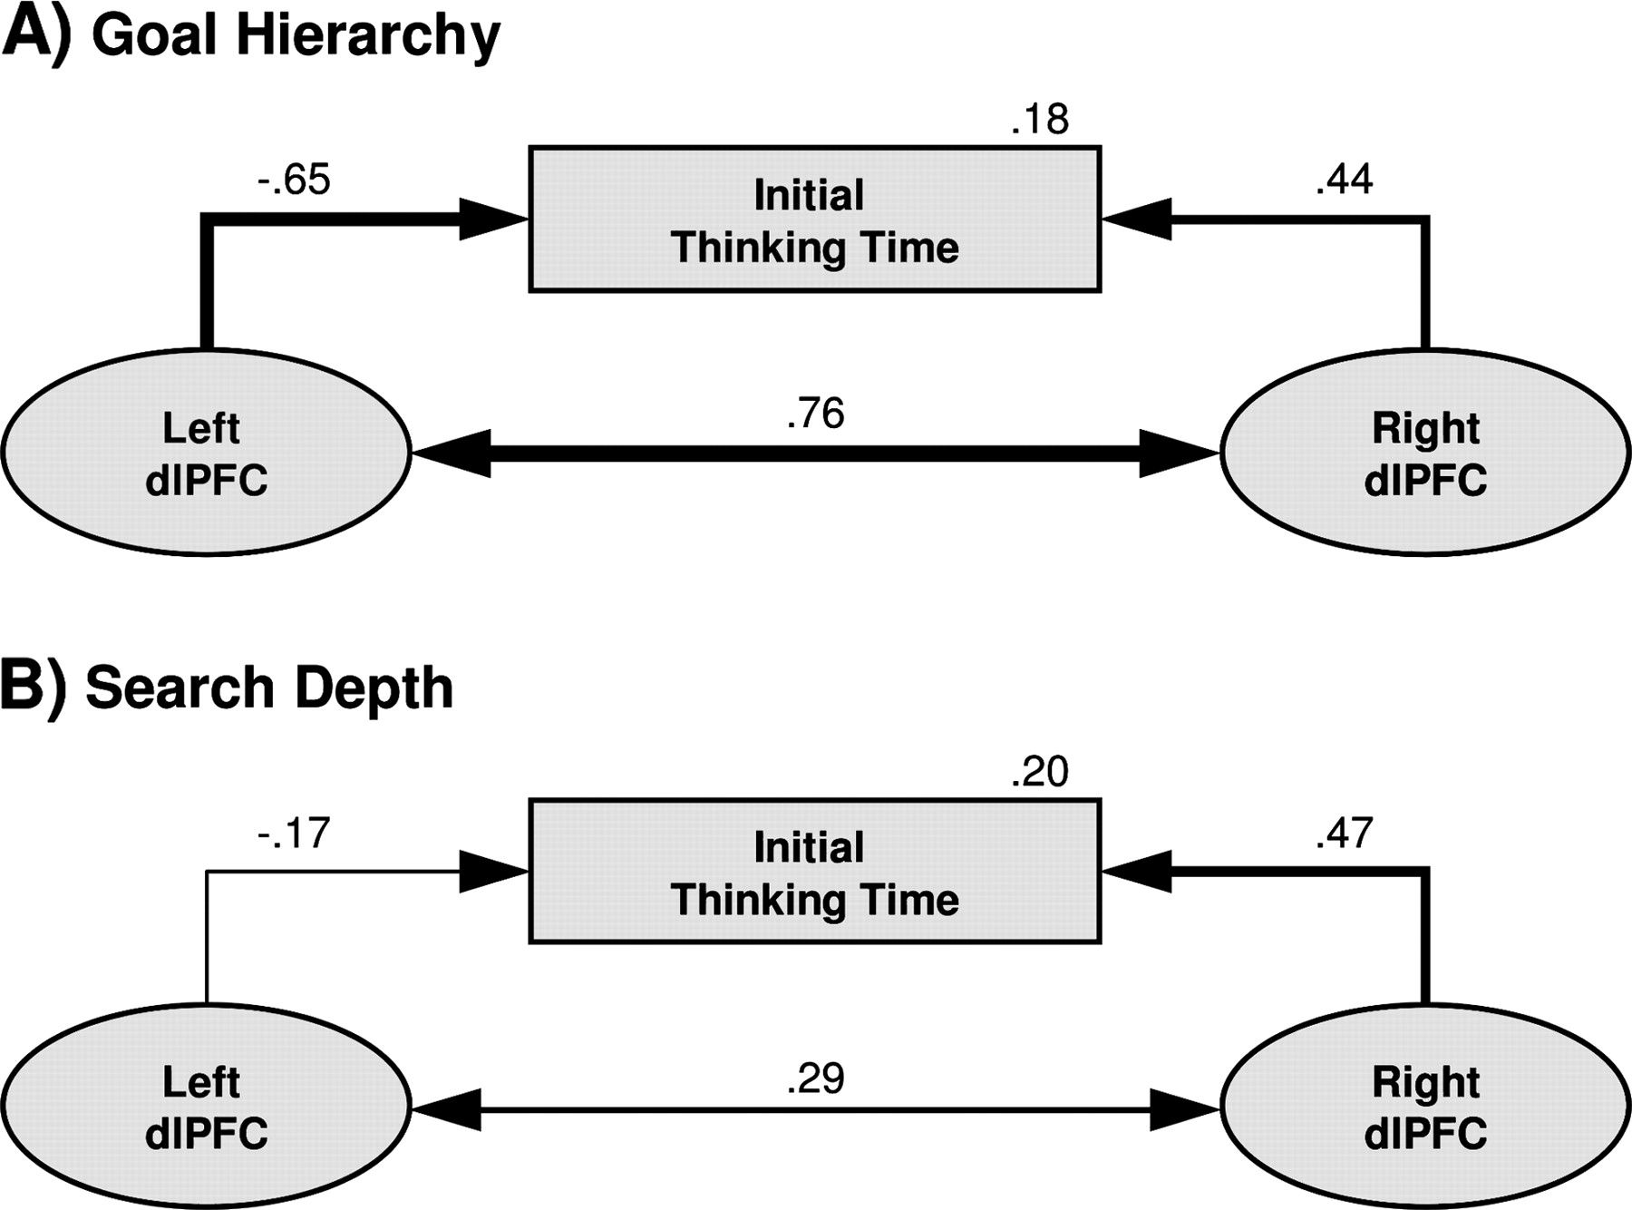
Figure 6. Brain–behavior relationships between main effects in dlPFC activation and initial thinking times for goal ...
Notes:
Figure 6. Brain–behavior relationships between main effects in dlPFC activation and initial thinking times for goal hierarchy (A) and search depth (B) as revealed by SEM. For both task parameters, hemodynamic activity of left and right dlPFC was modeled as latent variables based on the respective differential effects for time bins 3–7 (ranging from 0 to 8 s) and related to the manifest differences in initial thinking times. Manifest and latent variables are illustrated with boxes and circles, respectively. Standardized values are given for correlations between latent and manifest variables and for proportions of explained variance. Size of correlations is also reflected by thickness of arrows. A more detailed overview on the full models is provided in the Supplementary Fig. 4.
Unless provided in the caption above, the following copyright applies to the content of this slide: © The Author 2010. Published by Oxford University Press. All rights reserved. For permissions, please e-mail: journals.permissions@oup.com

Slide 7
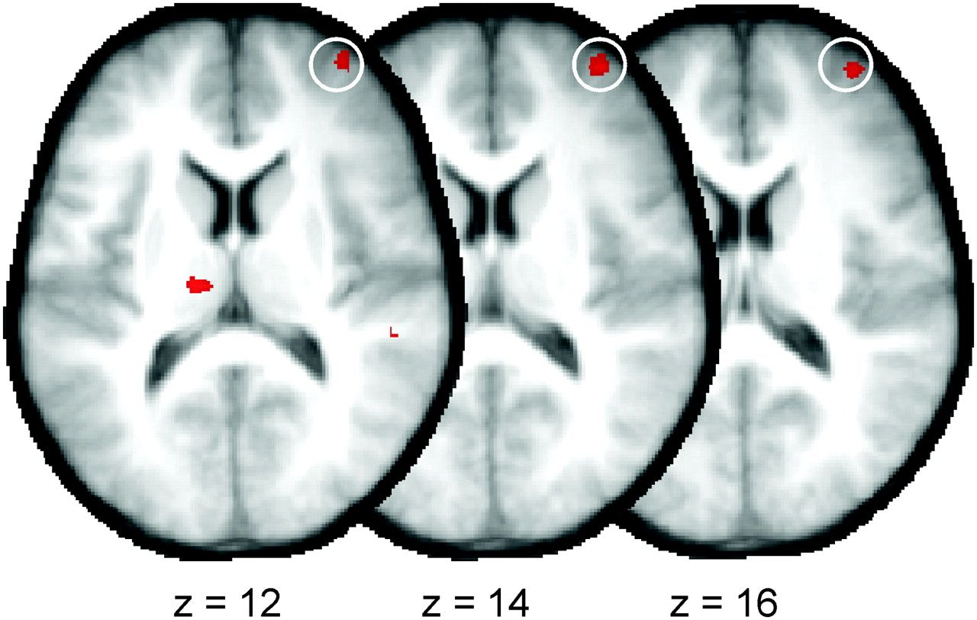
Figure 7. Activation of right aPFC (white circles) associated with higher demands on search depth (maximum peak at 36 ...
Notes:
Figure 7. Activation of right aPFC (white circles) associated with higher demands on search depth (maximum peak at 36 54 14). Reported activations passed a marginally lowered voxel-wise threshold of P 3.54) and exceeded an extension level of k > 20 voxels. Applying the same threshold to the analysis of goal hierarchy did not yield contributions of the aPFC.
Unless provided in the caption above, the following copyright applies to the content of this slide: © The Author 2010. Published by Oxford University Press. All rights reserved. For permissions, please e-mail: journals.permissions@oup.com

