Slide 1
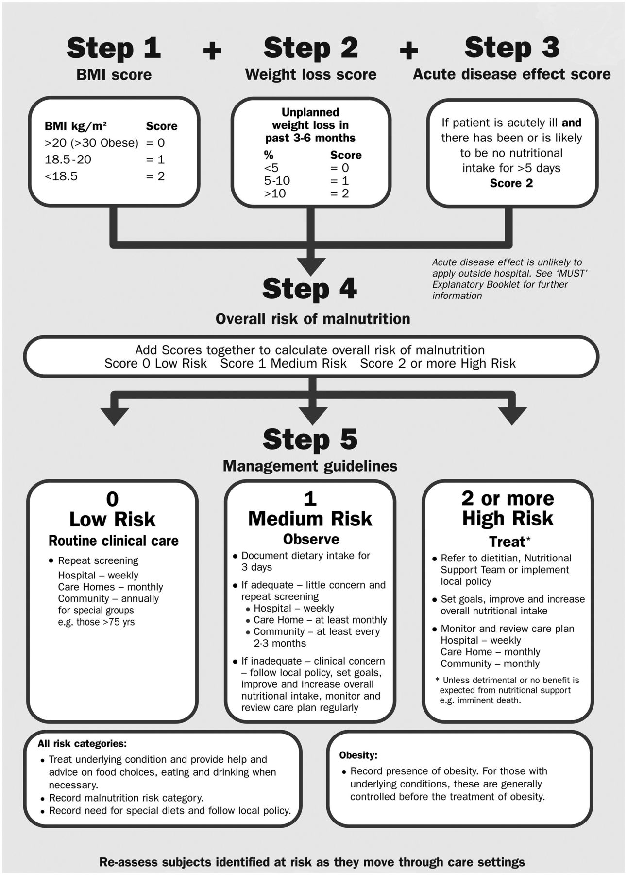
Fig. 1 MUST flowchart. The MUST is reproduced from the MUST explanatory booklet ...
Notes:
Fig. 1 MUST flowchart. The MUST is reproduced from the MUST explanatory booklet (http://www.bapen.org.uk/pdfs/must/must_explan.pdf) with the kind permission of BAPEN (British Association for Parenteral and Enteral Nutrition). For further information on MUST see www.bapen.co.uk.
Unless provided in the caption above, the following copyright applies to the content of this slide: © The Author 2012. Published by Oxford University Press on behalf of the British Society for Rheumatology. All rights reserved. For Permissions, please email: journals.permissions@oup.com

Slide 2
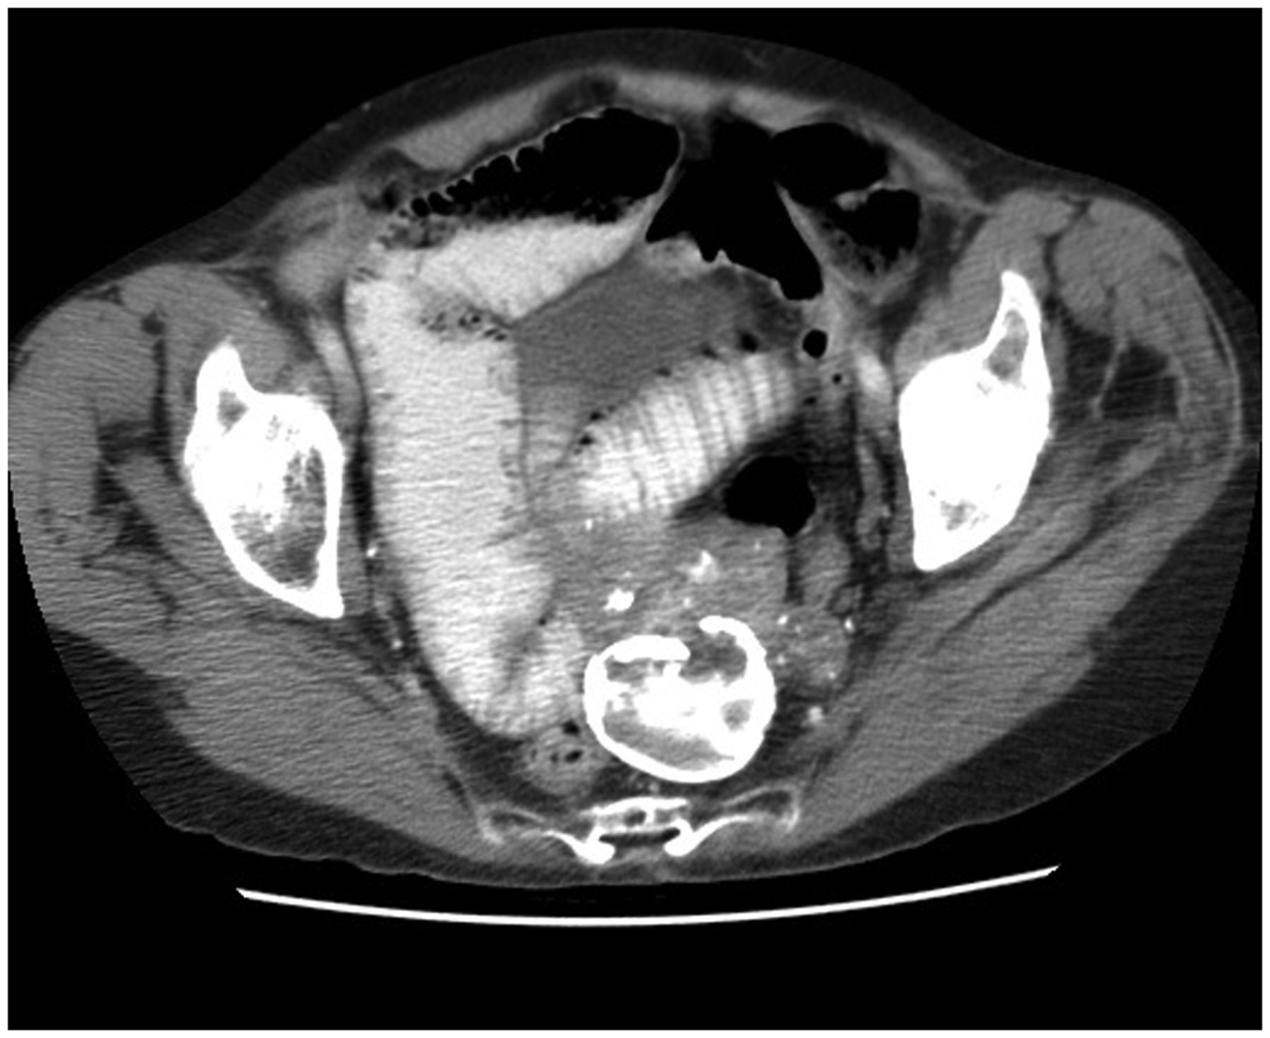
Fig. 2 Typical hide-bound appearance. Abdominal CT with contrast demonstrating the typical hide-bound appearance of ...
Notes:
Fig. 2 Typical hide-bound appearance. Abdominal CT with contrast demonstrating the typical hide-bound appearance of the small intestine associated with SSc involvement.
Unless provided in the caption above, the following copyright applies to the content of this slide: © The Author 2012. Published by Oxford University Press on behalf of the British Society for Rheumatology. All rights reserved. For Permissions, please email: journals.permissions@oup.com

