Slide 1
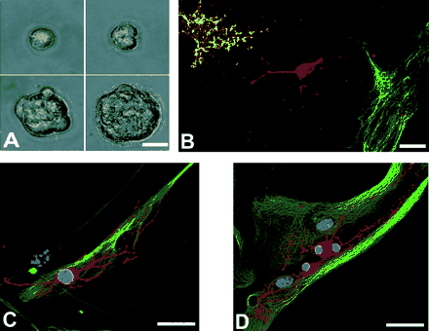
Fig. 1 (A) The generation of a quaternary neurospheres. (B–D) Upon differentiation of tertiary spheres, cells ...
Notes:
Fig. 1 (A) The generation of a quaternary neurospheres. (B–D) Upon differentiation of tertiary spheres, cells positive for astrocytic (GFAP, green), neuronal [DCX, (B) red; MAP-2, C red] and oligodendrocytic markers [O4, B yellow; RIP, (D) red] develop. DNA is stained with TO-PRO (blue). Scale bars: 15 μm upper left + right, 25 μm lower left, 40 μm lower right (A); 20 μm (B + C); 40 μm (D).
Unless provided in the caption above, the following copyright applies to the content of this slide: © The Author (2005). Published by Oxford University Press on behalf of the Guarantors of Brain. All rights reserved. For Permissions, please email: journals.permissions@oupjournals.org

Slide 2
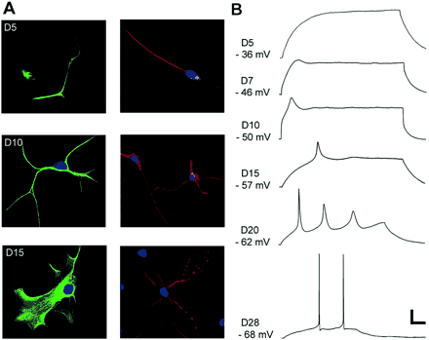
Fig. 2 (A) Immunocytochemical staining for glial (GFAP, left panel) and neuronal (MAP-2, right panel) markers at ...
Notes:
Fig. 2 (A) Immunocytochemical staining for glial (GFAP, left panel) and neuronal (MAP-2, right panel) markers at different stages of development. (B) Whole-cell patch-clamp recordings showing responses to a 0.1 nA intracellular current pulse at different stages of differentiation. The pulse duration varied from 300 to 500 ms depending on the maturation of membrane properties. Scale bars: 50 μm (A top panel); 20 μm (A lower panel); 15 mV and 50 ms (B).
Unless provided in the caption above, the following copyright applies to the content of this slide: © The Author (2005). Published by Oxford University Press on behalf of the Guarantors of Brain. All rights reserved. For Permissions, please email: journals.permissions@oupjournals.org

Slide 3
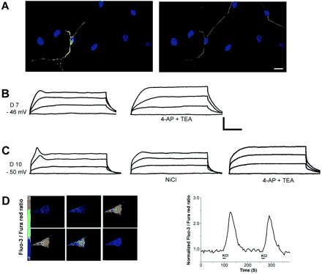
Fig. 3 (A) Progeny of an adult human multipotent progenitor after 7 days of differentiation (D7), filled with ...
Notes:
Fig. 3 (A) Progeny of an adult human multipotent progenitor after 7 days of differentiation (D7), filled with lucifer yellow during patch-clamp recordings (left, yellow), that also stains for the neuronal marker β-III-tubulin (right, red). DNA is stained with TO-PRO-3 (blue). (B) Injection of positive current (0–100 pA, 500 ms) during patch-clamp recordings from the same cell only revealed a depolarizing shift in the membrane potential that sagged to a more hyperpolarized potential during the current pulse. This ‘hump’ was abolished by the K+-channel blockers 0.5 mM 4-AP and 5 mM TEA (right panel). (C) A cell on D10 responded to positive current with a potential that was partly blocked by 500 μM NiCl (middle panel), indicating Ca2+ dependence. The residual ‘hump’ was abolished by 0.5 μM 4-AP and 5 mM TEA. (D) Pressure puff application of KCl 60 mM for 10 s to the peripheral process of a neuron-like cell loaded with fura red and fluo-3 on D10. KCl evoked a rapid elevation in [Ca2+]i that propagated from the application site at the peripheral process (image 2), progressing through the soma and reaching a peak (images 3 and 4) before slowly returning towards baseline (images 5 and 6). A typical response in [Ca2+]i is plotted as the fluorescence intensity ratio of fura red and fluo-3 against time (right). Scale bars: 20 μm (A); 30 mV and 120 ms (B and C).
Unless provided in the caption above, the following copyright applies to the content of this slide: © The Author (2005). Published by Oxford University Press on behalf of the Guarantors of Brain. All rights reserved. For Permissions, please email: journals.permissions@oupjournals.org

Slide 4
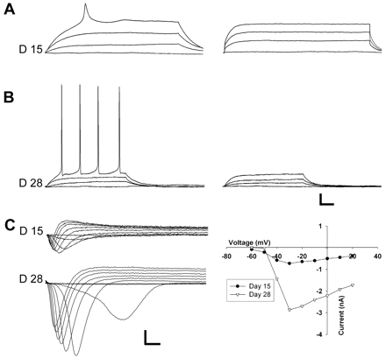
Fig. 4 (A) On D15, a neuron-like cell showed an overshooting, but immature looking AP (left) that was completely ...
Notes:
Fig. 4 (A) On D15, a neuron-like cell showed an overshooting, but immature looking AP (left) that was completely abolished by 0.5 μM TTX (right), indicating Na+-dependence. Current pulse: 0–100 pA, 500 ms. (B) Recordings from neuron-like cells during the fourth week of differentiation (left) revealed mature Na+-dependent, low-threshold, repetitive APs blocked by TTX (right). Current pulse: 0-100 pA, 300 ms. (C) Voltage-clamp recordings show development of Na+-currents during development. The inward currents are plotted as a function of the holding potential (right panel). Scale bars: 5 mV and 25 ms (A and B); 0.5 nA and 5 ms (C).
Unless provided in the caption above, the following copyright applies to the content of this slide: © The Author (2005). Published by Oxford University Press on behalf of the Guarantors of Brain. All rights reserved. For Permissions, please email: journals.permissions@oupjournals.org

Slide 5
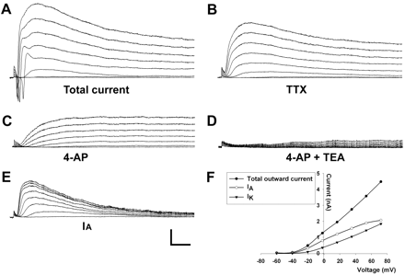
Fig. 5 (A) Voltage-clamp recordings in a D20 differentiated cell. The protocol consisted of a prepulse from a ...
Notes:
Fig. 5 (A) Voltage-clamp recordings in a D20 differentiated cell. The protocol consisted of a prepulse from a holding potential of −70 mV to −90 mV for 100 ms, followed by 200 ms steps of 10 mV to +60 mV. (B) A concentration 0.5 μM of TTX was added to block sodium currents. (C) 4-AP (500 μM) blocked the rapid component of the outward current, resembling the IA current. (D) TEA (5 mM) blocked the remaining IK current. (E) The IA current was calculated by subtracting the 4-AP insensitive from the total K+-currents. (F) The peak outward currents are plotted as the function of the holding potential. Scale bars: 1 nA and 50 ms.
Unless provided in the caption above, the following copyright applies to the content of this slide: © The Author (2005). Published by Oxford University Press on behalf of the Guarantors of Brain. All rights reserved. For Permissions, please email: journals.permissions@oupjournals.org

Slide 6
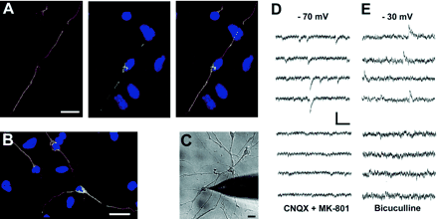
Fig. 6 (A) Immunocytochemical detection of VGlut-1 (green) in a cell co-stained with the neuronal marker ...
Notes:
Fig. 6 (A) Immunocytochemical detection of VGlut-1 (green) in a cell co-stained with the neuronal marker β-III-tubulin (red), indicating a glutamatergic neuron. DNA is stained with TO-PRO (blue). (B) Co-staining of GAD-65 (green) and β-III-tubulin (red), indicating a GABAergic neuron. DNA is stained with TO-PRO (blue). (D–E) Patch-clamp recordings in D25 neuron-like cells (C) lying in a network revealed spontaneous synaptic currents. At a holding potential of −70 mV, the inward currents were blocked by the glutamate-receptor antagonists CNQX (AMPA/kainate) and MK-801 (NMDA) (D), indicating glutamate-mediated synaptic communication. In another cell at a holding potential of −30 mV, outward currents were blocked by the GABAA-antagonist bicuculline (E), indicating GABAergic synaptic transmission. Scale bars: 20 μm (A–C); 20 pA and 50 ms (D); 15 pA and 200 ms (E).
Unless provided in the caption above, the following copyright applies to the content of this slide: © The Author (2005). Published by Oxford University Press on behalf of the Guarantors of Brain. All rights reserved. For Permissions, please email: journals.permissions@oupjournals.org

