Slide 1
Figure 1. (a) Shell length (µm) and (b) shell mass (ng) at 48-h post-fertilization in larvae of C. gigas cultured under ...
Notes:
Figure 1. (a) Shell length (µm) and (b) shell mass (ng) at 48-h post-fertilization in larvae of C. gigas cultured under control conditions (Ω ≫ 1 at 2.77) and at aragonite undersaturation (Ω < 1 at 0.77). Data plotted as the average value ± SE of all larval families (black circles). Fitted lines represent individually tested larval families. Nine larval families are shown for shell length and five for shell mass. (c) The difference between the means of shell length (± 95% CI) at aragonite undersaturation vs. control conditions across nine larval families, ranked by effect (Family 1 < Family 2–7 < Family 8–9). Genetic crosses are given earlier for each larval family (male-by-female crosses of pedigreed lines).
Unless provided in the caption above, the following copyright applies to the content of this slide: © International Council for the Exploration of the Sea 2016. All rights reserved. For Permissions, please email: journals.permissions@oup.comThis article is published and distributed under the terms of the Oxford University Press, Standard Journals Publication Model (https://academic.oup.com/journals/pages/open_access/funder_policies/chorus/standard_publication_model)

Slide 2
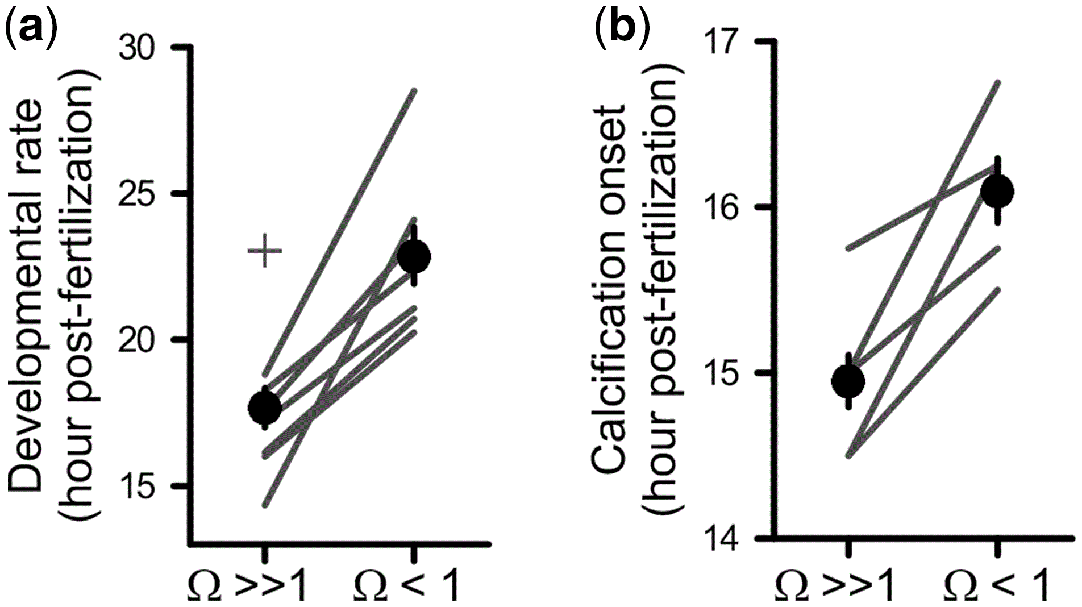
Figure 2. (a) The time to D-hinge, measured as the time (h) post-fertilization at which half of the larval population ...
Notes:
Figure 2. (a) The time to D-hinge, measured as the time (h) post-fertilization at which half of the larval population reached the veliger stage for larvae of C. gigas exposed to control conditions (Ω ≫ 1) and aragonite undersaturation (Ω < 1). One family did not develop to the veliger stage by 48 h post-fertilization (cross symbol). (b) Timing of calcification, measured as the h post-fertilization at which there was significant incorporation of 45Ca into the larval shell fraction, for larvae exposed to control and aragonite undersaturation conditions. Data are plotted as the average value ± SE of all larval families (black circles). Lines represent individual tested larval families. Eight families were measured for developmental rate, and five families measured for calcification onset.
Unless provided in the caption above, the following copyright applies to the content of this slide: © International Council for the Exploration of the Sea 2016. All rights reserved. For Permissions, please email: journals.permissions@oup.comThis article is published and distributed under the terms of the Oxford University Press, Standard Journals Publication Model (https://academic.oup.com/journals/pages/open_access/funder_policies/chorus/standard_publication_model)

Slide 3
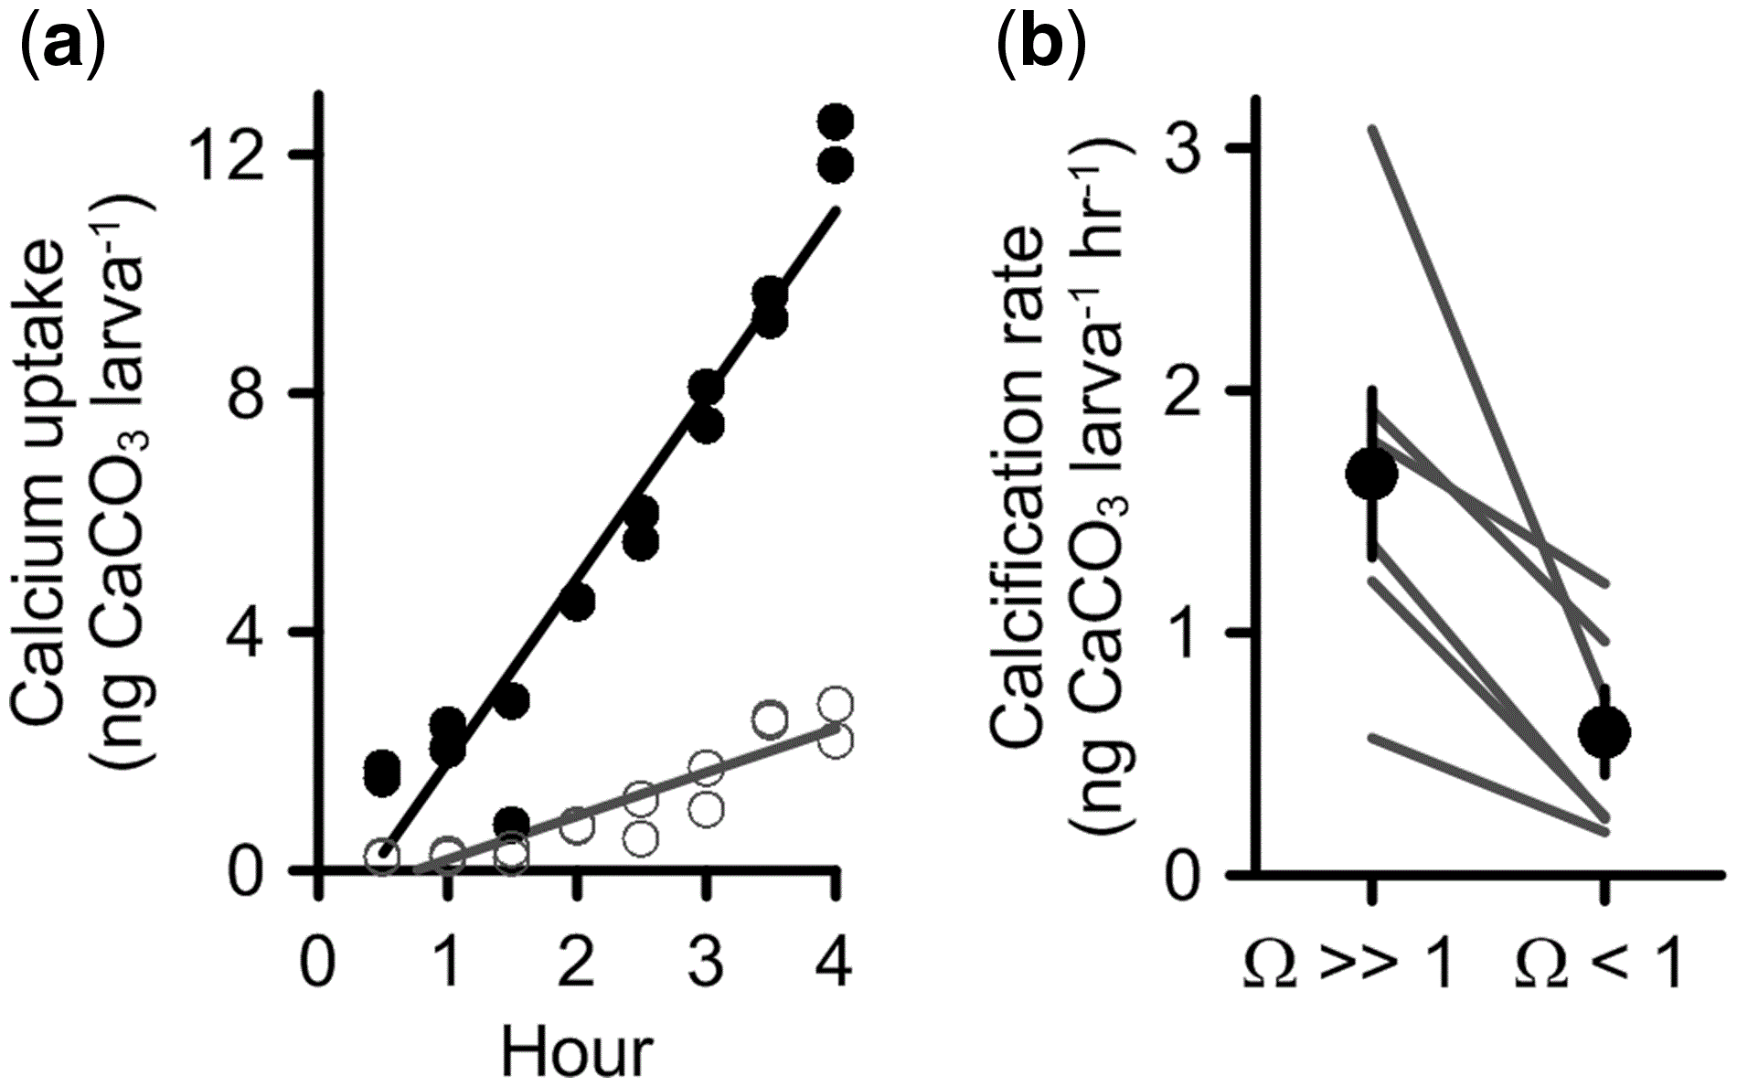
Figure 3. (a) ⁴⁵Ca uptake by larvae of C. gigas from Family 3. The accretion of calcium carbonate (ng ...
Notes:
Figure 3. (a) 45Ca uptake by larvae of C. gigas from Family 3. The accretion of calcium carbonate (ng CaCO3 larva−1) at control (black circles) and aragonite undersaturation (open circles). Each data point represents a different subsample of larvae. Two assays per control and aragonite undersaturation were combined after ANCOVA confirmed no difference in slope or intercept. (b) Mean (±SE; black circles) net calcification rate (ng CaCO3 larva−1 h−1) at control conditions (Ω ≫ 1 at 2.77) and aragonite undersaturation (Ω < 1 at 0.77) averaged across six different larval families (black lines).
Unless provided in the caption above, the following copyright applies to the content of this slide: © International Council for the Exploration of the Sea 2016. All rights reserved. For Permissions, please email: journals.permissions@oup.comThis article is published and distributed under the terms of the Oxford University Press, Standard Journals Publication Model (https://academic.oup.com/journals/pages/open_access/funder_policies/chorus/standard_publication_model)

Slide 4
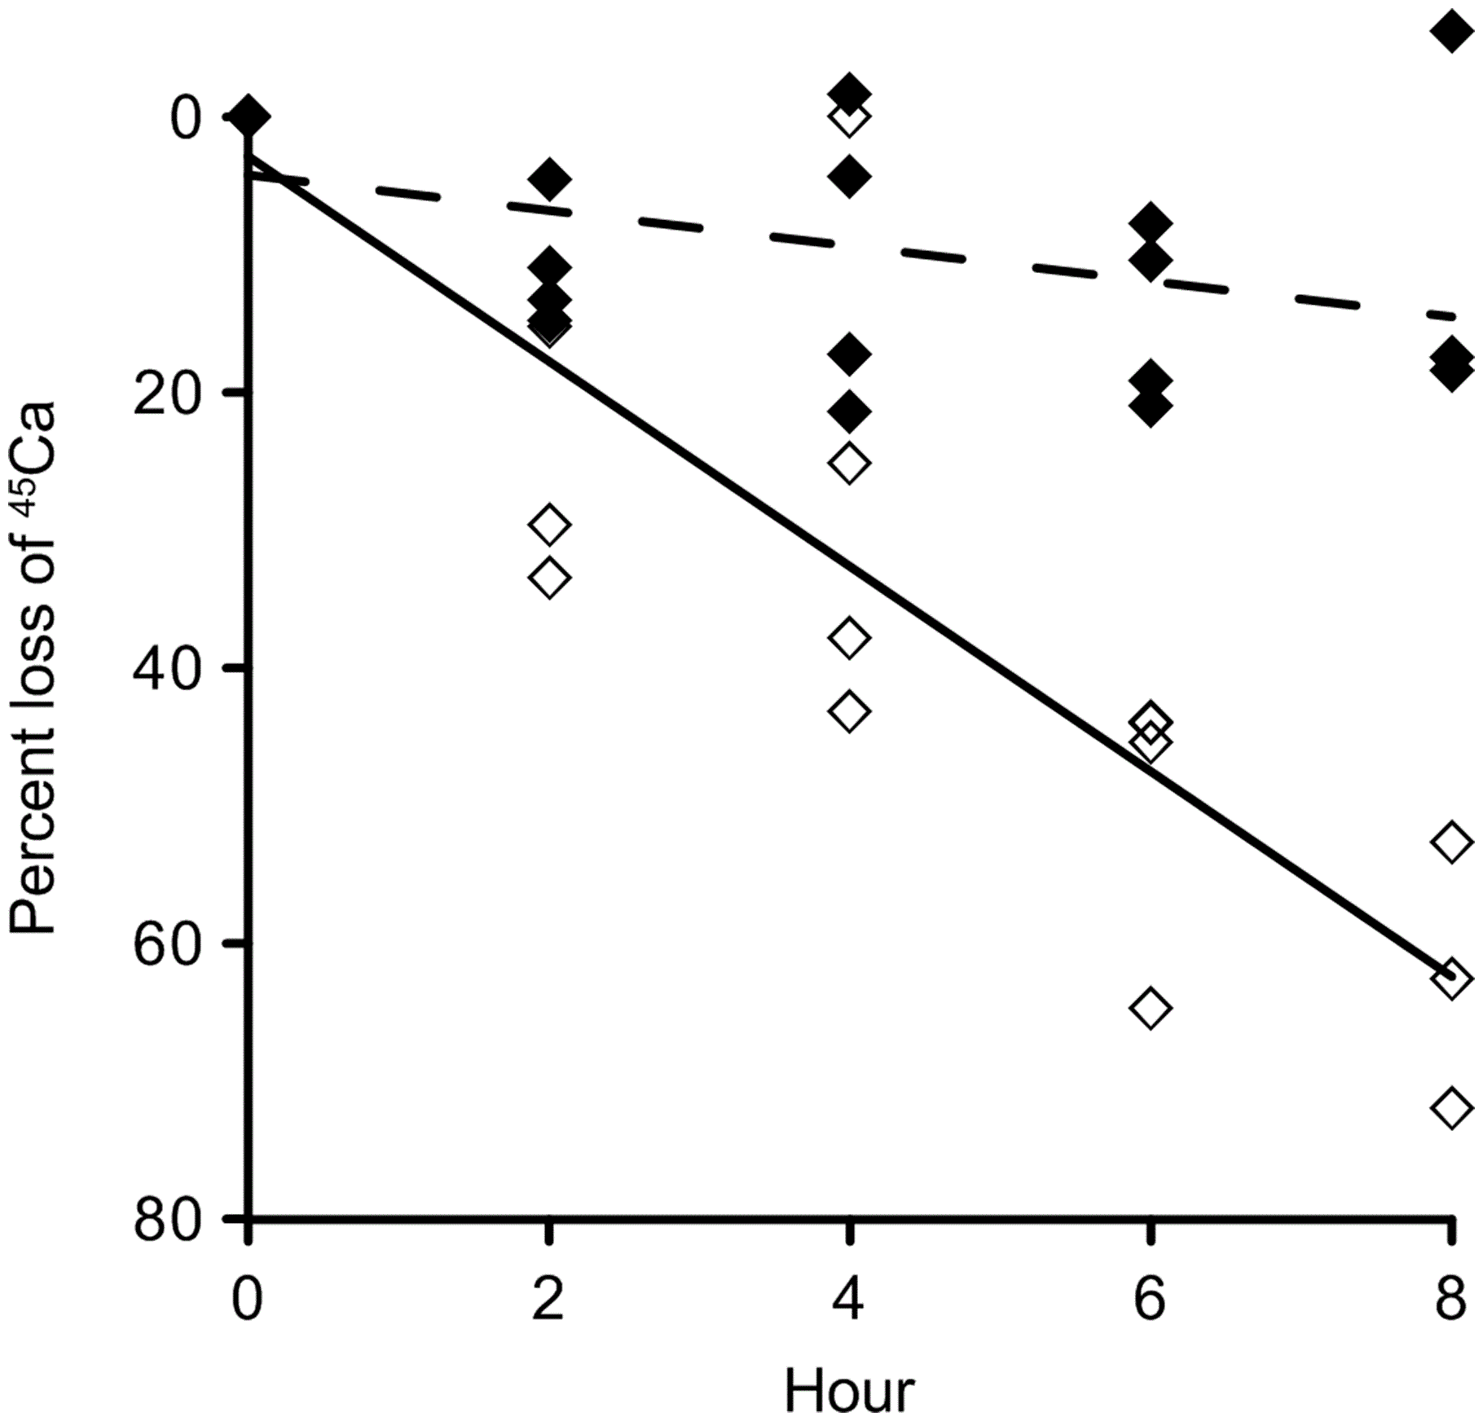
Figure 4. Percent loss of ⁴⁵Ca from shells of live larvae of C. gigas exposed to control (Ω ≫ 1 at 2.77; ...
Notes:
Figure 4. Percent loss of 45Ca from shells of live larvae of C. gigas exposed to control (Ω ≫ 1 at 2.77; solid symbols) and aragonite undersaturation (Ω < 1 at 0.77; open symbols) conditions. Prior to measurement of dissolution rate, larvae were incubated for 4 h in 45Ca-labelled seawater. Four separate 8-h time-course assays (including time zero) were conducted per treatment and combined after ANCOVA confirmed no difference in slope or intercept. At control conditions, there was no change in 45Ca (linear regression: F1,17 = 3.48; p = 0.08). At aragonite undersaturation, 45Ca from the shell decreased at a rate of 7.6% per h (percent loss = −4.18 – 7.6 × hour: F1,15 = 110; p < 0.0001).
Unless provided in the caption above, the following copyright applies to the content of this slide: © International Council for the Exploration of the Sea 2016. All rights reserved. For Permissions, please email: journals.permissions@oup.comThis article is published and distributed under the terms of the Oxford University Press, Standard Journals Publication Model (https://academic.oup.com/journals/pages/open_access/funder_policies/chorus/standard_publication_model)

Slide 5
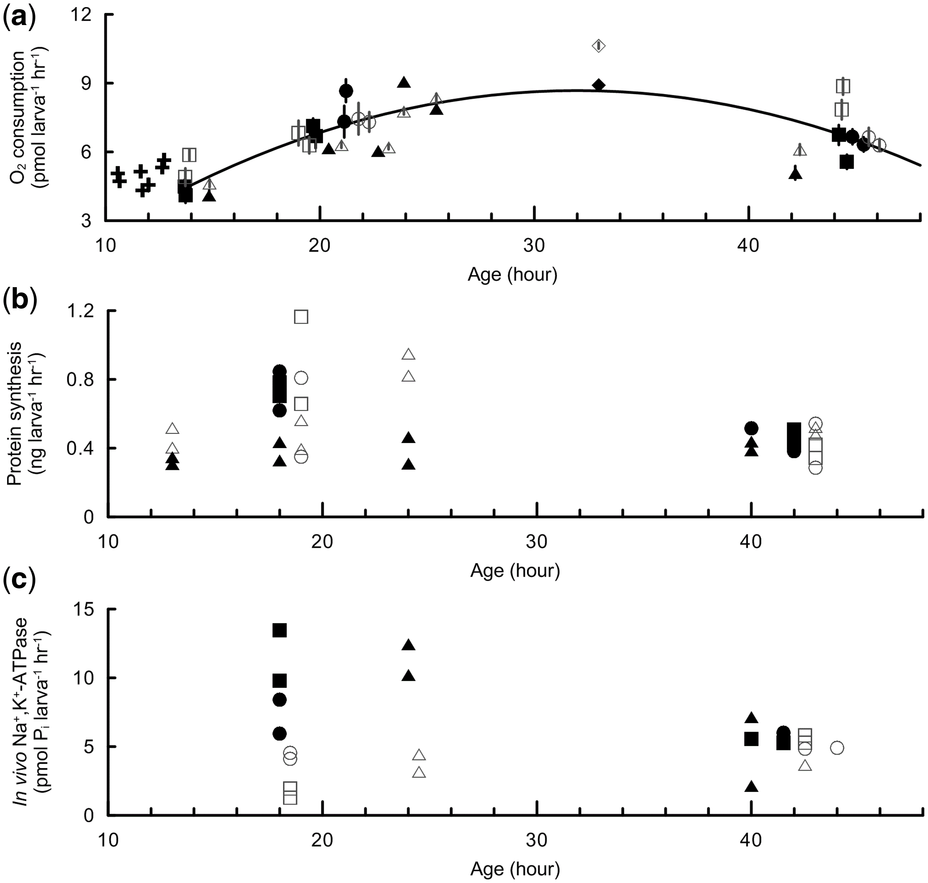
Figure 5. (a) Oxygen consumption rate (pmol O₂ larva⁻¹ h⁻¹) of C. gigas during the ...
Notes:
Figure 5. (a) Oxygen consumption rate (pmol O2 larva−1 h−1) of C. gigas during the trochophore-to-veliger transition at control conditions (filled) and aragonite undersaturation (open). Each data point represents the average oxygen consumption rate from 7 to 10 biological-oxygen-demand incubations initiated with larvae from a replicate culture vessel. Different symbols represent different larval families: Family 2 (circle), Family 8 (square), Family 3 (triangle), Family 5 (diamond), and cross symbols are measurements not included in the polynomial model because measurements were taken prior to the onset of calcification. Solid line is second-order polynomial model from 15- to 48-h post-fertilization, regardless of aragonite saturation treatment (root-mean-square error = 0.98). Total oxygen consumption during this time period was 248 pmol O2 larva−1. The standard error among biological-oxygen-demand respiration vials ranged from 0.01 to 0.69. (b) Absolute rates of PS in larvae of C. gigas exposed to control (filled) and aragonite undersaturation (open) conditions. Different symbols represent different larval families (same as in a). Each data point represents the slope of a single PS assay. (c) In vivo Na+,K+-ATPase activity in larvae of C. gigas exposed to control conditions and aragonite undersaturation. Data point symbols refer to different larval families (same as in panel a). For overlapping data points, offsets along the x-axis have been made for visual purposes, but at no more than 1 h.
Unless provided in the caption above, the following copyright applies to the content of this slide: © International Council for the Exploration of the Sea 2016. All rights reserved. For Permissions, please email: journals.permissions@oup.comThis article is published and distributed under the terms of the Oxford University Press, Standard Journals Publication Model (https://academic.oup.com/journals/pages/open_access/funder_policies/chorus/standard_publication_model)

Slide 6
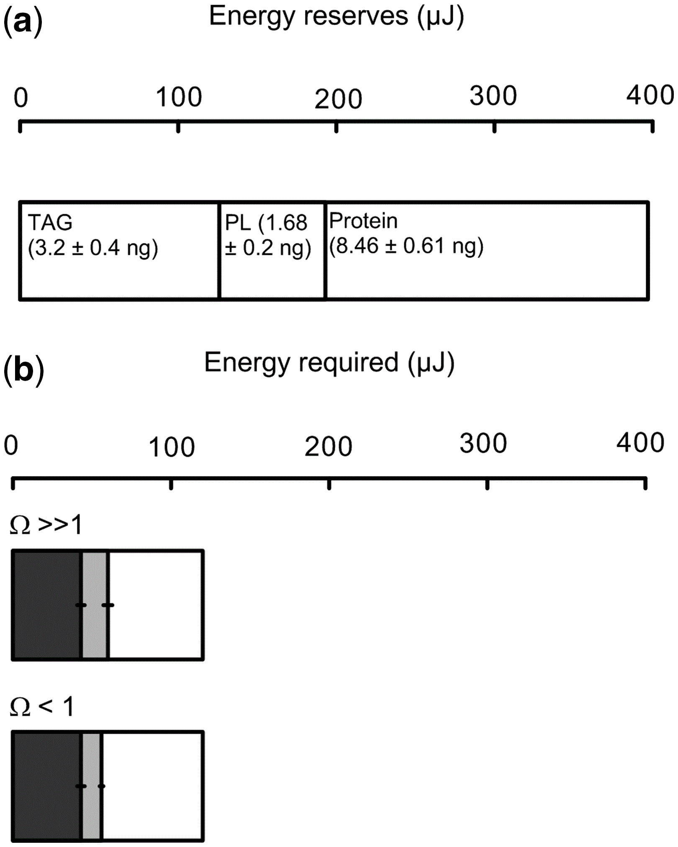
Figure 6. (a) Energy reserves (µJ) based on biochemical composition of larvae of C. gigas at 18-h post-fertilization ...
Notes:
Figure 6. (a) Energy reserves (µJ) based on biochemical composition of larvae of C. gigas at 18-h post-fertilization for triacylglycerols (TAG), phospholipids (PL), and protein. Values in parentheses are measured amounts (±SE) converted to energy equivalents (µJ). There was no effect of aragonite undersaturation treatment on measured biochemical content. (b) Energy required during the trochophore-to-veliger transition. Energy equivalents (µJ) for protein synthesis (dark grey) and in vivo Na+,K+-ATPase activity (light grey) in larvae of C. gigas exposed to control conditions (Ω ≫ 1 at 2.77) and aragonite undersaturation (Ω < 1 at 0.77). Energy allocated from the total ATP pool was calculated from concurrent measurements of protein synthesis, in vivo Na+,K+-ATPase, and respiration rate (Figure 5). The amount of energy remaining for other ATP-consuming processes is indicated by the white section of each horizontal stacked bar. Data plotted as the average ± SE.
Unless provided in the caption above, the following copyright applies to the content of this slide: © International Council for the Exploration of the Sea 2016. All rights reserved. For Permissions, please email: journals.permissions@oup.comThis article is published and distributed under the terms of the Oxford University Press, Standard Journals Publication Model (https://academic.oup.com/journals/pages/open_access/funder_policies/chorus/standard_publication_model)

Slide 7
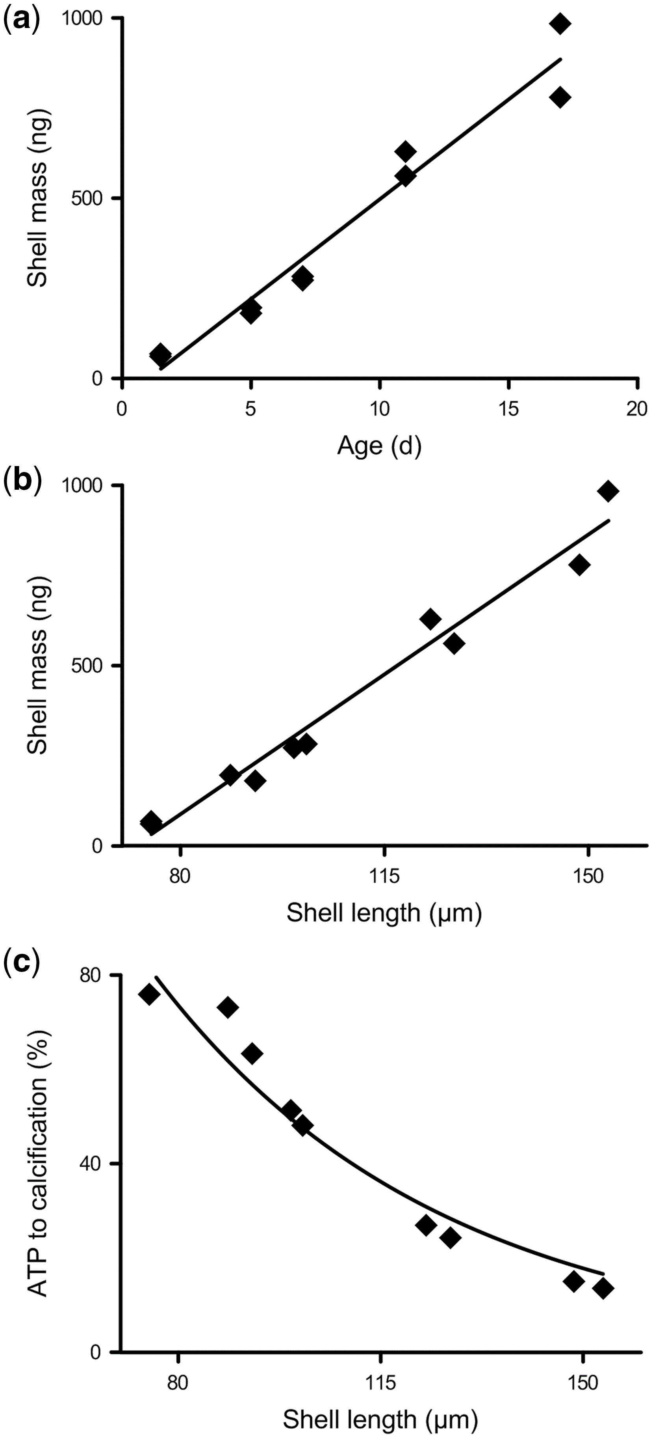
Figure 7. (a) Shell mass (ng) as a function of age (d post-fertilization) from measurements made between 2- and 17-d ...
Notes:
Figure 7. (a) Shell mass (ng) as a function of age (d post-fertilization) from measurements made between 2- and 17-d post-fertilization for larvae of C. gigas cultured at control conditions (Family 2). There is a linear relationship between shell mass and age (Shell mass = 57 × Age – 74). (b) Shell mass (ng) as a function of shell length (µm) (Shell mass = 11 × Shell length – 798). (c) The percent allocation of ATP to calcification as a function of shell length (µm). Rate of energy utilization (µJ larva−1 h−1) calculated from rates of oxygen consumption from this study (Figure 5a) and later stage larvae from Pace et al. (2006).
Unless provided in the caption above, the following copyright applies to the content of this slide: © International Council for the Exploration of the Sea 2016. All rights reserved. For Permissions, please email: journals.permissions@oup.comThis article is published and distributed under the terms of the Oxford University Press, Standard Journals Publication Model (https://academic.oup.com/journals/pages/open_access/funder_policies/chorus/standard_publication_model)

