Slide 1
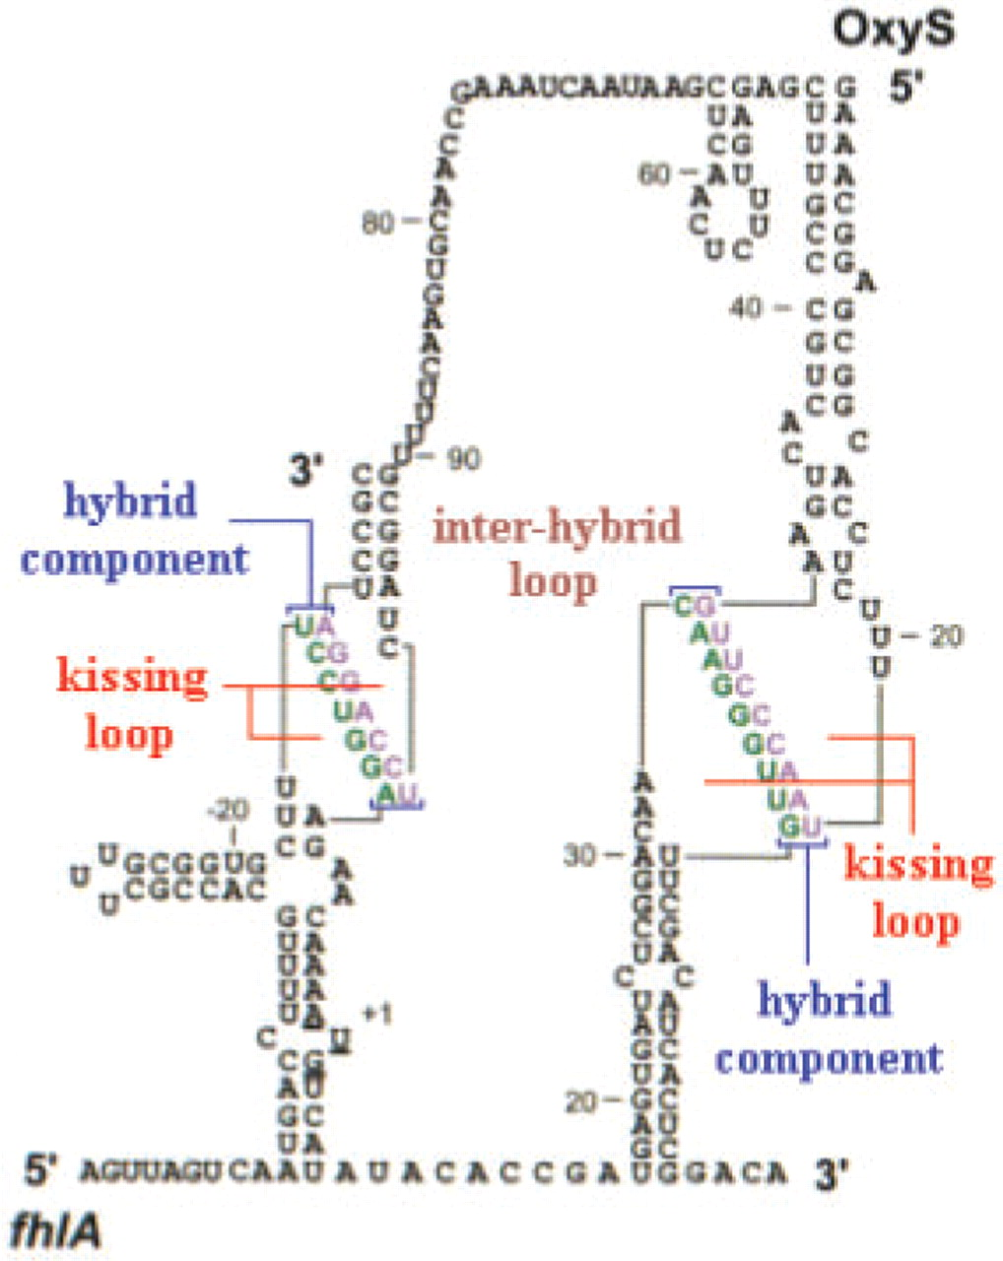
Fig. 1. Interaction components of OxyS–fhlA pair presented in Argaman and Altuvia (2000).
Notes:
Fig. 1. Interaction components of OxyS–fhlA pair presented in Argaman and Altuvia (2000).
Unless provided in the caption above, the following copyright applies to the content of this slide: © 2009 The Author(s)This is an Open Access article distributed under the terms of the Creative Commons Attribution Non-Commercial License (http://creativecommons.org/licenses/by-nc/2.0/uk/) which permits unrestricted non-commercial use, distribution, and reproduction in any medium, provided the original work is properly cited.

Slide 2
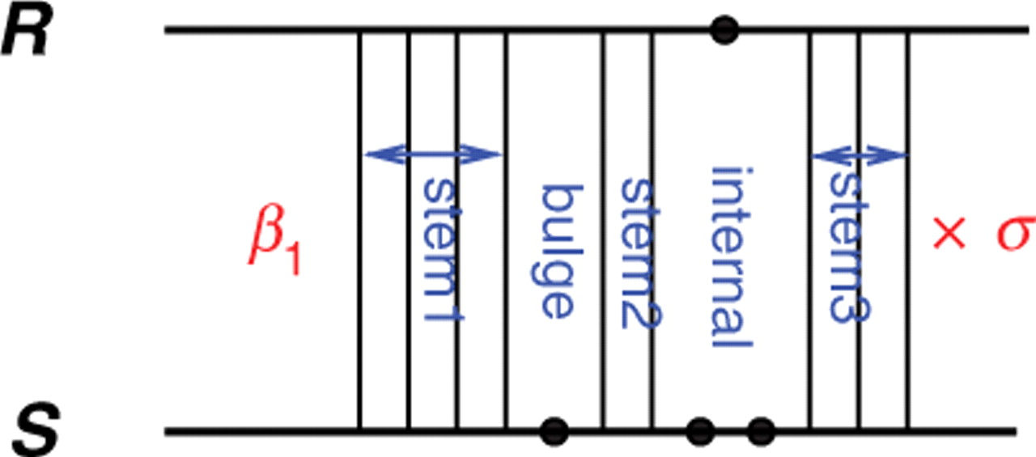
Fig. 2. A hybrid component between the two strands whose free energy is ...
Notes:
Fig. 2. A hybrid component between the two strands whose free energy is Ghybrid=β1+σ(Gstem1+Gbulge+Gstem2+Ginternal+Gstem3).
Unless provided in the caption above, the following copyright applies to the content of this slide: © 2009 The Author(s)This is an Open Access article distributed under the terms of the Creative Commons Attribution Non-Commercial License (http://creativecommons.org/licenses/by-nc/2.0/uk/) which permits unrestricted non-commercial use, distribution, and reproduction in any medium, provided the original work is properly cited.

Slide 3
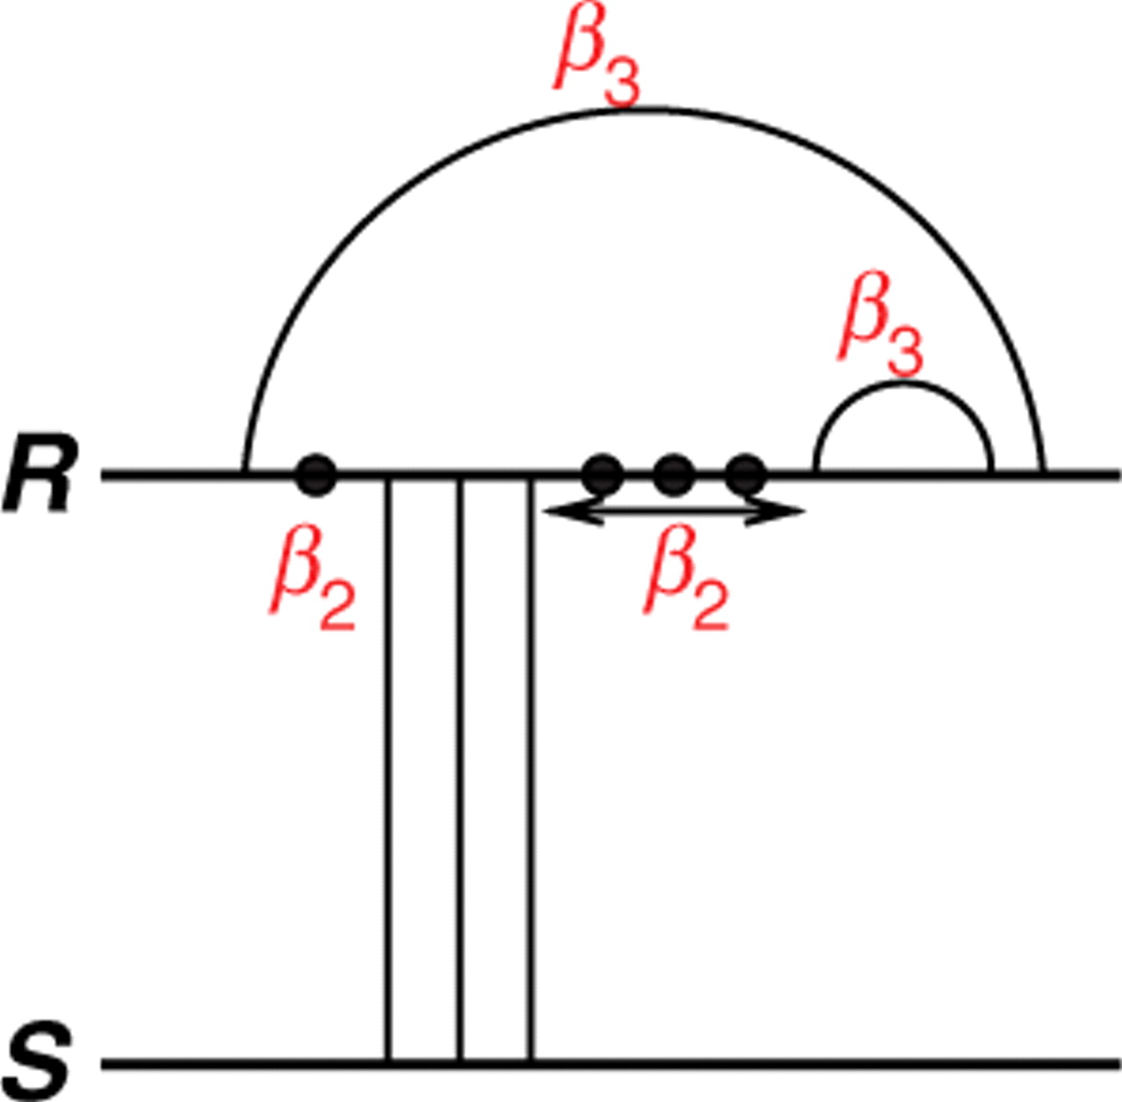
Fig. 3. A kissing loop in R that interacts with the other strand S. In this case, the free energy of the kissing loop ...
Notes:
Fig. 3. A kissing loop in R that interacts with the other strand S. In this case, the free energy of the kissing loop is Gkissing=4β2+2β3.
Unless provided in the caption above, the following copyright applies to the content of this slide: © 2009 The Author(s)This is an Open Access article distributed under the terms of the Creative Commons Attribution Non-Commercial License (http://creativecommons.org/licenses/by-nc/2.0/uk/) which permits unrestricted non-commercial use, distribution, and reproduction in any medium, provided the original work is properly cited.

Slide 4
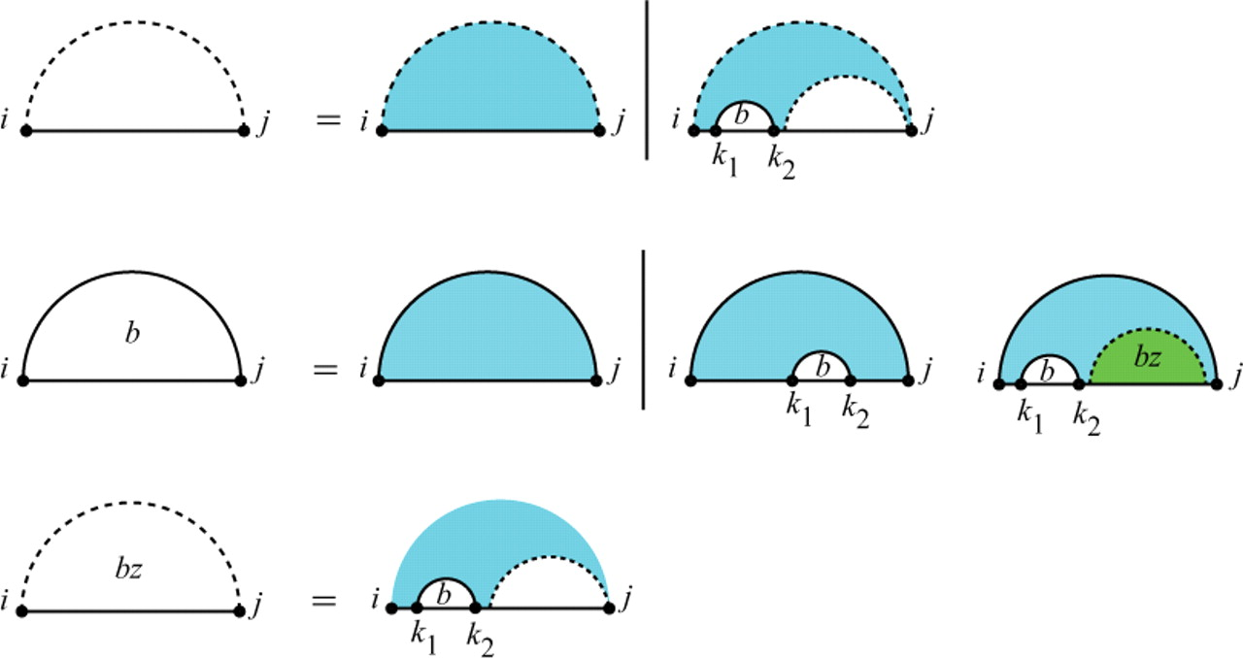
Fig. 4. McCaskill's algorithm: recursion for Q_{i,j}, the partition function for the subsequence [i, j]. ...
Notes:
Fig. 4. McCaskill's algorithm: recursion for Qi,j, the partition function for the subsequence [i, j]. Above, Qbi,j is the partition function for the subsequence [i, j] assuming i and j are base paired, and Qbzi,j is the partition function for the subsequence [i, j] assuming there is at least one arc in the region.
Unless provided in the caption above, the following copyright applies to the content of this slide: © 2009 The Author(s)This is an Open Access article distributed under the terms of the Creative Commons Attribution Non-Commercial License (http://creativecommons.org/licenses/by-nc/2.0/uk/) which permits unrestricted non-commercial use, distribution, and reproduction in any medium, provided the original work is properly cited.

Slide 5
Fig. 5. Cases of the interaction partition function Q^{I}_{<sub ...}
Notes:
Fig. 5. Cases of the interaction partition function QIiR,jR,iS,jS. The first case constitutes no bonds. In the second case, the leftmost bond is a direct bond on both subsequences. In the third case, the leftmost bond is covered by an interaction arc in at least one subsequence.
Unless provided in the caption above, the following copyright applies to the content of this slide: © 2009 The Author(s)This is an Open Access article distributed under the terms of the Creative Commons Attribution Non-Commercial License (http://creativecommons.org/licenses/by-nc/2.0/uk/) which permits unrestricted non-commercial use, distribution, and reproduction in any medium, provided the original work is properly cited.

Slide 6
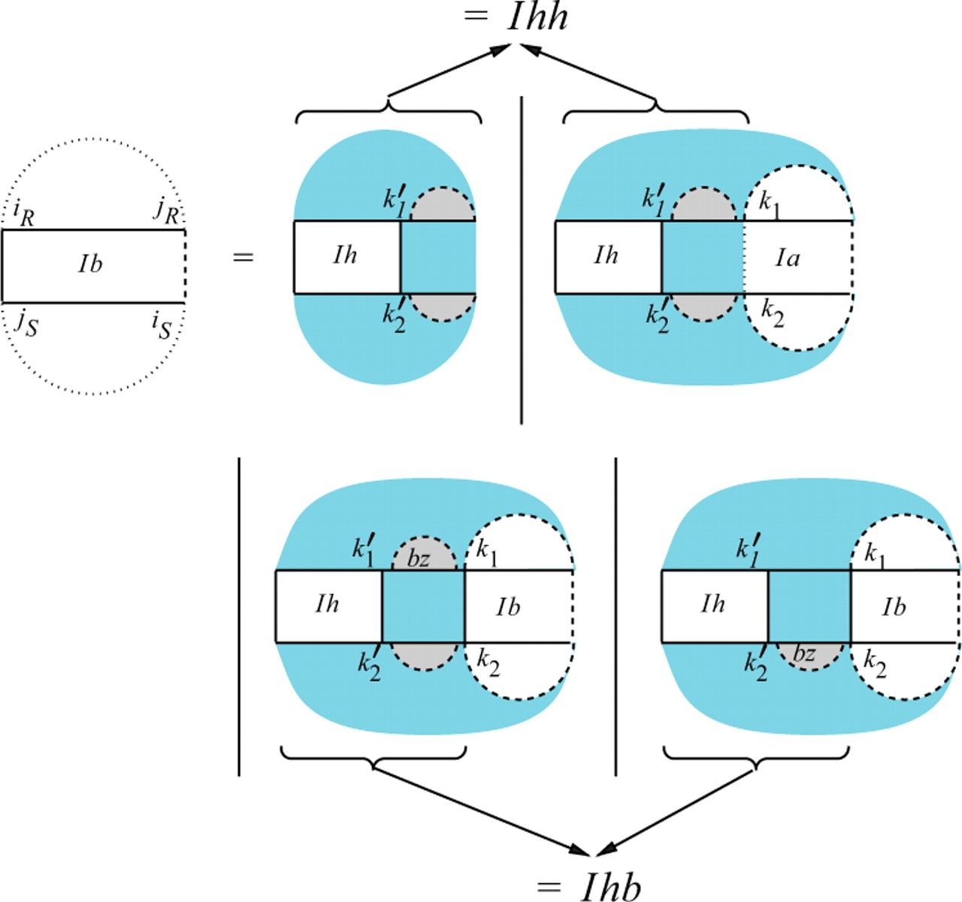
Fig. 6. Recursion for Q^{Ib}_{<sub ...}
Notes:
Fig. 6. Recursion for QIbiR,jR,iS,jS assuming iR○jS is a bond. We show a version of the recursion that contains two split points in each sequence for simplicity reasons. However, this would increase the complexity and can easily be resolved by introducing two additional matrices QIhh and QIhb for the region [iR,k1] × [k2, jS] as indicated by the arrows (see Supplementary Material for a full definition).
Unless provided in the caption above, the following copyright applies to the content of this slide: © 2009 The Author(s)This is an Open Access article distributed under the terms of the Creative Commons Attribution Non-Commercial License (http://creativecommons.org/licenses/by-nc/2.0/uk/) which permits unrestricted non-commercial use, distribution, and reproduction in any medium, provided the original work is properly cited.

Slide 7
Fig. 7. Cases of Q^{Ih}_{<sub ...}
Notes:
Fig. 7. Cases of QIhiR,jR,iS,jS the interaction partition function for a single hybrid component.
Unless provided in the caption above, the following copyright applies to the content of this slide: © 2009 The Author(s)This is an Open Access article distributed under the terms of the Creative Commons Attribution Non-Commercial License (http://creativecommons.org/licenses/by-nc/2.0/uk/) which permits unrestricted non-commercial use, distribution, and reproduction in any medium, provided the original work is properly cited.

Slide 8
Fig. 8. Cases of Q^{Ia}_{<sub ...}
Notes:
Fig. 8. Cases of QIaiR,jR,iS,jS, for which we assume at least one of iR and jS is the end point of an interaction arc.
Unless provided in the caption above, the following copyright applies to the content of this slide: © 2009 The Author(s)This is an Open Access article distributed under the terms of the Creative Commons Attribution Non-Commercial License (http://creativecommons.org/licenses/by-nc/2.0/uk/) which permits unrestricted non-commercial use, distribution, and reproduction in any medium, provided the original work is properly cited.

Slide 9
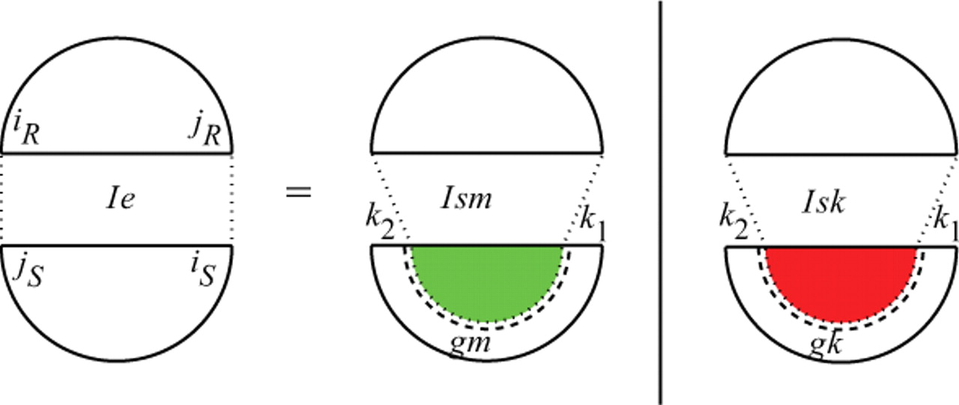
Fig. 9. Cases of Q^{Ie}_{<sub ...}
Notes:
Fig. 9. Cases of QIeiR,jR,iS,jS, for which iR•jR and iS•jS are equivalent interaction arcs.
Unless provided in the caption above, the following copyright applies to the content of this slide: © 2009 The Author(s)This is an Open Access article distributed under the terms of the Creative Commons Attribution Non-Commercial License (http://creativecommons.org/licenses/by-nc/2.0/uk/) which permits unrestricted non-commercial use, distribution, and reproduction in any medium, provided the original work is properly cited.

Slide 10
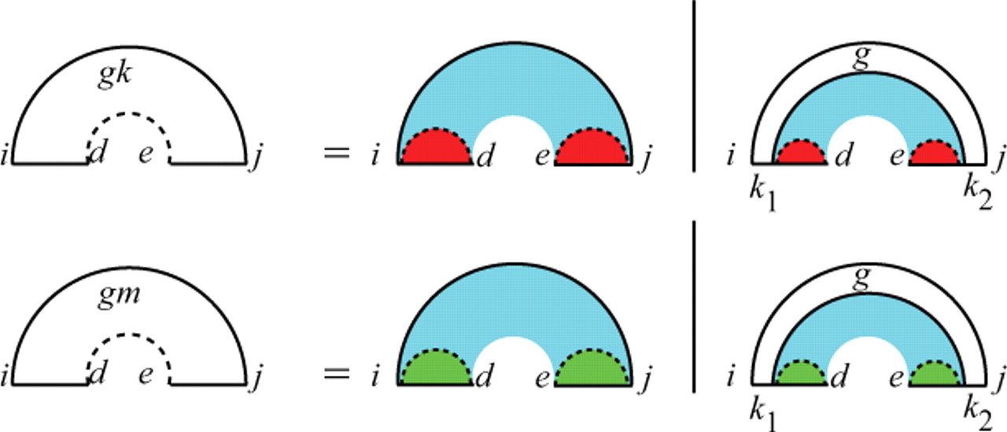
Fig. 10. Recursion for Q^{gk}_{i,d,e,j} and Q<sup ...
Notes:
Fig. 10. Recursion for Qgki,d,e,j and Qgmi,d,e,j, the partition functions for [i, j] excluding the gap [d, e], assuming i and j are base paired. The gap in Qgk is assumed to contain a direct bond hence the red color, and the gap in Qgm is assumed to contain multiple interaction arcs hence the green color. In both cases, i<k1≤d and e≤k2<j.
Unless provided in the caption above, the following copyright applies to the content of this slide: © 2009 The Author(s)This is an Open Access article distributed under the terms of the Creative Commons Attribution Non-Commercial License (http://creativecommons.org/licenses/by-nc/2.0/uk/) which permits unrestricted non-commercial use, distribution, and reproduction in any medium, provided the original work is properly cited.

Slide 11
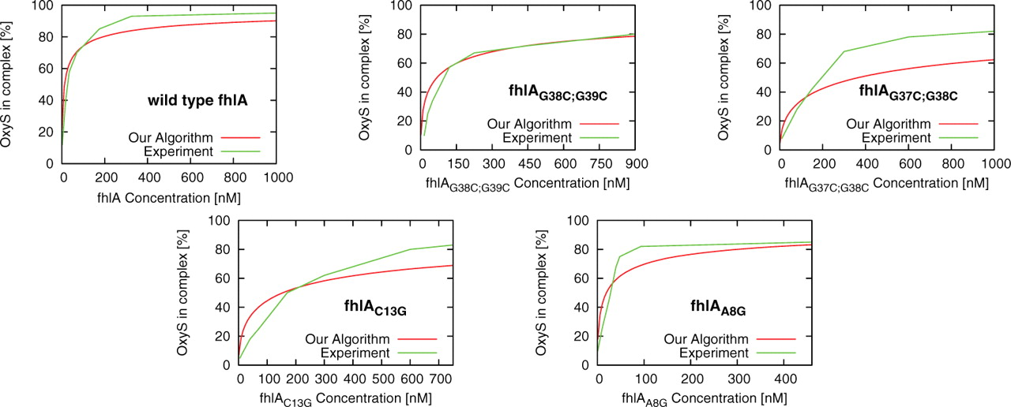
Fig. 11. Experimental and computational determination of equilibrium constants for pairs of OxyS with wild-type and ...
Notes:
Fig. 11. Experimental and computational determination of equilibrium constants for pairs of OxyS with wild-type and mutated fhlA. Horizontal axis denotes the initial concentration of fhlA, and the vertical axis denotes the percentage of OxyS in OxyS–fhlA complex. Initial concentration of OxyS was 2 × 10−9 M (Argaman and Altuvia, 2000). Both RNAcofold and UNAFold predict that the percentage of OxyS in complex is approximately 0 for the considered fhlA concentrations.
Unless provided in the caption above, the following copyright applies to the content of this slide: © 2009 The Author(s)This is an Open Access article distributed under the terms of the Creative Commons Attribution Non-Commercial License (http://creativecommons.org/licenses/by-nc/2.0/uk/) which permits unrestricted non-commercial use, distribution, and reproduction in any medium, provided the original work is properly cited.

