Slide 1
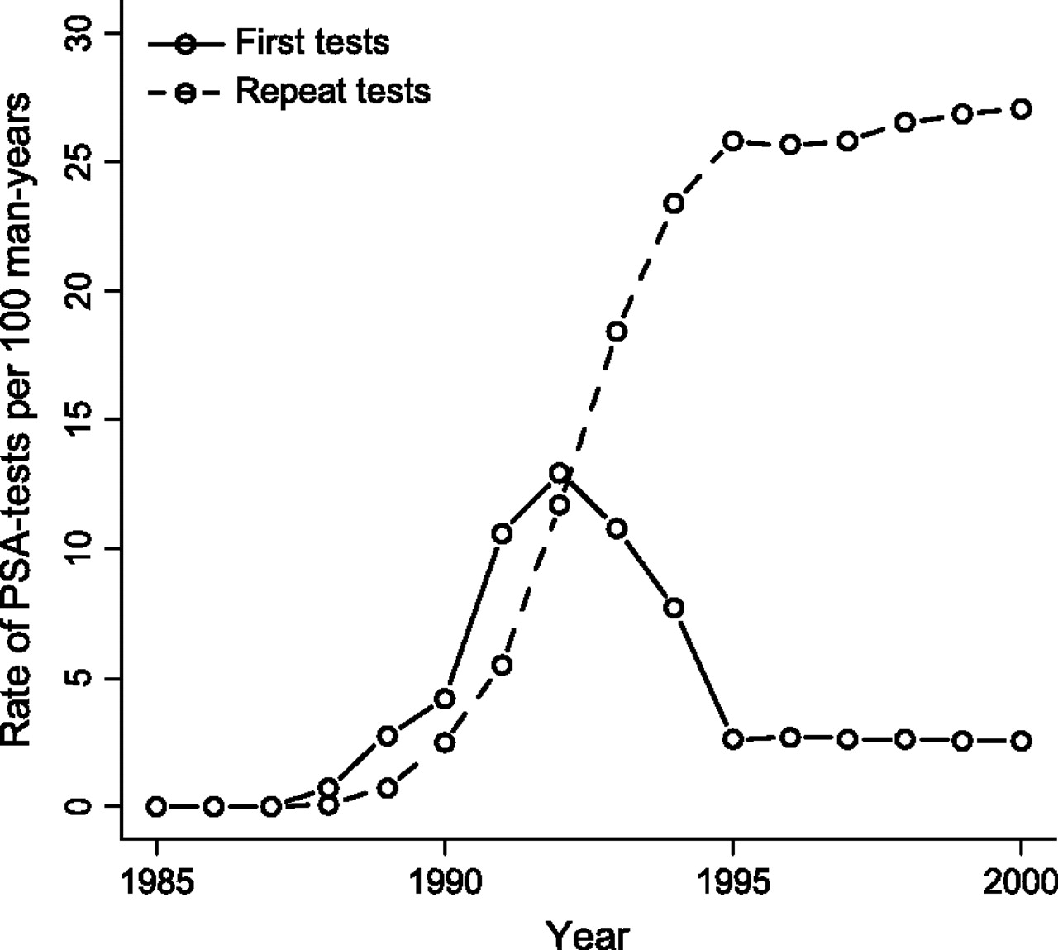
Figure 1 Frequency of first prostate-specific antigen (PSA) tests and repeat tests in the US population as generated ...
Notes:
Figure 1 Frequency of first prostate-specific antigen (PSA) tests and repeat tests in the US population as generated by microsimulation screening analysis (MISCAN). The frequencies are for men aged 50–84 years.
Unless provided in the caption above, the following copyright applies to the content of this slide: © The Author 2010. Published by Oxford University Press.This is an Open Access article distributed under the terms of the Creative Commons Attribution Non-Commercial License (http://creativecommons.org/licenses/by-nc/2.5), which permits unrestricted non-commercial use, distribution, and reproduction in any medium, provided the original work is properly cited.

Slide 2
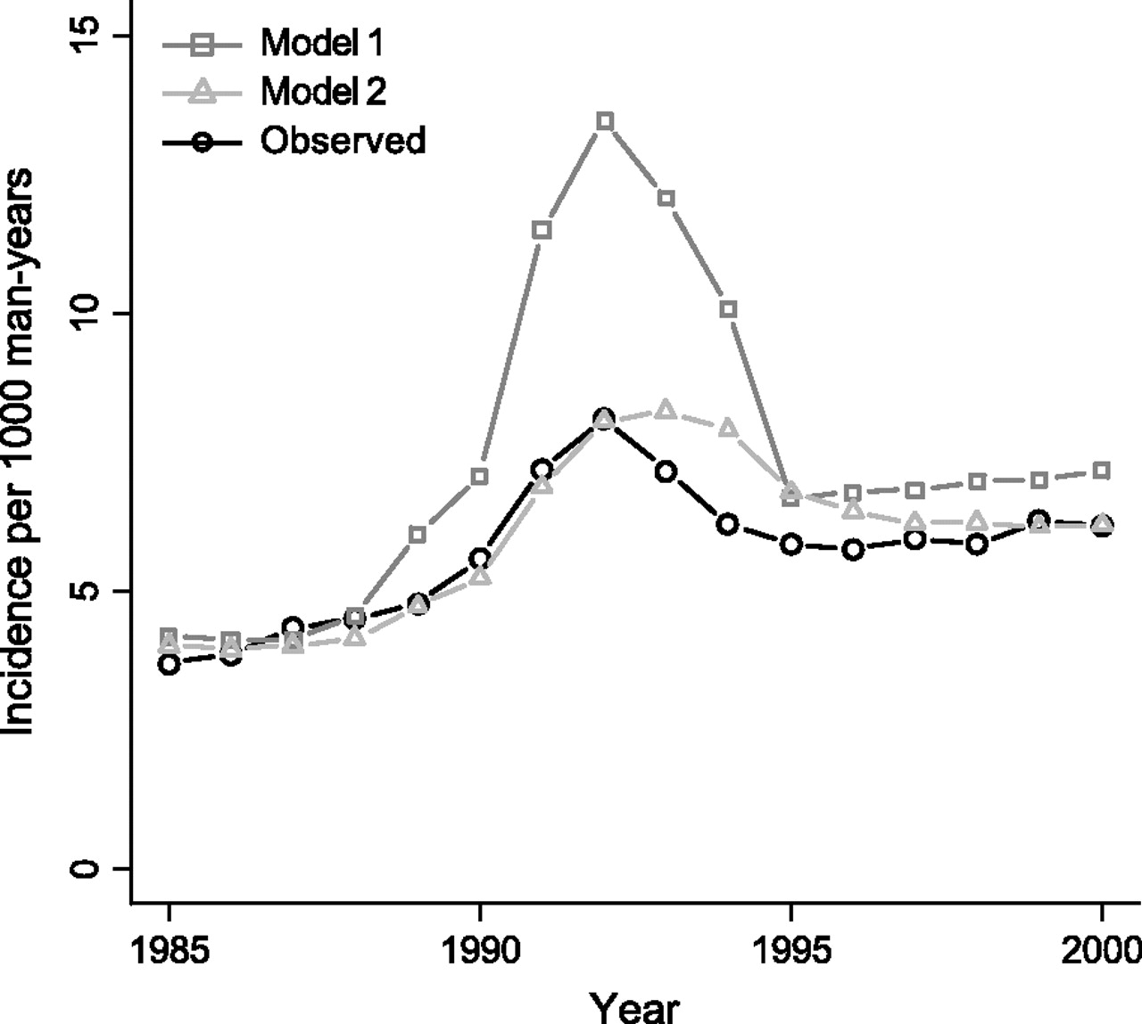
Figure 2 Observed and predicted age-adjusted incidence per 1000 man-years for men aged 50–84 years in the US models. ...
Notes:
Figure 2 Observed and predicted age-adjusted incidence per 1000 man-years for men aged 50–84 years in the US models. In model 1, prostate-specific antigen (PSA) screening in the US population is the same as in the Rotterdam section of the European Randomized Study of Screening for Prostate Cancer (ERSPC–Rotterdam). In model 2, the sensitivity of PSA screening is lower in the US population than in ERSPC–Rotterdam.
Unless provided in the caption above, the following copyright applies to the content of this slide: © The Author 2010. Published by Oxford University Press.This is an Open Access article distributed under the terms of the Creative Commons Attribution Non-Commercial License (http://creativecommons.org/licenses/by-nc/2.5), which permits unrestricted non-commercial use, distribution, and reproduction in any medium, provided the original work is properly cited.

