Slide 1
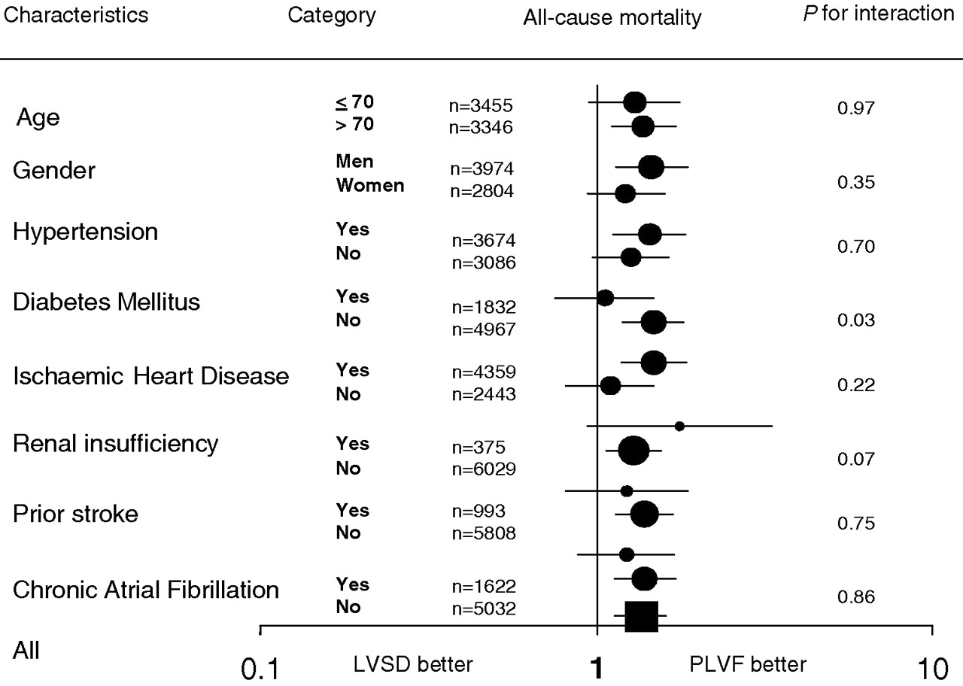
Fig. 2 Relation between left ventricular systolic function and mortality in subgroup of patients according to ...
Notes:
Fig. 2 Relation between left ventricular systolic function and mortality in subgroup of patients according to patient characteristics. Adjusted for age, gender, hypertension, diabetes, ischaemic heart disease, renal failure, prior stroke, chronic atrial fibrillation and pharmacological treatment.
Unless provided in the caption above, the following copyright applies to the content of this slide:

Slide 2
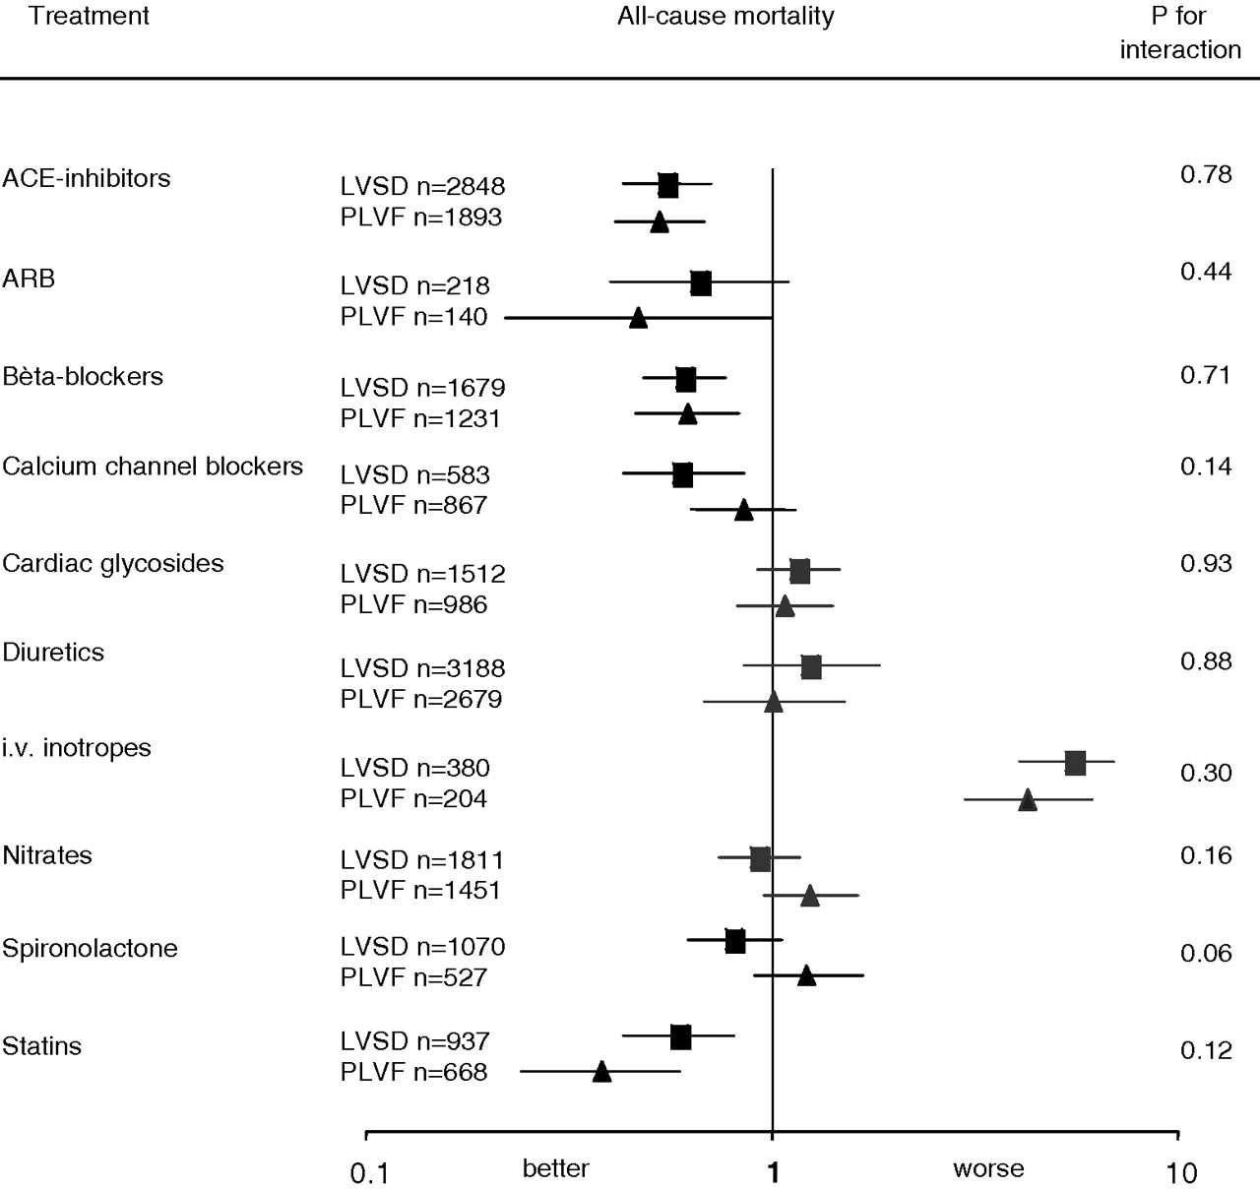
Fig. 1 All cause mortality with respect to pharmacological treatment. Adjusted for age, gender, hypertension, ...
Notes:
Fig. 1 All cause mortality with respect to pharmacological treatment. Adjusted for age, gender, hypertension, diabetes, ischaemic heart disease, renal failure, prior stroke, chronic atrial fibrillation and pharmacological treatment. LVSD: left ventricular systolic dysfunction PLVF: preserved left ventricular function.
Unless provided in the caption above, the following copyright applies to the content of this slide:

