Slide 1
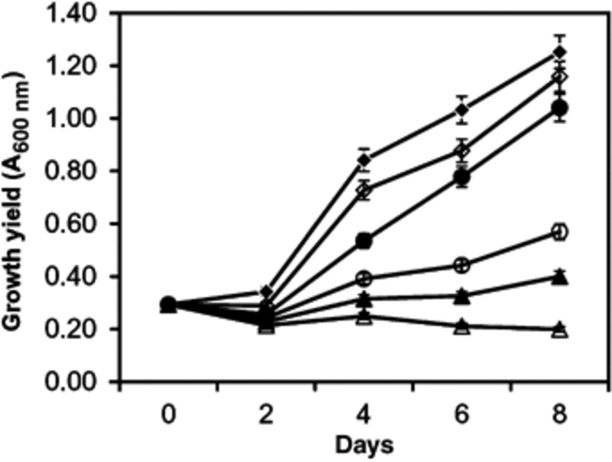
1 Concentration-dependent growth inhibition of Chlamydomonas sp. strain Ev-29 by the crude extract of ...
Notes:
1 Concentration-dependent growth inhibition of Chlamydomonas sp. strain Ev-29 by the crude extract of Fischerella sp. strain 52-1 from the culture liquid. Chlamydomonas cells were grown in the presence of the following concentrations of Fischerella extract: 500 (△), 50 (▲), 25 (○), 12 (●) and 5 μg mL−1 (◆); control (◊). The controls contained the solvent only. Vertical bars are SEs generated from the mean of three replicates.
Unless provided in the caption above, the following copyright applies to the content of this slide: © 2008 Federation of European Microbiological Societies Published by Blackwell Publishing Ltd

Slide 2
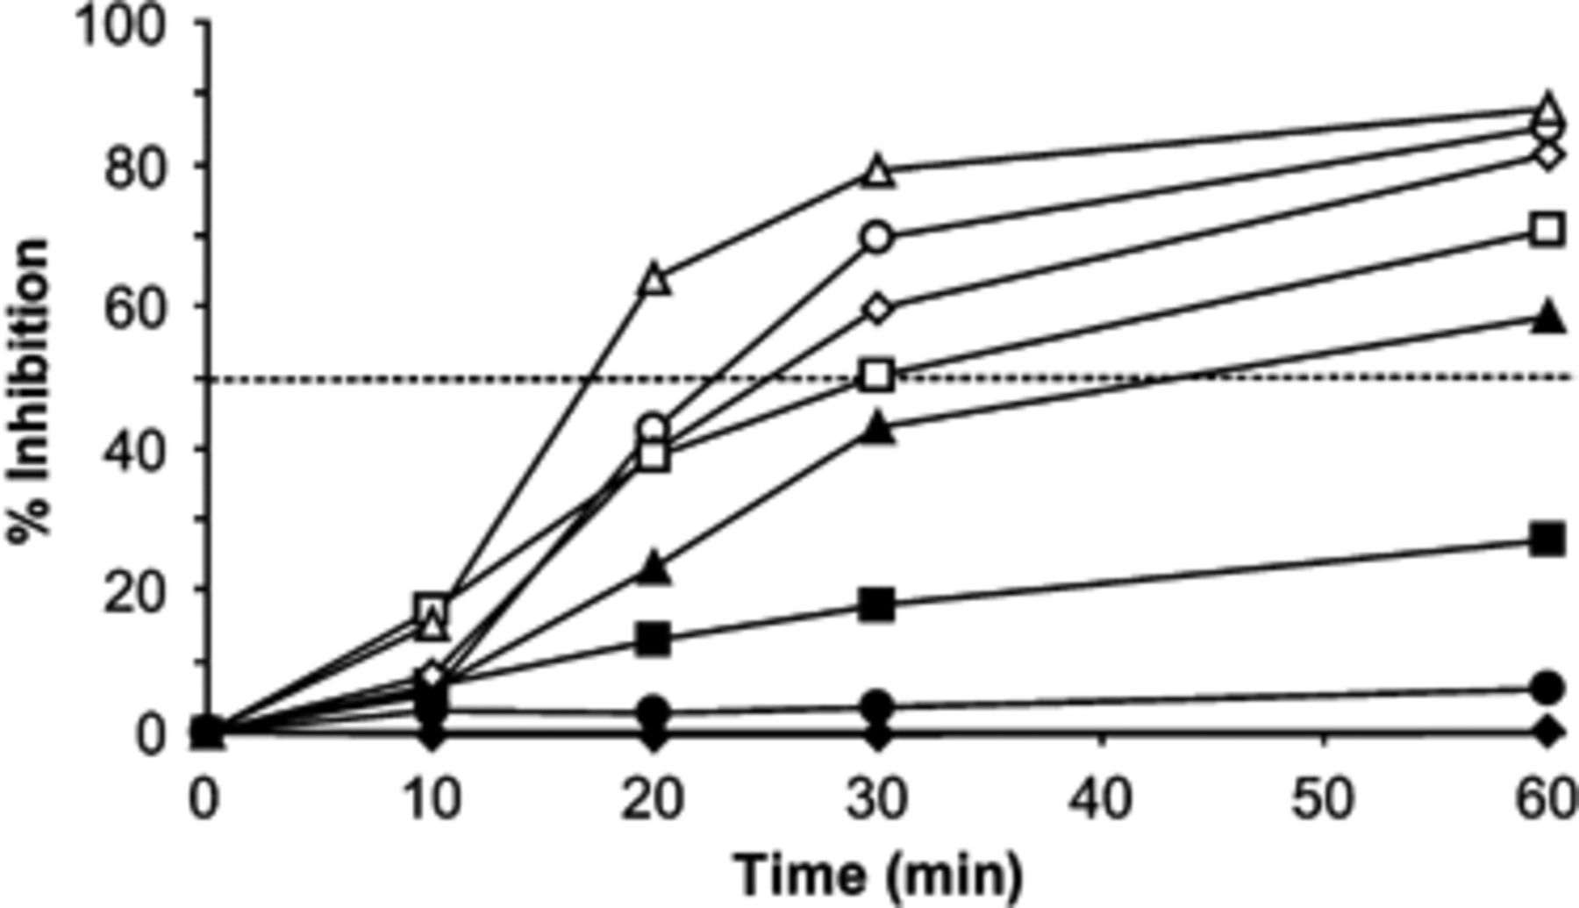
2 Inhibition of photosynthesis in Chlamydomonas sp. strain Ev-29 by the lipophilic extract of Fischerella sp. ...
Notes:
2 Inhibition of photosynthesis in Chlamydomonas sp. strain Ev-29 by the lipophilic extract of Fischerella sp. strain 52-1. Inhibition was dependent on extract concentration and time. The crude extract was obtained from the culture liquid and dry residue dissolved in ethyl alcohol. The following concentrations of Fischerella crude extract were used: 30 (△), 20 (○), 10 (◊), 7.5 (◻), 5 (▲), 3 (▪), 1 (●) and 0.1 μg mL−1 (◆).
Unless provided in the caption above, the following copyright applies to the content of this slide: © 2008 Federation of European Microbiological Societies Published by Blackwell Publishing Ltd

Slide 3
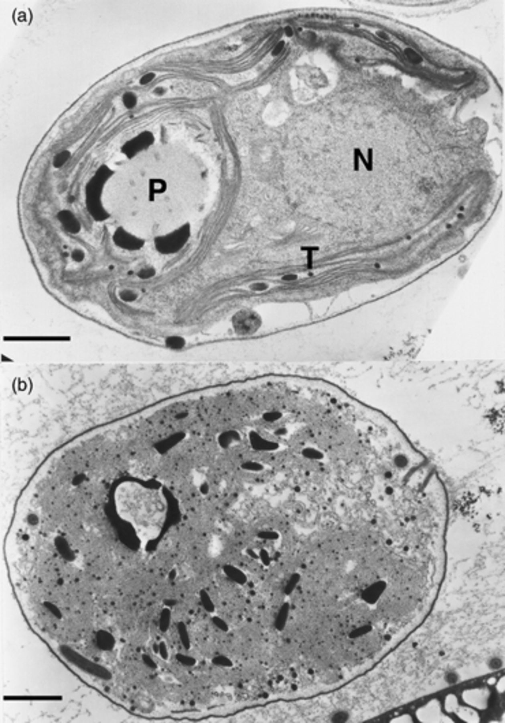
3 (a) Electron micrographs showing normal cells of Chlamydomonas sp. strain Ev-29 and (b) disintegration of ...
Notes:
3 (a) Electron micrographs showing normal cells of Chlamydomonas sp. strain Ev-29 and (b) disintegration of cell structures after 24 h of exposure to the crude toxin extract from the culture liquid of Fischerella sp. strain 52-1. N, nucleus; T, tylakoids; P, pyrenoid. Scale bar, 1 μm.
Unless provided in the caption above, the following copyright applies to the content of this slide: © 2008 Federation of European Microbiological Societies Published by Blackwell Publishing Ltd

