Slide 1
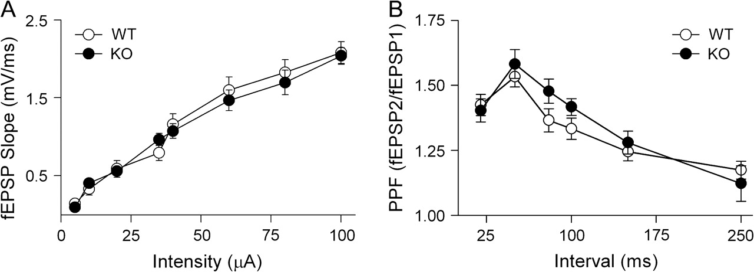
Figure 1. Baseline synaptic transmission is normal in D₁R^{−/−} mice. (A) fEPSP slope values across ...
Notes:
Figure 1. Baseline synaptic transmission is normal in D1R−/− mice. (A) fEPSP slope values across stimulus intensities. Open circles indicate WT slices (n = 14), and filled circles indicate D1R−/− slices (n = 11). (B) Paired-pulse facilitation ratio (second fEPSP slope/first fEPSP slope) evoked at different interstimulus intervals. WT (open circles, n = 11); D1R−/− (filled circles, n = 10).
Unless provided in the caption above, the following copyright applies to the content of this slide: © 2007 The AuthorsThis is an Open Access article distributed under the terms of the Creative Commons Attribution Non-Commercial License (http://creativecommons.org/licenses/by-nc/2.0/uk/) which permits unrestricted non-commercial use, distribution, and reproduction in any medium, provided the original work is properly cited.

Slide 2
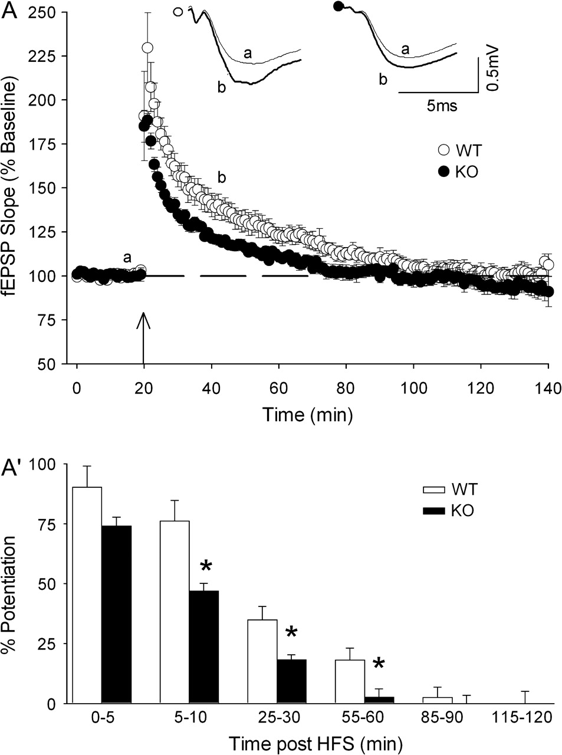
Figure 2. E-LTP magnitude is reduced in D₁R^{−/−} mice. (A) Time course of fEPSP changes induced by ...
Notes:
Figure 2. E-LTP magnitude is reduced in D1R−/− mice. (A) Time course of fEPSP changes induced by a single HFS train (100 Hz, 1 s) applied (arrow) in slices from WT mice (open circles, n = 6) and D1R−/− mice (filled circles, n = 5). The upper traces show representative averages of 8 consecutive fEPSPs recorded at the times indicated by the letters on the graph. (A') Bars represent means ± standard error of mean of fEPSP potentiation recorded in 5-min periods after tetanus, taken from the data in (A) (* indicates P < 0.05, Student's t-test).
Unless provided in the caption above, the following copyright applies to the content of this slide: © 2007 The AuthorsThis is an Open Access article distributed under the terms of the Creative Commons Attribution Non-Commercial License (http://creativecommons.org/licenses/by-nc/2.0/uk/) which permits unrestricted non-commercial use, distribution, and reproduction in any medium, provided the original work is properly cited.

Slide 3
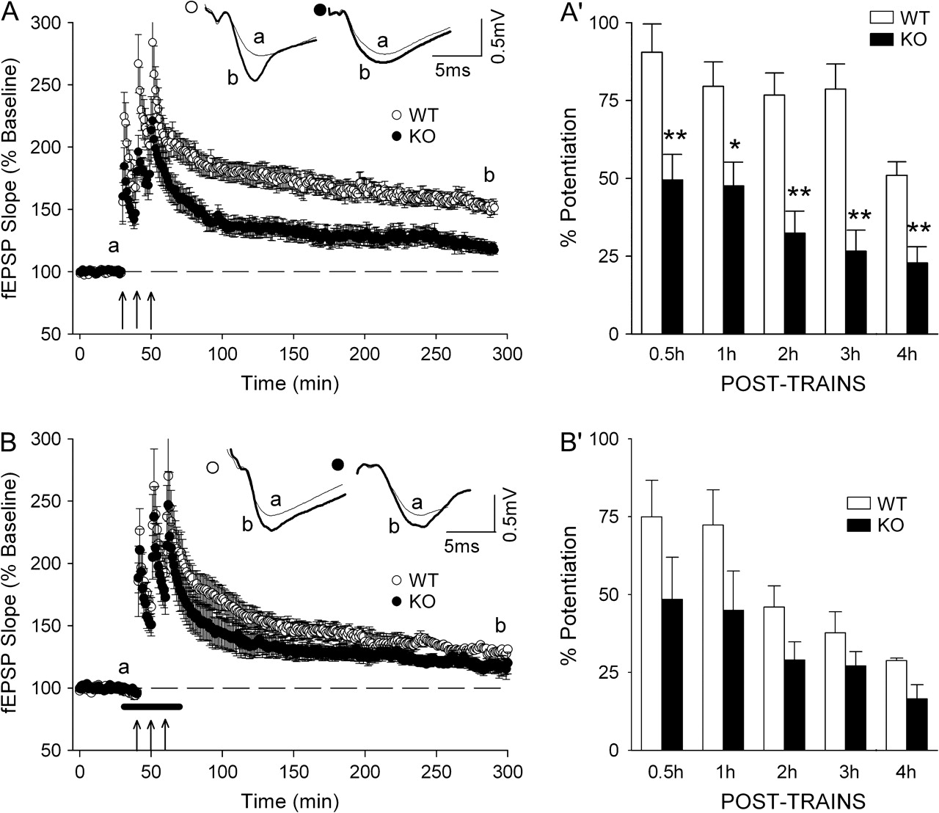
Figure 3. Genetic inactivation of D₁R has the same effect on L-LTP magnitude as pharmacological inhibition ...
Notes:
Figure 3. Genetic inactivation of D1R has the same effect on L-LTP magnitude as pharmacological inhibition with a D1/D5R antagonist. (A) The plots summarize the time course of fEPSP changes induced by 3 HFS trains (arrows) in slices from WT (open circles, n = 10) and D1R−/− (filled circles, n = 6) mice. (A') Comparison of fEPSP potentiation level at different times after tetanus in the experiments shown in (A) (*P < 0.05, **P < 0.01; Bonferroni's test). (B, B') show results of experiments similar to that depicted in (A, A'), respectively, but the tetanization protocol was delivered in the presence (horizontal filled bar) of 0.1 μM SCH23390, a D1/D5 antagonist. WT (open circles, n = 5) and D1R−/− (filled circles, n = 5). The upper traces in (A, B) show representative averaged fEPSPs evoked at the indicated times during one representative experiment for each experimental condition.
Unless provided in the caption above, the following copyright applies to the content of this slide: © 2007 The AuthorsThis is an Open Access article distributed under the terms of the Creative Commons Attribution Non-Commercial License (http://creativecommons.org/licenses/by-nc/2.0/uk/) which permits unrestricted non-commercial use, distribution, and reproduction in any medium, provided the original work is properly cited.

Slide 4
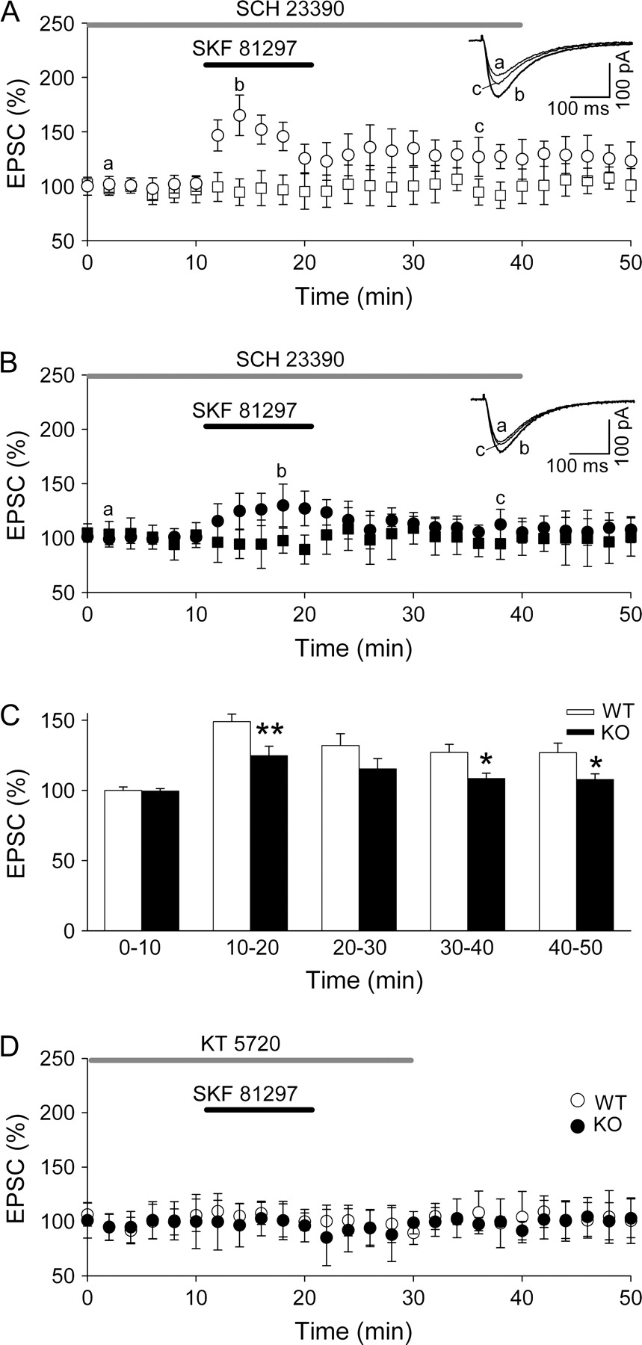
Figure 4. Inactivation of D₁R reduces the D₁/D₅R agonist–induced NMDA EPSC amplitude ...
Notes:
Figure 4. Inactivation of D1R reduces the D1/D5R agonist–induced NMDA EPSC amplitude enhancement through a PKA-mediated mechanism. (A) Time course of 50 μM SKF81297 effects on normalized mean EPSC amplitudes evoked by SCC stimulation in control (open circles, n = 6) and in the presence of 5 μM SCH23390 (open squares, n = 4) in slices from WT mice. Inset shows averaged EPSCs (n = 10), recorded before (a), during (b), and after (c) SKF81297 perfusion in the absence of SCH23390. (B) Summary data and averaged EPSCs (inset) show the 50 μM SKF81297 effects in control (filled circles, n = 6) and in the presence of 5 μM SCH23390 (filled squares, n = 4) in slices from D1R−/− mice. (C) Means of normalized EPSC amplitudes recorded in 10-min periods before and after SKF81297 perfusion in the absence of SCH23390 in WT and D1R−/− mice, taken from the data in (A, B). Significant differences between WT and D1R−/− mice were established at *P < 0.05 and **P < 0.01 (Student's t-test). (D) Summary data of 50 μM SKF81297 effects in the presence of 1 μM KT5720 in slices from WT (open circles, n = 4) and D1R−/− mice (filled circle, n = 4). In all experiments, superfusion of drugs started 10 min before SKF81297 was applied, and values are given as the mean ± standard error of mean.
Unless provided in the caption above, the following copyright applies to the content of this slide: © 2007 The AuthorsThis is an Open Access article distributed under the terms of the Creative Commons Attribution Non-Commercial License (http://creativecommons.org/licenses/by-nc/2.0/uk/) which permits unrestricted non-commercial use, distribution, and reproduction in any medium, provided the original work is properly cited.

Slide 5
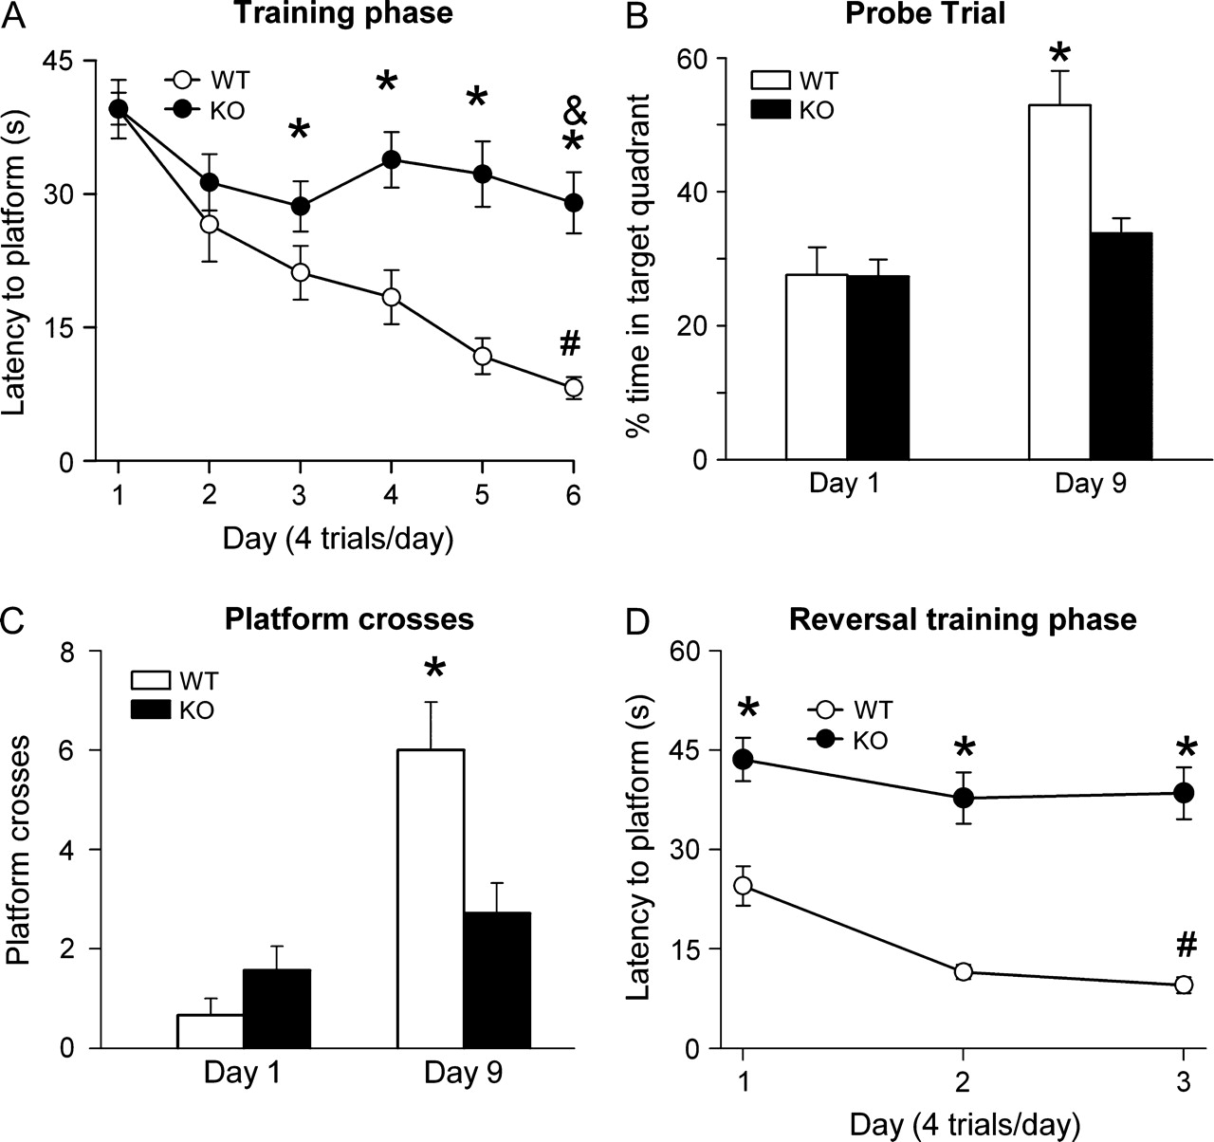
Figure 5. Hippocampus-dependent learning is impaired in dopamine D₁R^{−/−} mice. (A) Escape latency ...
Notes:
Figure 5. Hippocampus-dependent learning is impaired in dopamine D1R−/− mice. (A) Escape latency during the training phase in the Morris water maze for WT and D1R−/− mice. Data show the mean values ± standard error of mean, *P < 0.005, Tuckey's test. (B) Probe trial performed 3 days after the training phase to evaluate memory consolidation. Histograms represent the percentage of time spent in the target quadrants during the probe trial (60 s), *P < 0.05, Student's t-test. (C) Number of crosses over the former platform location during the probe trial in the beginning of the training phase (day 1) and in the probe trial (day 9), *P < 0.01, Student's t-test. (D) Escape latency during the relearning phase (60-s trials). For this test, the platform was located in the opposite quadrant to the training phase, *P < 0.001, n = 15, Tuckey's test.
Unless provided in the caption above, the following copyright applies to the content of this slide: © 2007 The AuthorsThis is an Open Access article distributed under the terms of the Creative Commons Attribution Non-Commercial License (http://creativecommons.org/licenses/by-nc/2.0/uk/) which permits unrestricted non-commercial use, distribution, and reproduction in any medium, provided the original work is properly cited.

Slide 6
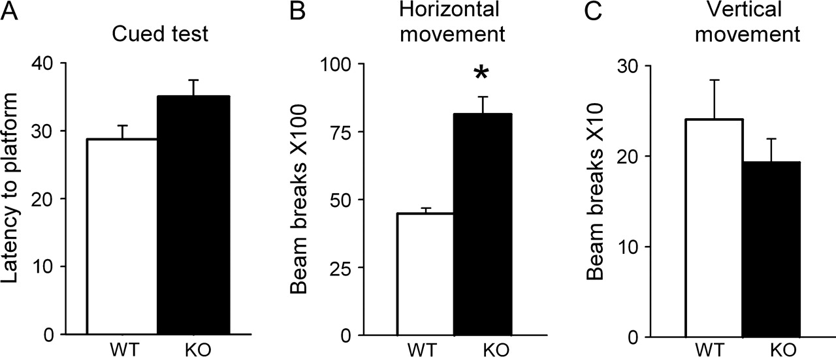
Figure 6. Locomotion and visual acuity are not impaired in D₁R^{−/−} mice. Histograms illustrate (A) ...
Notes:
Figure 6. Locomotion and visual acuity are not impaired in D1R−/− mice. Histograms illustrate (A) that D1R−/− and WT mice have similar escape latencies with the visible platform in the Morris water maze, cued test. (B, C): horizontal (B) and vertical (C) locomotor activity during 60 min. (*P < 0.001, n = 22, Student's t-test).
Unless provided in the caption above, the following copyright applies to the content of this slide: © 2007 The AuthorsThis is an Open Access article distributed under the terms of the Creative Commons Attribution Non-Commercial License (http://creativecommons.org/licenses/by-nc/2.0/uk/) which permits unrestricted non-commercial use, distribution, and reproduction in any medium, provided the original work is properly cited.

Slide 7
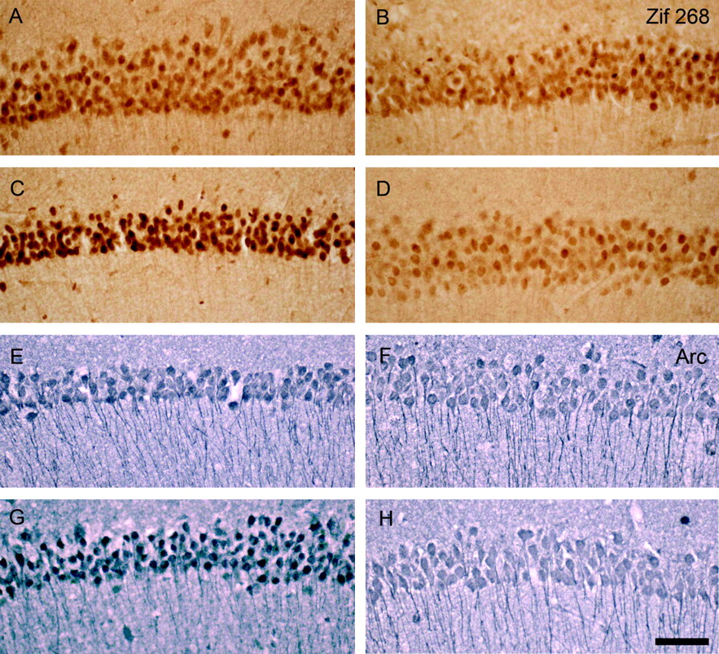
Figure 7. D₁R is required for activity-induced Zif268 and Arc expression in CA1 pyramidal cells after HFS of ...
Notes:
Figure 7. D1R is required for activity-induced Zif268 and Arc expression in CA1 pyramidal cells after HFS of Schaffer collaterals. Photomicrographs of the CA1 pyramidal cell layer of the hippocampus from transverse brain slices of WT (A, C, E, and G) and D1R−/− mice (B, D, F, and H) illustrating Zif268 (in brown) and Arc (in purple) expression in basal conditions (A, B, E, and F) and 1 h after HFS (C, D, G, and H). Bar indicates 50 μm.
Unless provided in the caption above, the following copyright applies to the content of this slide: © 2007 The AuthorsThis is an Open Access article distributed under the terms of the Creative Commons Attribution Non-Commercial License (http://creativecommons.org/licenses/by-nc/2.0/uk/) which permits unrestricted non-commercial use, distribution, and reproduction in any medium, provided the original work is properly cited.

Slide 8
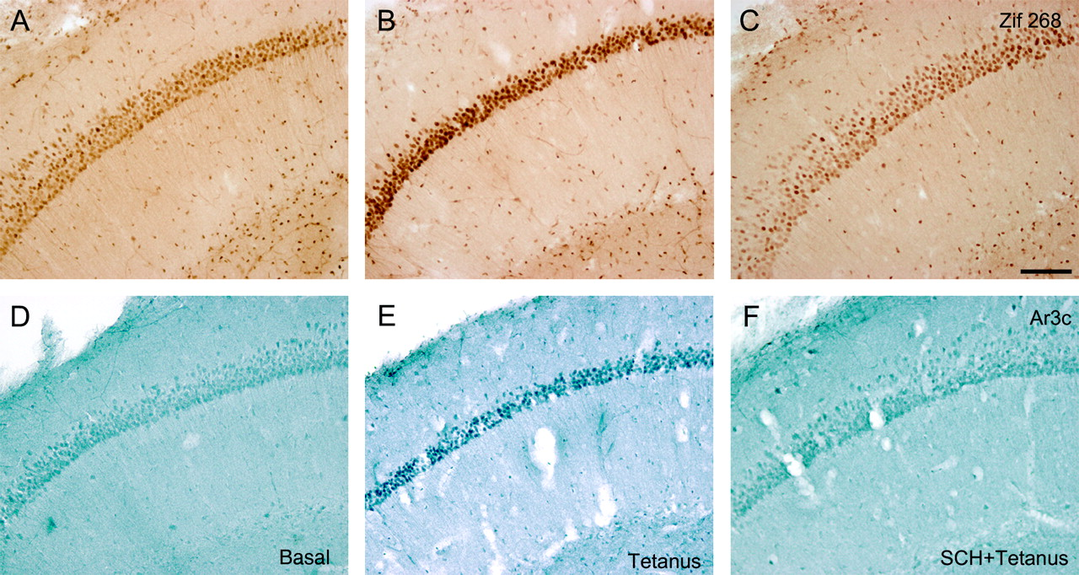
Figure 8. D₁R antagonist SCH23390 blocked LTP-induced Zif268 and Arc expression in CA1 pyramidal cells. ...
Notes:
Figure 8. D1R antagonist SCH23390 blocked LTP-induced Zif268 and Arc expression in CA1 pyramidal cells. Photomicrographs of the CA1 pyramidal cell layer of the hippocampus from transverse brain slices of WT animals illustrating Zif268 (in brown) and Arc (in purple) expression in basal conditions (A, D), 1 h after HFS (B, E), and 1 h after HFS in the presence of 0.5 μM SCH23390, a D1/D5R antagonist (C, F). Note the inhibition of Zif268- and Arc-induced expression by LTP in the presence of SCH23390. Bar indicates 100 μm.
Unless provided in the caption above, the following copyright applies to the content of this slide: © 2007 The AuthorsThis is an Open Access article distributed under the terms of the Creative Commons Attribution Non-Commercial License (http://creativecommons.org/licenses/by-nc/2.0/uk/) which permits unrestricted non-commercial use, distribution, and reproduction in any medium, provided the original work is properly cited.

