Slide 1
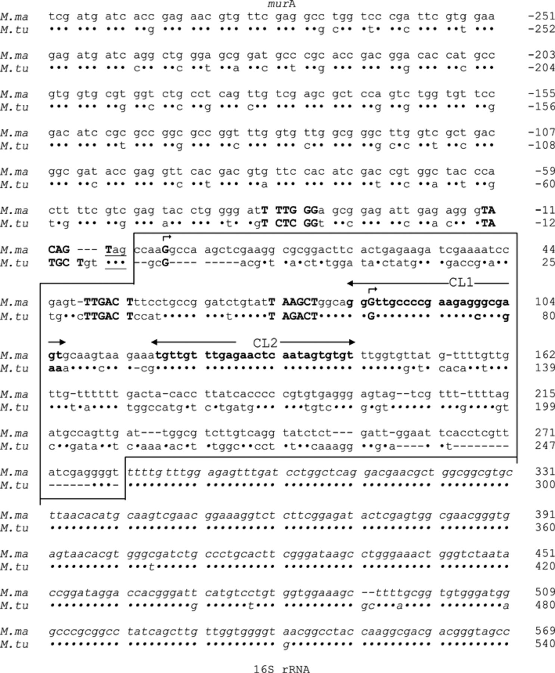
2 Sequences of the 3′-region of murA, the intergenic region and the 5′-regions of 16S rRNA of M. marinum (see ...
Notes:
2 Sequences of the 3′-region of murA, the intergenic region and the 5′-regions of 16S rRNA of M. marinum (see box in Fig. 1(c)) and comparison with M. tuberculosis. M. ma, M. marinum; M. tu, M. tuberculosis.●, identical nucleotide; − deletion. Nucleotides are numbered, both upstream (−) and downstream (+) from the transcription start points of the P1 promoters (see Fig. 3). Sequences of murA genes are shown as codons (NCBI GenBank Accession No. AY532648). Termination codons are underlined. The intergenic regions are shown within the box. Promoter elements (−35 boxes, −10 boxes) and transcription start points are indicated by bold upper case letters; the direction of transcription is shown by the superscript bent arrow. The highly conserved sequence motifs CL1 and CL2 are shown in bold lower case letters. The 5′-regions of 16S rRNA are indicated by lower case italics (NCBI GenBank Accession No. AY532649; this sequence and that cited in http://www.sanger.ac.uk/cgi-bin/blast/submitblast/m_marinum are identical).
Unless provided in the caption above, the following copyright applies to the content of this slide: © 2004 Federation of European Microbiological Societies

Slide 2
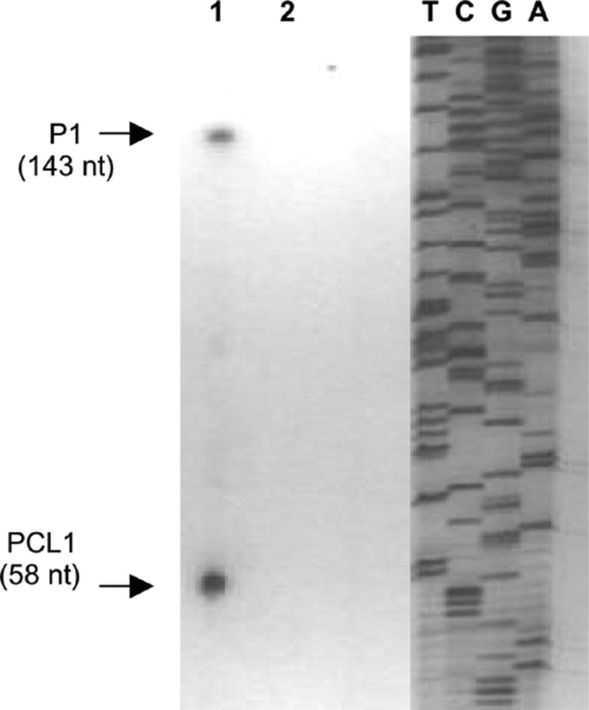
3 Transcription start points of pre-rRNA of M. marinum (type strain). The 5′ ends of pre-rRNA were located by ...
Notes:
3 Transcription start points of pre-rRNA of M. marinum (type strain). The 5′ ends of pre-rRNA were located by extending 32P-labelled primer JY15. Lanes T, C, G, A are products of sequencing reactions carried out using primer JY15 and a PCR-amplified (RAC1–RAC8) DNA. The transcription start points ts (P1) and ts (PCL1), indicate the appropriate promoter, and the numbers in parenthesis indicate the size (nucleotides) of each primer extension product. Lane 1, RNA (15 μg) isolated from M. marinum Type strain; lane 2, no RNA. The photographs were digitally processed.
Unless provided in the caption above, the following copyright applies to the content of this slide: © 2004 Federation of European Microbiological Societies

Slide 3
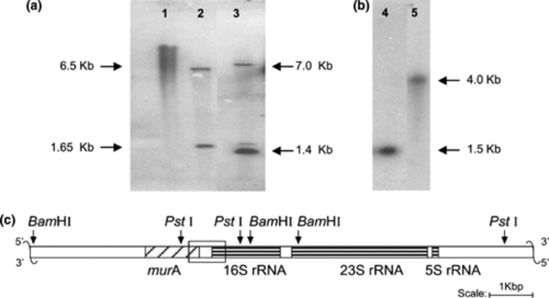
1 Southern-blot transfer of restriction enzyme digests and hybridization reveal that M. marinum has one rrn ...
Notes:
1 Southern-blot transfer of restriction enzyme digests and hybridization reveal that M. marinum has one rrn operon per genome. (a) Hybridization with a 32P-labelled 16S rDNA fragment amplified by using primers RAC6 and RAC103. The probe spans the PstI site from 650 to 655 bp downstream from the 5′end of the 16S rRNA gene. 1, Unrestricted DNA isolated from M. marinum Type strain; 2, PstI digest of M. marinum Type strain DNA; 3, PstI digest of M. tuberculosis H37Rv DNA. (b) Hybridization with a 32P-labelled PCR fragment amplified using primers RI5 and RI3 spanning internal transcribed spacer 1. 4, PstI digest of M. marinum Type strain DNA; 5, BamHI digest of M. marinum Type strain DNA. (c) Restriction fragment map of the rrn operon of M. marinum Type strain derived from the data of (a) and (b). The DNA within the region enclosed by the box was amplified by PCR and its nucleotide sequence was established.
Unless provided in the caption above, the following copyright applies to the content of this slide: © 2004 Federation of European Microbiological Societies

