Slide 1
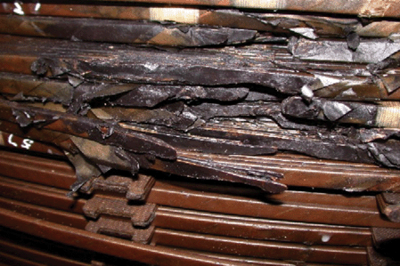
1: Failure in a large South African generator transformer, three weeks after the Halloween storm of 2003. The ...
Notes:
1: Failure in a large South African generator transformer, three weeks after the Halloween storm of 2003. The disruption of the winding and insulation by the arcing fault at the time of final failure is clear. The arcing fault also destroys evidence that might lead to a better understanding of the progression of damage after initiation by the geomagnetic current event. (From Thompson 2010)
Unless provided in the caption above, the following copyright applies to the content of this slide:

Slide 2
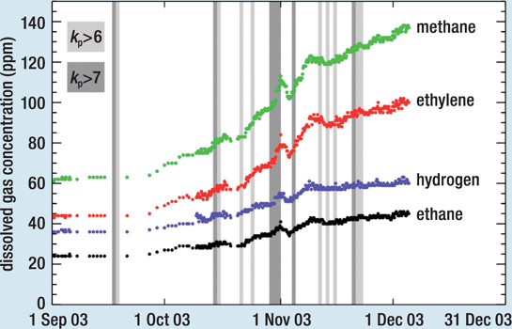
2: Results of dissolved gas analysis for a transformer in South Africa during the geomagnetically active period ...
Notes:
2: Results of dissolved gas analysis for a transformer in South Africa during the geomagnetically active period in late 2003, also showing intervals of kP 6 and 7 level geomagnetic activity. This shows continued gas generation throughout the period. The ratios of different gases indicate low temperature degradation of paper insulation (which ultimately led to the transformer being removed from service). Similar trends were observed at several other sites across the South African grid throughout this period, suggesting that the damage was caused by a nationwide factor. (From Thompson 2010)
Unless provided in the caption above, the following copyright applies to the content of this slide:

