Slide 1
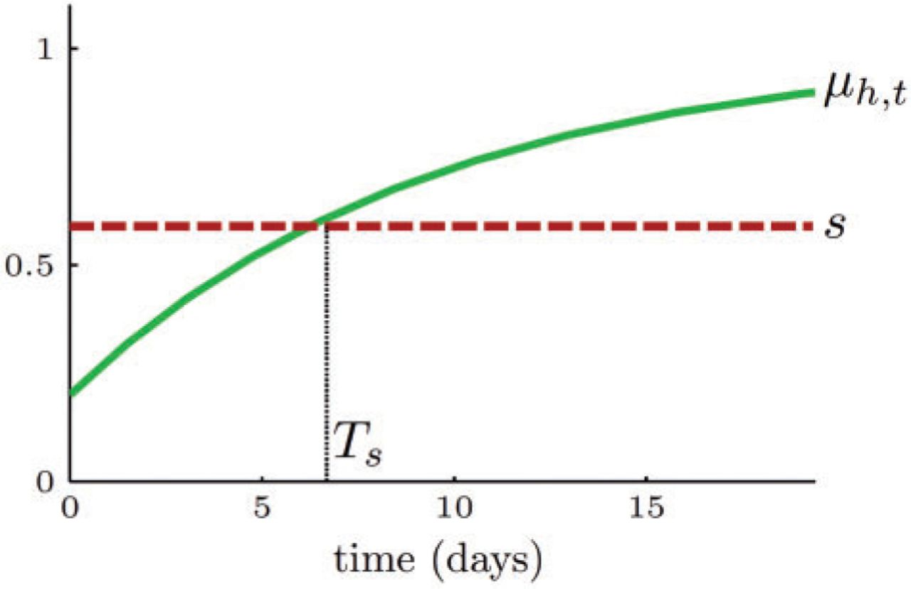
Figure 1 The measure of high-valuation institutions (plain green) and the asset supply (dashed red).
Notes:
Figure 1 The measure of high-valuation institutions (plain green) and the asset supply (dashed red).
Unless provided in the caption above, the following copyright applies to the content of this slide: © The Author 2014. Published by Oxford University Press on behalf of The Review of Economic Studies Limited.

Slide 2
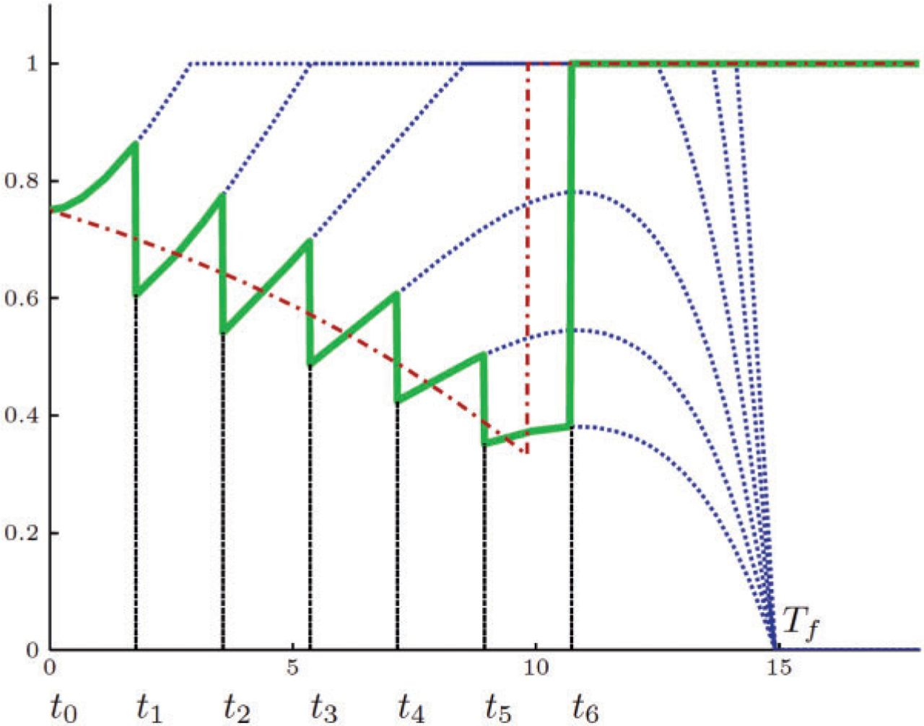
Figure 3 The realized holdings with continuous-updating are represented by the downward sloping curve (dash-dotted ...
Notes:
Figure 3 The realized holdings with continuous-updating are represented by the downward sloping curve (dash-dotted red). The realized holdings with infrequent updating are represented by the sawtooth curve (solid green). The consecutive holding plans with infrequent updating are represented by hump-shaped curves (dotted blue).
Unless provided in the caption above, the following copyright applies to the content of this slide: © The Author 2014. Published by Oxford University Press on behalf of The Review of Economic Studies Limited.

Slide 3
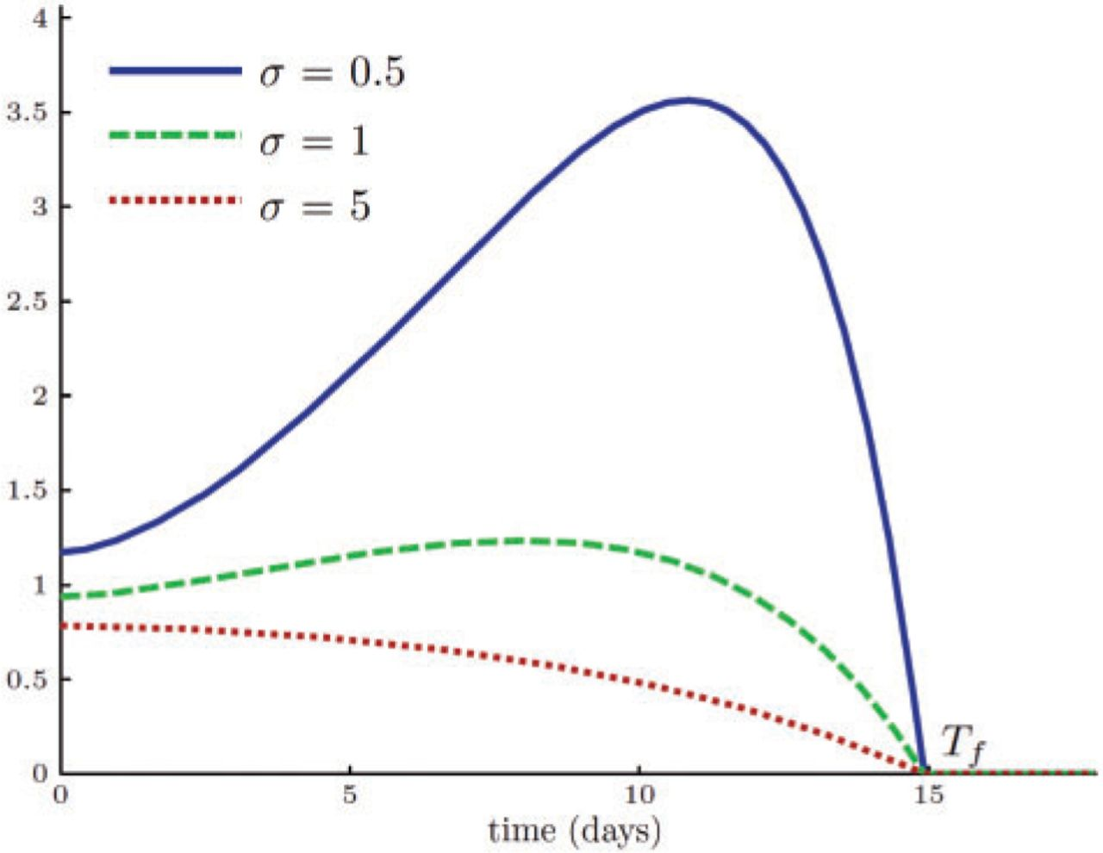
Figure 2 The function Q_{u} for various values of σ.
Notes:
Figure 2 The function Qu for various values of σ.
Unless provided in the caption above, the following copyright applies to the content of this slide: © The Author 2014. Published by Oxford University Press on behalf of The Review of Economic Studies Limited.

Slide 4
Figure 4 The relationship between size of the shock, 1 − μ_{h,0}, and volume per unit of asset supply (left ...
Notes:
Figure 4 The relationship between size of the shock, 1 − μh,0, and volume per unit of asset supply (left panel), between the size of the shock and price drop in percent (middle panel), and between price drop and volume (right panel), for known preferences (dashed red curves) vs. uncertain preferences (plain blue curves).
Unless provided in the caption above, the following copyright applies to the content of this slide: © The Author 2014. Published by Oxford University Press on behalf of The Review of Economic Studies Limited.

Slide 5
Figure 5 The relationship between individual trading volume and trading profits (left panel), between individual ...
Notes:
Figure 5 The relationship between individual trading volume and trading profits (left panel), between individual average inventory and trading profits (middle panel), and between individual average inventory and trading profits (right panel), for known preferences (red x-marks) vs. uncertain preferences (blue dots).
Unless provided in the caption above, the following copyright applies to the content of this slide: © The Author 2014. Published by Oxford University Press on behalf of The Review of Economic Studies Limited.

