Slide 1
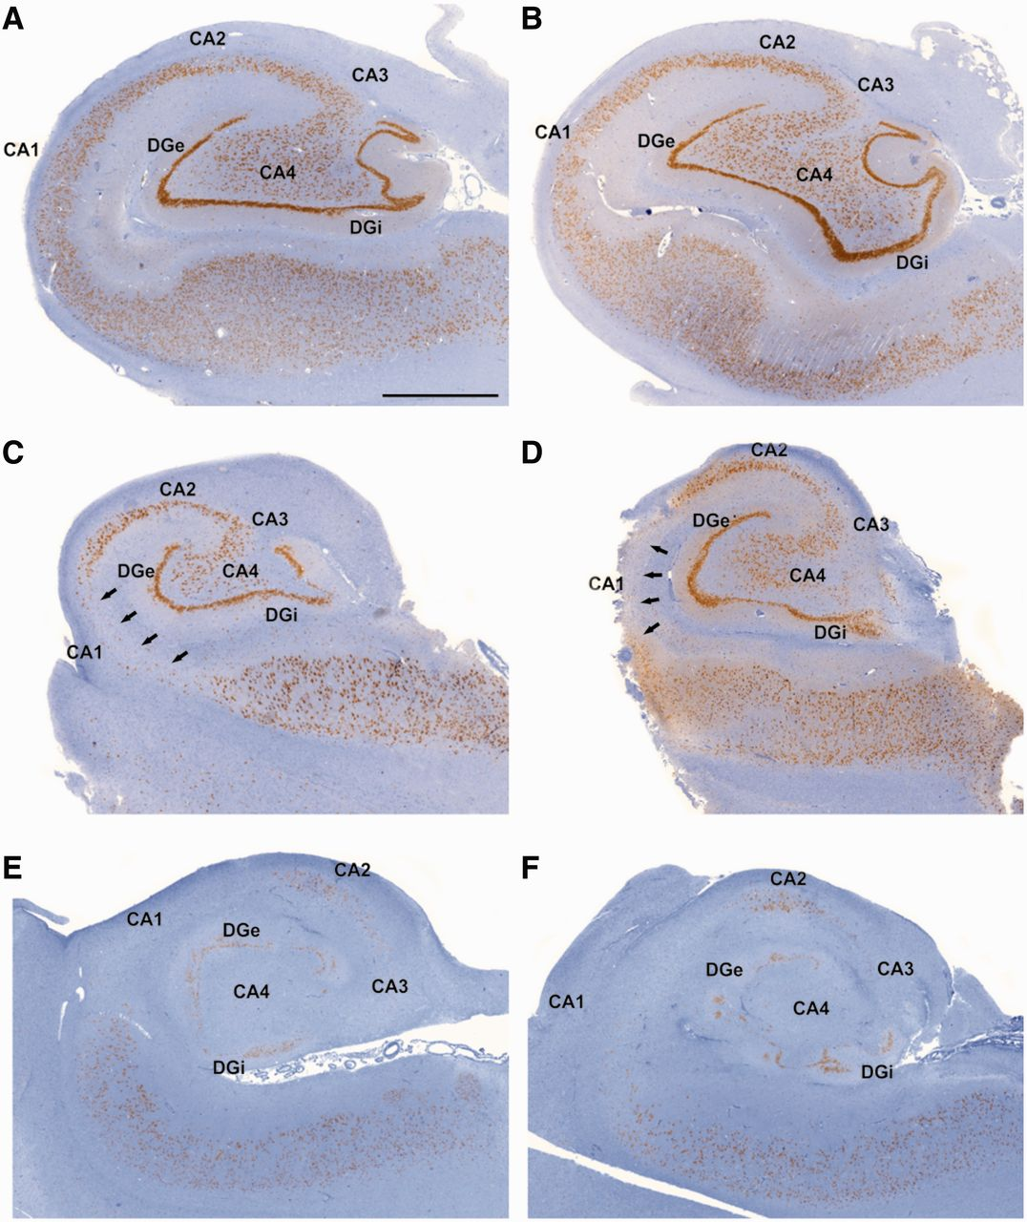
Figure 1 Subfield specific patterns of hippocampal damage in patients with TLE. The neuronal density patterns/patterns ...
Notes:
Figure 1 Subfield specific patterns of hippocampal damage in patients with TLE. The neuronal density patterns/patterns of hippocampal sclerosis were assessed at two separate levels of the same hippocampal specimen along the anterior–posterior axis (A→B, C→D and E→F) and did not show any differences. (A and B) No hippocampal sclerosis, no segmental cell loss in the hippocampal subfields CA1, CA2, CA3 and CA4. (C and D) HS ILAE Type 2 (CA1-sclerosis), the CA1 sector is heavily depleted of pyramidal cells (black arrows) whereas sectors CA2, CA3 and CA4 are well preserved. (E and F) HS ILAE Type 1 (classic hippocampal sclerosis), all sectors are affected by a severe pyramidal cell loss. Scale bars: A–F = 2000 µm. DGe = dentate gyrus (external limb); DGi = dentate gyrus (internal limb).
Unless provided in the caption above, the following copyright applies to the content of this slide: © The Author (2014). Published by Oxford University Press on behalf of the Guarantors of Brain. All rights reserved. For Permissions, please email: journals.permissions@oup.com

Slide 2
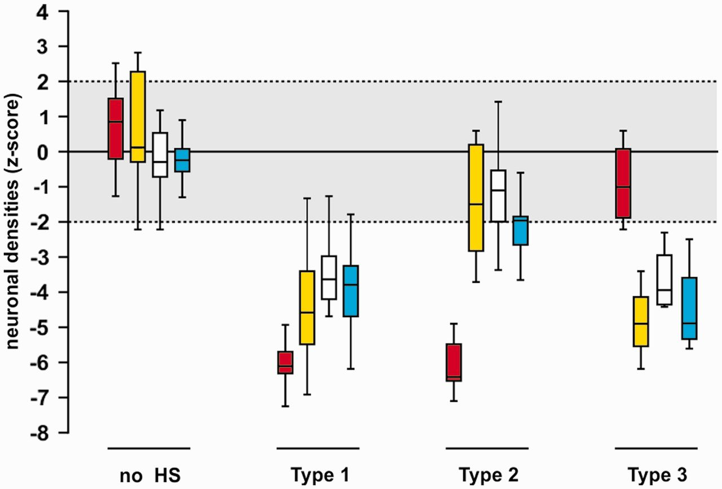
Figure 2 Neuronal density measurements in hippocampal sclerosis subtypes. Cluster analysis of NeuN immunoreactive ...
Notes:
Figure 2 Neuronal density measurements in hippocampal sclerosis subtypes. Cluster analysis of NeuN immunoreactive neuronal cell counts at different hippocampal subfields. No hippocampal sclerosis: n = 19; HS ILAE Type 1: n = 63; HS ILAE Type 2: n = 13; HS ILAE Type 3: n = 5. Red: CA1; yellow: CA3; white: CA4; blue: dentate gyrus (internal limb) using our previously proposed hippocampal subfield specific classification scheme (modified from Blumcke et al., 2007). The grey shading indicates the range of normal neuronal cell densities (in z-scores).
Unless provided in the caption above, the following copyright applies to the content of this slide: © The Author (2014). Published by Oxford University Press on behalf of the Guarantors of Brain. All rights reserved. For Permissions, please email: journals.permissions@oup.com

Slide 3
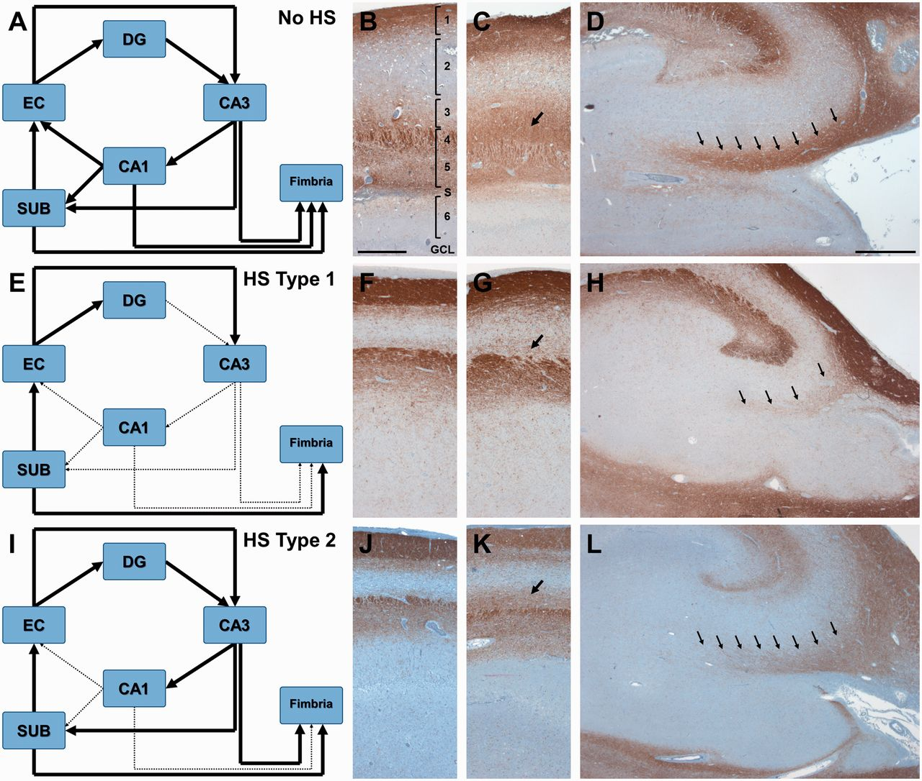
Figure 3 An alternative model of how the hippocampus communicates with the rest of the brain without CA1. (A, E and I) ...
Notes:
Figure 3 An alternative model of how the hippocampus communicates with the rest of the brain without CA1. (A, E and I) Schematic representation of the polysynaptic intrahippocampal pathway (modified from Duvernoy et al., 2013). (A–D) No hippocampal sclerosis; (E–H) HS ILAE Type 1; (I–L) HS ILAE Type 2. Dotted and thinned connecting lines in E and I highlight areas of reduced connectivity between particular switch-points of the polysynaptic intrahippocampal pathway compared to an intact interconnection in patients with no hippocampal sclerosis. (B, F and J) Higher magnification at the level of CA1 (CNPase immunohistochemistry). (C, G and K) Higher magnification at the level of CA2 (CNPase immunohistochemistry). (D, H and L) Higher magnification at the level of CA3/4 (CNPase immunohistochemistry). Arrows in C, G and K: myelinated fibres of the stratum radiatum preserved in no hippocampal sclerosis (C) and HS ILAE Type 2 (K) whereas were significantly reduced in HS ILAE Type 1 (G). Arrows in D, H and L: myelinated fibres from CA3 into the fimbria in no hippocampal sclerosis (D) and HS ILAE Type 2 (L) whereas were significantly reduced in hippocampal sclerosis Type 1 (H). 1 = alveus/stratum oriens; 2 = stratum pyramidale; 3 = stratum radiatum; 4/5 = stratum lacunosum-moleculare; S = hippocampal sulcus; 6 = stratum moleculare (of the dentate gyrus); GCL = granule cell layer; SUB = subiculum; EC = entorhinal cortex. Scale bar in B = 500 µm, applies also to F, J, C, G and K. Scale bar in D = 1000 µm, applies also for H and L.
Unless provided in the caption above, the following copyright applies to the content of this slide: © The Author (2014). Published by Oxford University Press on behalf of the Guarantors of Brain. All rights reserved. For Permissions, please email: journals.permissions@oup.com

Slide 4
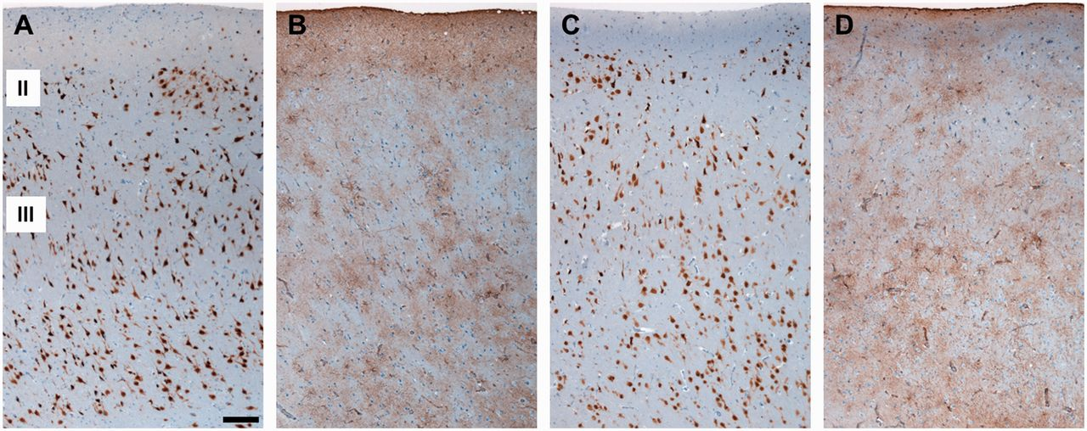
Figure 4 Histopathology analysis of the entorhinal cortex did not reveal differences between HS ILAE subtypes. NeuN ...
Notes:
Figure 4 Histopathology analysis of the entorhinal cortex did not reveal differences between HS ILAE subtypes. NeuN labeled neurons in the entorhinal cortex from a patient with TLE with HS ILAE Type 1 in A and a patient with TLE with HS ILAE Type 2 in C. We did not observe any significant pathology pattern in both patient cohorts. GFAP staining obtained from serial sections to A (in B) and C (in D) confirmed the characteristic astroglial reaction without evidence for layer specific neuronal cell loss. (II and III) in A indicate the layers of the entorhinal cortex. Scale bar in A = 200 µm, applies also to B–D.
Unless provided in the caption above, the following copyright applies to the content of this slide: © The Author (2014). Published by Oxford University Press on behalf of the Guarantors of Brain. All rights reserved. For Permissions, please email: journals.permissions@oup.com

Slide 5
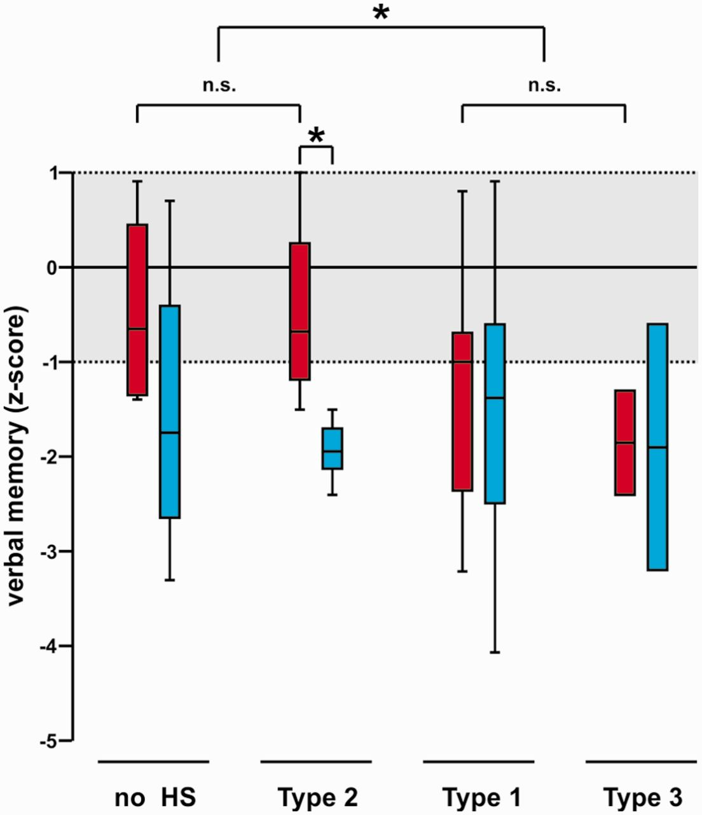
Figure 7 Pre- and postoperative loss in verbal memory is related to HS ILAE subtypes. Box plots of preoperative (red) ...
Notes:
Figure 7 Pre- and postoperative loss in verbal memory is related to HS ILAE subtypes. Box plots of preoperative (red) and postoperative (blue) verbal memory scores (transformed into z-scores) in relation to hippocampal sclerosis subtypes in patients with left-sided TLE. No hippocampal sclerosis: n = 4; HS ILAE Type 1: n = 35; HS ILAE Type 2: n = 4; HS ILAE Type 3: n = 2. A normal range of verbal memory scores was considered between −1 and +1. Note the significant greater loss in verbal memory in hippocampal sclerosis Type 2 (CA1 predominant sclerosis) and cases with no hippocampal sclerosis compared to HS ILAE Type 1 and 3, in which cell loss affected also the dentate gyrus and CA4 (Fig. 2) *P = <0.05.
Unless provided in the caption above, the following copyright applies to the content of this slide: © The Author (2014). Published by Oxford University Press on behalf of the Guarantors of Brain. All rights reserved. For Permissions, please email: journals.permissions@oup.com

Slide 6
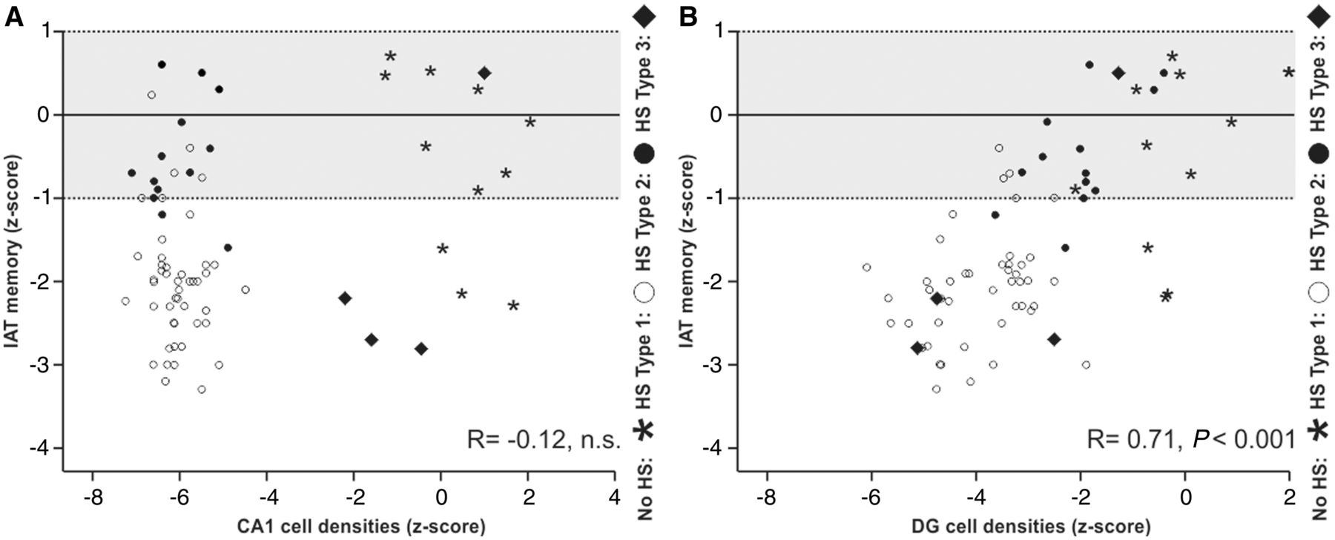
Figure 6 Relationship between preoperative IAT, CA1 pyramidal cell loss and granule cell loss. Relationship between ...
Notes:
Figure 6 Relationship between preoperative IAT, CA1 pyramidal cell loss and granule cell loss. Relationship between preoperative ipsilateral IAT memory scores (transformed into z-scores) and pyramidal cell loss in CA1 (A) or granule cell loss in the dentate gyrus (B). No hippocampal sclerosis: n = 13; HS ILAE Type 1: n = 48; HS ILAE Type 2: n = 13; HS ILAE Type 3: n = 4. Memory function is sustained even in the presence of most severe cell loss in CA1 (A) whereas it was significantly impaired in patients with granule cell loss (B). The grey shading indicates the normal range of memory scores. Labelling of hippocampal sclerosis subtypes: open circle = HS ILAE Type 1, closed circle = HS ILAE Type 2, diamonds = HS ILAE Type 3, asterisks = no hippocampal sclerosis.
Unless provided in the caption above, the following copyright applies to the content of this slide: © The Author (2014). Published by Oxford University Press on behalf of the Guarantors of Brain. All rights reserved. For Permissions, please email: journals.permissions@oup.com

Slide 7
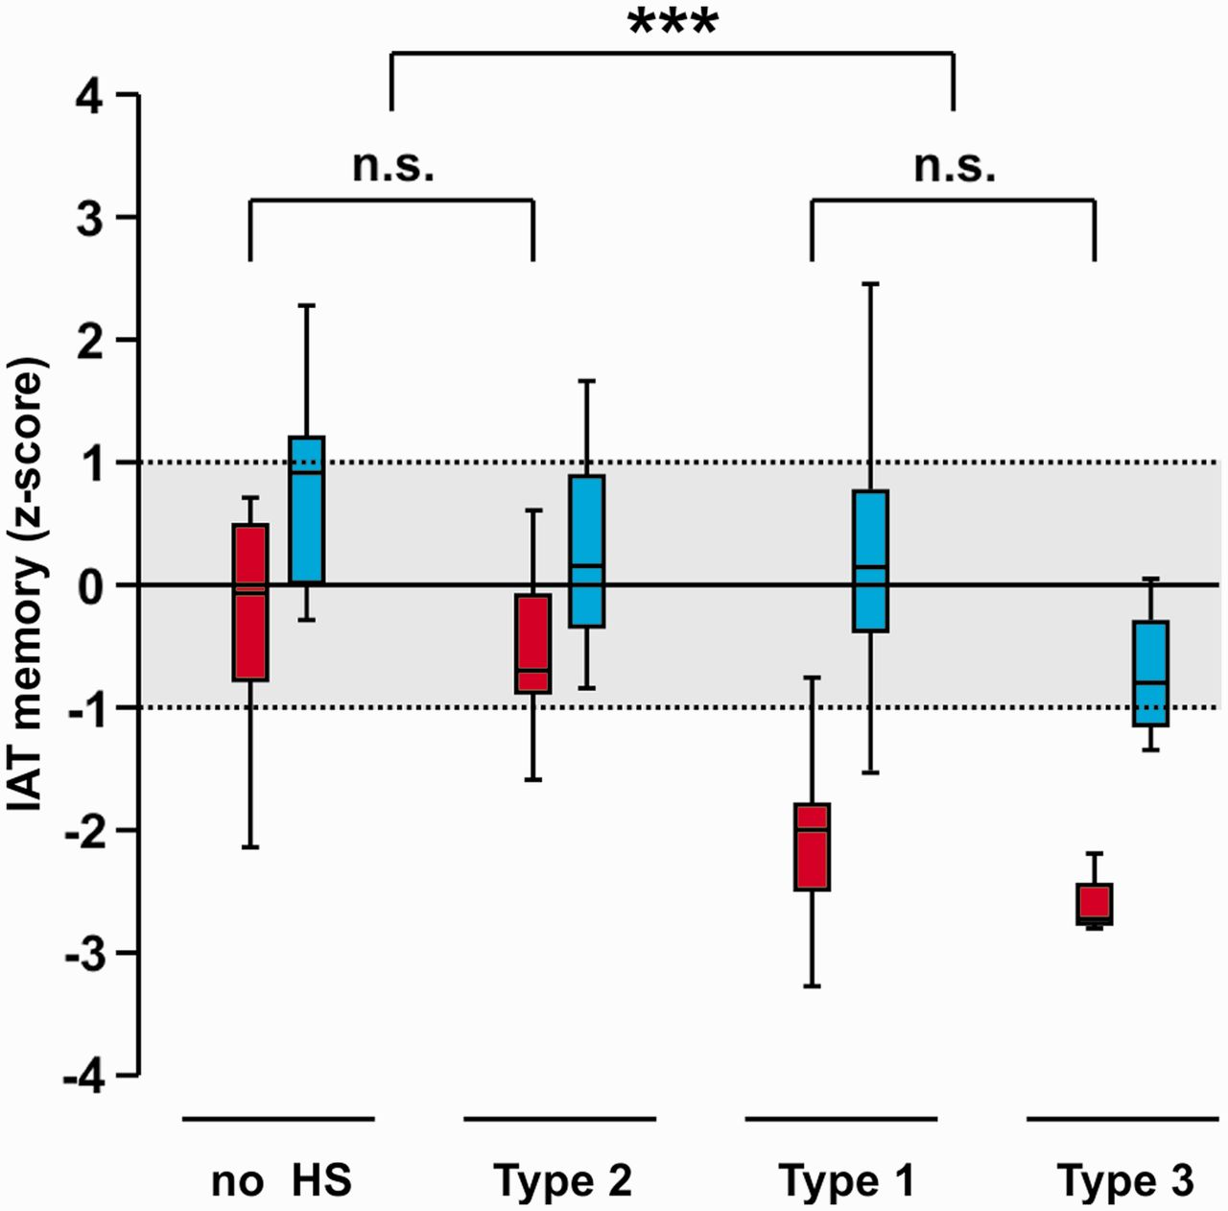
Figure 5 Relationship between preoperative IAT and hippocampal sclerosis patterns. Relationship between hippocampal ...
Notes:
Figure 5 Relationship between preoperative IAT and hippocampal sclerosis patterns. Relationship between hippocampal sclerosis subtypes and preoperative ipsilateral (in red) or contralateral (in blue) IAT memory scores (transformed into z-scores). No hippocampal sclerosis: n = 13; HS ILAE Type 1: n = 48; HS ILAE Type 2: n = 13; HS ILAE Type 3: n = 4. Note significant lower ipsilateral memory scores in HS ILAE Type 1 (classical hippocampal sclerosis) and HS ILAE Type 3 (CA4 predominant sclerosis) compared to no-hippocampal sclerosis (hippocampi without neuronal cell loss) and HS ILAE Type 2 (CA1 predominant sclerosis). Note that all contralateral memory scores in blue corresponded to normal values (grey shading). ***P = <0.001.
Unless provided in the caption above, the following copyright applies to the content of this slide: © The Author (2014). Published by Oxford University Press on behalf of the Guarantors of Brain. All rights reserved. For Permissions, please email: journals.permissions@oup.com

