Slide 1
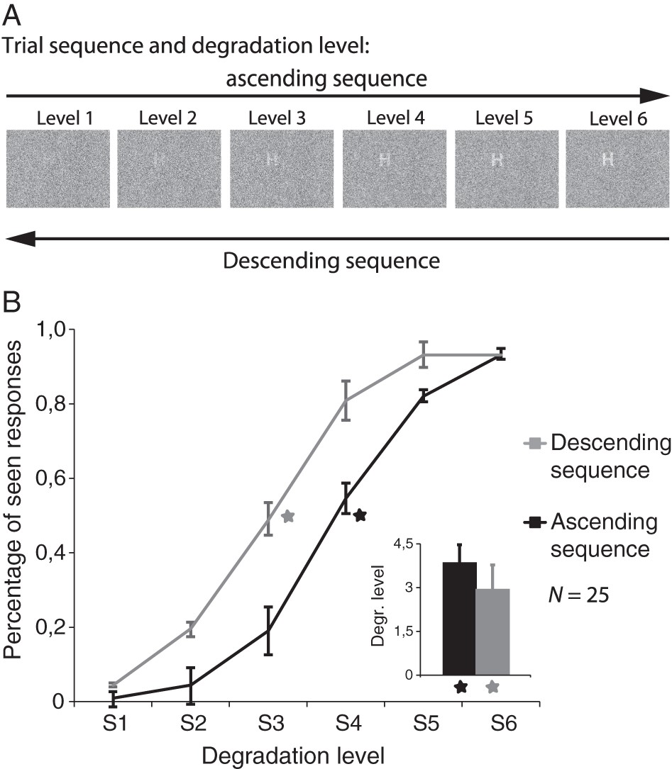
Figure 1. Experimental design and behavioral results. (A) Example stimuli used in the study. Stimuli were presented in ...
Notes:
Figure 1. Experimental design and behavioral results. (A) Example stimuli used in the study. Stimuli were presented in the upper left quadrant at 4° eccentricity. Bottom-up information was manipulated by parametrically varying the ratio of dot density between the figure and the background. Six levels of degradation were used. To create top-down effects, we increased and subsequently decreased the visibility of an initially hidden letter. As stimulus recognition occurs during the rising phase (ascending sequence), target-specific expectations are generated. By reducing the visibility of the following items (descending sequence), these expectations (or priors) interact with the sensory information of the stimuli. (B) Behavioral results. The x-axis shows the 6 stimulus degradation levels. The y-axis indicates the percentage of seen responses. The ascending sequence is shown in black, and the descending sequence is shown in gray. Error bars indicate SEM. Note the horizontal shift of the psychometric function for the descending sequence, which carries the top-down information. The inset shows the average visibility threshold (inflection point) per sequence obtained by fitting a sigmoid function.
Unless provided in the caption above, the following copyright applies to the content of this slide: © The Author 2015. Published by Oxford University Press. All rights reserved. For Permissions, please e-mail: journals.permissions@oup.com

Slide 2
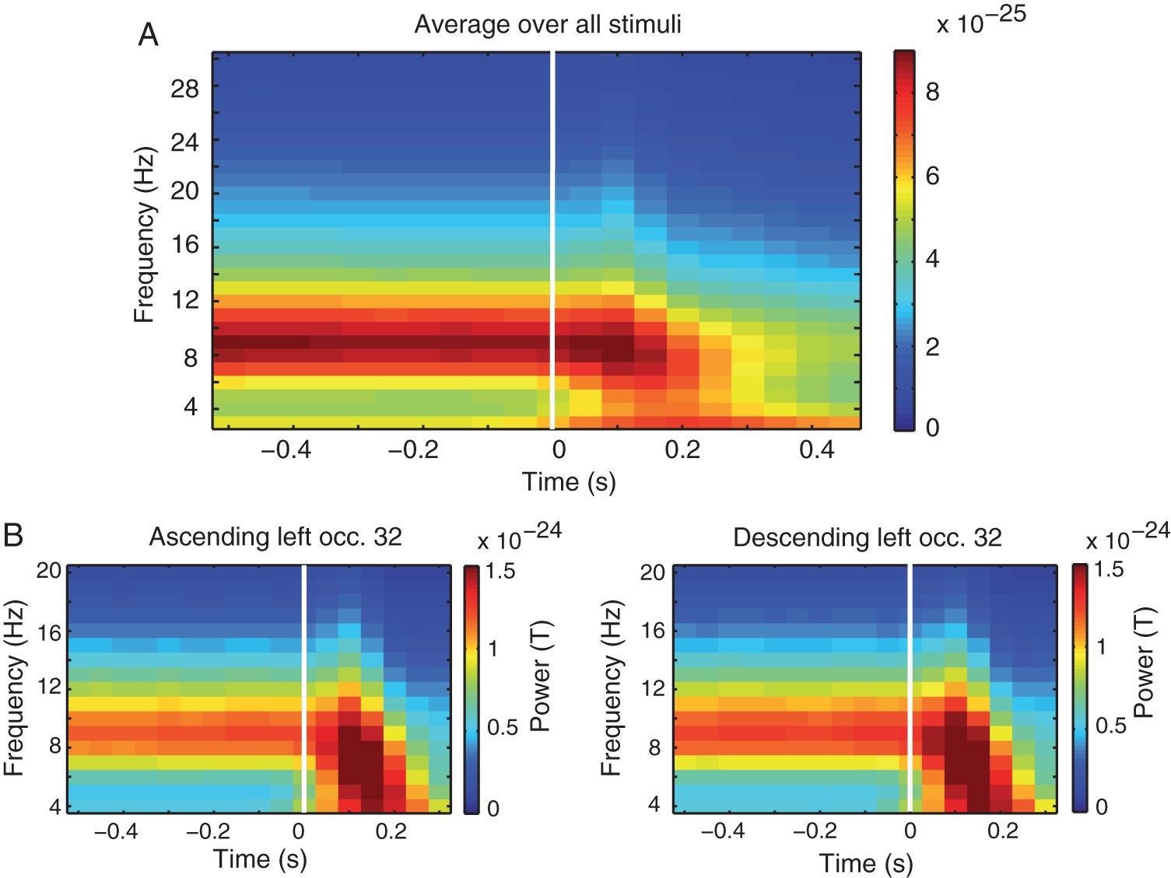
Figure 2. Time course of alpha power. (A) Time–frequency plot obtained by averaging over all stimulus conditions and ...
Notes:
Figure 2. Time course of alpha power. (A) Time–frequency plot obtained by averaging over all stimulus conditions and MEG sensors. X-axis denotes time. The white line indicates stimulus onset. Y-axis denotes frequency. (B) Time–frequency plots for an example left occipital sensor for the ascending (left plot) and descending (right plot) sequence. Note the strong alpha power during the baseline time period and the alpha desynchronization after stimulus presentation. The reduction in alpha power temporally coincides with the P1m–N1m component.
Unless provided in the caption above, the following copyright applies to the content of this slide: © The Author 2015. Published by Oxford University Press. All rights reserved. For Permissions, please e-mail: journals.permissions@oup.com

Slide 3
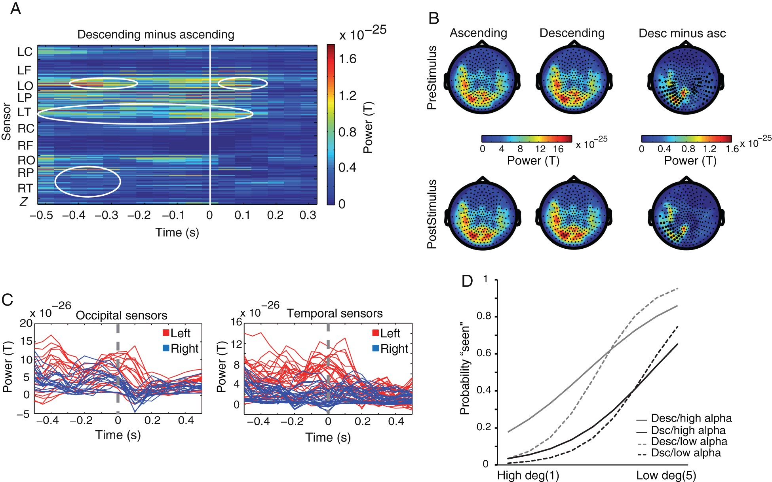
Figure 3. Alpha power results. (A) Alpha power (8–12 Hz) differences between the descending and ascending sequence for ...
Notes:
Figure 3. Alpha power results. (A) Alpha power (8–12 Hz) differences between the descending and ascending sequence for all MEG sensors. The x-axis represents time, the y-axis, the left (L) and right (R) MEG sensors located in C, central; F, frontal; O, occipital; P, parietal; T, temporal; Z, centro-occipital regions. The color scale indicates the strength of alpha power in Tesla. Time 0, highlighted by the white line, corresponds to the onset of stimulus presentation. The circled areas contain the significant time-sensor pairs (all effects P < 0.05, cluster-corrected for MCP). (B) Alpha power topographies of the pre- (−0.5 to −0.25 s) and post- (0–0.15 s) stimulus time period for the ascending and descending sequences (first and second head) and their difference (third head). Significant sensors are highlighted by black dots. (C) Time course of the difference in alpha power between the ascending and descending sequences for left (red) and right (blue) occipital and temporal sensors. X-axis represents time; y-axis represents alpha power in Tesla. Left occipital sensors show 2 peaks, one during the baseline period (−0.45 to −0.25 s), and another after stimulus presentation (0.05–0.15 s). Note the apparent phase opposition between left and right occipital sensors. (D) Results of the single-trial analysis. Prestimulus alpha power predicted seen versus unseen responses depending on both the level of stimulus degradation and whether expectations were present or absent, as evidenced by a significant three-way interaction (Wald's χ2(1) = 4.67, P = 0.0306). The probability to see a letter was higher for low degradation levels (x-axis, levels 1–5) and when an expectation was formed (gray lines). High prestimulus alpha power was associated with a higher probability to see the letter when stimulus evidence was weak (solid lines: +2SD alpha, dashed lines −2SD alpha), especially in the descending sequence, that is, when expectations were present.
Unless provided in the caption above, the following copyright applies to the content of this slide: © The Author 2015. Published by Oxford University Press. All rights reserved. For Permissions, please e-mail: journals.permissions@oup.com

Slide 4
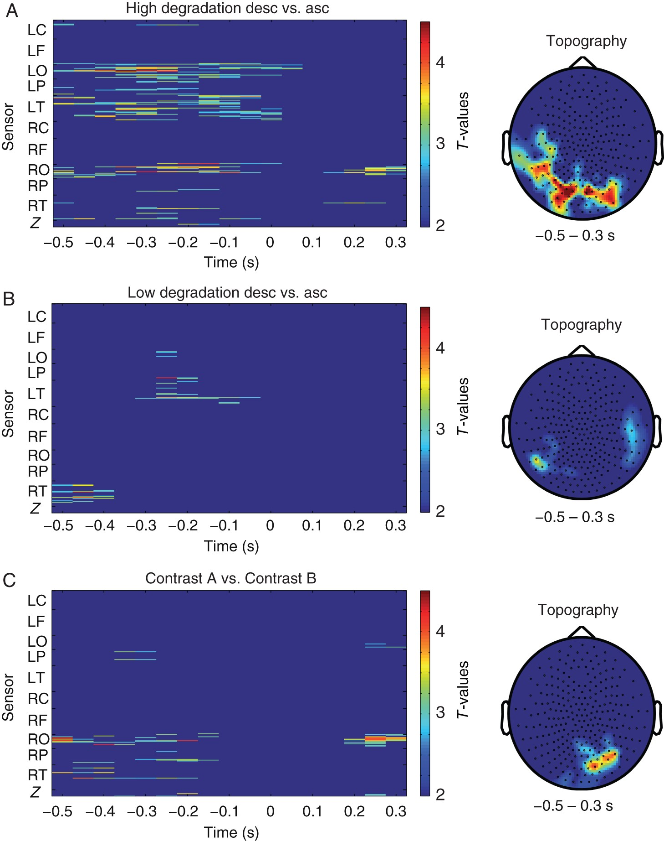
Figure 4. Alpha power differences between the descending and ascending sequence for (A) highly degraded stimuli ...
Notes:
Figure 4. Alpha power differences between the descending and ascending sequence for (A) highly degraded stimuli (average of levels 11+10 + 9 and 1 + 2 + 3, respectively) and (B) low degraded stimuli (average of levels 8 + 7 + 6 and 4 + 5 + 6, respectively). Topographies of the effects averaged over the whole analysis window (−0.5 to 0.3 s poststimulus). The color scale indicates the direction and strength of the differences in t-values; no negative P-values were observed. (C) Interaction effect, that is, the difference in contrast (A) and (B). All effects are significant at P < 0.05, cluster-corrected for MCP. The interaction reveals a stronger modulation of alpha oscillations for highly degraded stimuli with a selective right occipital topography (in accordance with the stimuli being presented in the left visual field), which is most evident during the baseline period and the time window of the early evoked sensory components.
Unless provided in the caption above, the following copyright applies to the content of this slide: © The Author 2015. Published by Oxford University Press. All rights reserved. For Permissions, please e-mail: journals.permissions@oup.com

Slide 5
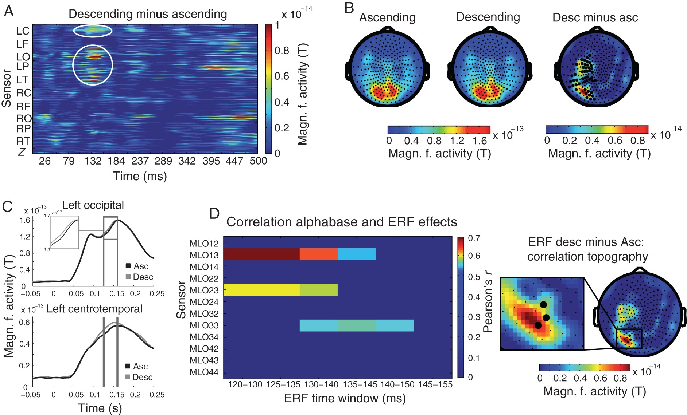
Figure 5. Event-related magnetic field results. (A) ERF differences between the descending and ascending sequence for ...
Notes:
Figure 5. Event-related magnetic field results. (A) ERF differences between the descending and ascending sequence for all MEG sensors. The x-axis represents time after stimulus onset. The color scale indicates magnetic field activity in Tesla. The circled areas contain the significant time-sensor pairs (all effects P < 0.05, cluster-corrected for MCP). (B) ERF topographies of the significant time period (0.125–0.155 s) for both sequences (first and second topography) and their difference (third topography). (C) Example ERF time courses of 2 significant sensors. Gray lines mark the time period during which the difference is significant. (D) Results of the correlation analysis. Left plot: Pearson's correlation across subjects between prestimulus alpha power and ERF over occipital sensors for the differences between descending and ascending conditions, respectively. The x-axis shows 6 ERF time windows; the ERF difference in each of them was correlated with the alpha baseline effect (−0.45 to −0.25 s). The y-axis shows individual MEG sensors. The color scale indicates the strength of the correlation masked by FDR-corrected significance (P < 0.05). Right image: ERF difference topography between 0.12 and 0.15 s and enlarged snapshot with the significant sensors of the correlation.
Unless provided in the caption above, the following copyright applies to the content of this slide: © The Author 2015. Published by Oxford University Press. All rights reserved. For Permissions, please e-mail: journals.permissions@oup.com

Slide 6
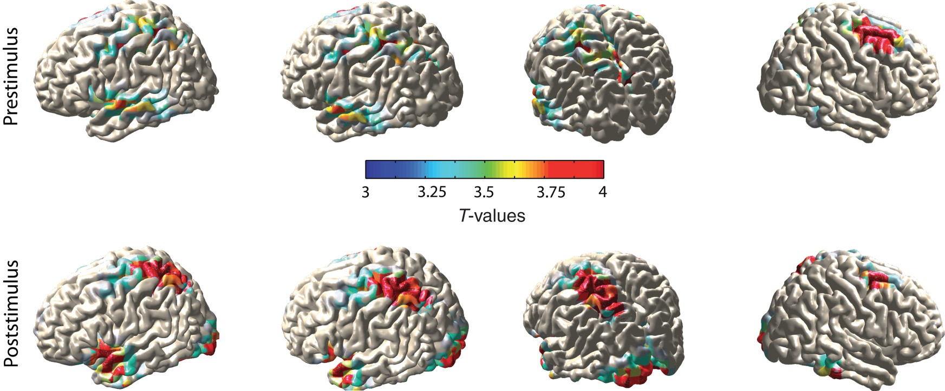
Figure 6. Alpha power Beamformer source reconstruction results. Results were obtained by contrasting the descending ...
Notes:
Figure 6. Alpha power Beamformer source reconstruction results. Results were obtained by contrasting the descending with the ascending condition for the pre- (−0.45 to −0.25 s) and post- (−0.05 to 0.15 s) stimulus time period. Sources are masked by significance (P < 0.05, MCP-corrected). The color scale reflects t-values. Sources of alpha activity during the baseline period were found in the left temporal cortex with peaks in anterior and posterior STG, HG/PT, left SPL, and right SFG. Sources of alpha activity during the stimulation period were found in anterior STG and TP, left superior parietal, inferior, and superior frontal lobes, and left early visual cortex extending into the VWFA. For MNI coordinates of peak activity, see Tables 2–3. Note the striking similarities between the sources found for the baseline and stimulation period. STG: superior temporal gyrus; SPL: superior parietal lobe; SFG: superior frontal gyrus; TP: temporal pole; VWFA: visual word form area; HG/PT: Heschl's gyrus/planum temporale.
Unless provided in the caption above, the following copyright applies to the content of this slide: © The Author 2015. Published by Oxford University Press. All rights reserved. For Permissions, please e-mail: journals.permissions@oup.com

