Slide 1
Figure 1. Typical histological features of hepatosplenic T-cell lymphoma in biopsies of spleen, bone marrow, and ...
Notes:
Figure 1. Typical histological features of hepatosplenic T-cell lymphoma in biopsies of spleen, bone marrow, and liver.
Unless provided in the caption above, the following copyright applies to the content of this slide: © The Author 2009. Published by Oxford University Press on behalf of the European Society for Medical Oncology. All rights reserved. For permissions, please email: journals.permissions@oxfordjournals.org

Slide 2
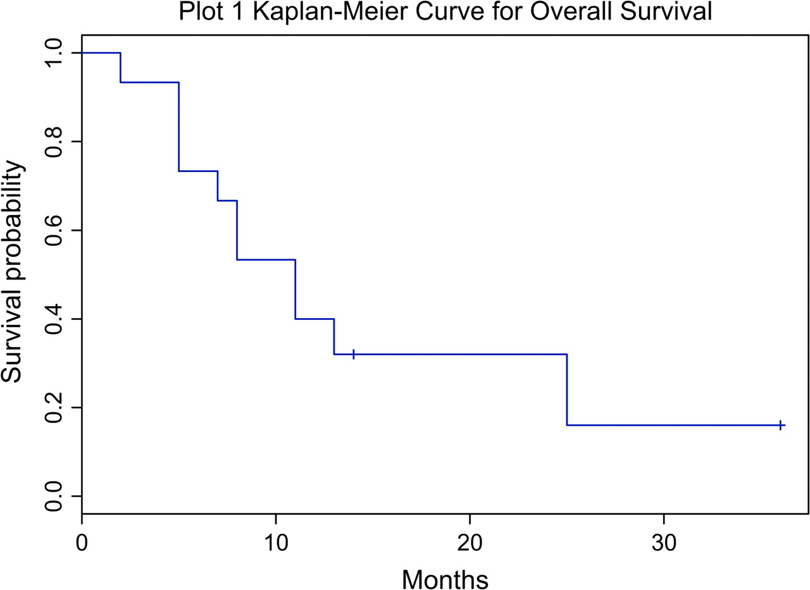
Figure 2. Kaplan–Meier curve for overall survival.
Notes:
Figure 2. Kaplan–Meier curve for overall survival.
Unless provided in the caption above, the following copyright applies to the content of this slide: © The Author 2009. Published by Oxford University Press on behalf of the European Society for Medical Oncology. All rights reserved. For permissions, please email: journals.permissions@oxfordjournals.org

Slide 3
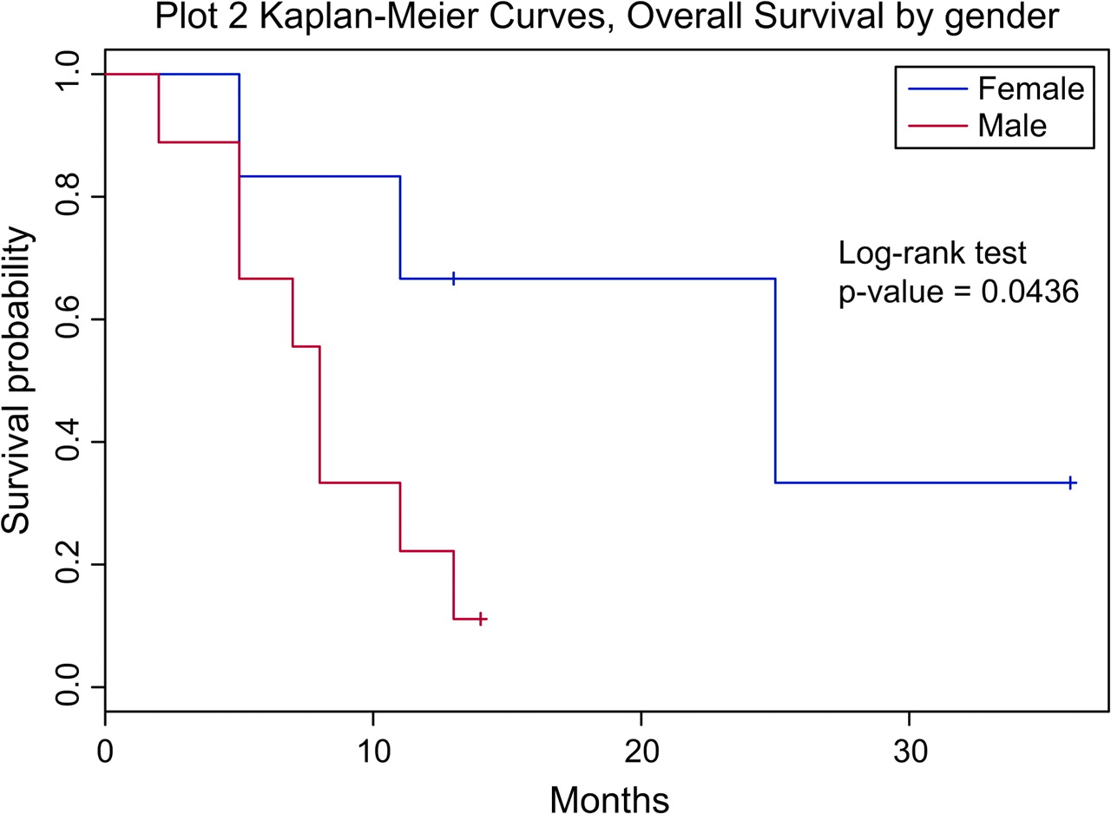
Figure 3. Kaplan–Meier curve for overall survival by gender.
Notes:
Figure 3. Kaplan–Meier curve for overall survival by gender.
Unless provided in the caption above, the following copyright applies to the content of this slide: © The Author 2009. Published by Oxford University Press on behalf of the European Society for Medical Oncology. All rights reserved. For permissions, please email: journals.permissions@oxfordjournals.org

