Slide 1
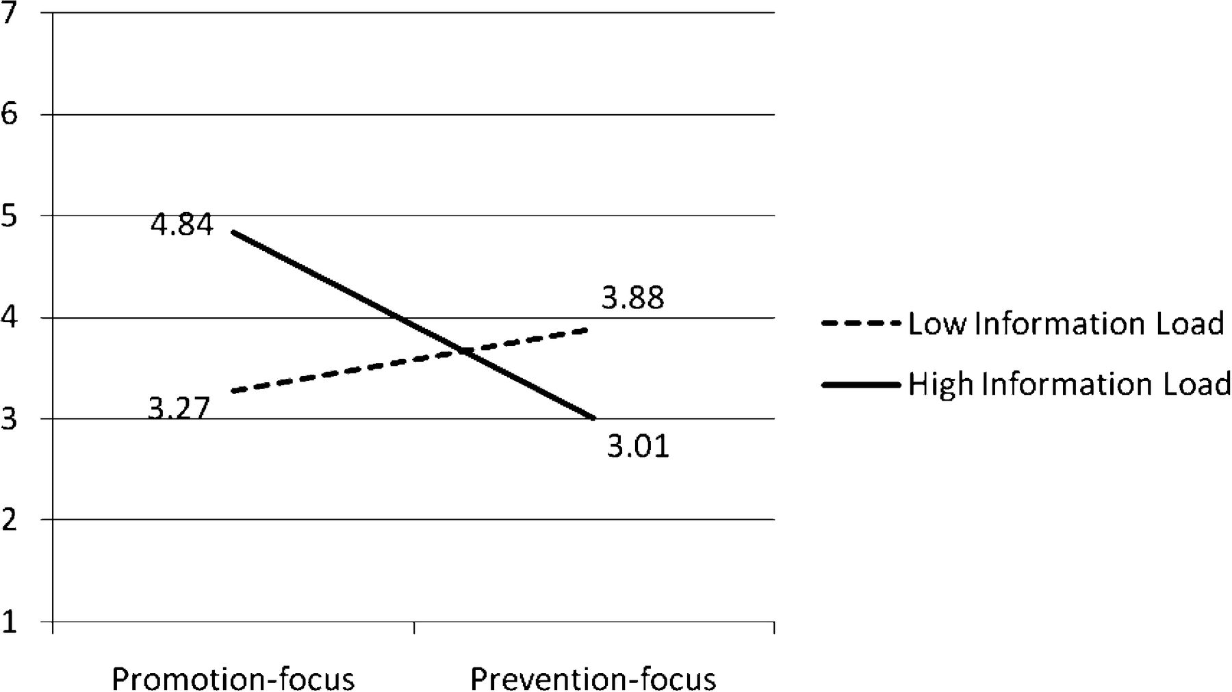
Figure 1. Brand Evaluations (Study 1)
Notes:
Figure 1. Brand Evaluations (Study 1)
Unless provided in the caption above, the following copyright applies to the content of this slide: © 2011 by JOURNAL OF CONSUMER RESEARCH, Inc.

Slide 2
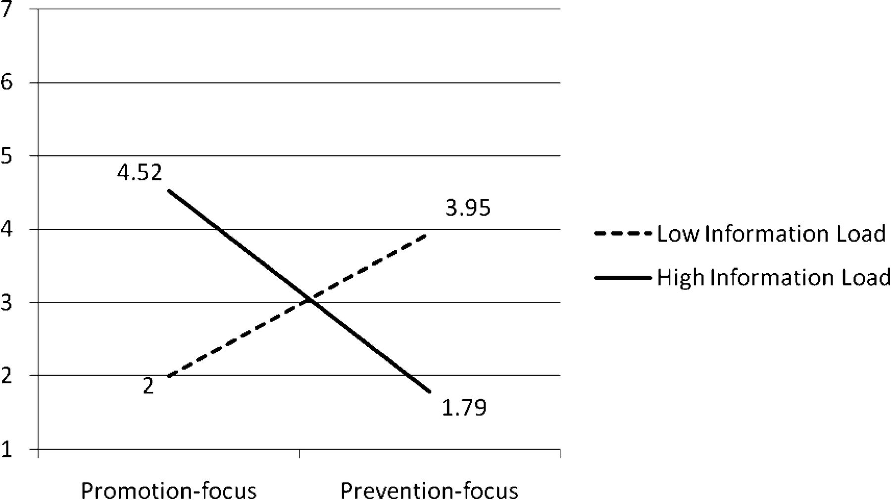
Figure 2. Brand Evaluations (Study 2)
Notes:
Figure 2. Brand Evaluations (Study 2)
Unless provided in the caption above, the following copyright applies to the content of this slide: © 2011 by JOURNAL OF CONSUMER RESEARCH, Inc.

Slide 3
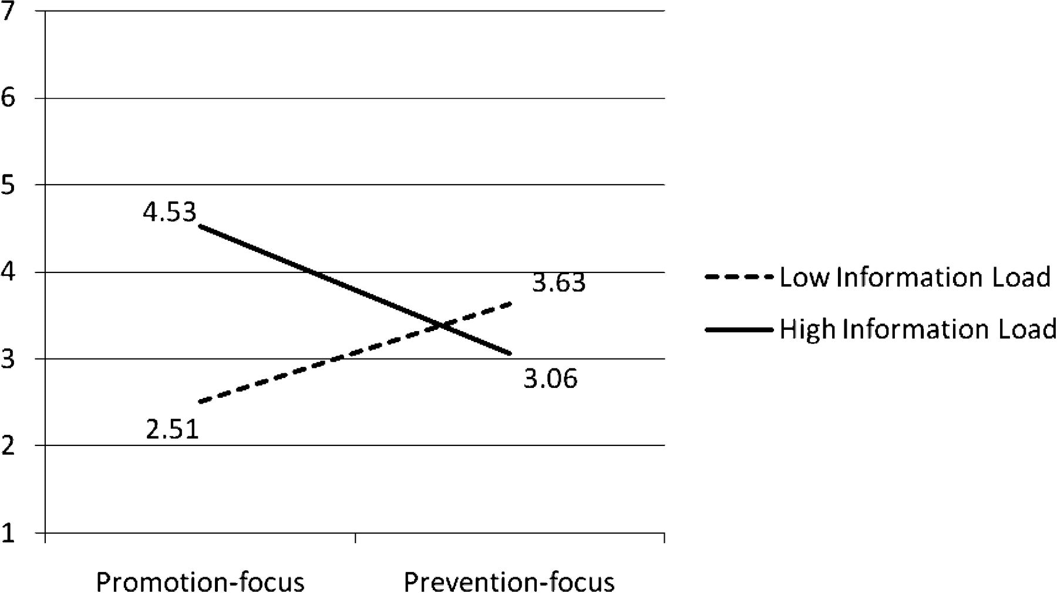
Figure 3. Brand Evaluations (Study 3)
Notes:
Figure 3. Brand Evaluations (Study 3)
Unless provided in the caption above, the following copyright applies to the content of this slide: © 2011 by JOURNAL OF CONSUMER RESEARCH, Inc.

Slide 4
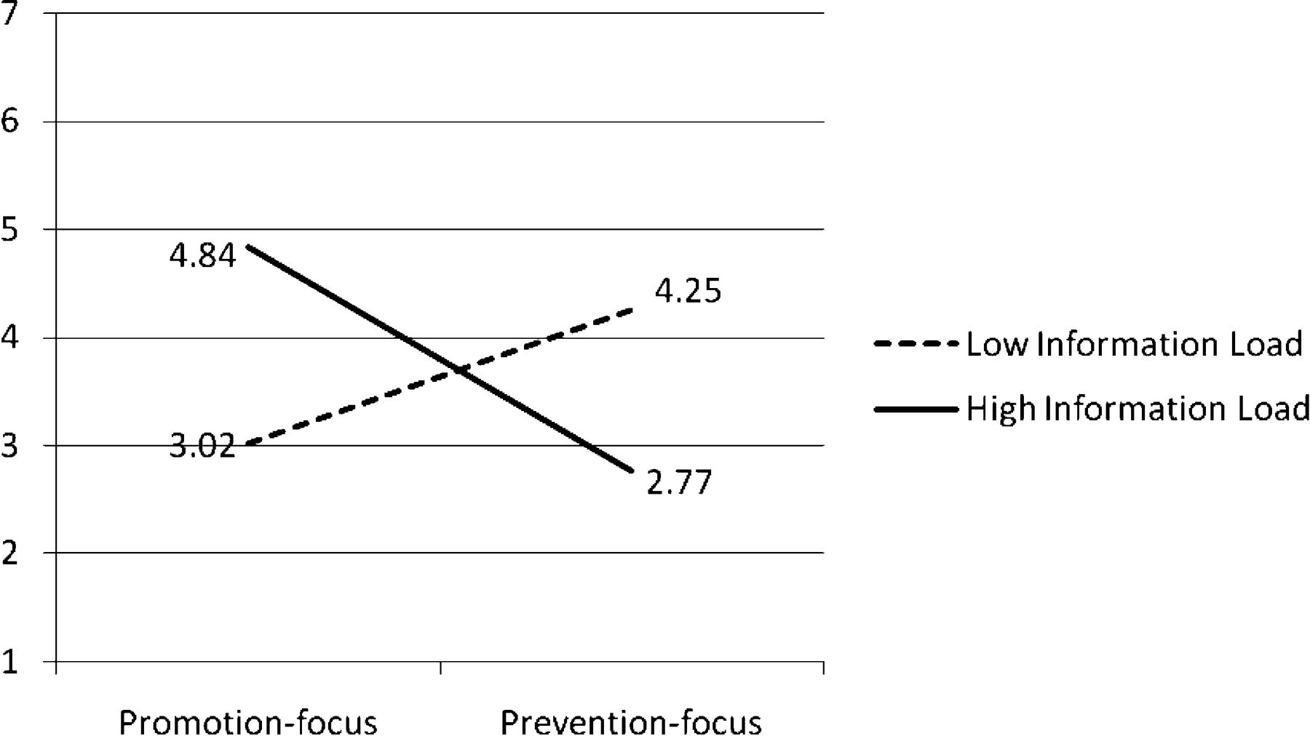
Figure 4. Brand Evaluations (Study 4)
Notes:
Figure 4. Brand Evaluations (Study 4)
Unless provided in the caption above, the following copyright applies to the content of this slide: © 2011 by JOURNAL OF CONSUMER RESEARCH, Inc.

