Slide 1
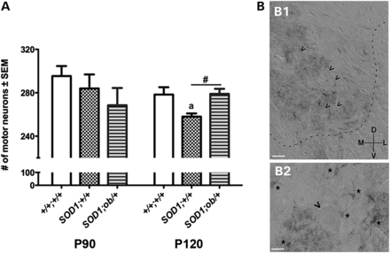
Figure 7. Leptin-deficient, mutant SOD1 mice display rescued motor neuron loss despite lacking expression of the leptin ...
Notes:
Figure 7. Leptin-deficient, mutant SOD1 mice display rescued motor neuron loss despite lacking expression of the leptin receptor Ob-Rb by motor neurons. (A) At P120, but not P90, significant motor neuron loss occurs in the lumbar spinal cord of SOD1;+/+ compared with +/+;+/+ mice (aP < 0.007). Motor neuron loss is rescued in SOD1;ob/+ mice (#P = 0.003). n ≥ 3. Error bars ± SEM. (B) Ob-Rb localization in spinal ventral horn. (B1) Immunohistological staining of the spinal cord for the leptin receptor Ob-Rb. The ventral horn is shown and the gray–white junction is outlined with a dashed line. The orientation is shown in the lower left: ‘D’, dorsal; ‘V’, ventral; ‘M’, medial and ‘L’, lateral. In this differential contrast image, motor neurons are highlighted by the ‘<’ symbol and at least 5 are visible in this focal plane. Numerous small immunoreactive cells are seen but motor neurons are not immunostained. Calibration bar = 45 μm. (B2) Higher power image of a single motor neuron (identified by ‘<’ symbol) and many small immunoreactive cells (identified by ‘*’ symbol). These small immunopositive cells bear processes and several are juxtaposed to the motor neuron. Calibration bar = 23 μm.
Unless provided in the caption above, the following copyright applies to the content of this slide: © The Author 2014. Published by Oxford University Press. All rights reserved. For Permissions, please email: journals.permissions@oup.com

Slide 2
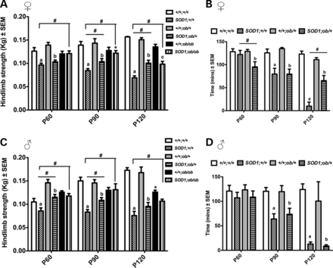
Figure 6. Leptin-deficient, mutant SOD1 mice display improved motor function. (A) Mutant SOD1 females show progressive ...
Notes:
Figure 6. Leptin-deficient, mutant SOD1 mice display improved motor function. (A) Mutant SOD1 females show progressive hind limb weakening compared with non-Tg controls (aP < 0.0001, bP < 0.002 and cP < 0.0003). Compared with SOD1;+/+ mice, SOD1;ob/+ and SOD1;ob/ob females possess improved hind limb grip strength at several disease time points (#P < 0.01). Except for a modest decrease in hind limb grip strength of +/+;ob/ob compared with +/+;ob/+ animals at P90 (*P = 0.02), there are no other differences among non-Tg controls. (B) Compared with non-Tg mice, both female SOD1;+/+ and SOD1;ob/+ mice show decreased time on the treadmill (aP < 0.005, bP < 0.03); however, P120 SOD1;ob/+ mice run significantly longer than SOD1;+/+ mice (#P < 0.02). n ≥ 10. (C) Mutant SOD1 males show progressive hind limb weakening compared with non-Tg controls (aP < 0.0001, bP < 0.006). Compared with SOD1;+/+ mice, SOD1;ob/+ and SOD1;ob/ob males possess improved hind limb grip strength at several disease time points (#P ≤ 0.05). P120 +/+;ob/ob males show decreased hind limb strength compared with other non-Tg controls (*P ≤ 0.003). For all hind limb tests, n ≥ 10, except in +/+;ob/ob and SOD1;ob/ob animals, n = 4. (D) SOD1;+/+ and SOD1;ob/+ males show decreased time on the treadmill compared with non-Tg controls (aP ≤ 0.0005, bP ≤ 0.03). n ≥ 4. Error bars ± SEM. aSignificantly different from +/+;/+/+, bsignificantly different from +/+;ob/+, csignificantly different from +/+;ob/ob, #significantly different from SOD1;ob/+ and/or SOD1;ob/ob, * significantly different from +/+;+/+ and +/+;ob/+ or SOD;+/+ and SOD1;ob/+.
Unless provided in the caption above, the following copyright applies to the content of this slide: © The Author 2014. Published by Oxford University Press. All rights reserved. For Permissions, please email: journals.permissions@oup.com

Slide 3
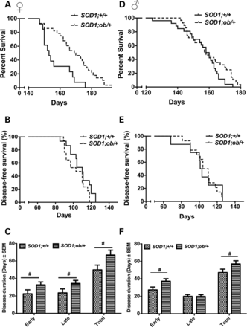
Figure 5. Leptin-deficient, mutant SOD1 mice demonstrate increased survival. (A). Kaplan–Meir survival plots for female ...
Notes:
Figure 5. Leptin-deficient, mutant SOD1 mice demonstrate increased survival. (A). Kaplan–Meir survival plots for female mice. SOD1;ob/+ females live longer than SOD1,+/+ mice (P = 0.0030 by Wilcoxon test). n ≥ 13. (B) Kaplan–Meir survival plots for disease onset in female mice. Between genotypes, there is no significant difference in disease onset, as measured by the day that peak bodyweight was attained (P = 0.7035 by Wilcoxon test). (C) Compared with SOD1;+/+, SOD1;ob/+ females show increased duration of the early (#P = 0.0409) and late phases of disease (#P = 0.0356), as well as total disease duration (#P = 0.0226). n ≥ 8. (D) Kaplan–Meir survival plots for male mice. SOD1;ob/+ males do not live significantly longer than SOD1;+/+ mice (P = 0.4202 by Wilcoxon test). n ≥ 26. (E) Kaplan–Meir survival plots for disease onset in male mice. There is no significant difference in disease onset between male genotypes (P = 0.1622 by Wilcoxon test). (F) Compared with SOD1;+/+, SOD1;ob/+ males show increased duration of the early (#P = 0.0136) but not late phase of disease (P = 0.4868), as well as an overall increase in disease duration (#P = 0.0367). n ≥ 15. Error bars ± SEM.
Unless provided in the caption above, the following copyright applies to the content of this slide: © The Author 2014. Published by Oxford University Press. All rights reserved. For Permissions, please email: journals.permissions@oup.com

Slide 4
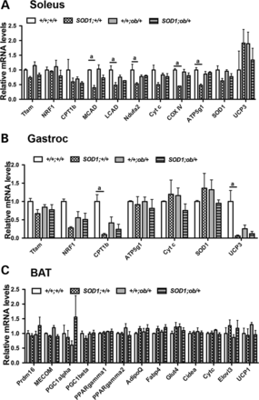
Figure 4. Expression of metabolic genes in skeletal muscle and BAT of mutant SOD1 mice. (A) Isolated soleus muscle from ...
Notes:
Figure 4. Expression of metabolic genes in skeletal muscle and BAT of mutant SOD1 mice. (A) Isolated soleus muscle from P120 mice show significant reductions in transcript expression of genes involved in FAO, such as MCAD and LCAD (aP < 0.05), as well as ETC activity, such as Ndufa2, COXIV and ATP5g1 (aP < 0.05). Partial rescue was obtained in SOD1;ob/+ mice for MCAD, Ndufa2, COXIV and ATP5g1, although this did not attain significance. (B) Isolated gastrocnemius (gastroc) muscle from P120 mice do not show coordinated changes in the transcript expression profiles of key metabolic genes, except significant reductions between +/+;+/+ and SOD1;+/+ mice in the expression of CPT1B (aP < 0.05) and UCP3 (aP < 0.001). No rescue was obtained in SOD1;ob/+ for both genes. (C) Isolated BAT do not show changes in gene expression. n ≥ 3. Error bars ± SEM.
Unless provided in the caption above, the following copyright applies to the content of this slide: © The Author 2014. Published by Oxford University Press. All rights reserved. For Permissions, please email: journals.permissions@oup.com

Slide 5
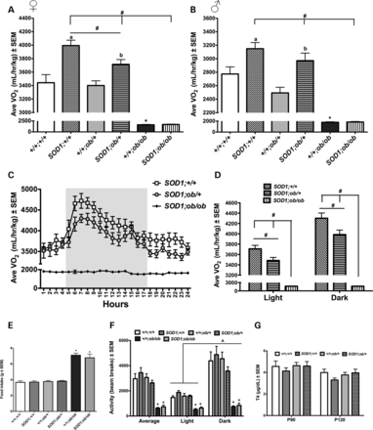
Figure 3. Leptin-deficient, mutant SOD1 females exhibit decreased energy expenditure. Average VO₂ levels in ...
Notes:
Figure 3. Leptin-deficient, mutant SOD1 females exhibit decreased energy expenditure. Average VO2 levels in female (A) and male (B) mice. In both sexes, average VO2 levels are significantly elevated in SOD1;+/+ compared with +/+;+/+ mice (aP < 0.04). (A) Although SOD1;ob/+ females still show elevated energy expenditure compared with +/+;ob/+ mice (bP < 0.008), they demonstrate reduced average VO2 levels compared with SOD1;+/+ mice (#P = 0.02). SOD1;ob/ob females also show decreased average VO2 levels compared with SOD1;+/+ mice (#P < 0.0001), with no difference compared with +/+;ob/ob mice. (B) Among males, only SOD1;ob/ob mice show reduced VO2 levels compared with SOD1;+/+ and SOD1;ob/+ mice (#P < 0.0001). For both males and females, control +/+;ob/ob mice show decreased VO2 levels compared with all other genotypes (*P < 0.0001). For (A) and (B), n ≥ 8 except for ob/ob mice, n ≥ 3. (C) Energy expenditure in P120 mutant SOD1 females across a 24-h time period. Gray shading indicates duration of dark cycle. (D) Quantification of data in (C), divided into average VO2 levels during the light and dark cycles. Reduced VO2 levels in leptin-deficient mice are found during both cycles (#P ≤ 0.05). (E) With exemption of leptin null mice (*P < 0.0001), all genotypes consumed the same amount of food during a 24-h period. n ≥ 5 except for ob/ob mice, n ≥ 3. (F) With the exemption of leptin null mice (*P < 0.0001), there were no significant differences in average activity levels (X-axis beam breaks) among genotypes, whether it was during the light or dark cycles. All mice were more active during the dark phase (^P ≤ 0.0001). n ≥ 10 except for ob/ob mice, n ≥ 3. (G) There are no differences in serum T4 levels among genotypes. n ≥ 7. Error bars ± SEM. aSignificantly different from +/+;/+/+, bsignificantly different from +/+;ob/+, #significantly different from SOD1;/+/+ and/or SOD1;ob/+, *significantly different from +/+;+/+ and +/+;ob/+ or SOD;+/+ and SOD1;ob/+, ^ significantly different from light cycle.
Unless provided in the caption above, the following copyright applies to the content of this slide: © The Author 2014. Published by Oxford University Press. All rights reserved. For Permissions, please email: journals.permissions@oup.com

Slide 6
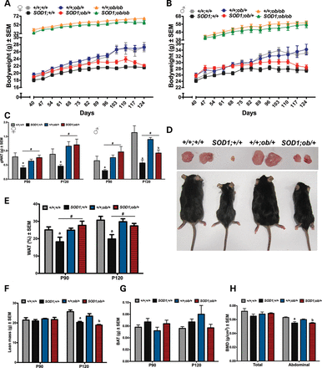
Figure 2. Leptin-deficient, mutant SOD1 mice display improved bodyweight and WAT mass. Female (A) and male (B) non-Tg ...
Notes:
Figure 2. Leptin-deficient, mutant SOD1 mice display improved bodyweight and WAT mass. Female (A) and male (B) non-Tg mice gain weight between P40 and ∼P120. Although the bodyweight of mutant SOD1 animals start plateauing around P90, leptin-deficient SOD1;ob/+ and SOD1;ob/ob still weigh more compared with SOD1;+/+ mice. n ≥ 7. (C) SOD1;+/+ animals have significantly less gonadal WAT (gWAT) than +/+;+/+ mice (aP ≤ 0.05), which is rescued in SOD1;ob/+ animals at P90 (#P < 0.04) and P120 (#P < 0.008). n ≥ 5. (D) P150 mice and respective gonadal WAT pads. Cachexia is attenuated in SOD1;ob/+ mice. (E) As measured by DEXA scan, the total % of WAT is less in SOD1;+/+ compared with +/+;+/+ mice at P90 (aP = 0.047) and P120 (aP < 0.001). This defect is rescued in SOD1;ob/+ mice (#P < 0.02). n ≥ 3. (F) Total lean mass is decreased in P120 mutant SOD1 compared with non-Tg mice (a,bP ≤ 0.002). n ≥ 3. (G) There are no differences in BAT weight among genotypes. n ≥ 5. (H) P120 mutant SOD1 animals possess significantly less abdominal BMD compared with non-Tg controls (a,bP < 0.04). n ≥ 3. Error bars ± SEM. aSignificantly different from +/+;/+/+, bsignificantly different from +/+;ob/+, #significantly different from SOD1;/+/+.
Unless provided in the caption above, the following copyright applies to the content of this slide: © The Author 2014. Published by Oxford University Press. All rights reserved. For Permissions, please email: journals.permissions@oup.com

Slide 7
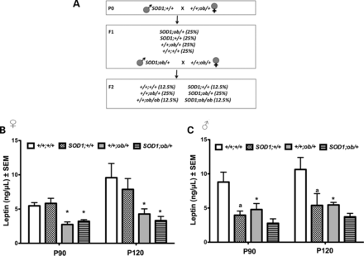
Figure 1. (A) Two-step breeding strategy to generate leptin-deficient mutant SOD1 mice. In parenthesis are the expected ...
Notes:
Figure 1. (A) Two-step breeding strategy to generate leptin-deficient mutant SOD1 mice. In parenthesis are the expected genotype frequencies. (B) Serum leptin levels from P90 and P120 mice. Leptin-haploinsufficient mice possess 50% of wild-type serum leptin levels (*P < 0.05). Only SOD1;+/+ males possess significantly decreased serum leptin levels at both P90 and P120 (aP < 0.05). n ≥ 7. Error bars ± SEM.
Unless provided in the caption above, the following copyright applies to the content of this slide: © The Author 2014. Published by Oxford University Press. All rights reserved. For Permissions, please email: journals.permissions@oup.com

