Slide 1
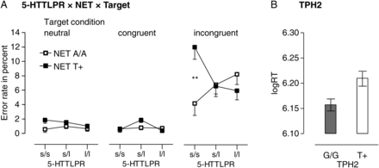
Figure 1. (A) Interaction of 5-HTTLPR with NET (P = 0.003) on error rate (in percent) as a function of target type ...
Notes:
Figure 1. (A) Interaction of 5-HTTLPR with NET (P = 0.003) on error rate (in percent) as a function of target type (neutral, congruent, and incongruent) with the comparison on incongruent targets remaining significant after FDR correction for multiple comparisons; (B) effect of TPH2 (P = 0.008) on log-transformed reaction time (logRT) averaged across targets; **P < 0.01.
Unless provided in the caption above, the following copyright applies to the content of this slide: © The Author 2012. Published by Oxford University Press. All rights reserved. For Permissions, please e-mail: journals.permissions@oup.com

Slide 2
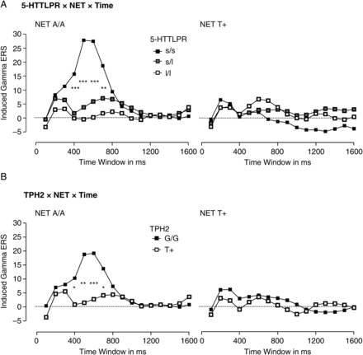
Figure 2. Simple comparisons between genotype groups in the time–frequency domain based on interactions of (A) 5-HTTLPR ...
Notes:
Figure 2. Simple comparisons between genotype groups in the time–frequency domain based on interactions of (A) 5-HTTLPR with NET (P = 0.023) and (B) of TPH2 with NET (P = 0.064) on ERS in the induced gamma-band frequency range in percent as a function of time; conventional P values: *P < 0.05, **P < 0.01, ***P < 0.001. Note that for (A) all comparisons and for (B) the comparisons between 400 and 600 ms remained significant after FDR correction for multiple comparisons.
Unless provided in the caption above, the following copyright applies to the content of this slide: © The Author 2012. Published by Oxford University Press. All rights reserved. For Permissions, please e-mail: journals.permissions@oup.com

