Slide 1
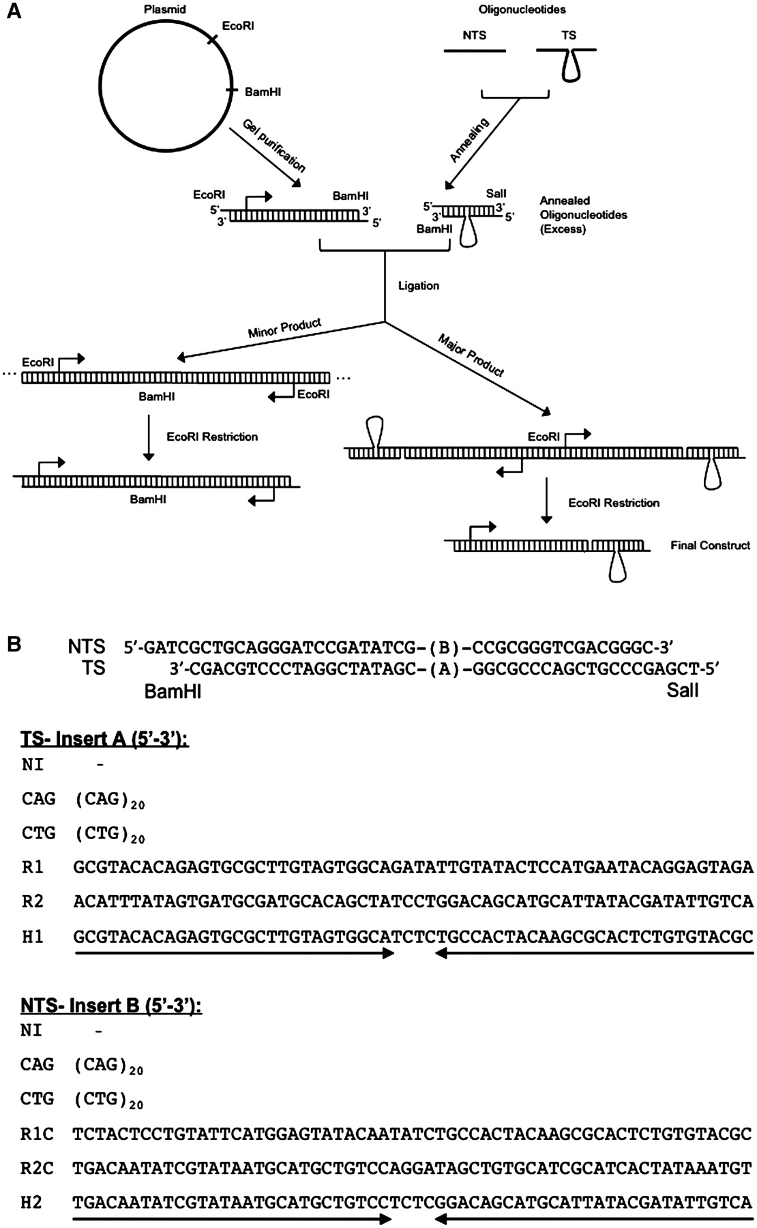
Figure 1. ( A ) Preparation of DNA substrates. The plasmid was cut with restriction enzymes EcoRI and BamHI to yield a ...
Notes:
Figure 1. ( A ) Preparation of DNA substrates. The plasmid was cut with restriction enzymes EcoRI and BamHI to yield a fragment containing the T7 RNAP and RNAPII promoters. Oligonucleotides were designed such that, when annealed, they would produce a slip-out and contain BamHI and SalI sticky ends. The olgonucleotides were ligated to the promoter fragment through the BamHI site. Oligonucleotides were not 5′ phosphorylated in order to prevent self-ligation and were used in excess to promote ligation of most promoter fragments to an oligonucleotide. A minor fraction, consisting of promoter fragments ligated through the BamHI site still appeared, however, this fraction does not interfere with our analysis because its transcription product is longer than that produced by our construct of interest. Due to lack of 5′ phosphorylation of oligonucleotides, our substrates contain a nick in the NTS, however, the presence of a nick on the NTS had no effect on the observed transcription arrest ( Supplementary Figure SI6 ). Ligation was followed by EcoRI digestion to obtain the final substrates containing one promoter fragment, with T7 RNAP and RNAPII promoters (designated by the arrow), and a slip-out. ( B ) Sequences used in this study. Oligonucleotides sequences, which will become the TS or the NTS when ligated to a promoter fragment, are shown. Different combinations of oligonucleotides result in different inserts in the middle but have the same flanking sequence (shown on top). The sequence of different inserts is indicated in the 5′ to 3′ direction. NI (‘No insert’) refers to oligonucleotides containing only the flanking sequence. The designation of inserts is as follows: CAG, 20 CAG repeats; CTG, 20 CTG repeats; R1, random sequence; R1C, complementary to R1; R2, random sequence; R2C, complementary to R2; H1, capable of forming a perfect hairpin; H2, capable of forming a perfect hairpin.
Unless provided in the caption above, the following copyright applies to the content of this slide: © The Author(s) 2011. Published by Oxford University Press.This is an Open Access article distributed under the terms of the Creative Commons Attribution Non-Commercial License (http://creativecommons.org/licenses/by-nc/3.0), which permits unrestricted non-commercial use, distribution, and reproduction in any medium, provided the original work is properly cited.

Slide 2
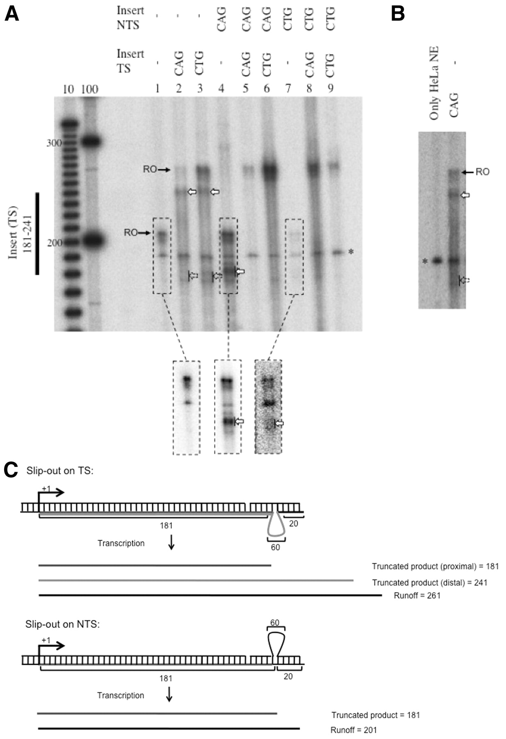
Figure 2. ( A ) RNAPII transcription is arrested by a CTG or CAG slip-out on either TS or NTS in HeLa NE. Runoff ...
Notes:
Figure 2. ( A ) RNAPII transcription is arrested by a CTG or CAG slip-out on either TS or NTS in HeLa NE. Runoff products (indicated by black arrows and RO) appeared as expected (201 nt for no insert on TS and 261 nt for CAG or CTG insert on TS). Run-off products often contained several closely located bands, probably due to either somewhat increased probability of spontaneous transcription termination near the end of substrates or template independent addition of several nucleotides to the runoff transcript. This heterogeneity occurs in close vicinity of run-off product and does not affect interpretation of our results. Truncated products appeared at ∼240 nt and at ∼180 nt for constructs with a CTG hairpin or a CAG loop on the TS. Truncated products also appeared at ∼180 nt when a CAG or CTG slip-out was on the NTS. Pronounced products are indicated by white-block arrows and less pronounced products are indicated by dashed-block arrows. Dashed boxes show magnification of that area with contrast. Asterisk (*) indicates a 190-nt band that appears in extract even without DNA substrates (see B ). (B) Band at 190 nt in HeLa NE is independent of DNA substrates. Transcription reaction was performed in the absence of DNA substrates (lane 1) and the band at 190 nt was still present. ( C ) Diagram of truncated products that appear when a CTG or CAG slip-out is on either the transcribed or NTS. When a slip-out was on the TS, truncated products correspond to proximal (181 nt) and distal (241 nt) end of the slip-out. When a slip-out was on the NTS, truncated products correspond to the position of the slip-out (181 nt).
Unless provided in the caption above, the following copyright applies to the content of this slide: © The Author(s) 2011. Published by Oxford University Press.This is an Open Access article distributed under the terms of the Creative Commons Attribution Non-Commercial License (http://creativecommons.org/licenses/by-nc/3.0), which permits unrestricted non-commercial use, distribution, and reproduction in any medium, provided the original work is properly cited.

Slide 3
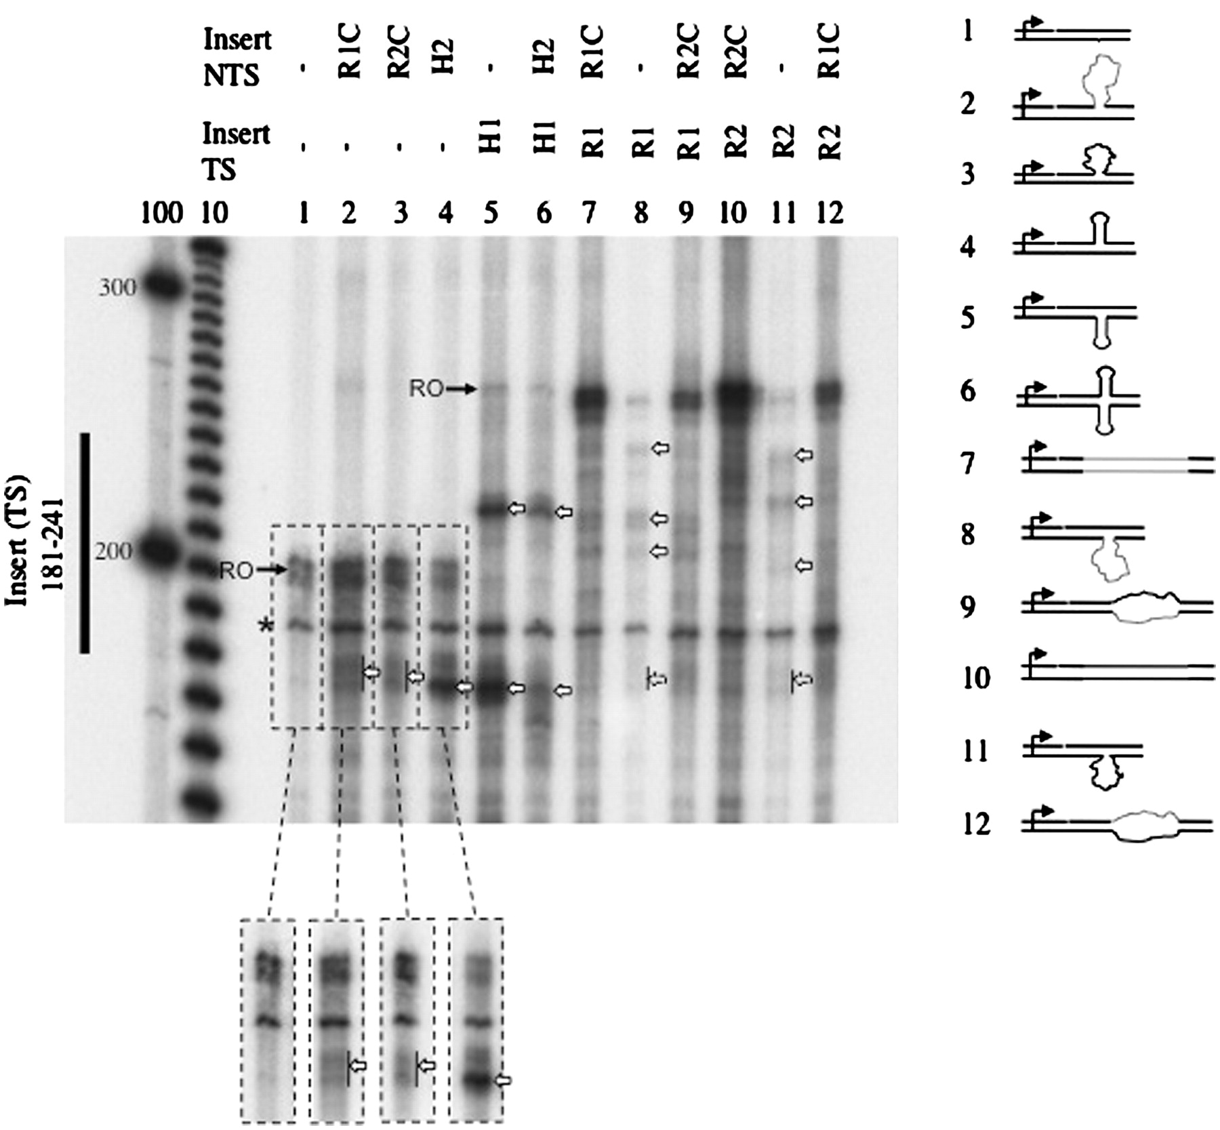
Figure 3. RNAPII transcription is arrested by a hairpin or loop on either strand. Hairpin or loop structures present on ...
Notes:
Figure 3. RNAPII transcription is arrested by a hairpin or loop on either strand. Hairpin or loop structures present on the TS or NTS cause RNAPII arrest. Runoff (full-length) transcripts (indicated by a black arrow and RO) appeared at 201 nt, as expected, for constructs containing no insert on TS and 261 nt for those with an insert on TS. The presence of a hairpin or loop on the TS gave rise to a complicated pattern of blockage. The presence of a hairpin or loop on the NTS gave rise to truncated products at ∼170–180 nt. White arrows indicate truncated products with intensity comparable to or exceeding that of the run-off and dashed-block arrows indicate less pronounced blockage that is still comparable to the runoff. The designation of inserts is as follows: (−), no insert; R1, random sequence; R1C, complementary to R1; R2, random sequence; R2C, complementary to R2; H1, capable of forming a perfect hairpin; H2, capable of forming a perfect hairpin.
Unless provided in the caption above, the following copyright applies to the content of this slide: © The Author(s) 2011. Published by Oxford University Press.This is an Open Access article distributed under the terms of the Creative Commons Attribution Non-Commercial License (http://creativecommons.org/licenses/by-nc/3.0), which permits unrestricted non-commercial use, distribution, and reproduction in any medium, provided the original work is properly cited.

Slide 4
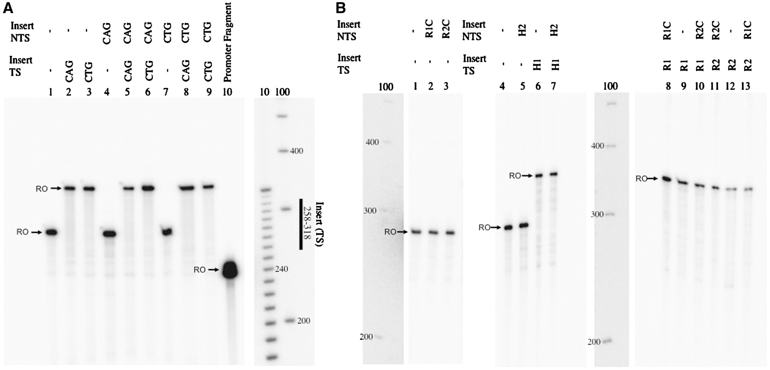
Figure 4. T7 RNAP transcription in a purified system is not arrested by a DNA slip-out. ( A ) T7 RNAP transcription ...
Notes:
Figure 4. T7 RNAP transcription in a purified system is not arrested by a DNA slip-out. ( A ) T7 RNAP transcription was performed using DNA substrates containing CAG or CTG slip-outs. Transcription product sizes were as expected for full length transcripts (indicated by a black arrow and RO), 278 nt for constructs with no insert in TS and 338 nt for those with either an insert on the TS and no truncated products appeared for any of the tested substrates. ( B ) T7 RNAP transcription of substrates with a hairpin or a loop produced full-length transcripts (338 nt or 278 nt) and no truncated products.
Unless provided in the caption above, the following copyright applies to the content of this slide: © The Author(s) 2011. Published by Oxford University Press.This is an Open Access article distributed under the terms of the Creative Commons Attribution Non-Commercial License (http://creativecommons.org/licenses/by-nc/3.0), which permits unrestricted non-commercial use, distribution, and reproduction in any medium, provided the original work is properly cited.

Slide 5
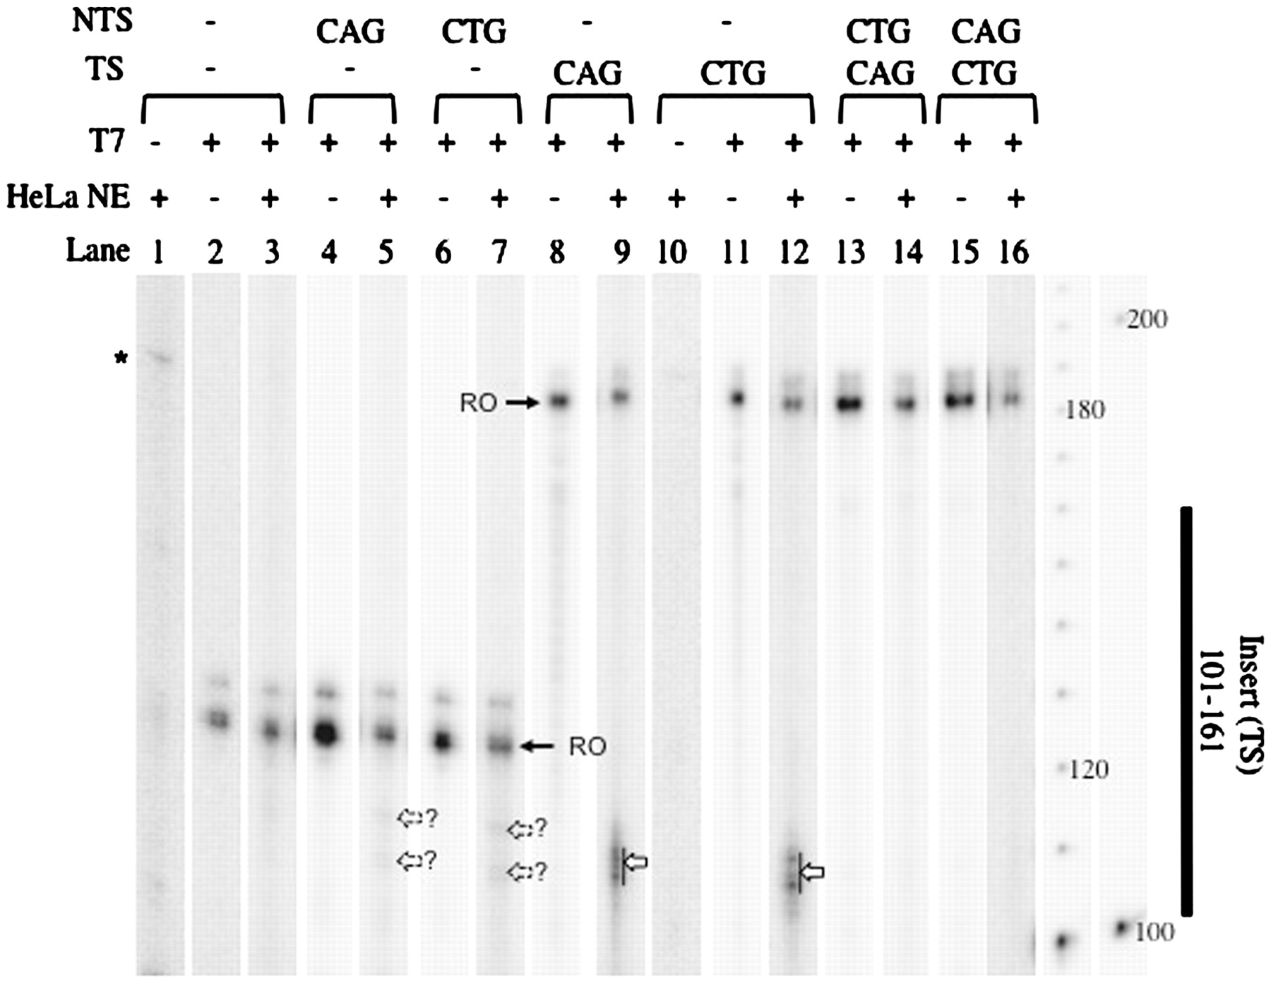
Figure 5. Addition of nuclear extracts causes partial T7 RNAP transcription arrest by a CAG or CTG slip-out. DNA ...
Notes:
Figure 5. Addition of nuclear extracts causes partial T7 RNAP transcription arrest by a CAG or CTG slip-out. DNA substrates contained only the T7 RNAP promoter and the RNAPII protocol for transcription was followed with addition of T7 RNAP. Full-length products (indicated by a black arrow and RO) appeared, as expected at 181 or 121 nt. Truncated products appeared when the slip-out was on the TS at ∼100–110 nt (lanes 9 and 12). For substrates with a CAG or CTG slip-out on the non-TS, two very faint bands appear at ∼100–110 nt in the presence of nuclear extracts (lanes 5 and 7, indicated by dashed arrow). Overall T7 RNAP transcription was weaker in the presence of nuclear extracts; therefore each lane is shown separately to have comparable exposures. Lanes 1 and 10 show a control in which reactions were performed without the addition of T7 RNAP and as expected, no transcription products appear. The 190-nt band, which was observed on all previous experiments using nuclear extracts, is not readily seen here because of lower exposure of the gel, which is required to not overexpose the run-off products, since the yield is much higher for T7 RNAP than for RNAPII. However, the band is seen in lane 1 (control where no transcription is taking place) as it is shown with a higher exposure.
Unless provided in the caption above, the following copyright applies to the content of this slide: © The Author(s) 2011. Published by Oxford University Press.This is an Open Access article distributed under the terms of the Creative Commons Attribution Non-Commercial License (http://creativecommons.org/licenses/by-nc/3.0), which permits unrestricted non-commercial use, distribution, and reproduction in any medium, provided the original work is properly cited.

Slide 6
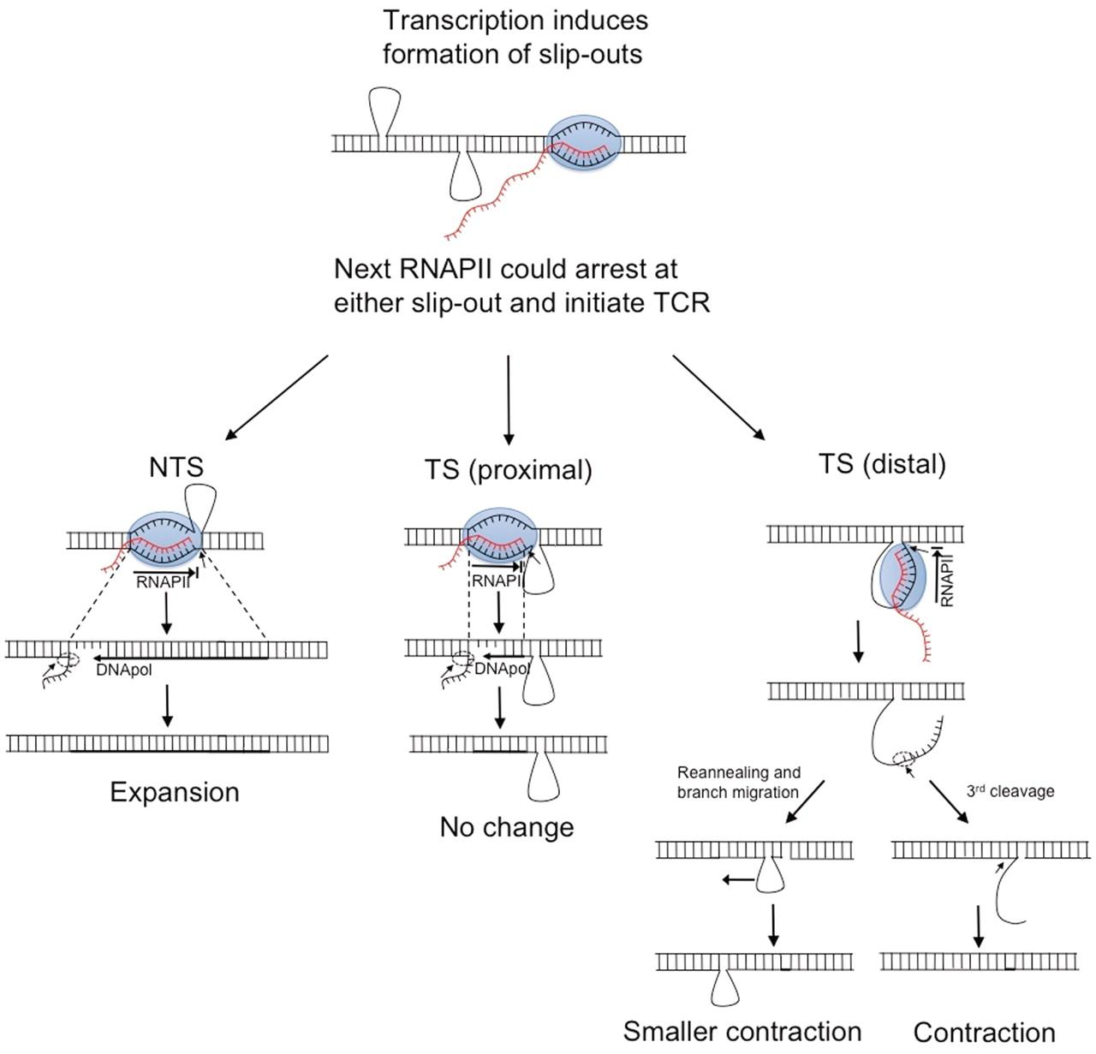
Figure 6. Model for transcription-dependent repeat instability. In genes involved in polyglutamine diseases CTG repeats ...
Notes:
Figure 6. Model for transcription-dependent repeat instability. In genes involved in polyglutamine diseases CTG repeats are present on the TS and CAG repeats are on the NTS. After the passing of RNAPII has induced the formation of slipped-strand structures, the next RNAPII can arrest at either a CAG slip-out on the NTS or a CTG slip-out on the TS (at either the proximal or distal position). If arrest at a CAG slip-out on the NTS initiates TCR and repair proteins cut the TS, the CAG slip-out would get copied during repair patch formation leading to expansion. TCR due to arrest at the proximal end of the CTG slip-out on the TS could lead to no change in repeat number if incisions are made before the slip-out. TCR due to arrest at the distal end of the CTG slip-out, which is bigger than the transcription bubble, on the TS could lead to either complete contraction of the slip-out or a smaller contraction. If, after the TCR has excised the DNA fragment, the remaining slip-out re-anneals and branch migrates it would escape further contraction. However, complete contraction could occur if an additional cleavage event occurs, removing the remaining part of the slip-out.
Unless provided in the caption above, the following copyright applies to the content of this slide: © The Author(s) 2011. Published by Oxford University Press.This is an Open Access article distributed under the terms of the Creative Commons Attribution Non-Commercial License (http://creativecommons.org/licenses/by-nc/3.0), which permits unrestricted non-commercial use, distribution, and reproduction in any medium, provided the original work is properly cited.

