Slide 1
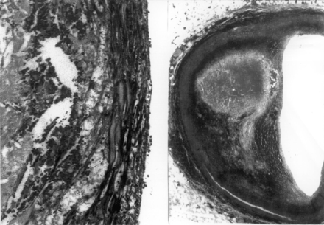
Fig. 1 Histopathologic section of a human coronary atheroma. At low magnification (right panel), a large lipid core ...
Notes:
Fig. 1 Histopathologic section of a human coronary atheroma. At low magnification (right panel), a large lipid core and thin fibrous cap are clearly evident. Higher power (left panel) reveals foam cell infiltration into the fibrous cap. Erythrocytes are noted in the lipid core just below the fibrous cap, the result of incipient cap disruption or intra-plaque hemorrhage. Reproduced with permission [8].
Unless provided in the caption above, the following copyright applies to the content of this slide: Copyright © 1999, European Society of Cardiology

Slide 2
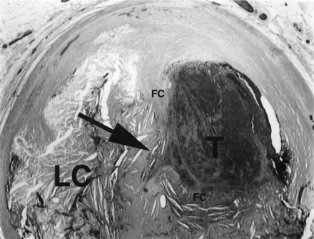
Fig. 2 Photomicrograph demonstrating plaque rupture in a human coronary atherosclerotic lesion with overlying ...
Notes:
Fig. 2 Photomicrograph demonstrating plaque rupture in a human coronary atherosclerotic lesion with overlying occlusive thrombus (T). The arrow indicates the site of disruption of the fibrous cap (FC) of the lesion. The lipid core (LC) is noted underneath the fibrous cap. Courtesy of Dr. John T. Fallon.
Unless provided in the caption above, the following copyright applies to the content of this slide: Copyright © 1999, European Society of Cardiology

Slide 3
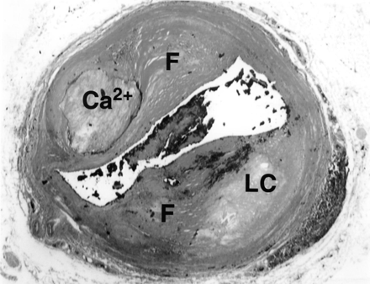
Fig. 3 Chronic stenotic atheromatous lesions in the human coronary artery. The lesion on the upper left-hand portion ...
Notes:
Fig. 3 Chronic stenotic atheromatous lesions in the human coronary artery. The lesion on the upper left-hand portion of the section is typical of a calcified type Vb lesion, in which fibrous connective tissue (F) surrounds an area of calcium deposition (Ca2+), which has replaced the lipid core. A fibrotic type Vc lesion is noted on the lower right-hand portion of the section, containing dense fibrotic tissue (F) overlying the lipid core (LC). Courtesy of Dr. John T. Fallon.
Unless provided in the caption above, the following copyright applies to the content of this slide: Copyright © 1999, European Society of Cardiology

Slide 4
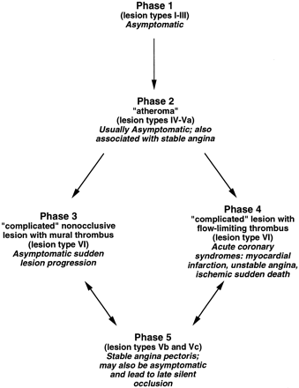
Fig. 4 Schematic representation of the phases of atherosclerotic lesion progression, and the associated pathologic ...
Notes:
Fig. 4 Schematic representation of the phases of atherosclerotic lesion progression, and the associated pathologic lesion types and clinical syndromes. Adapted with permission [34].
Unless provided in the caption above, the following copyright applies to the content of this slide: Copyright © 1999, European Society of Cardiology

Slide 5
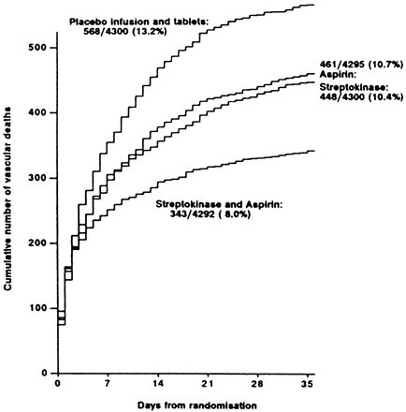
Fig. 5 Vascular mortality data in the first 35 days after acute myocardial infarction in the Second International ...
Notes:
Fig. 5 Vascular mortality data in the first 35 days after acute myocardial infarction in the Second International Study of Infarct Survival (ISIS-2). Reproduced with permission [11].
Unless provided in the caption above, the following copyright applies to the content of this slide: Copyright © 1999, European Society of Cardiology

