Slide 1
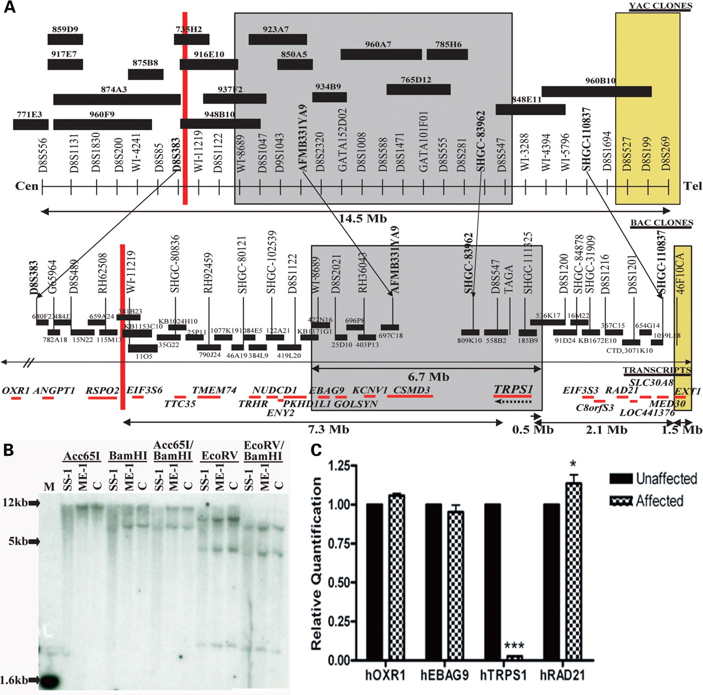
Figure 1. Genetic rearrangements in human chromosome 8q that result in Ambras syndrome. (A) Patient ME-1 has a ...
Notes:
Figure 1. Genetic rearrangements in human chromosome 8q that result in Ambras syndrome. (A) Patient ME-1 has a pericentric inversion with a breakpoint in 8q23.1 that lies 7.3 Mb downstream of TRPS1 (red line). Patient SS-1 has a 6.7 Mb deletion in 8q23 that encompasses TRPS1 (gray box). Patient BN-1 has a 1.5 Mb deletion in 8q24, 2.1 Mb upstream of TRPS1 (yellow box). (B) Southern blot analysis using a TRPS1 cDNA probe revealed less intense hybridization signals in patient SS-1 than in a control individual. No differences were detected between hybridization signals in patient ME-1 and a control individual. (C) A bar graph depicting quantitative reverse transcriptase-polymerase chain reaction values for OXR1, EBAG9, TRPS1 and RAD21 in the lymphoblasts of patient ME-1 and an unaffected parent. Data are represented as mean ± SD. Patient ME-1 had a significant reduction in TRPS1 expression.
Unless provided in the caption above, the following copyright applies to the content of this slide: © The Author 2008. Published by Oxford University Press. All rights reserved. For Permissions, please email: journals.permissions@oxfordjournals.org

Slide 2
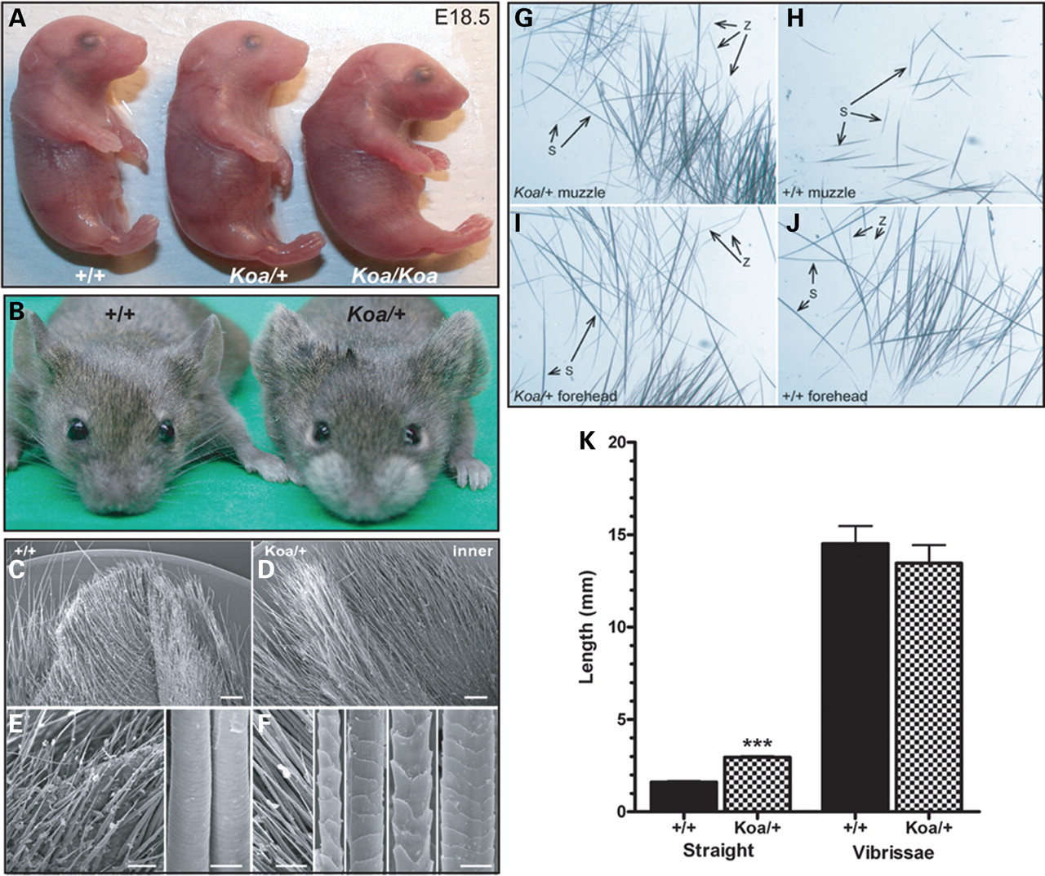
Figure 2. Hair abnormalities in Koa mutant mice. (A) Koa/Koa embryos are smaller than their Koa/+ and wild-type ...
Notes:
Figure 2. Hair abnormalities in Koa mutant mice. (A) Koa/Koa embryos are smaller than their Koa/+ and wild-type littermates at E18.5, with a curved back and a flatter, wider head. (B) Koa/+ mice have long hair on both surfaces of the pinnae of the ears and around the muzzle. (C–F) Scanning electron microscopy revealed that the inner surface of the Koa/+ pinna is obscured by a dense population of long, heterogeneous hair fibers that resemble pelage hair types, specifically auchene, awl, guard and zigzag. (G–J) Whereas only straight hairs were detected in a wild-type muzzle (excluding vibrissae), both straight and zigzag hairs were found in a Koa/+ muzzle. Both straight and zigzag hairs were present in the foreheads of wild-type and Koa/+ mice. (K) A bar graph illustrating that the straight hairs on the Koa/+ muzzle were significantly longer than the straight hairs on the wild-type muzzle, whereas the difference in length of vibrissae hairs was not statistically significant. Data are represented as mean ± SD.
Unless provided in the caption above, the following copyright applies to the content of this slide: © The Author 2008. Published by Oxford University Press. All rights reserved. For Permissions, please email: journals.permissions@oxfordjournals.org

Slide 3
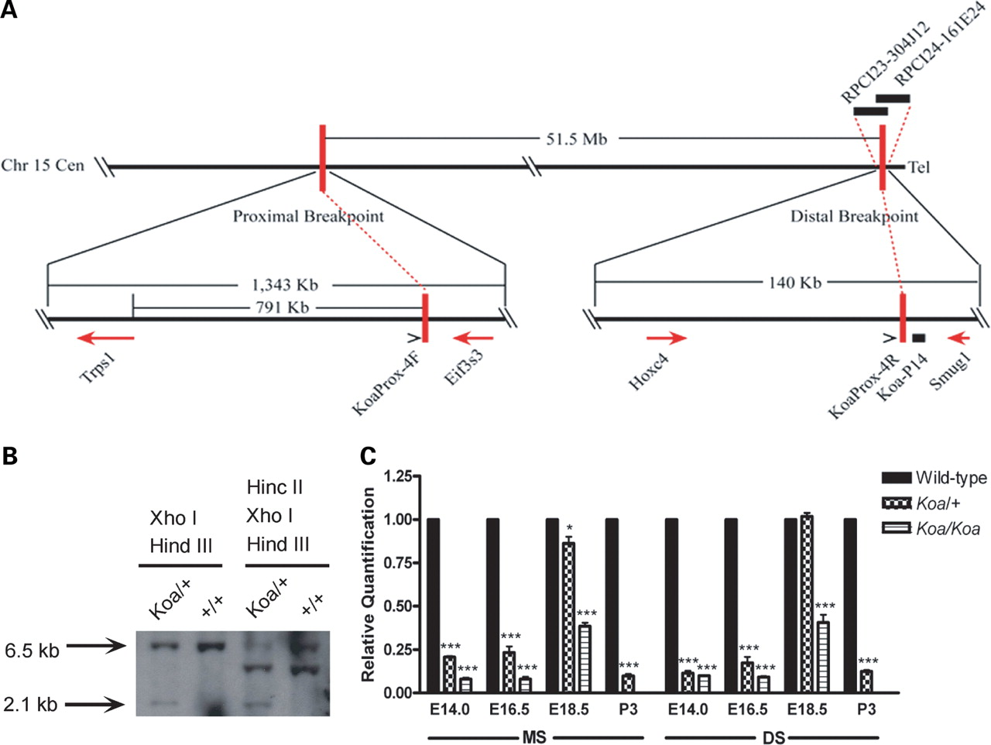
Figure 3. Characterization of the Koa inversion mutation. (A) The Koa phenotype is due to a 51.5 Mb inversion on mouse ...
Notes:
Figure 3. Characterization of the Koa inversion mutation. (A) The Koa phenotype is due to a 51.5 Mb inversion on mouse chromosome 15. The proximal Koa inversion breakpoint was mapped between Trps1 and Eif3s3, 791 kb upstream of Trps1. The distal inversion breakpoint falls between Hoxc4 and Smug1. (B) Southern blot analysis using probe Koa-P14 identified a 2.1 kb band of altered size in a Koa/+ mouse that was not present in its +/+ littermate. (C) A bar graph depicting quantitative real time-polymerase chain reaction values for Trps1 expression in the muzzle skin (MS) and dorsal skin (DS) at E14.0, E16.5, E18.5 and P3 in wild-type, Koa/+ and Koa/Koa mice. Data are represented as mean ± SD. Trps1 expression was significantly reduced in both Koa/+ and Koa/Koa MS at all timepoints examined, with lower expression in the homozygous mutants than in heterozygous mice. Trps1 expression was significantly reduced in both Koa/+ and Koa/Koa samples at E14.0, E16.5 and P3 in the DS. Trps1 expression differences were less extreme in the MS and DS at E18.5.
Unless provided in the caption above, the following copyright applies to the content of this slide: © The Author 2008. Published by Oxford University Press. All rights reserved. For Permissions, please email: journals.permissions@oxfordjournals.org

Slide 4
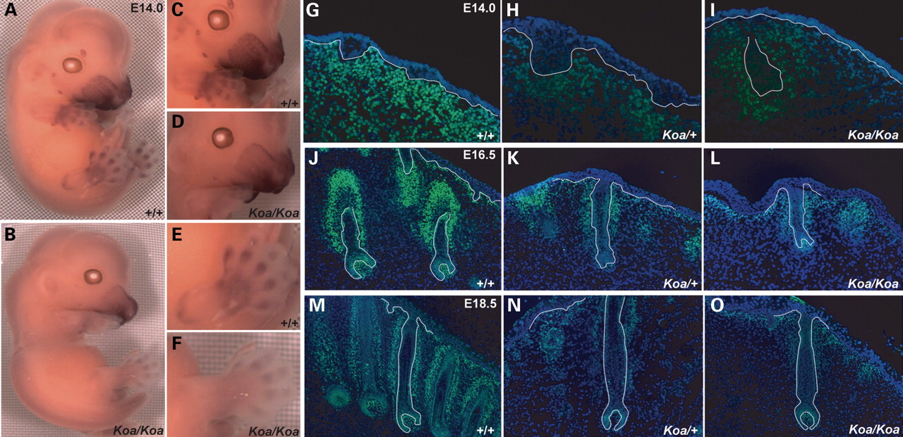
Figure 4. Reduced expression of Trps1 in Koa mutant mice. (A, C, E) Trps1 transcripts were detected in the maxilla, ...
Notes:
Figure 4. Reduced expression of Trps1 in Koa mutant mice. (A, C, E) Trps1 transcripts were detected in the maxilla, mandible, philtrum, nose, muzzle skin, the mesenchyme surrounding the developing vibrissae and tactile follicles, and the prospective phalanges and joints of the limbs at E14.0 in a wild-type mouse by whole mount in situ hybridization. (B, D, F) Trps1 expression was reduced at all sites of transcript localization in a Koa/Koa mutant. (G–I) As detected by immunofluorescence, Trps1 expression is drastically reduced in the nuclei of dermal cells underlying the developing vibrissae follicles of Koa/+ and Koa/Koa mice at E14.0. (J–O) By E16.5 and E18.5, Trps1 expression is notably decreased in the nuclei of mesenchymal cells surrounding the vibrissae follicles, the dermal papillae cells, the germinative matrix and the precortex of Koa/+ and Koa/Koa mice. Trps1, green; DAPI, blue. Dotted line indicates basement membrane.
Unless provided in the caption above, the following copyright applies to the content of this slide: © The Author 2008. Published by Oxford University Press. All rights reserved. For Permissions, please email: journals.permissions@oxfordjournals.org

Slide 5
Figure 5. Altered configuration of transcription factor binding sites due to Koa inversion. A 100 bp stretch spanning ...
Notes:
Figure 5. Altered configuration of transcription factor binding sites due to Koa inversion. A 100 bp stretch spanning the Koa proximal inversion breakpoint is highly conserved between wild-type mouse and human sequences, with 74% of the basepairs identical. The wild-type mouse sequence contains eight transcription factor binding sites within this region, including SRF, COUP, Elf1, C/EBPdel, GR, ER, C/EBPalp and Oct1. The Koa inversion creates a new Sp1 transcription factor binding site and translocates three additional Sp1 binding sites within this 100 bp stretch, in addition to CACCCbi, ETF and NF1 sites. Identical base pairs are indicated by an asterisk. Inverted basepairs in the Koa sequence are in red. Sp1 binding sites are highlighted in yellow.
Unless provided in the caption above, the following copyright applies to the content of this slide: © The Author 2008. Published by Oxford University Press. All rights reserved. For Permissions, please email: journals.permissions@oxfordjournals.org

