Slide 1
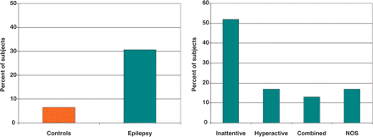
Fig. 1 ADHD is significantly elevated in youth with epilepsy (left panel) and predominantly characterized by the ...
Notes:
Fig. 1 ADHD is significantly elevated in youth with epilepsy (left panel) and predominantly characterized by the inattentive subtype (right panel).
Unless provided in the caption above, the following copyright applies to the content of this slide: © The Author (2007). Published by Oxford University Press on behalf of the Guarantors of Brain. All rights reserved. For Permissions, please email: journals.permissions@oxfordjournals.org

Slide 2
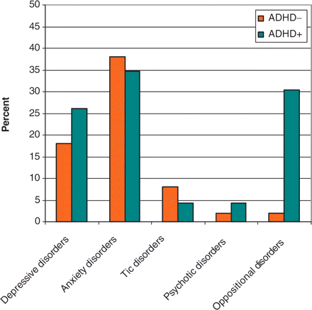
Fig. 5 Rates of K-SADS defined psychiatric comorbidities in epilepsy ADHD+/− groups.
Notes:
Fig. 5 Rates of K-SADS defined psychiatric comorbidities in epilepsy ADHD+/− groups.
Unless provided in the caption above, the following copyright applies to the content of this slide: © The Author (2007). Published by Oxford University Press on behalf of the Guarantors of Brain. All rights reserved. For Permissions, please email: journals.permissions@oxfordjournals.org

Slide 3
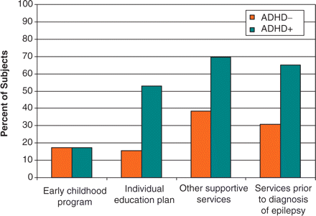
Fig. 2 Special educational services provided to children with epilepsy.
Notes:
Fig. 2 Special educational services provided to children with epilepsy.
Unless provided in the caption above, the following copyright applies to the content of this slide: © The Author (2007). Published by Oxford University Press on behalf of the Guarantors of Brain. All rights reserved. For Permissions, please email: journals.permissions@oxfordjournals.org

Slide 4
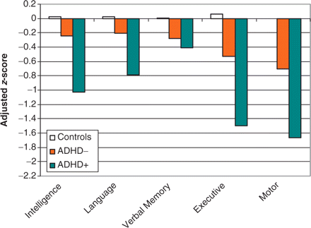
Fig. 3 Mean adjusted (age, gender) cognitive domain scores in controls and epilepsy ADHD+/− groups. Lower scores ...
Notes:
Fig. 3 Mean adjusted (age, gender) cognitive domain scores in controls and epilepsy ADHD+/− groups. Lower scores represent poorer performance.
Unless provided in the caption above, the following copyright applies to the content of this slide: © The Author (2007). Published by Oxford University Press on behalf of the Guarantors of Brain. All rights reserved. For Permissions, please email: journals.permissions@oxfordjournals.org

Slide 5
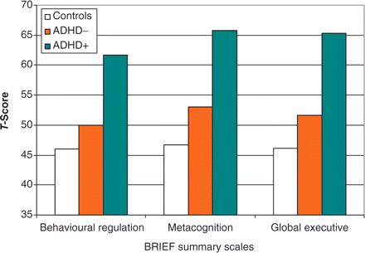
Fig. 4 Mean BRIEF scores in controls and epilepsy ADHD+/− groups. Higher scores represent greater abnormality.
Notes:
Fig. 4 Mean BRIEF scores in controls and epilepsy ADHD+/− groups. Higher scores represent greater abnormality.
Unless provided in the caption above, the following copyright applies to the content of this slide: © The Author (2007). Published by Oxford University Press on behalf of the Guarantors of Brain. All rights reserved. For Permissions, please email: journals.permissions@oxfordjournals.org

Slide 6
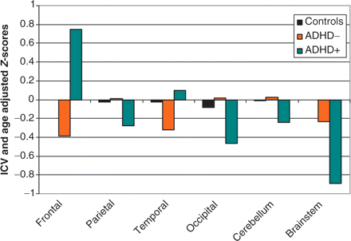
Fig. 6 Adjusted (age, ICV) z-scores for total lobar, cerebellum and brainstem volumes.
Notes:
Fig. 6 Adjusted (age, ICV) z-scores for total lobar, cerebellum and brainstem volumes.
Unless provided in the caption above, the following copyright applies to the content of this slide: © The Author (2007). Published by Oxford University Press on behalf of the Guarantors of Brain. All rights reserved. For Permissions, please email: journals.permissions@oxfordjournals.org

Slide 7
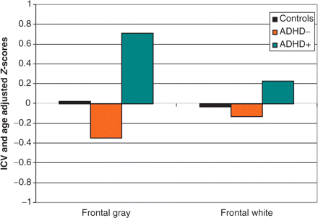
Fig. 7 Adjusted (age, ICV) z-scores for segmented frontal lobe volumes.
Notes:
Fig. 7 Adjusted (age, ICV) z-scores for segmented frontal lobe volumes.
Unless provided in the caption above, the following copyright applies to the content of this slide: © The Author (2007). Published by Oxford University Press on behalf of the Guarantors of Brain. All rights reserved. For Permissions, please email: journals.permissions@oxfordjournals.org

Slide 8
Fig. 8 VBM results showing regions of frontal lobe volume increase in epilepsy ADHD+ relative to controls (yellow), ...
Notes:
Fig. 8 VBM results showing regions of frontal lobe volume increase in epilepsy ADHD+ relative to controls (yellow), increases relative to epilepsy ADHD− (green), and increases relative to both groups (red). P < .05, corrected for multiple comparisons.
Unless provided in the caption above, the following copyright applies to the content of this slide: © The Author (2007). Published by Oxford University Press on behalf of the Guarantors of Brain. All rights reserved. For Permissions, please email: journals.permissions@oxfordjournals.org

