Slide 1
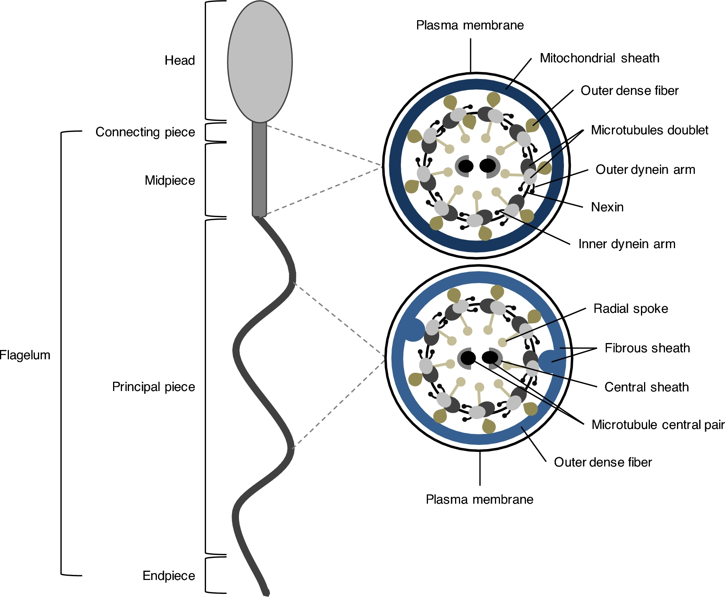
Figure 1. Schematic representation of human spermatozoon and flagellum structure. Human sperm is divided into two ...
Notes:
Figure 1. Schematic representation of human spermatozoon and flagellum structure. Human sperm is divided into two parts: head and flagellum. The flagellum is further divided into four structures: connecting piece, midpiece, principal piece, and endpiece. A cross-section shows that the flagellum structure differs between midpiece and principal piece. In midpiece, plasma membrane and mitochondrial sheath surround the outer dense fibers. Within outer dense fibers, the axoneme composed of the microtubule doublets associated with the dyneins arms (inner and outer), radial spoke, and microtubule central pair. Nexin connects adjacent microtubule doublet. In the principal piece, plasma membrane and fibrous sheath surround the outer dense fibers. In two opposing microtubule doublets, the outer dense fibers are replaced by longitudinal columns of fibrous sheath.
Unless provided in the caption above, the following copyright applies to the content of this slide: © The Authors 2016. Published by Oxford University Press on behalf of Society for the Study of Reproduction. All rights reserved. For permissions, please journals.permissions@oup.com

Slide 2
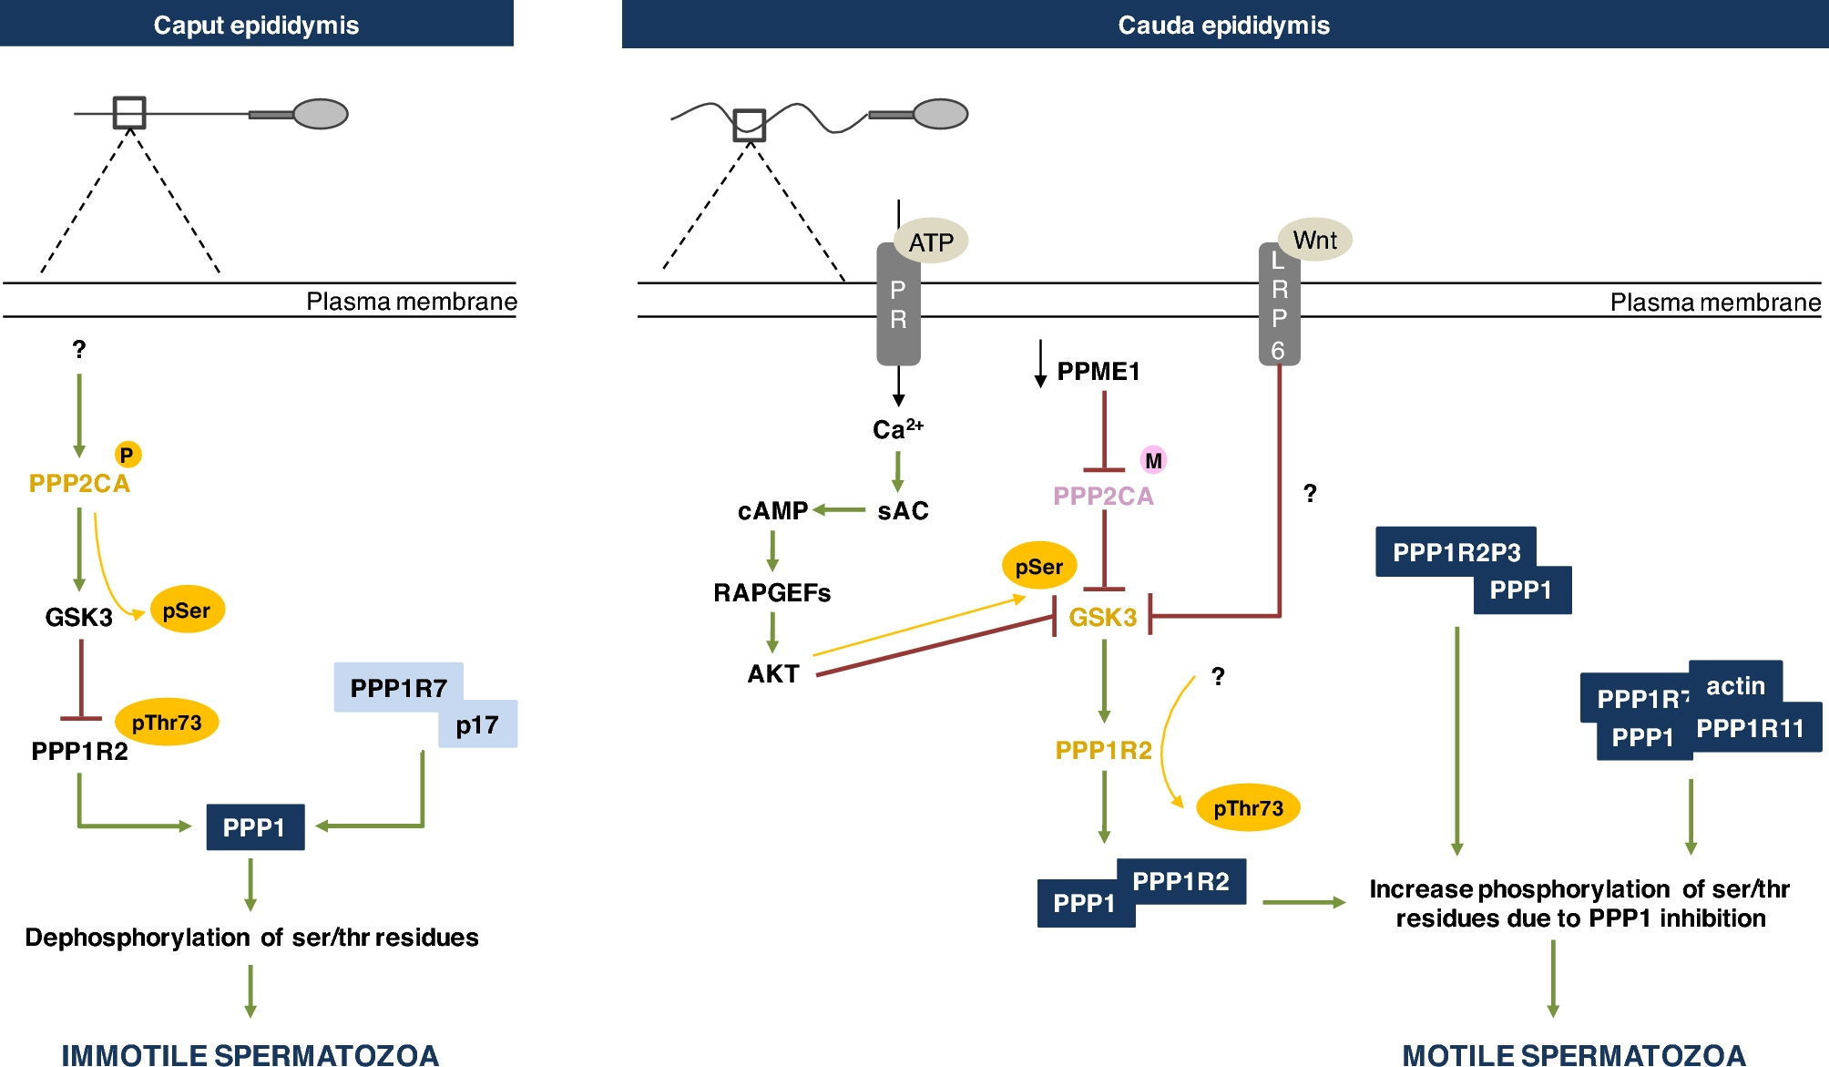
Figure 2. Schematic representation of the signaling events required for sperm motility acquisition in the epididymis. ...
Notes:
Figure 2. Schematic representation of the signaling events required for sperm motility acquisition in the epididymis. In caput epididymis, PPP2CA is phosphorylated and consequently active, which in turn dephosphorylates GSK3 at serine residues, rendering it active. GSK3 phosphorylates PPP1R2 at thr73 which inhibits the interaction between PPP1R2 and PPP1 resulting in active PPP1. PPP1R7 is bound to p17, which leads to free and active PPP1. Active PPP1 results in dephosphorylation of key residues and consequently immotile sperm. In cauda epididymis, PPME1 activity decreases increasing PPP2CA methylation, resulting in inhibition of PPP2CA. Consequently, GSK3 serine phosphorylation increases leading to GSK3 inhibition. Also, Wnt binds to LRP6 receptor which promotes GSK3 inhibition by an unknown mechanism. Moreover, ATP binds to purinergic receptors (PR), resulting in calcium influx. Calcium activates sAC, which produces cAMP activating Rap guanine nucleotide exchange factor (RAPGEFs). The latter activates AKT that phosphorylates GSK3 at serine residues inactivating it [65]. GSK3 is inhibited, which leads to decrease Thr73 PPP1R2 phosphorylation (the phosphatase responsible is unknown). Consequently, PPP1R2 binds PPP1. Also, PPP1 is bound to PPPP1R2P3 and in a complex with PPP1R7, actin, and PPP1R11. Thus, PPP1 activity is inhibited and ser/thr phosphorylation of key residues increases leading to motile sperm. P, phosphorylation; M, methylation; green arrows, activation; red arrows, inhibition; yellow arrows, phosphorylation; yellow, phosphorylated proteins; pink, methylated proteins.
Unless provided in the caption above, the following copyright applies to the content of this slide: © The Authors 2016. Published by Oxford University Press on behalf of Society for the Study of Reproduction. All rights reserved. For permissions, please journals.permissions@oup.com

Slide 3
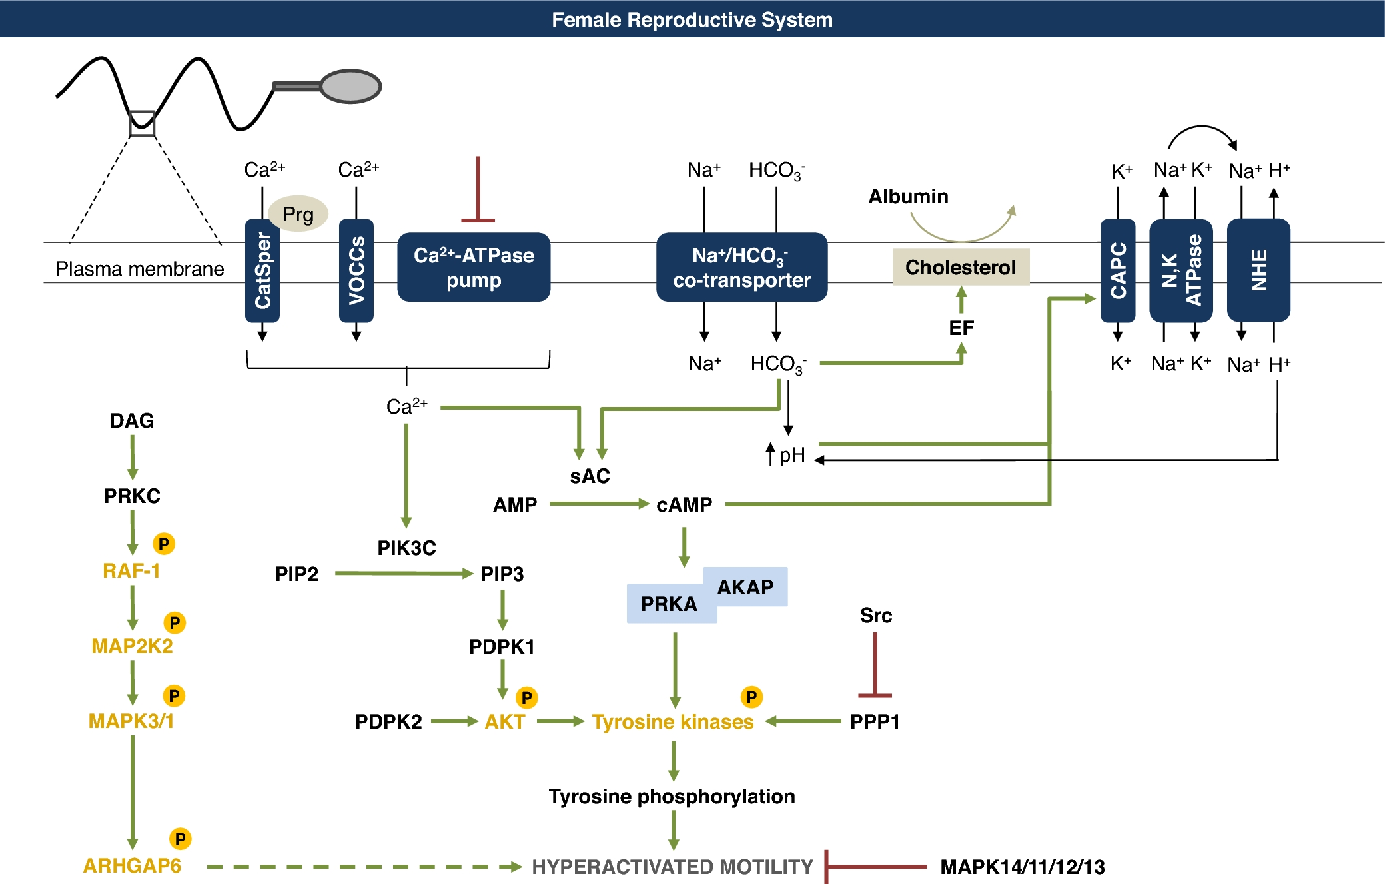
Figure 3. Schematic representation of the signaling events required for sperm hyperactivated motility in the female ...
Notes:
Figure 3. Schematic representation of the signaling events required for sperm hyperactivated motility in the female reproductive system. Several mechanisms are responsible for intracellular Ca2+ increase in sperm. Progesterone binding to CatSper activates VOCCs and inhibition of Ca2+-ATPase pump promotes Ca2+ influx. In sperm, HCO3− and Na+ increase due to activation of Na+/HCO3− cotransporter. Potassium enters through a calcium-activated potassium channels (CAPC) and Na,K-ATPase. The Na+ gradient created by the Na,K-ATPase activates the Na+/H+ exchanger that promotes the influx of Na+ and de efflux of H+. HCO3− activates exchange factors (EF) that promote cholesterol externalization, becoming vulnerable to albumin. HCO3− and Ca2+ activate sAC, which converts AMP to cAMP and activates PRKA. PRKA activates tyrosine kinases, by phosphorylation. Also, Ca2+ activates PIK3C, which forms PIP3, that in turn activates PDPK1 and PDPK1 and PDPK2 activate AKT by phosphorylation. AKT activates tyrosine kinases by phosphorylation. At the same time, DAG activates PRKC which phosphorylates RAF-1, RAF-1 activates MAP2K2, and MAP2K2 activates MAPK3/1. Again, MAPK3/1 activates tyrosine kinases by phosphorylation. MAPK3/1 phosphorylates ARHGAP6 which may be involved in hyperactivated motility. MAPK14/11/12/13 inhibits hyperactivated motility. Src inhibits PPP1, which allows an increase of tyrosine kinases phosphorylation. Tyrosines kinases phosphorylate key proteins inducing hyperactivated motility. P, phosphorylation; Prg, progesterone; green arrows, activation; red arrows, inhibition; dashed arrow, predicted function; yellow, phosphorylated proteins.
Unless provided in the caption above, the following copyright applies to the content of this slide: © The Authors 2016. Published by Oxford University Press on behalf of Society for the Study of Reproduction. All rights reserved. For permissions, please journals.permissions@oup.com

