Slide 1
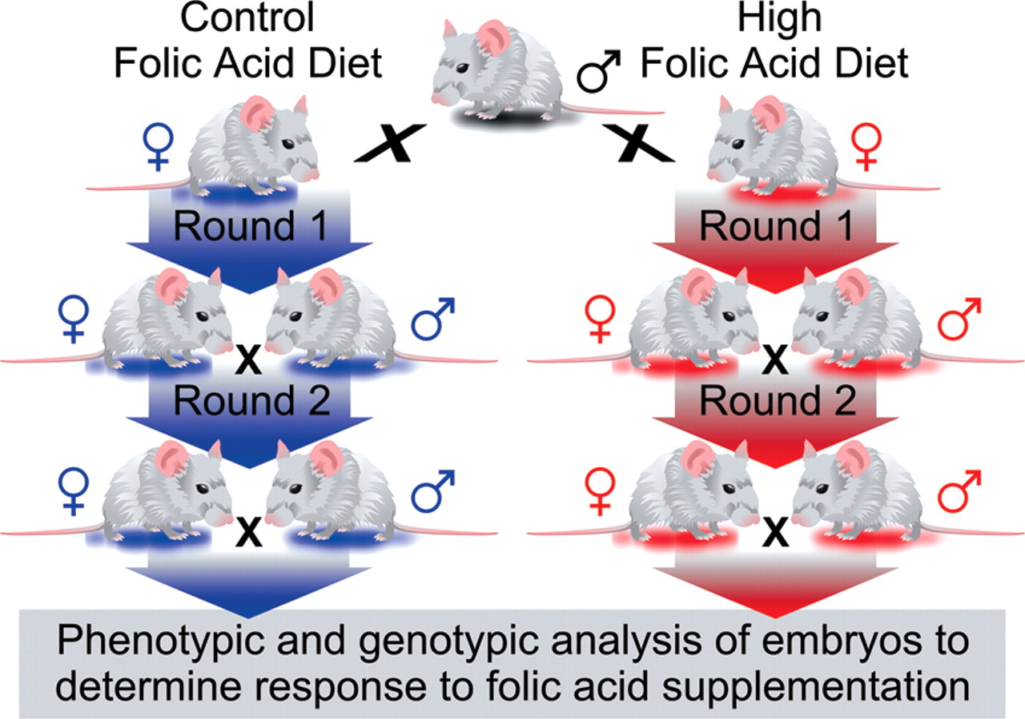
Figure 1. Long-term folic acid (FA) experimental design. The lines were bred and maintained on two diets that only ...
Notes:
Figure 1. Long-term folic acid (FA) experimental design. The lines were bred and maintained on two diets that only differ in the concentration of FA (2 p.p.m. for the control FA diet or 10 p.p.m. for the high FA diet). Following two generations on the control or high FA diet, heterozygous males and females from the same diet were timed-mated and embryos recovered and scored for phenotype and genotype.
Unless provided in the caption above, the following copyright applies to the content of this slide: © The Author 2011. Published by Oxford University Press. All rights reserved. For Permissions, please email: journals.permissions@oup.com

Slide 2
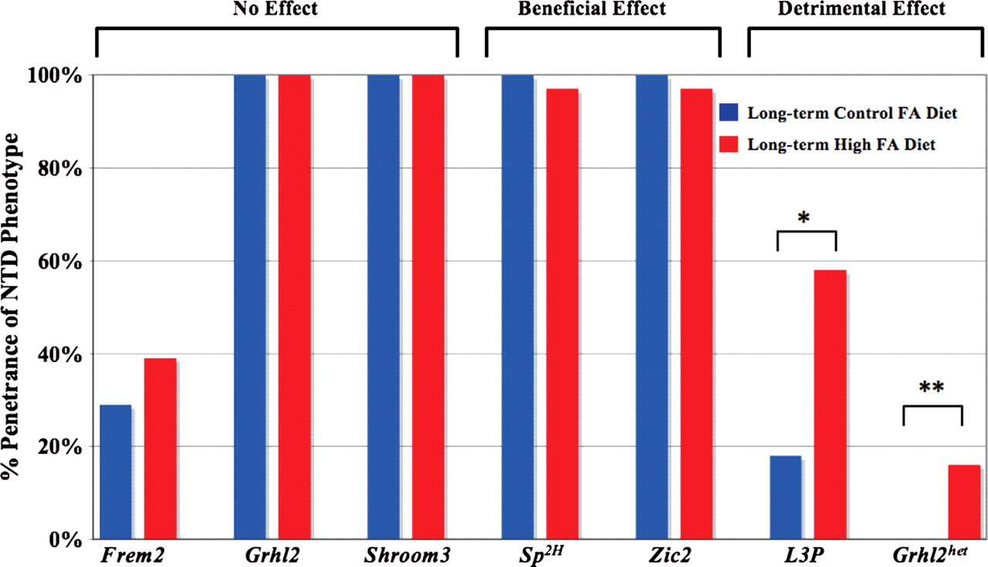
Figure 2. Long-term FA supplementation and the incidence of NTDs. Long-term FA supplementation did not reduce the ...
Notes:
Figure 2. Long-term FA supplementation and the incidence of NTDs. Long-term FA supplementation did not reduce the incidence of NTDs in homozygous mutant embryos for Frem2 (39% NTD penetrance, 7/18 mutant embryos on the long-term high FA diet), Grhl2 (100%, 13/13) or Shroom3 (100%, 7/7) but did slightly decrease the incidence of NTDs in mutant embryos for Sp2H (97%, 29/30) and Zic2 (95%, 35/37 of which one lived postnatally). FA supplementation increased the rate of NTDs in L3P mutant embryos (58%, 14/24) and Grhl2 heterozygous embryos (16%, 6/37; listed as Grhl2het). *P= 0.012; **P= 0.009.
Unless provided in the caption above, the following copyright applies to the content of this slide: © The Author 2011. Published by Oxford University Press. All rights reserved. For Permissions, please email: journals.permissions@oup.com

Slide 3
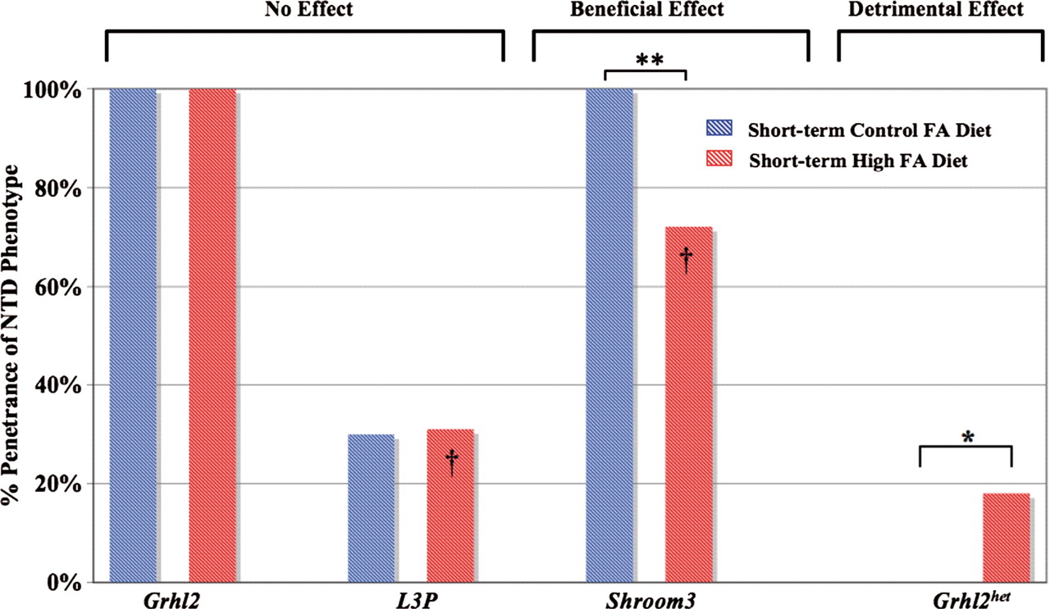
Figure 3. Short-term FA supplementation and incidence of NTDs. Short-term high FA did not affect the incidence of NTDs ...
Notes:
Figure 3. Short-term FA supplementation and incidence of NTDs. Short-term high FA did not affect the incidence of NTDs in homozygous mutant embryos for Grhl2 (100% NTD penetrance, 4/4 mutant embryos) or L3P (31%, 5/16). Short-term high FA decreased the NTD rate in Shroom3 mutant embryos (72%, 16/22), but increased the NTD rate in Grhl2 heterozygous embryos (18%, 4/23; listed as Grhl2het, similar to long-term high FA). The beneficial (Shroom3) or no effect (L3P) of short-term high FA differed from no effect (Shroom3) or detrimental (L3P) response upon long-term high FA (highlighted by dagger). *P = 0.046; **P = 0.02.
Unless provided in the caption above, the following copyright applies to the content of this slide: © The Author 2011. Published by Oxford University Press. All rights reserved. For Permissions, please email: journals.permissions@oup.com

