Slide 1
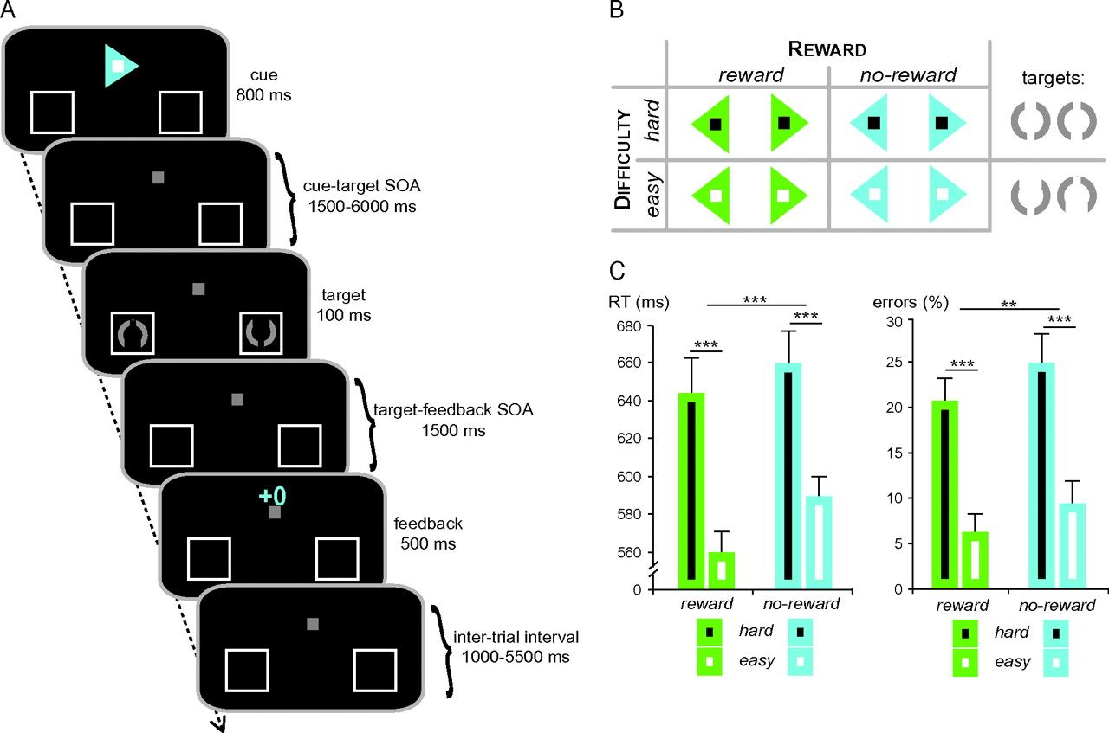
Figure 1. Paradigm and task performance. (A) Each trial started with a colored arrow cue pointing to the target ...
Notes:
Figure 1. Paradigm and task performance. (A) Each trial started with a colored arrow cue pointing to the target location. Additionally, the cue indicated the difficulty level of the upcoming target discrimination, as well as the potential to win money for accurate performance. After a variable SOA, the target display was briefly presented and participants decided via button press which gap in the target circle was bigger (top vs. bottom). Each trial ended with a visually presented performance feedback. (B) The potential to win money in the current trial (factor Reward) was indicated by the color of the arrow cue (e.g., green = reward vs. blue = no-reward), while the difficulty level (factor Difficulty) was indicated by the color of the embedded square (e.g., black = hard vs. white = easy). (C) In terms of the target discrimination performance, both RTs and error rates were affected by Reward and Difficulty, albeit, as expected, in opposite directions. Error bars depict the standard error of the mean across subjects; asterisks indicate significant main effects (***P < 0.001; **P < 0.01).
Unless provided in the caption above, the following copyright applies to the content of this slide: © The Author 2011. Published by Oxford University Press. All rights reserved. For permissions, please e-mail: journals.permissions@oup.com

Slide 2
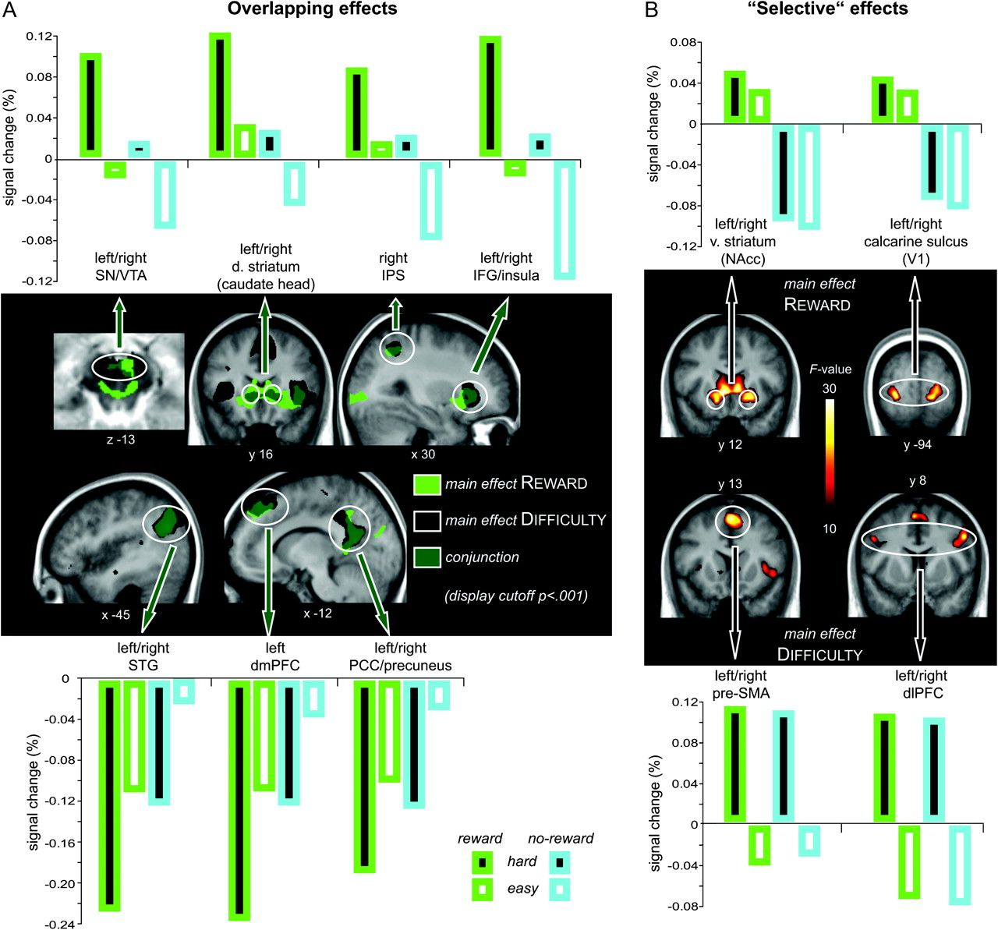
Figure 2. Neural modulations of cue-related reward and difficulty anticipation. (A) Activations associated with the ...
Notes:
Figure 2. Neural modulations of cue-related reward and difficulty anticipation. (A) Activations associated with the main effect of reward (green) are overlaid with activations associated with the main effect of difficulty (black) in a conjunction contrast with a display cutoff at a significance threshold of P < 0.001. Both anticipated reward and anticipated difficulty increased activity within overlapping cortical and subcortical attentional control regions (upper panel) and decreased activity within overlapping regions of the default-mode network (lower panel). Bar graphs represent BOLD signal values extracted based on the local maxima of the conjunction analysis (Table 3). (B) In addition, anticipated reward increased activity within bilateral ventral striatum, V1, and PCC (not shown), while anticipated difficulty increased activity within bilateral pre-SMA and dlPFC. Bar graphs represent BOLD signal values extracted based on the local maxima of the respective main effects (Tables 1 and 2).
Unless provided in the caption above, the following copyright applies to the content of this slide: © The Author 2011. Published by Oxford University Press. All rights reserved. For permissions, please e-mail: journals.permissions@oup.com

Slide 3
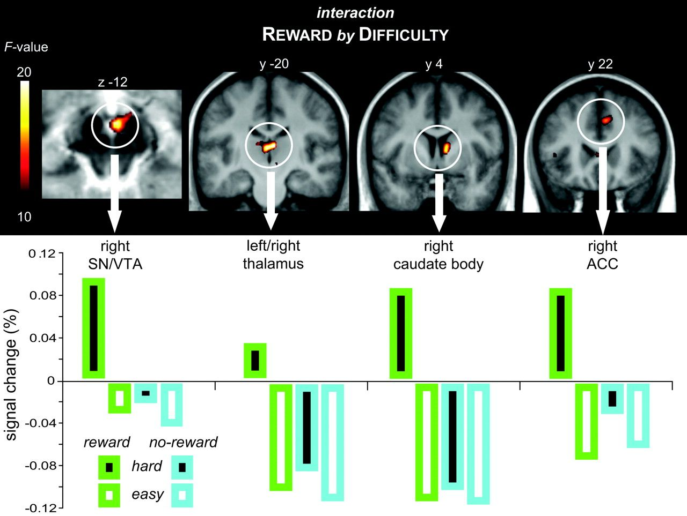
Figure 3. Interaction between cue-related reward and difficulty anticipation. The right SN/VTA complex, posterior ...
Notes:
Figure 3. Interaction between cue-related reward and difficulty anticipation. The right SN/VTA complex, posterior thalamus, right caudate body, and the right aMCC exhibited a significant interaction between anticipated reward and difficulty in the voxel-wise rANOVA. The BOLD signal change values revealed that this effect was driven by a selective activity increase for cues predicting both reward and high difficulty.
Unless provided in the caption above, the following copyright applies to the content of this slide: © The Author 2011. Published by Oxford University Press. All rights reserved. For permissions, please e-mail: journals.permissions@oup.com

