Slide 1
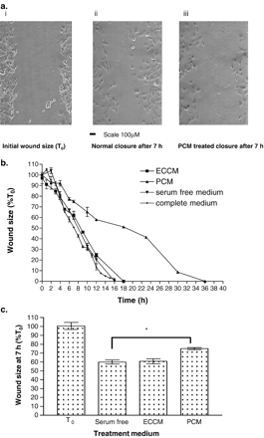
Fig. 1 The influence of pericyte conditioned medium (PCM) on endothelial cell migration. (a) Photomicrographs ...
Notes:
Fig. 1 The influence of pericyte conditioned medium (PCM) on endothelial cell migration. (a) Photomicrographs showing the representative wound generated in a confluent monolayer of human microvascular endothelial cells (HMEC-1) grown on a glass microscope slide following a 7 h exposure to complete medium (ii) and PCM (iii). (b) Graph showing the effect over time of PCM on endothelial cell migration compared to endothelial cell conditioned medium (ECCM), serum-free and complete medium controls. The data are presented as wound size expressed as a percentage of the initial wound size at time zero (T0). The end-point of the experiment was determined as complete closure of the wound. All data points represent the mean of three individual experiments; error bars indicate standard error of the mean. (c) Graph showing the effect of PCM compared to controls after 7 h (50% wound closure). The effect of PCM on endothelial cell migration at 7 h was significantly different than the controls *p=0.013 (Student's t-test).
Unless provided in the caption above, the following copyright applies to the content of this slide: Copyright © 2005, European Society of Cardiology

Slide 2
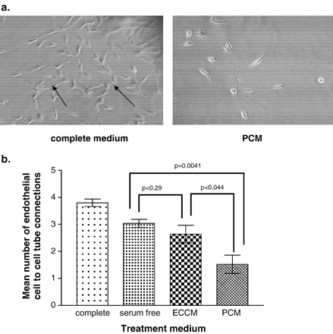
Fig. 2 The influence of PCM on in vitro tubule formation. (a) Photomicrograph showing (i) the ability of HMEC-1 to ...
Notes:
Fig. 2 The influence of PCM on in vitro tubule formation. (a) Photomicrograph showing (i) the ability of HMEC-1 to form angiogenic cell-to-cell connective structures between individual cells when incubated in wells coated with the synthetic basement membrane Matrigel. The arrows in the micrograph indicated the structures identified as an angiogenic tube. The inhibitory action of PCM on HMEC-1 branch formation can be observed in (ii). (b) Graph showing the effect of PCM on HMEC-1 cell-to-cell tube formation on Matrigel. All data points represent the mean of three individual experiments; error bars indicate standard error of the mean. PCM significantly reduced the number of tubes formed (p=0.0041) compared to serum-free medium. There was no significant effect of ECCM, although significant differences between ECCM and PCM responses were observed (p=0.04).
Unless provided in the caption above, the following copyright applies to the content of this slide: Copyright © 2005, European Society of Cardiology

Slide 3
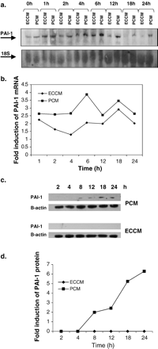
Fig. 3 Expression of PAI-1 in endothelial cells following exposure to PCM: Representative Northern blot of total RNA ...
Notes:
Fig. 3 Expression of PAI-1 in endothelial cells following exposure to PCM: Representative Northern blot of total RNA (a) and Western blot of protein (c) isolated from HMEC-1 exposed to PCM or ECCM over a 24 h period. PAI-1 mRNA and protein levels are indicated as well as 18S or actin loading controls. Graphs show densitometric analysis of mRNA bands (b) and protein bands (d). Data are expressed as fold induction of PAI-1 mRNA induction after correction for loading controls.
Unless provided in the caption above, the following copyright applies to the content of this slide: Copyright © 2005, European Society of Cardiology

Slide 4
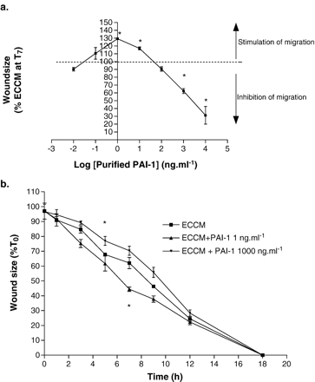
Fig. 4 The influence of PAI-1 on endothelial cell migration. (a) Graph showing the influence of various doses of ...
Notes:
Fig. 4 The influence of PAI-1 on endothelial cell migration. (a) Graph showing the influence of various doses of purified PAI-1 protein on endothelial cell migration. Wound size at 7 h relative to the ECCM control (shown as a dashed line) was plotted for each concentration. (b) The effect of a single application of PAI-1 (1 and 1000 ng ml−1) on the migration of HMEC-1. (c) The effect of re-application of PAI-1 (1000 ng ml−1) at 7 h. (d) Graph showing the influence of transient PAI-1 transfection on endothelial cell migration. The wound size at 7 h (%T0) is shown after correction for the effects of lipofectin and empty vector. For comparison the effects of PCM and a serum-free control are shown. Data points are the mean of three individual experiments ± standard error of the mean. Results that are significantly different from the ECCM control are indicated (* p<0.05).
Unless provided in the caption above, the following copyright applies to the content of this slide: Copyright © 2005, European Society of Cardiology

Slide 5
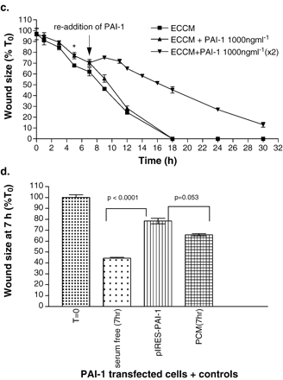
Fig. 4 The influence of PAI-1 on endothelial cell migration. (a) Graph showing the influence of various doses of ...
Notes:
Fig. 4 The influence of PAI-1 on endothelial cell migration. (a) Graph showing the influence of various doses of purified PAI-1 protein on endothelial cell migration. Wound size at 7 h relative to the ECCM control (shown as a dashed line) was plotted for each concentration. (b) The effect of a single application of PAI-1 (1 and 1000 ng ml−1) on the migration of HMEC-1. (c) The effect of re-application of PAI-1 (1000 ng ml−1) at 7 h. (d) Graph showing the influence of transient PAI-1 transfection on endothelial cell migration. The wound size at 7 h (%T0) is shown after correction for the effects of lipofectin and empty vector. For comparison the effects of PCM and a serum-free control are shown. Data points are the mean of three individual experiments ± standard error of the mean. Results that are significantly different from the ECCM control are indicated (* p<0.05).
Unless provided in the caption above, the following copyright applies to the content of this slide: Copyright © 2005, European Society of Cardiology

Slide 6
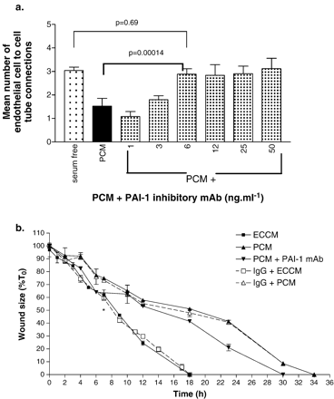
Fig. 5 The effect of a PAI-1 inhibitory antibody on HMEC-1 tubule formation and endothelial cell migration. (a) ...
Notes:
Fig. 5 The effect of a PAI-1 inhibitory antibody on HMEC-1 tubule formation and endothelial cell migration. (a) Graph showing the effect of the PAI-1 inhibitory monoclonal antibody (mAb) on the PCM-mediated inhibition of endothelial cell-to-cell tube formation. PCM significantly reduced tube formation (p=0.0041) compared to the serum-free control. These effects were inhibited at concentrations at 6 ng ml−1 (p=0.00014) or higher, with no significant effects observed at lower concentrations (p>0.05). Data points are the mean of three individual experiments ± standard error of the mean. (b) Effect of the PAI-1 inhibitory mAb (7.5 ng ml−1) on the migration of HMEC-1 in the in vitro wound scrape assay. The PAI-1 antibody significantly inhibited PCM induced anti-migratory action between 2 and 6 h (p=0.014) and at 18 and 23 h (p=0.01 and p=0.03, respectively). Data points are the mean of three individual experiments ± standard error of the mean. An IgG antibody (7.5 ng ml−1) was used as a control.
Unless provided in the caption above, the following copyright applies to the content of this slide: Copyright © 2005, European Society of Cardiology

