Slide 1
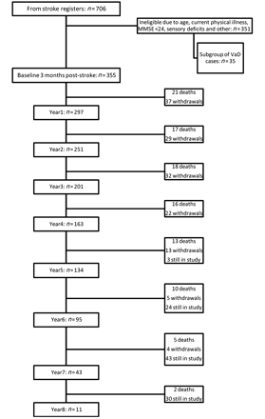
Figure 1 Flow chart showing numbers screened, recruited and numbers of assessments at each year of the study, together ...
Notes:
Figure 1 Flow chart showing numbers screened, recruited and numbers of assessments at each year of the study, together with deaths and withdrawals. Where totals show ‘still in study’, this refers to individuals who have so far completed less than 5–8 years of follow-up but who have not yet died or withdrawn from the study. MMSE = Mini-Mental State Examination; VaD = vascular dementia.
Unless provided in the caption above, the following copyright applies to the content of this slide: © The Author (2011). Published by Oxford University Press on behalf of the Guarantors of Brain.This is an Open Access article distributed under the terms of the Creative Commons Attribution Non-Commercial License (http://creativecommons.org/licenses/by-nc/3.0), which permits unrestricted non-commercial use, distribution, and reproduction in any medium, provided the original work is properly cited.

Slide 2
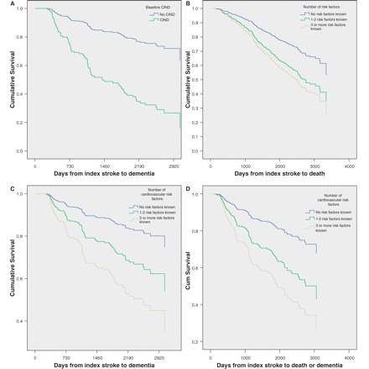
Figure 2 Survival curves to show time (A) to dementia by presence of CIND at baseline, (B) to death by number of ...
Notes:
Figure 2 Survival curves to show time (A) to dementia by presence of CIND at baseline, (B) to death by number of cardiovascular risk factors, (C) to dementia by number of cardiovascular risk factors and (D) to death or dementia by number of cardiovascular risk factors. The mean number of days from stroke to dementia or death in the non-demented and DSM IV demented groups was 1483 ± 922 and 1059 ± 676 (P = 0.001).
Unless provided in the caption above, the following copyright applies to the content of this slide: © The Author (2011). Published by Oxford University Press on behalf of the Guarantors of Brain.This is an Open Access article distributed under the terms of the Creative Commons Attribution Non-Commercial License (http://creativecommons.org/licenses/by-nc/3.0), which permits unrestricted non-commercial use, distribution, and reproduction in any medium, provided the original work is properly cited.

