Slide 1
Figure 1 Boundary curves on the (λ, q) plane for an extreme (a = 1) Kerr black hole with r_{o} =∞, ...
Notes:
Figure 1 Boundary curves on the (λ, q) plane for an extreme (a = 1) Kerr black hole with ro =∞, θe = π/2 and θo = 30°. The graph of qm,a(λ) is shown by the red curve, qr,a(λ) by the green and qc(rc), λc(rc) by the blue. In the left-hand panel, the emitter is located at re = 6rg, such that re > r(−)ph, and hence the valid region is bounded by qr,a(λ) from above and qm,a(λ) from below, while the qc(rc), λc(rc) describes the line below which a photon directed radially inward is inevitably captured by the hole. In the central panel, the emitter is now located at re = 3rg, such that r(+)ph≤re≤r(−)ph. The parameter space is again bounded by qm,a(λ) from below; however, in this case, the upper limit is given by qc(rc), λc(rc) for λ≤λc(re), and by qr,a(λ) otherwise. Finally, we see that for re = 2rg (right-hand panel), these boundaries still apply, even though the graph of qr,a(λ) is now concave (true for all r≤ 2rg).
Unless provided in the caption above, the following copyright applies to the content of this slide: © 2005 RAS

Slide 2
Figure 2 Closed loops on the (λ, q) plane (top row) and their projection on to the observer's sky (the α, β plane; ...
Notes:
Figure 2 Closed loops on the (λ, q) plane (top row) and their projection on to the observer's sky (the α, β plane; bottom row) for an extreme (a = 1) Kerr black hole with ro =∞, θe = π/2 and θo = 30°. Geodesics with N = 0 are shown as solid lines, those with N = 1 as dashed lines, and those with N = 2 as dotted loops. Also shown for reference on the (λ, q) plane representation are the parameter space boundaries (light dot-dashed lines). From left to right, each panel has re = 8, 6, 4, 3, 2, 1rg. Note the change in the relative locations of the loops as the emitter moves inwards; for re = 8rg, the loops for each image order are completely detached. However, as the emitter moves in to 6rg, the N = 0, 1 loops overlap and by the time the emitter reaches 4rg, the N = 0 loop overlaps both the N = 1 and N = 2 loops. At 3rg, the N = 0 loop again crosses the N = 1, 2 loops; however, in this case the N = 1 and N = 2 loops now touch. Moving the emitter inward to 2rg, the N = 0 loop detaches itself and moves inside the N = 1, 2 loops, which cross. Moving the emitter still further inward, to just above r+, we now see that the N = 1, 2 loops have detached, with the N = 1 loop now occurring between the N = 0, 2 loops.
Unless provided in the caption above, the following copyright applies to the content of this slide: © 2005 RAS

Slide 3
Figure 3 As in Fig. 2 for a Schwarzschild (a = 0) black hole, with (from left to right) r_{e} = 8, 6, 4, 3, ...
Notes:
Figure 3 As in Fig. 2 for a Schwarzschild (a = 0) black hole, with (from left to right) re = 8, 6, 4, 3, 2.5, 2rg. The loops display a qualitatively similar behaviour to that described in the a = 1 case. We note that the restoration of spherical symmetry to the system (due to the absence of rotation) has removed the asymmetry of the loops on both planes, and hence changed the points of overlap of the loops with respect to the a = 1 case. For re≤ 3rg, there are no photons with N = 2 that propagate to infinity; furthermore, for re < 3rg, there are no N = 1 photons that can propagate to infinity either. More importantly, for re < 3rg a distant observer is unable to form a complete (i.e. φ = 0 → 2π) image of the ring even using direct (N = 0) photons.
Unless provided in the caption above, the following copyright applies to the content of this slide: © 2005 RAS

Slide 4
Figure 4 Two emitting rings around an extreme Kerr black hole located at r_{e} = 6r_{g} and ...
Notes:
Figure 4 Two emitting rings around an extreme Kerr black hole located at re = 6rg and θae = 149° (solid lines), θbe = 151° (dashed lines) with the direct, first- and second-order images denoted by black (thin), red (medium) and blue (thick) lines, respectively (in colour on the web). The observer is located at radial infinity with polar coordinate θo = 25° (left panel), θo = 30° (centre panel) and θo = 35° (right panel). In the left panel, |θo| < |θa,be|, producing circular images of the emitting rings. In the centre panel, we now have that |θae| < |θo| < |θbe| and the image of the θae ring has now separated such that the zeroth- and second-order images appear from the south pole of the hole, while the first-order image appears from behind the north pole. Finally, in the right-hand panel, we have that |θo| > |θa,be| and so images of both θa,be follow this behaviour.
Unless provided in the caption above, the following copyright applies to the content of this slide: © 2005 RAS

Slide 5
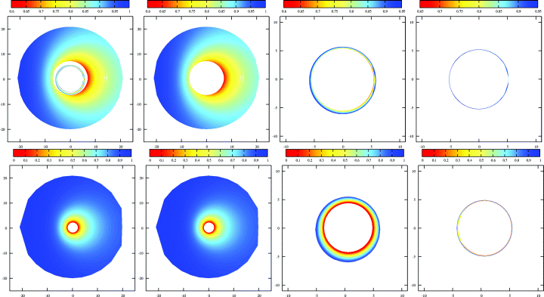
Figure 5 The contribution of orbiting photons (higher-order images) to a distant observer's image of a geometrically ...
Notes:
Figure 5 The contribution of orbiting photons (higher-order images) to a distant observer's image of a geometrically thin, optically thick, Keplerian accretion disc around Schwarzschild (top row) and extreme Kerr (bottom row) black holes. In both cases, the observer is located at radial infinity with θo = 15°, the disc extends from the marginally stable orbit (6rg for Schwarzschild, 1rg for extreme Kerr) to 20rg and the images are coloured by the associated value of the redshift parameter, g = Eo/Ee. From left to right, the panels show the contributions from (i) all image orders (N = 0 … 2), (ii) the direct (N = 0) image, (iii) the first-order (N = 1) image and (iv) the second-order (N = 2) image. Note that, in the Schwarzschild case, while the orbiting photons are not obscured from the observer by the accretion disc, the total flux (integrated area) measured by the observer from the photons is negligible. Additionally, for the Kerr case, the increased radial extent of the disc completely obscures the contribution of the photons.
Unless provided in the caption above, the following copyright applies to the content of this slide: © 2005 RAS

Slide 6
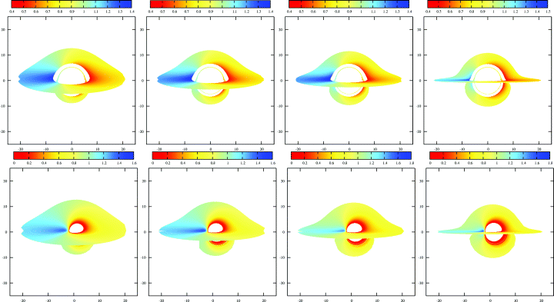
Figure 6 As in Fig. 5, showing the contribution of photons with N = 0 … 2. From left to right, the panels are for and ...
Notes:
Figure 6 As in Fig. 5, showing the contribution of photons with N = 0 … 2. From left to right, the panels are for and . As the inclination of the system increases, the contribution from photons emitted from the near side of the accretion disc directly to the observer is suppressed, reducing the obscuration of the higher-order images by the disc as measured by the observer. The total area subtended by the unobscured first-order (N = 1) image increases independently of this effect, due to lensing of photons that are emitted from the underside of the far side of the accretion disc, relative to the observer. In the case of the Schwarzschild black hole (top row), we note that the (total) area of the second-order image remains approximately constant with inclination. For the extreme Kerr black hole (bottom row), photons forming the second-order image are completely absorbed by the disc, removing their contribution from the overall image received by the observer. Additionally, in contrast to the Schwarzschild case, the images are asymmetric about the α = 0 axis due to the effect of black hole spin, particularly noticeable for the higher-order cases. For the most extreme inclination, the total area subtended by the first-order image is of the same order as that from the direct image.
Unless provided in the caption above, the following copyright applies to the content of this slide: © 2005 RAS

Slide 7
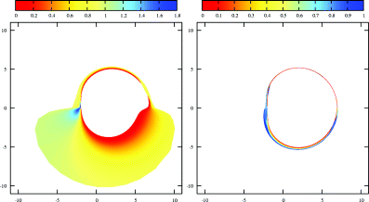
Figure 7 Unobscured N = 1 (left-hand panel) and N = 2 (right-hand panel) images of a thin, Keplerian accretion disc ...
Notes:
Figure 7 Unobscured N = 1 (left-hand panel) and N = 2 (right-hand panel) images of a thin, Keplerian accretion disc around an extreme Kerr black hole, with the disc extending from rms to 20rg. The observer is located at radial infinity with an inclination of . The images are highly asymmetric, indicating the strong coupling of these photons to the black hole spin.
Unless provided in the caption above, the following copyright applies to the content of this slide: © 2005 RAS

Slide 8
Figure 8 Relativistic line profiles generated from images (Fig. 5, top row) of a geometrically thin, Keplerian ...
Notes:
Figure 8 Relativistic line profiles generated from images (Fig. 5, top row) of a geometrically thin, Keplerian accretion disc around a Schwarzschild (a = 0) black hole. The observer is located at θo = 15° and the disc extends from rms to 20rg. All profiles are normalized such that they contain one photon and are unsmoothed. From left to right, the panels show the contributions from (i) photons with N = 0 … 2, (ii) N = 0, (iii) N = 1 and (iv) N = 2. In all cases, an ∈ (re) ∝r−3e radial emissivity has been applied to the line profile. We consider three different types of angular component: (i) f(μe) ∝ constant (black, solid lines); (ii) f(μe) ∝μ−1e (red, dotted lines); (iii) f(μe) ∝ (1 + 2.06μe) (blue, dashed lines). The principal effect of the higher-order images is to boost the overall flux in the system by ∼4 per cent, while leaving the overall shape of the line approximately unchanged. (In colour on the web).
Unless provided in the caption above, the following copyright applies to the content of this slide: © 2005 RAS

Slide 9
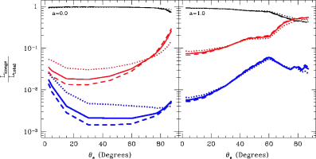
Figure 11 Variation of (unobscured, integrated) luminosity associated with each image as a fraction of the total ...
Notes:
Figure 11 Variation of (unobscured, integrated) luminosity associated with each image as a fraction of the total luminosity of the system with inclination for a thin, Keplerian accretion disc around Schwarzschild (left panel) and extreme Kerr (right panel) black holes. In both cases, the disc extends from rms to 20rg and the observer is located at radial infinity. We show the contributions from (i) the direct image (black, thin lines), (ii) the first-order image (red, medium lines) and (iii) the second-order image (blue, thick lines). In all cases, we have applied an ∈(re) ∝r−3e radial emissivity and have considered angular emissivities of the form (i) f(μe) ∝ constant (solid lines), (ii) f(μe) ∝μ−1e (dotted lines) and (iii) f(μe) ∝ (1 + 2.06μe) (dashed lines). In the case of the Schwarzschild black hole, the contribution from the higher-order images is ≤20 per cent of the total luminosity, even at high inclinations. However, in the case of the extreme Kerr black hole, at inclinations of ≧75°, the first-order image can dominate the luminosity of the system, due to the formation of caustics within the image.
Unless provided in the caption above, the following copyright applies to the content of this slide: © 2005 RAS

Slide 10
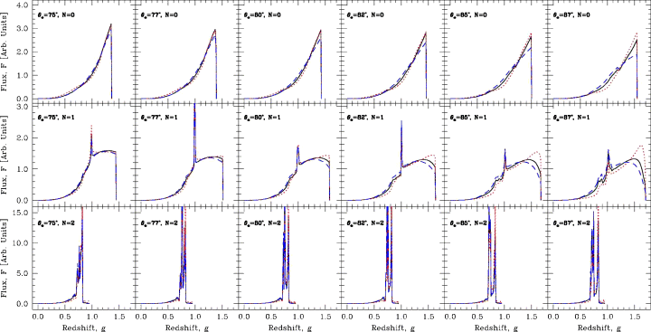
Figure 10 As in Fig. 9 for accretion discs around an extreme Kerr black hole. In contrast to the Schwarzschild case, ...
Notes:
Figure 10 As in Fig. 9 for accretion discs around an extreme Kerr black hole. In contrast to the Schwarzschild case, the lines extend down to lower energies due to the reduced separation between the inner edge of the disc (at the marginally stable orbit) and the black hole event horizon. Additionally, the line due to the first-order photons extends to higher energies than that due to the zeroth-order photons, with the upper edge of the line occurring at g≈ 1.8 in the most extreme case. Both the first- and second-order line profiles have significantly increased structure compared to the zeroth-order profile. The shape of the zeroth- and second-order line profiles remain approximately constant with increasing inclination. However, the internal structure of the first-order profile shows a distinctive change, with the fraction of radiation in the blue wing of the profile exhibiting a marked increase compared to that in the red wing as the observer moves towards the equatorial plane. (In colour on the web).
Unless provided in the caption above, the following copyright applies to the content of this slide: © 2005 RAS

Slide 11
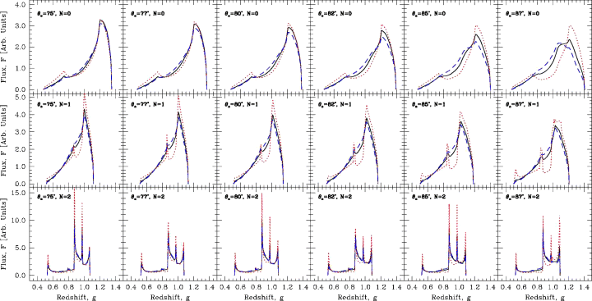
Figure 9 The contribution of orbiting photons (higher-order images) to the iron Kα line profiles for a geometrically ...
Notes:
Figure 9 The contribution of orbiting photons (higher-order images) to the iron Kα line profiles for a geometrically thin, Keplerian accretion disc around a Schwarzschild black hole. In all cases, the inner edge of the accretion disc is located at the innermost stable orbit, which occurs at 6rg and the outer edge of the disc is located at 20rg. The observer is located at radial infinity with inclination (from left to right) in steps. All profiles are normalized to the apparent area on the observer's sky and are unsmoothed. The line profiles are generated by photons in (i) the zeroth-order (direct) image (top row), (ii) the first-order image (middle row) and (iii) the second-order image (bottom row). Obscuration by the disc is ignored. In all cases, an ∈(re) ∝r−3e radial emissivity has been applied to the line profile. We consider three different types of angular component: (i) f(μe) ∝ constant (black, solid lines); (ii) f(μe) ∝μ−1e (red, dotted lines); (iii) f(μe) ∝ (1 + 2.06μe) (blue, dashed lines). Line profiles generated by the zeroth-order photons have the standard skewed, double-peaked structure. Those generated by the first-order photons have a similar structure, while those from the second-order photons are far more complex. As the observer moves towards higher inclinations, gravitational lensing effects become apparent in the line profile generated from zeroth-order photons. There is a corresponding increase in the complexity of the profile generated from the first-order photons. Note, however, that the structure of the profile generated from the second-order photons remains approximately constant with increasing inclination. (In colour on the web).
Unless provided in the caption above, the following copyright applies to the content of this slide: © 2005 RAS

