Slide 1
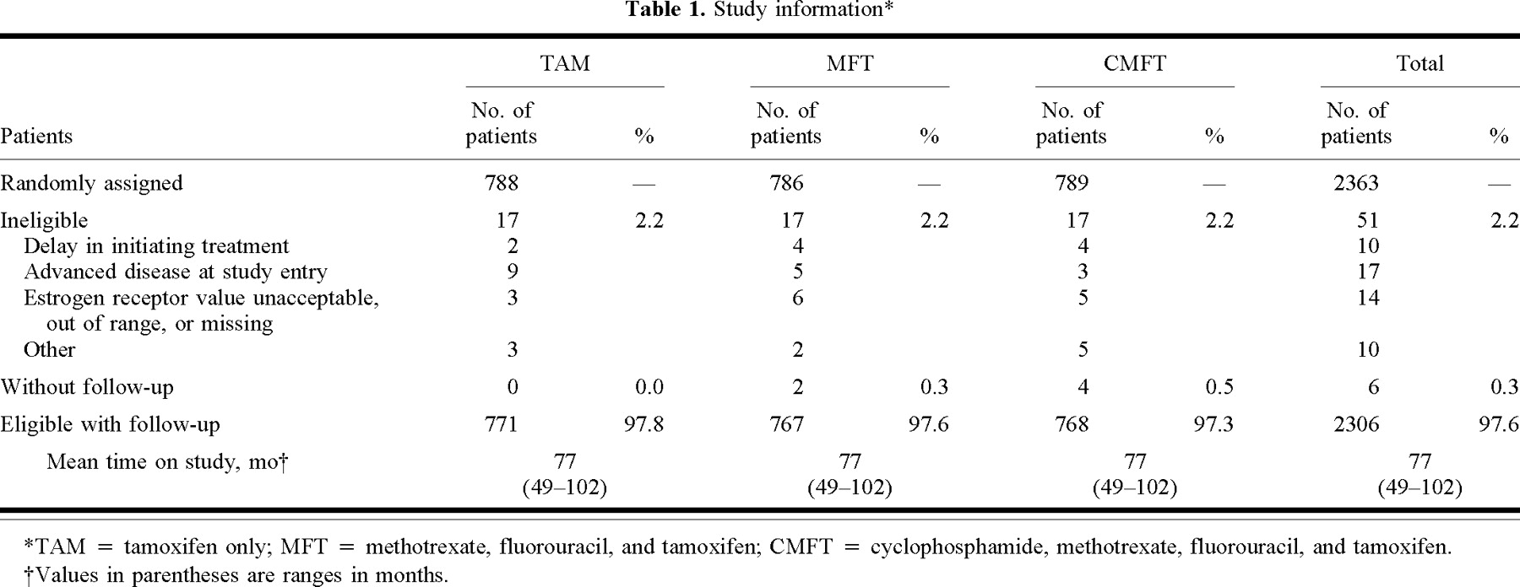
Notes:
Unless provided in the caption above, the following copyright applies to the content of this slide: © Oxford University Press

Slide 2
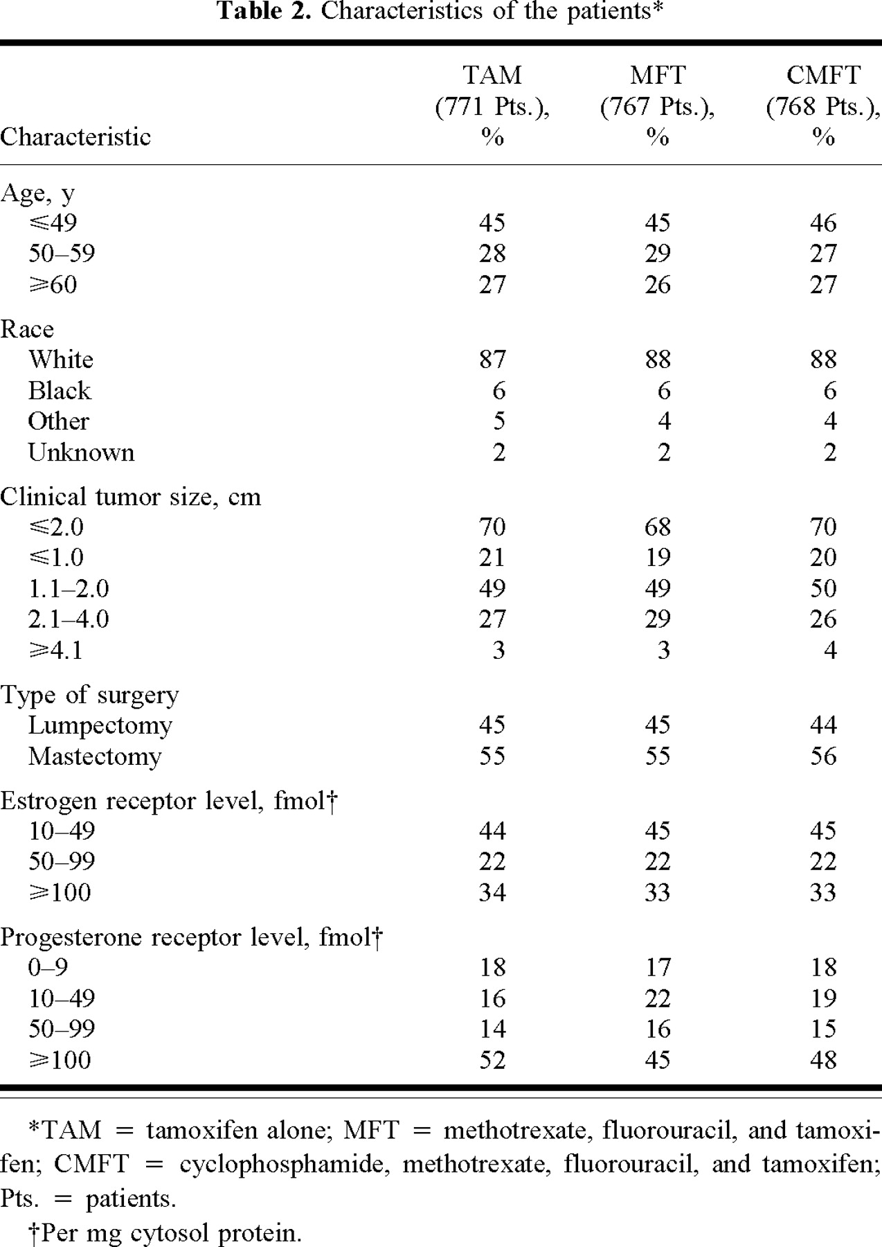
Notes:
Unless provided in the caption above, the following copyright applies to the content of this slide: © Oxford University Press

Slide 3
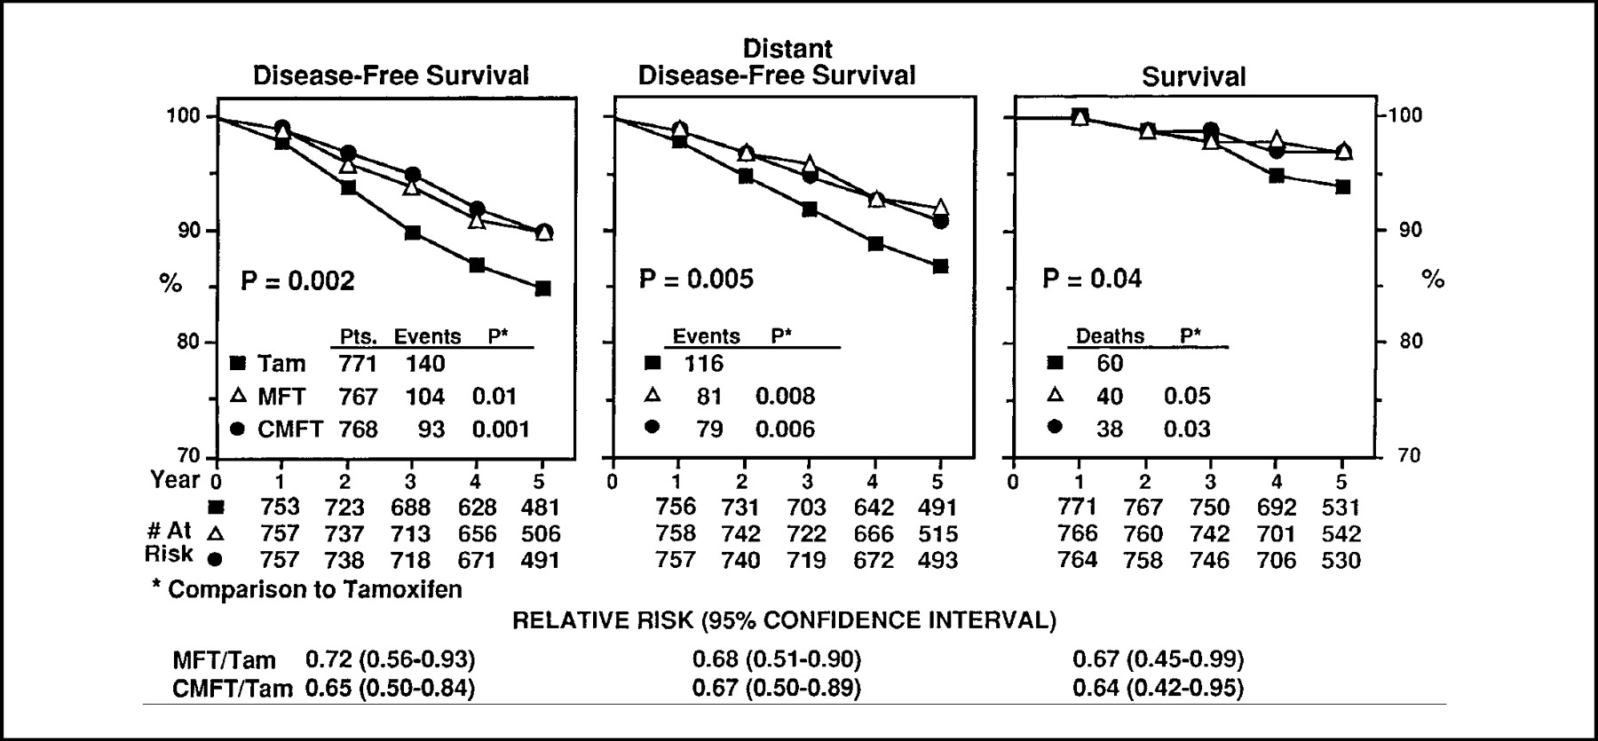
Fig. 1. Disease-free survival, distant disease-free survival, and survival according to treatment group. Benefit ...
Notes:
Fig. 1. Disease-free survival, distant disease-free survival, and survival according to treatment group. Benefit from MFT (methotrexate, fluorouracil, and tamoxifen) or CMFT (cyclophosphamide, methotrexate, fluorouracil, and tamoxifen) is further indicated by the relative risk (95% confidence interval) of the occurrence of events related to those outcomes. Pts. = patients; Tam = tamoxifen alone; # = number. The P values are two-sided.
Unless provided in the caption above, the following copyright applies to the content of this slide: © Oxford University Press

Slide 4
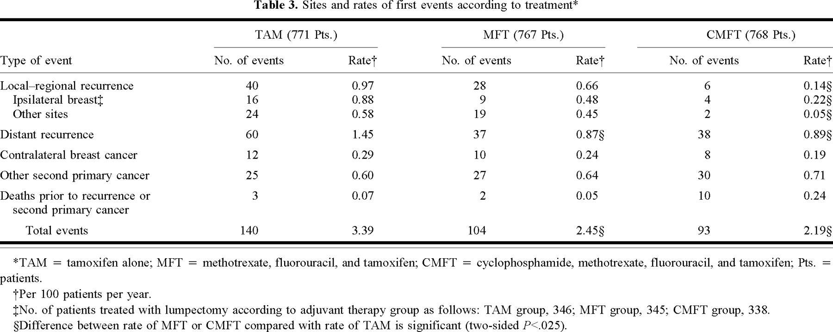
Notes:
Unless provided in the caption above, the following copyright applies to the content of this slide: © Oxford University Press

Slide 5
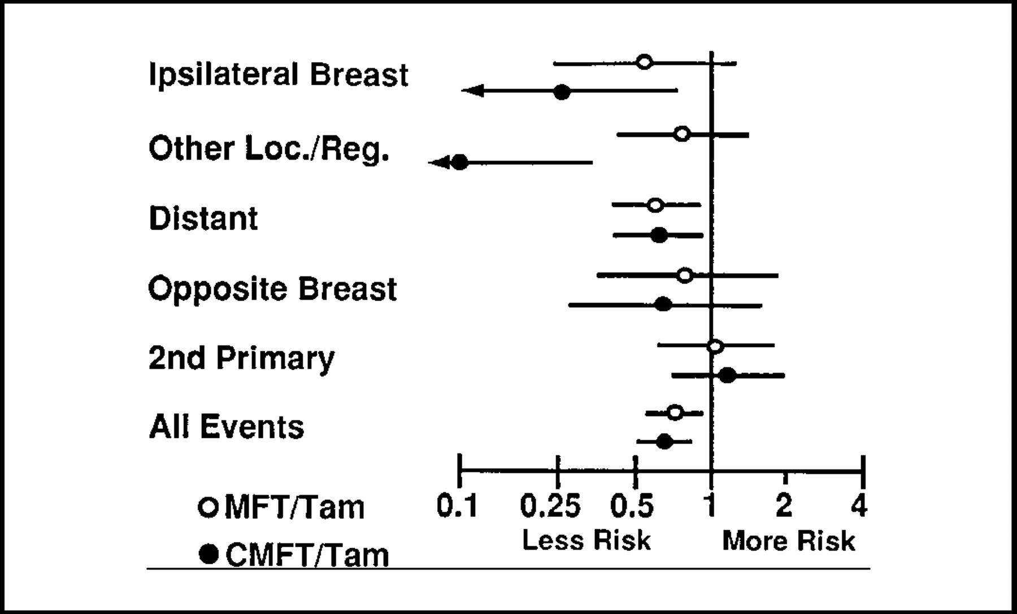
Fig. 2. Benefit from MFT (methotrexate, fluorouracil, and tamoxifen) or CMFT (cyclophosphamide, methotrexate, ...
Notes:
Fig. 2. Benefit from MFT (methotrexate, fluorouracil, and tamoxifen) or CMFT (cyclophosphamide, methotrexate, fluorouracil, and tamoxifen) relative to tamoxifen alone (Tam). Relative risks (open and closed circles) and 95% confidence intervals (horizontal lines) for sites of first events. Loc./Reg. = local—regional.
Unless provided in the caption above, the following copyright applies to the content of this slide: © Oxford University Press

Slide 6
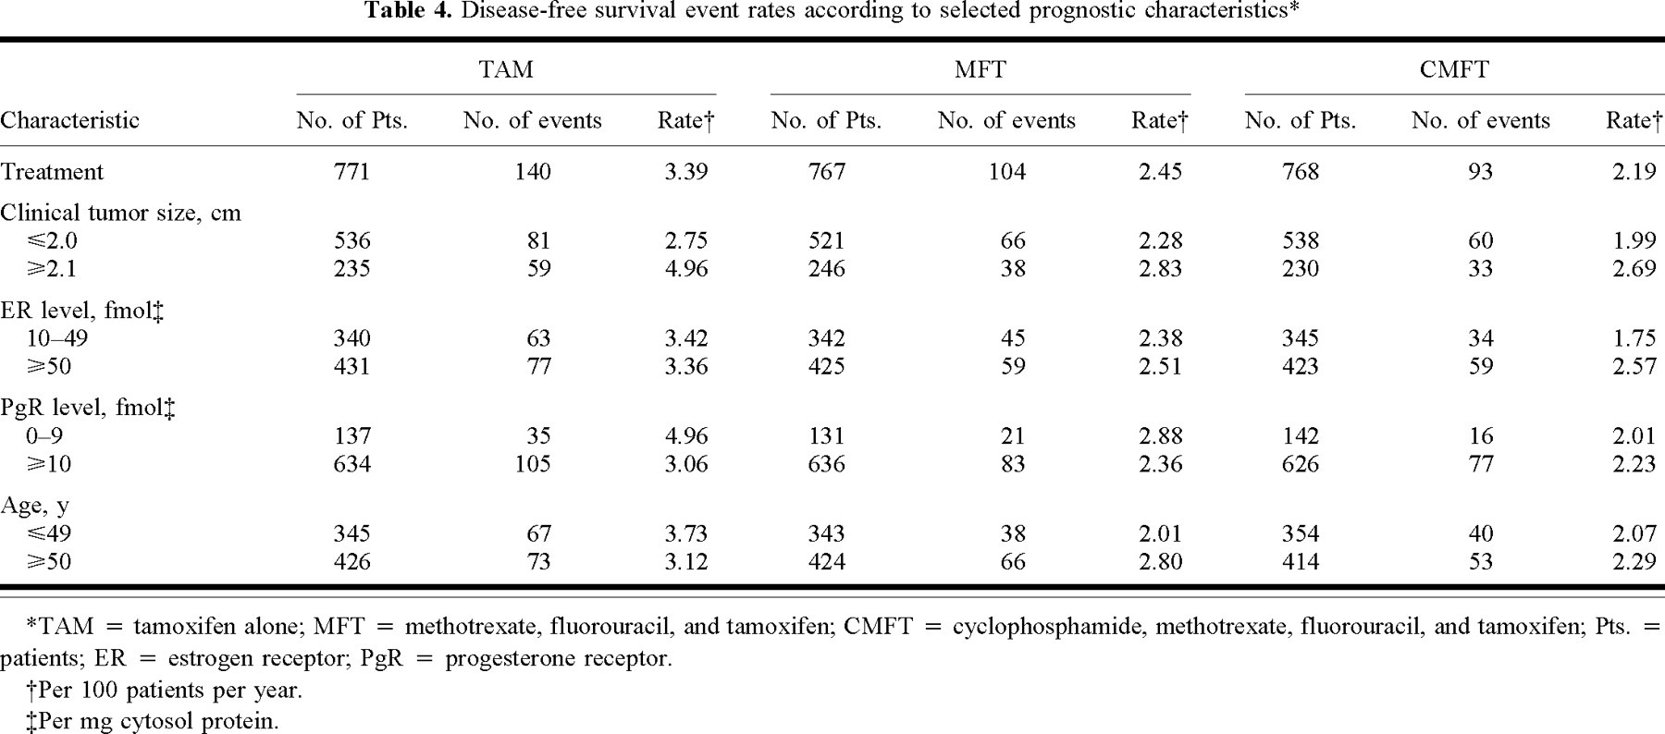
Notes:
Unless provided in the caption above, the following copyright applies to the content of this slide: © Oxford University Press

Slide 7
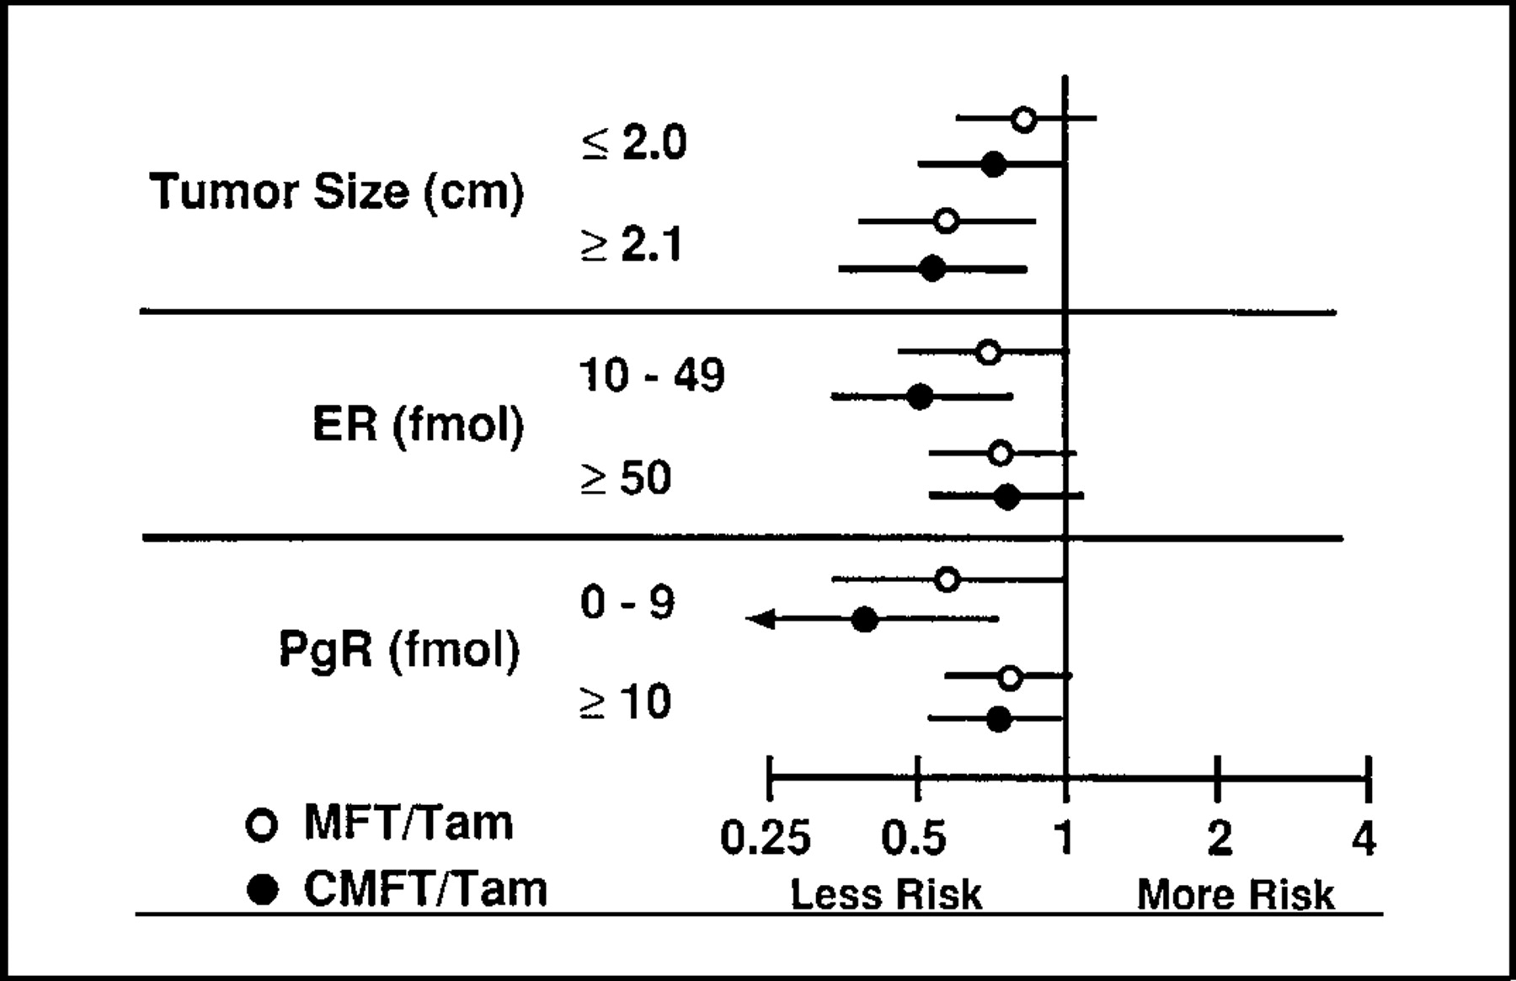
Fig. 3. Relative risks (open and closed circles) and 95% confidence intervals (horizontal lines) of occurrence of ...
Notes:
Fig. 3. Relative risks (open and closed circles) and 95% confidence intervals (horizontal lines) of occurrence of events related to disease-free survival according to tumor size, estrogen receptor (ER) status, and progesterone receptor (PgR) status. MFT = methotrexate, fluorouracil, and tamoxifen; CMFT = cyclophosphamide, methotrexate, fluorouracil, and tamoxifen; Tam = tamoxifen alone. Tumor ER and PgR contents are given as fmol/mg cytosol protein.
Unless provided in the caption above, the following copyright applies to the content of this slide: © Oxford University Press

Slide 8
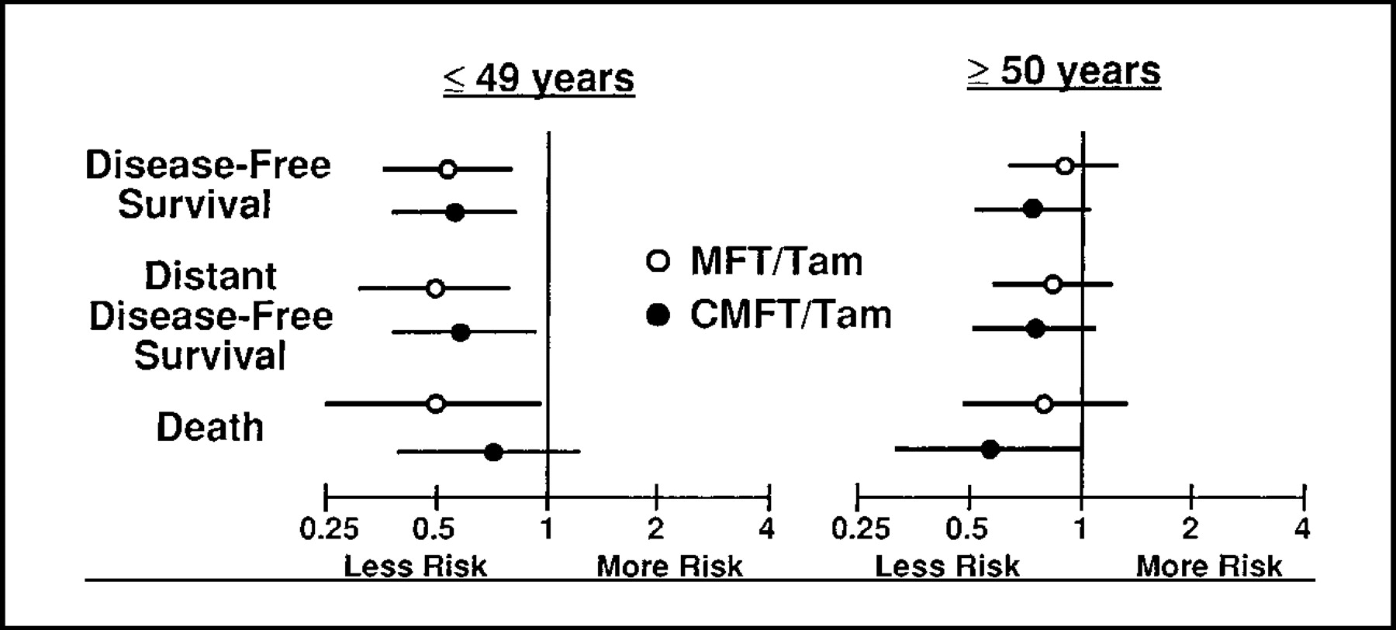
Fig. 4. Relative risks (open and closed circles) and 95% confidence intervals (horizontal lines) of occurrence of ...
Notes:
Fig. 4. Relative risks (open and closed circles) and 95% confidence intervals (horizontal lines) of occurrence of events related to disease-free survival, distant disease-free survival, and death according to patient age. MFT = methotrexate, fluorouracil, and tamoxifen; CMFT = cyclophosphamide, methotrexate, fluorouracil, and tamoxifen; Tam = tamoxifen alone.
Unless provided in the caption above, the following copyright applies to the content of this slide: © Oxford University Press

Slide 9
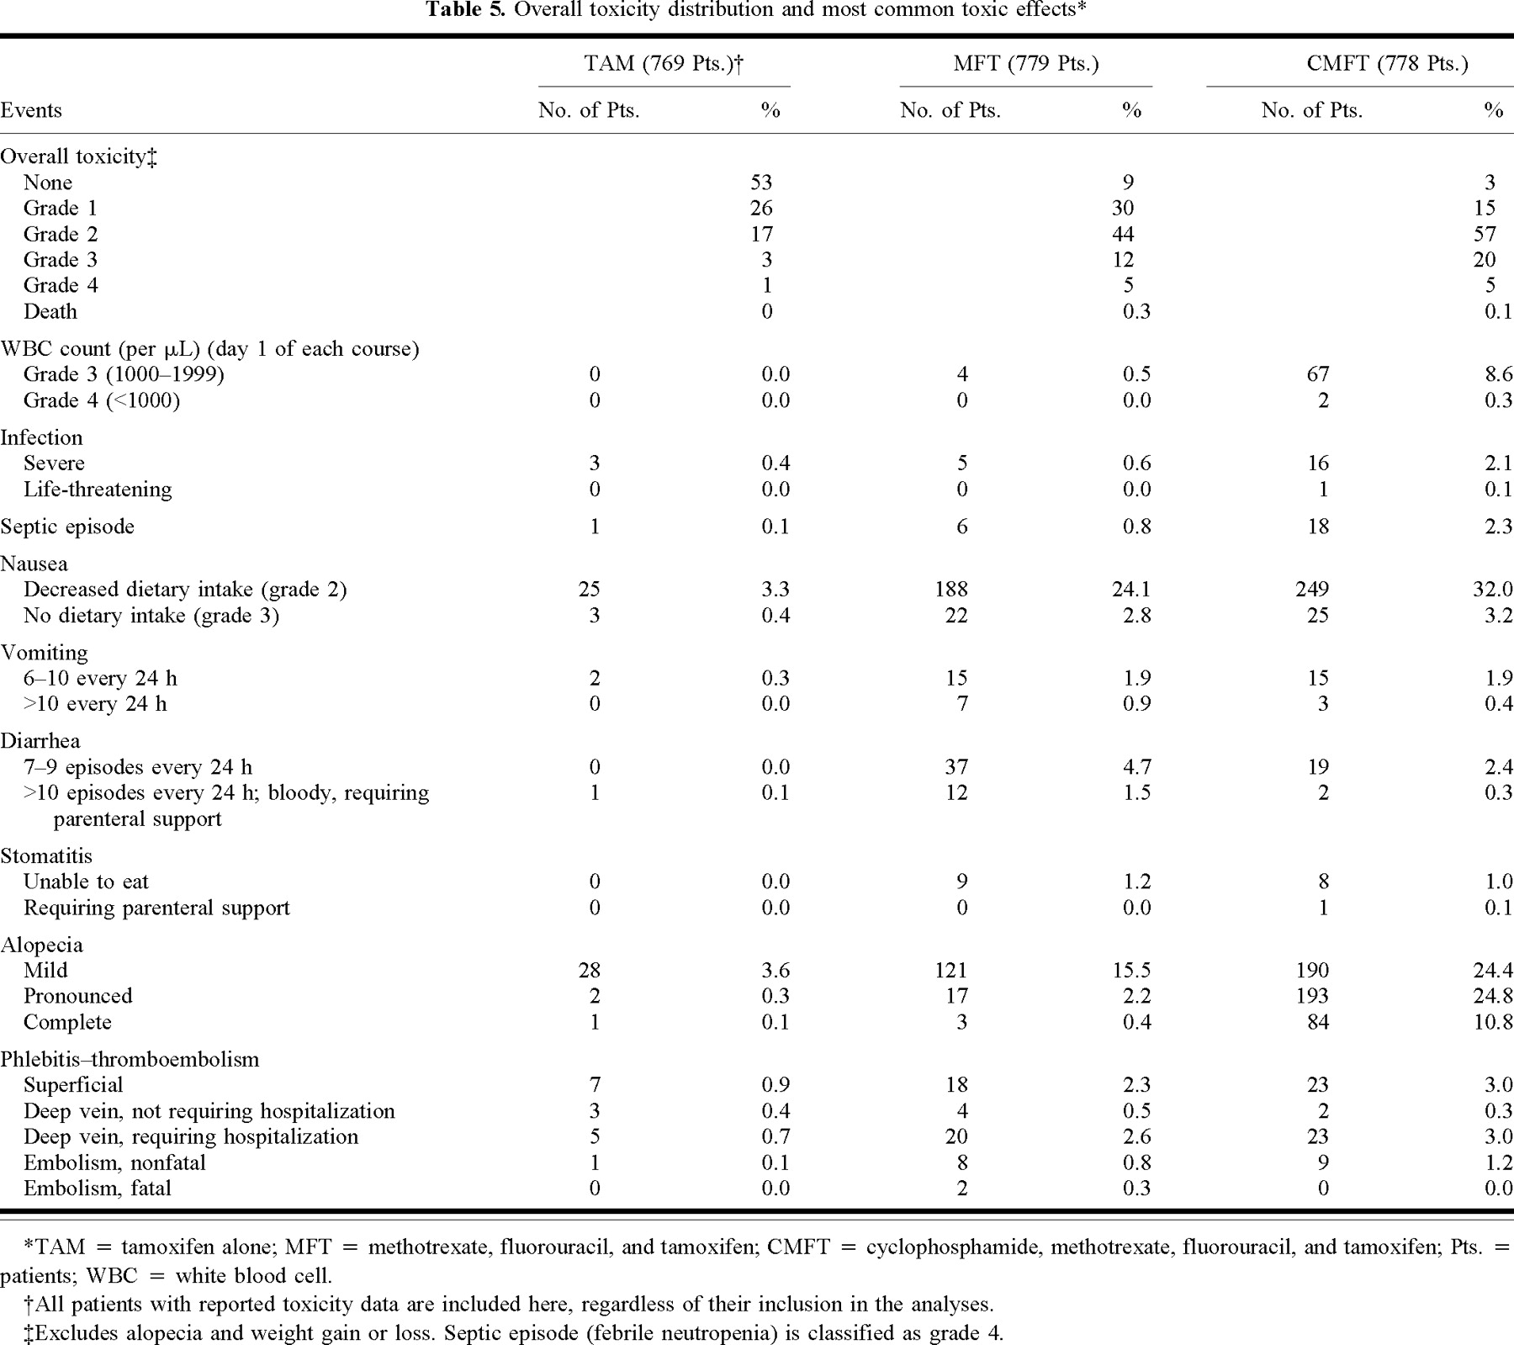
Notes:
Unless provided in the caption above, the following copyright applies to the content of this slide: © Oxford University Press

Slide 10
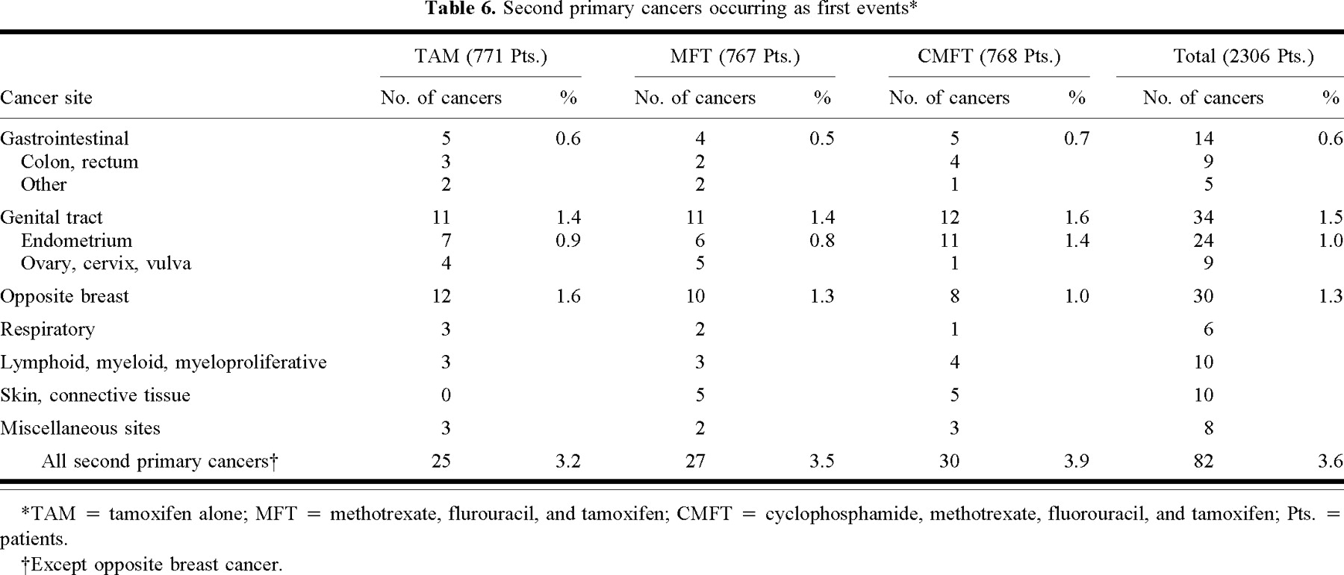
Notes:
Unless provided in the caption above, the following copyright applies to the content of this slide: © Oxford University Press

Slide 11
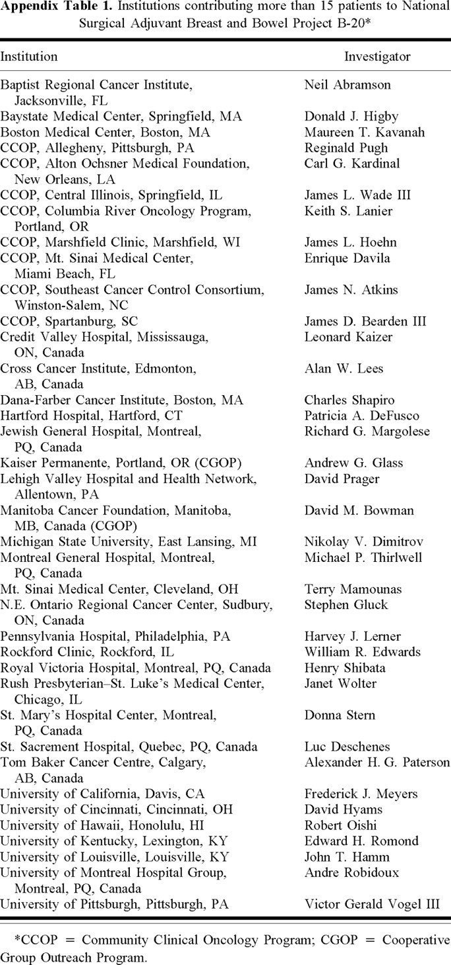
Notes:
Unless provided in the caption above, the following copyright applies to the content of this slide: © Oxford University Press

